Slide 1
Decentralized Data Sharing System based on Secure Multi-party Computation
Max Premi, Master Semester Project (12 credits)
Supervised by: David Froelicher
and Juan Ramon Troncoso-Pastoriza
Professor: Jean-Pierre Hubaux

Slide 2
Outline
Goals of the project
Systems Design
Systems Comparison
Prio’s Input Range explanation
Novel Unlynx Input Range Implementation
Systems Comparison with Input Range
Conclusion
Future Work

Slide 3
Goals of the project
Compare Unlynx against a Secure MPC system and design an improve version of Unlynx from the best of both systems
Implement a multi-party computation (MPC) system (Prio [1] ) into Unlynx’s [2] framework.
Design and implement an input validation algorithm for Unlynx.
Compare both systems with the least significant differences in settings/models.
Discuss the guidelines to create a privacy-preserving data sharing protocol allying both systems advantages.
[1] H. Corrigan-Gibbs & D. Boneh. Prio: Private, Robust, and Scalable Computation of Aggregate Statistics. Stanford University
[2] D. Froelicher, P. Egger, J.S Sousa, J.L Raisaro, Z. Huang, C. Mouchet, B. Ford & J.P Hubaux. UnLynx: A Decentralized System for Privacy-Conscious Data Sharing.EPFL

Slide 4
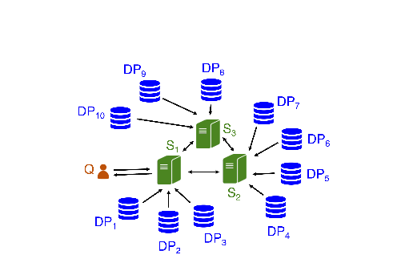
System design
Collective authority of m servers (CA), n data providers (DPs), 1 querier.
Prio uses the same system, as Unlynx,
except data providers hold a single value.
Goal is to compute an aggregation
function over private data.
Approaches: MPC, Homomorphic
encryption.
Collective authority with m = 3 servers, and n = 10 data providers
Notes:
Unlynx ensures confidentiality, privacy, a threat model fitted for real-world application and can handle differential privacy. Prio is one of the few MPC system that ensures correctness, scalability and good performances.

Slide 5
Systems comparison
But best solution is usually a combination of those
Unlynx | Prio
Functionality: Sum, Count or Select Security, Privacy & Correctness: Anytrust model DPs honest but curious Homomorphic encryption EC ElGamal Properties: Proof of correctness via zero-knowledge proofs Data encrypted at DPs Static CA No proof for input validation Limited functionality | Functionality: max/min, set intersections, least-square regression Via Affine-aggretable encondings (AFEs) Security, Privacy & Correctness: Privacy -> Anytrust Correctness if all servers are trusted Secret shared scheme Properties: Secret shared non-interactive proof = input validation Support more aggregation functions Non-static CA Weaker threat model Bad scaling with number of servers

Slide 6
Systems pipelines for comparison
Prio
UnLynx
Initialisation (Step 0)
Initialisation (Step 0)
Query
(Step 1)
Response & Range Proofs Creation (Step 2)
Query
(Step 1)
Response & Range Proofs Creation (Step 2)
Range Proofs Verification
(Step 3)
Collective Aggregation
(Step 4)
Range Proofs Verification
(Step 3)
Collective Aggregation
(Step 4)
Key Switch
(Step 5)
Range Proofs Verification
(Step 3)
Newly added
protocol
Decryption using querier’s private key
(Step 6)
Secret shared non-interactive proof = SNIPs
Undertaken by
querier data providers collective authority

Slide 7



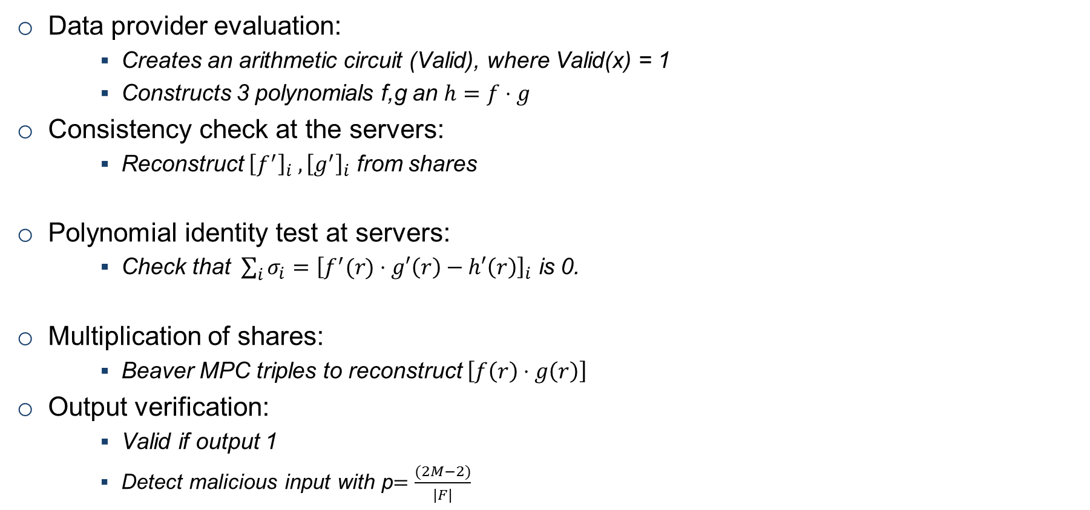

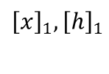
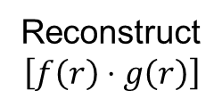


More about Secret Shared Non Interactive Proof
Data provider evaluation:
Creates an arithmetic circuit (Valid), where Valid(x) = 1
Constructs 3 polynomials f,g an $h=f⋅g$
Consistency check at the servers:
Reconstruct ${\left[f^{′}\right]}_{i} , {\left[g^{′}\right]}_{i}$ from shares
Polynomial identity test at servers:
Check that $\sum_{i}{σ_{i}}={\left[f^{′}(r)⋅g′\left(r\right)−h′\left(r\right)\right]}_{i}$ is 0.
Multiplication of shares:
Beaver MPC triples to reconstruct $\left[f\left(r\right)⋅g\left(r\right)\right]$
Output verification:
Valid if output 1
Detect malicious input with p$=\frac{(2M−2)}{|F|}$
X
Valid
f,g and h
$${\left[x\right]}_{1},{\left[h\right]}_{1}$$
$${\left[x\right]}_{2},{\left[h\right]}_{2}$$
$${\left[x\right]}_{3},{\left[h\right]}_{3}$$
$${\left[f′\right]}_{i},{\left[g′\right]}_{i}$$
Collective random $r$
S1
S2
S3
Sum evaluated polynomials
S2
Reconstruct
$$\left[f\left(r\right)⋅g\left(r\right)\right]$$
S1
S3
Communication
Step
Notes:
There are M multiplication gates

Slide 8
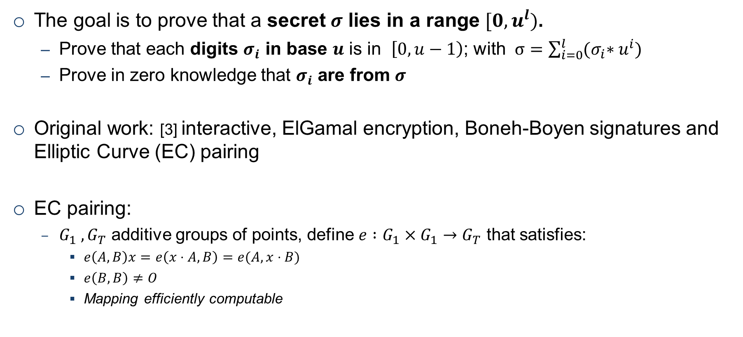
EC ElGamal Input range proof
The goal is to prove that a secret $σ$ lies in a range $[0, u^{l})$.
Prove that each digits $σ_{i}$ in base $u$ is in $\left[0,u−1\right)$; with $σ=\sum_{i=0}^{l}{{(σ}_{i}∗u^{i})}$
Prove in zero knowledge that $σ_{i}$ are from $σ$
Original work: [3] interactive, ElGamal encryption, Boneh-Boyen signatures and Elliptic Curve (EC) pairing
EC pairing:
$G_{1} , G_{T}$ additive groups of points, define $e :G_{1}×G_{1}→G_{T}$ that satisfies:
$e\left(A,B\right)x=e\left(x⋅A,B\right)=e(A,x⋅B)$
$e\left(B,B\right)≠O$
Mapping efficiently computable
[3] J. Camenish, R. Chaabouni and A.Shelat, Efficient Protocols for Set Membership and Range proofs

Slide 9
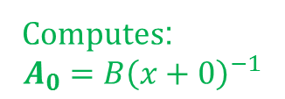
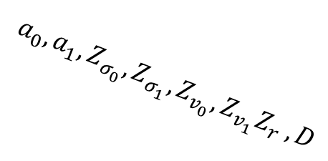



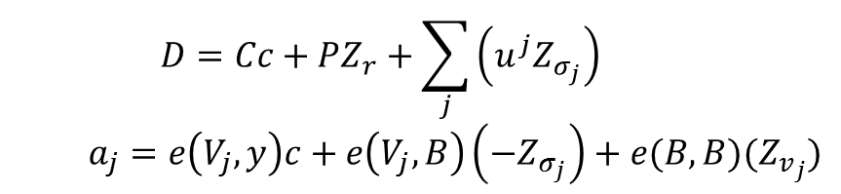







Example of Proof Pipeline
Global inputs: $[0, u^{l})$, $C=σ+P⋅r{ }$
Example for $\left[0, 2^{2}\right):$
Proof creation
Signatures
$$σ=\sum_{j}{σ_{j}⋅ u^{j} }$$
Computes:
$$A_{0}=B{\left(x+0\right)}^{−1}$$
$$A_{0},A_{1},x⋅B$$
Computes:
$$V_{0}=A_{σ_{0}}v_{0}$$
$$V_{1}=A_{σ_{1}}v_{1}$$
Picks:
$$c=H\left(B,C,x⋅B\right)$$
$$s_{0},s_{1},t_{0},t_{1},m_{0},m_{1}$$
Picks $\left(x,x⋅B\right)$
$$σ$$
$$A_{1}=B{\left(x+1\right)}^{−1}$$
$$a_{0}=e\left(V_{0},B\right)\left(−s_{0}\right)+e\left(B,B\right)\left(t_{0}\right)$$
$$a_{1}=e\left(V_{1},B\right)\left(−s_{1}\right)+e(B,B)(t_{1})$$
$Z_{σ_{0}}=s_{0}−σ_{0}c ;Z_{v_{0}}=t_{0}−v_{0}c$
$Z_{σ_{1}}=s_{1}−σ_{1}c ;Z_{v_{1}}=t_{1}−v_{1}c$
$$a_{0},a_{1},Z_{σ_{0}},Z_{σ_{1}}, Z_{v_{0}}, Z_{v_{1}}Z_{r} ,D$$
Verification
$$D=Cc+PZ_{r}+\sum_{j}{\left(u^{j}Z_{σ_{j}}\right)}$$
$$a_{j}=e\left(V_{j},y\right)c+e\left(V_{j},B\right)\left(−Z_{σ_{j}}\right)+e(B,B)(Z_{v_{j}})$$
$$Z_{r}=m−rc$$
$$D=\sum_{j}{(u^{j}s_{j}+P⋅m_{j})}$$

Slide 10
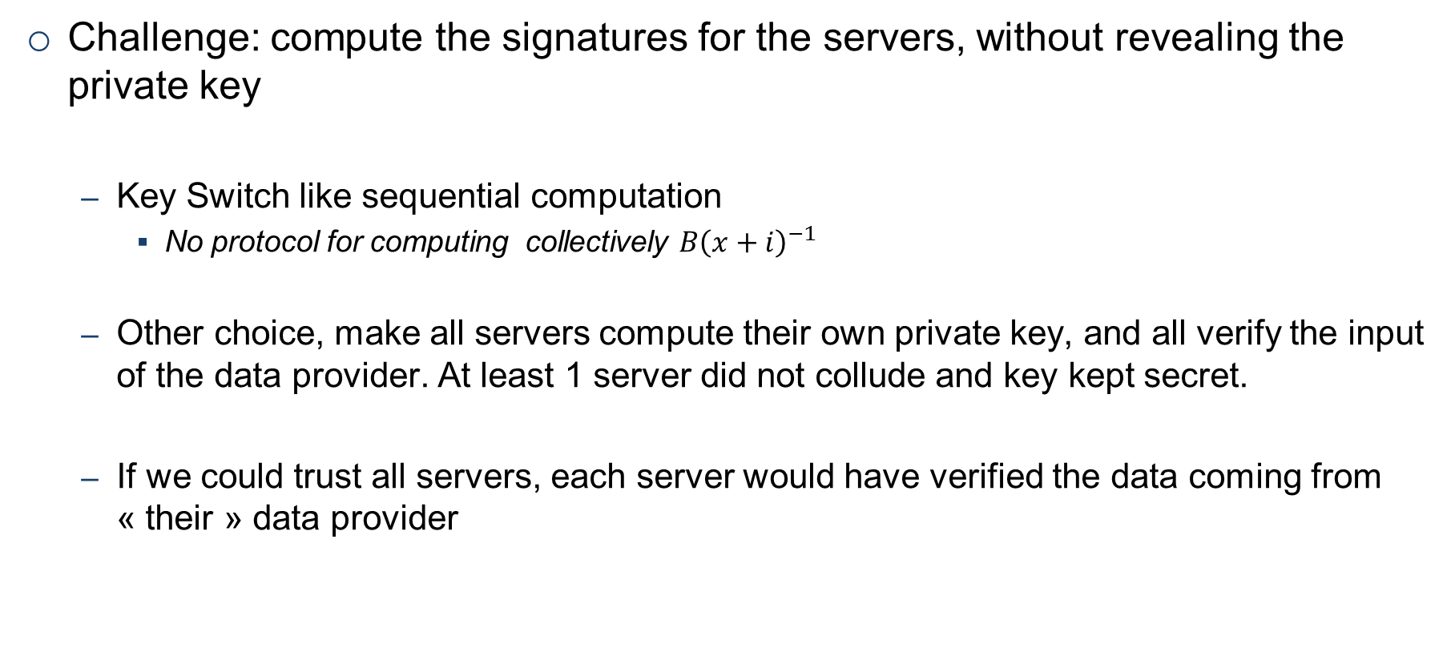
Adaptation to Unlynx threat model
Challenge: compute the signatures for the servers, without revealing the private key
Key Switch like sequential computation
No protocol for computing collectively $B{\left(x+i\right)}^{−1}$
Other choice, make all servers compute their own private key, and all verify the input of the data provider. At least 1 server did not collude and key kept secret.
If we could trust all servers, each server would have verified the data coming from « their » data provider
Notes:
(((St sure at least one have computed without revealing pk)))

Slide 11
Setup to compare the systems
We define 3 setups to be compared:
Prio
Trusted Unlynx : Unlynx system with Prio’s threat model
Unlynx
Trusted Unlynx DPs only need to prove to one server
In Unlynx systems, DPs only send one input
Done to compare Prio and Unlynx with the exact same settings

Slide 12
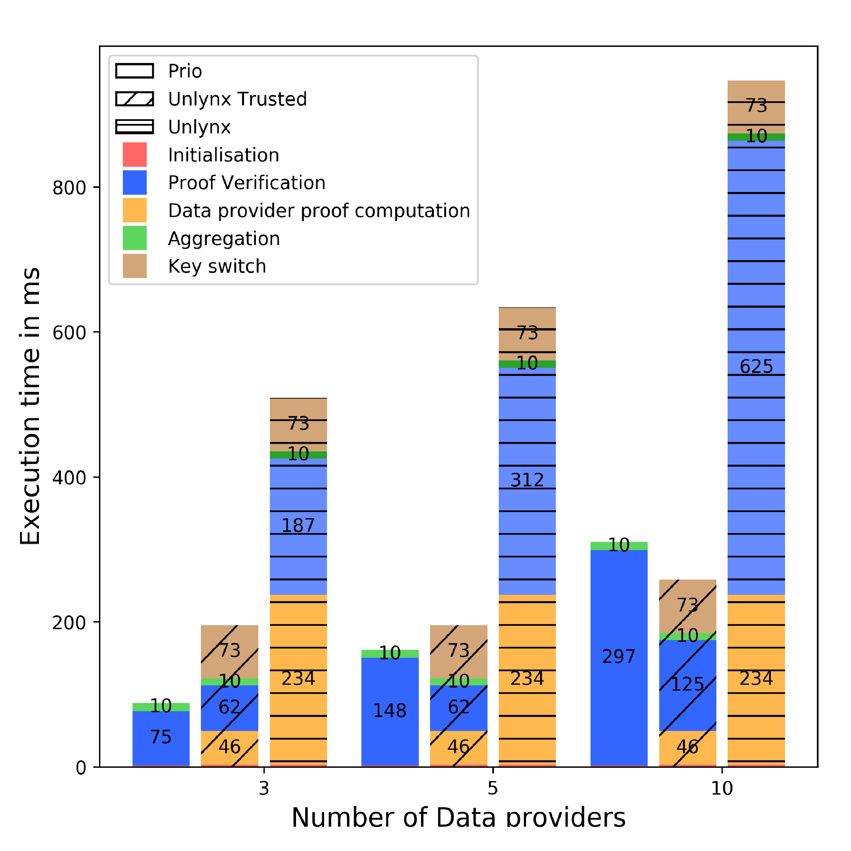

Scaling with number of data providers
Prio : 64 bits inputs, Unlynx range $\left[{0,16}^{16}\right)$. Number of servers fixed to 5. Data are assumed to be evenly distributed
Initialisation negligible
Unlynx DP proof creation 5 times higher than trusted Unlynx
Verification grows linearly
Aggregation, key switch do not change
Overall trusted unlynx outperfomrs both protocols with the growing number of DPs
Test ran on VMWare, Ubuntu64 bits v17.10, 6.1 GB RAM, 2 cores Intel I5-4590 @3.3Ghz.
10 runs. Single Threaded implementaiton.

Slide 13
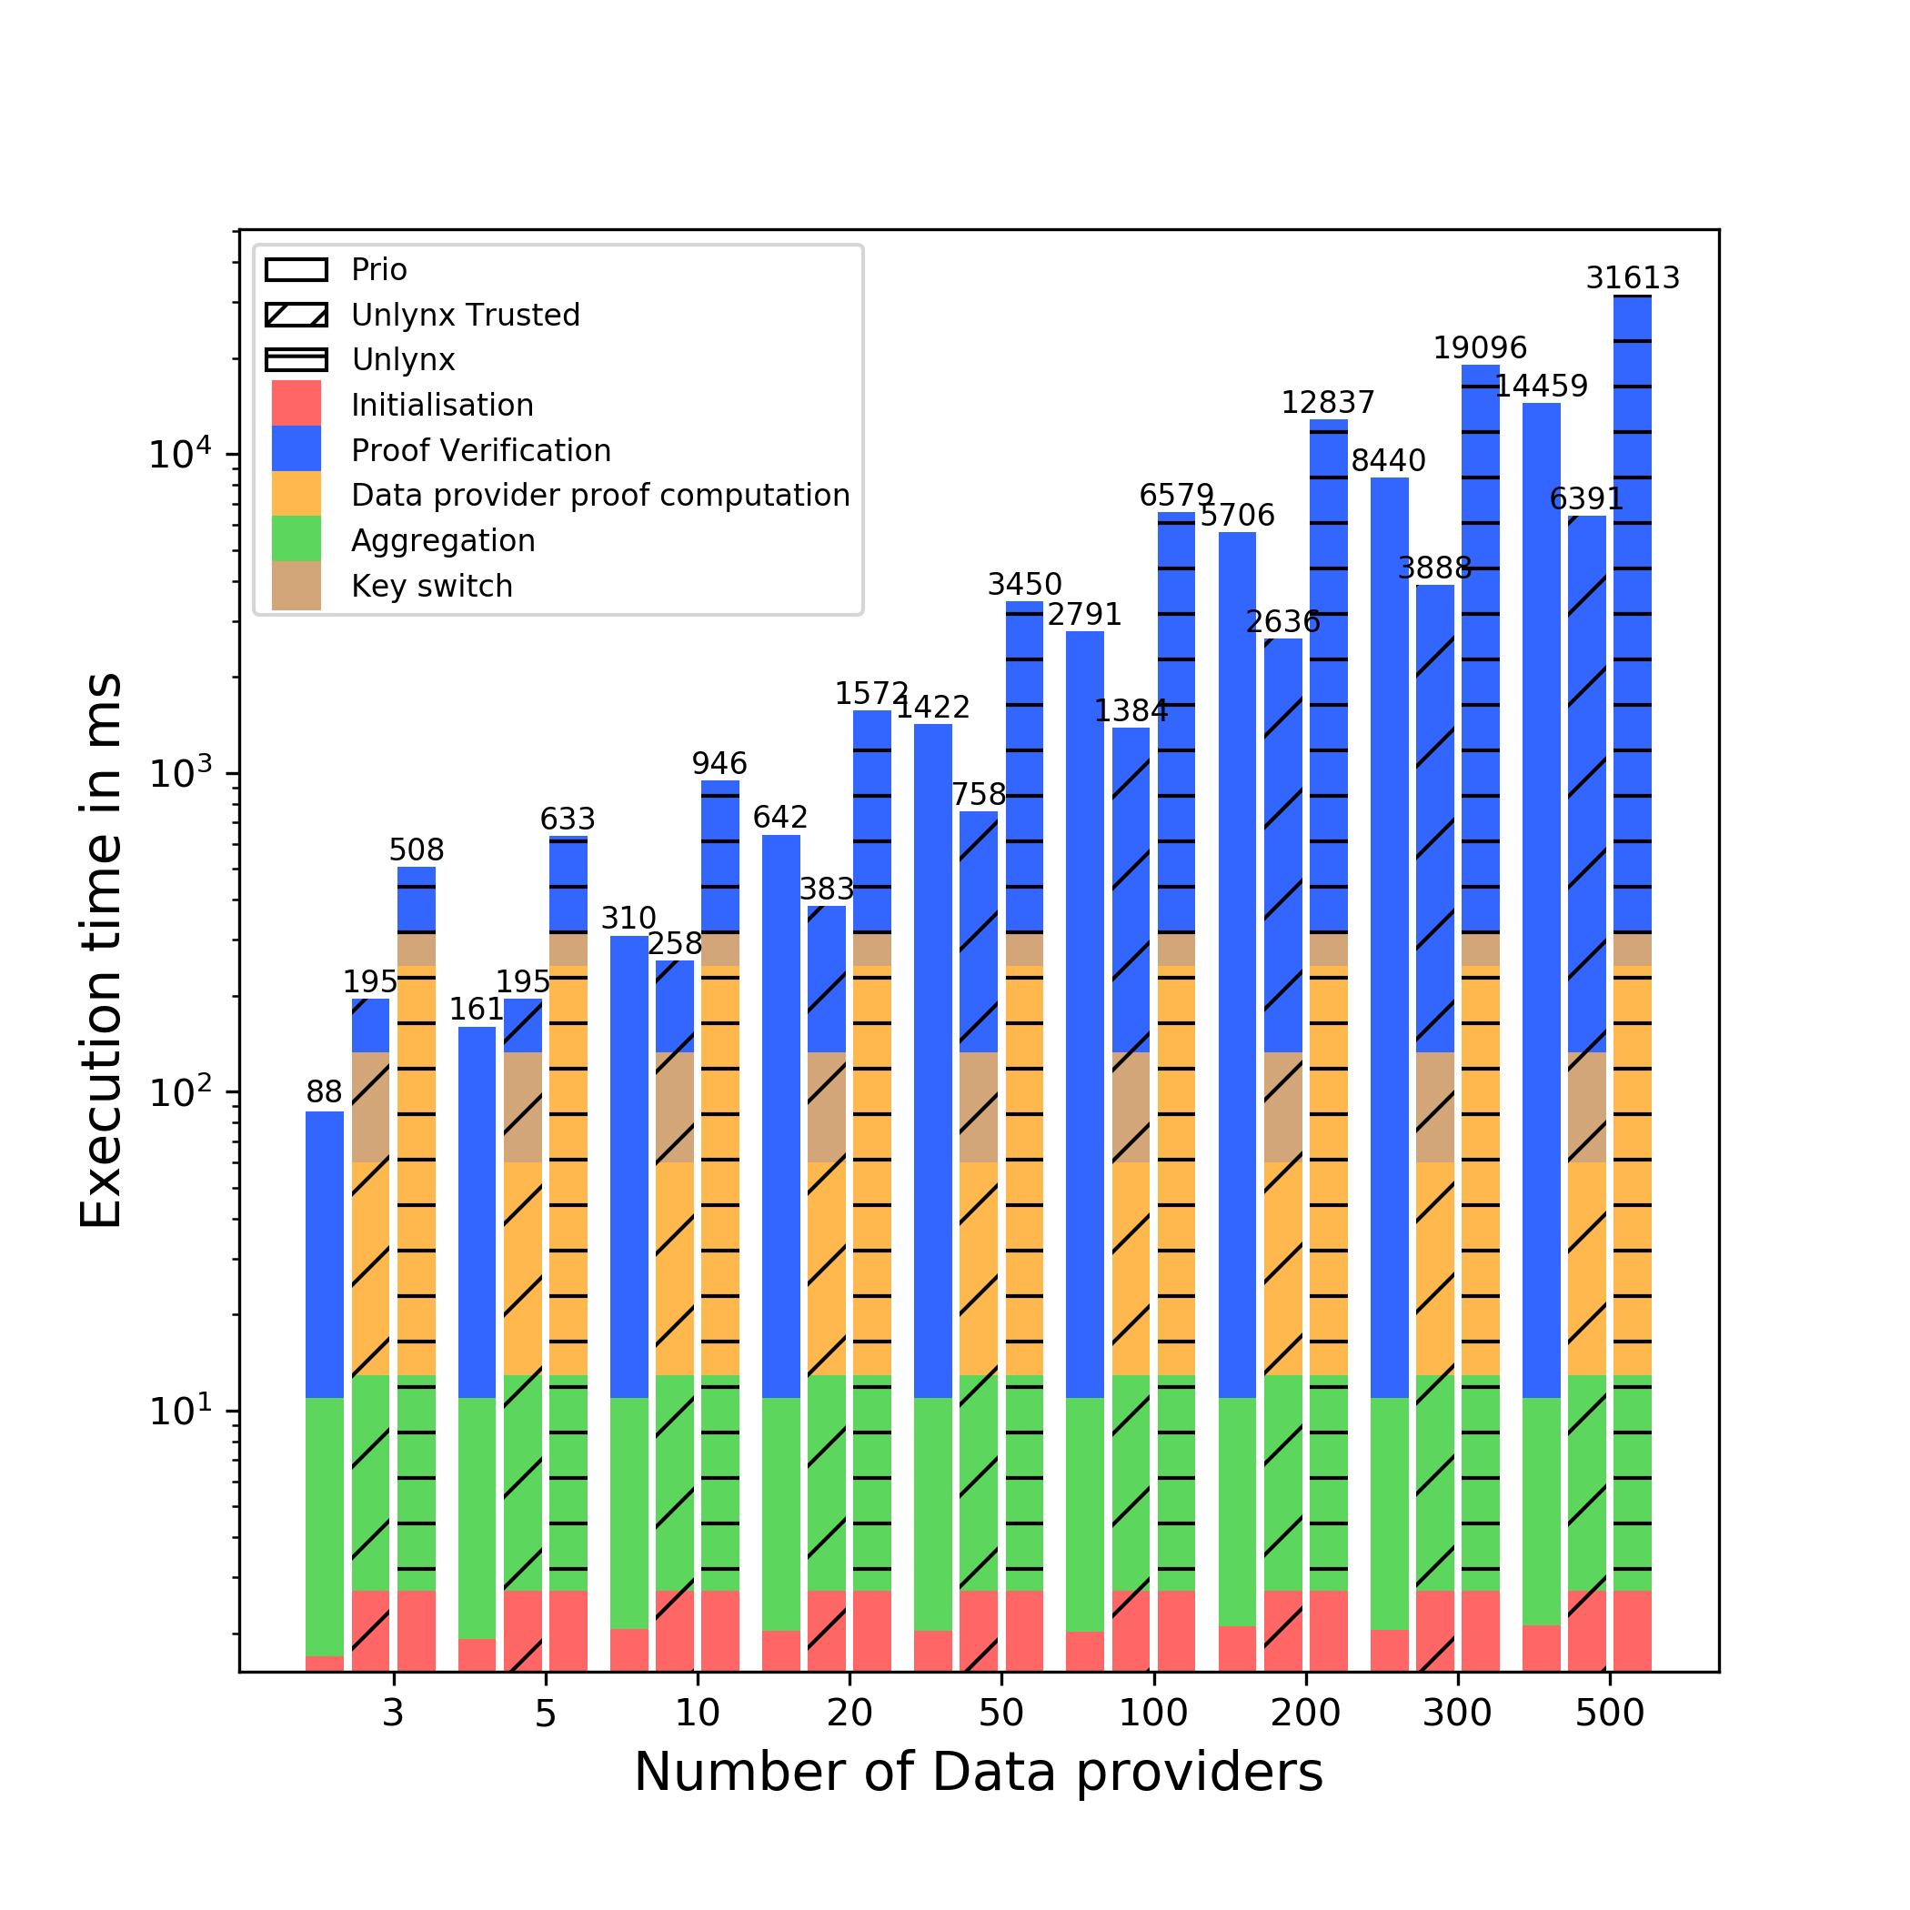
²

Slide 14
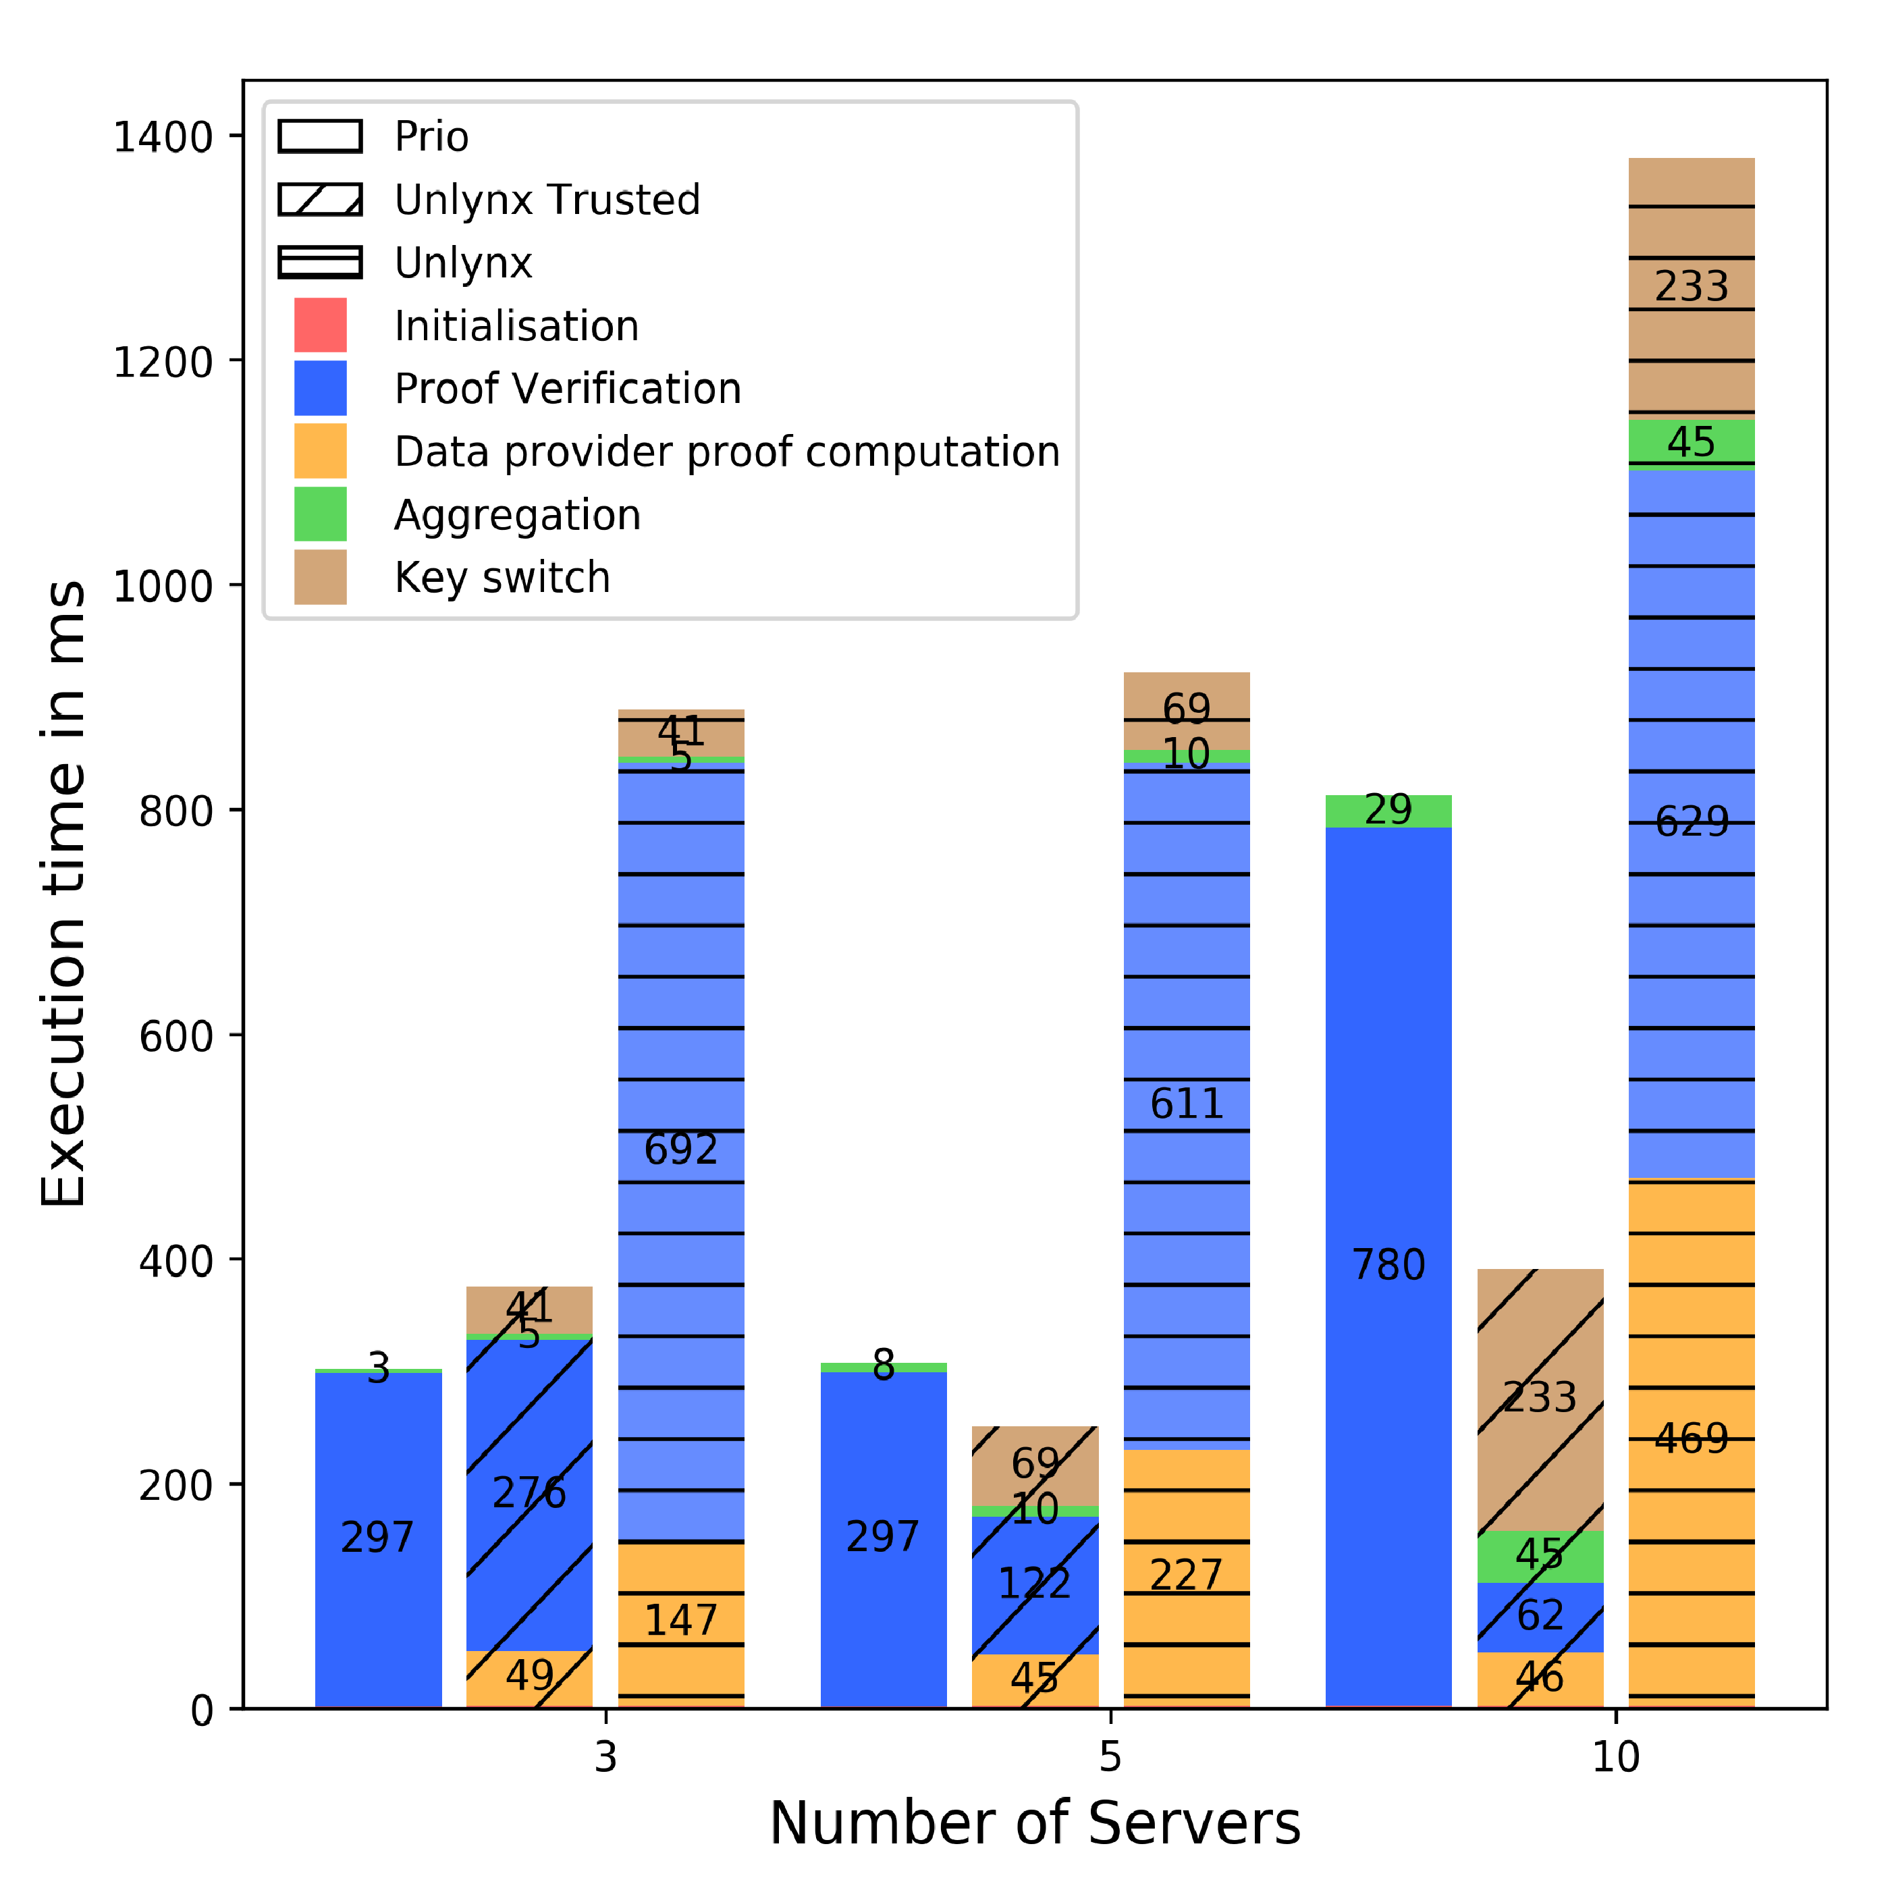

Scaling with number of servers
Prio : 64 bits inputs, Unlynx range $\left[{0,16}^{16}\right)$. Number of data providers fixed to 10. Data are assumed to be evenly distributed
DP proof constant for trusted Unlynx , linear growth for Unlynx
Verification grows linearly for Prio, decreases linearly for trusted Unlynx
Aggregation of shares faster than ciphers
Overall trusted Unlynx outperfomrs both protocols with the growing number of servers. With large number of server Prio is outperformed by Unlynx

Slide 15
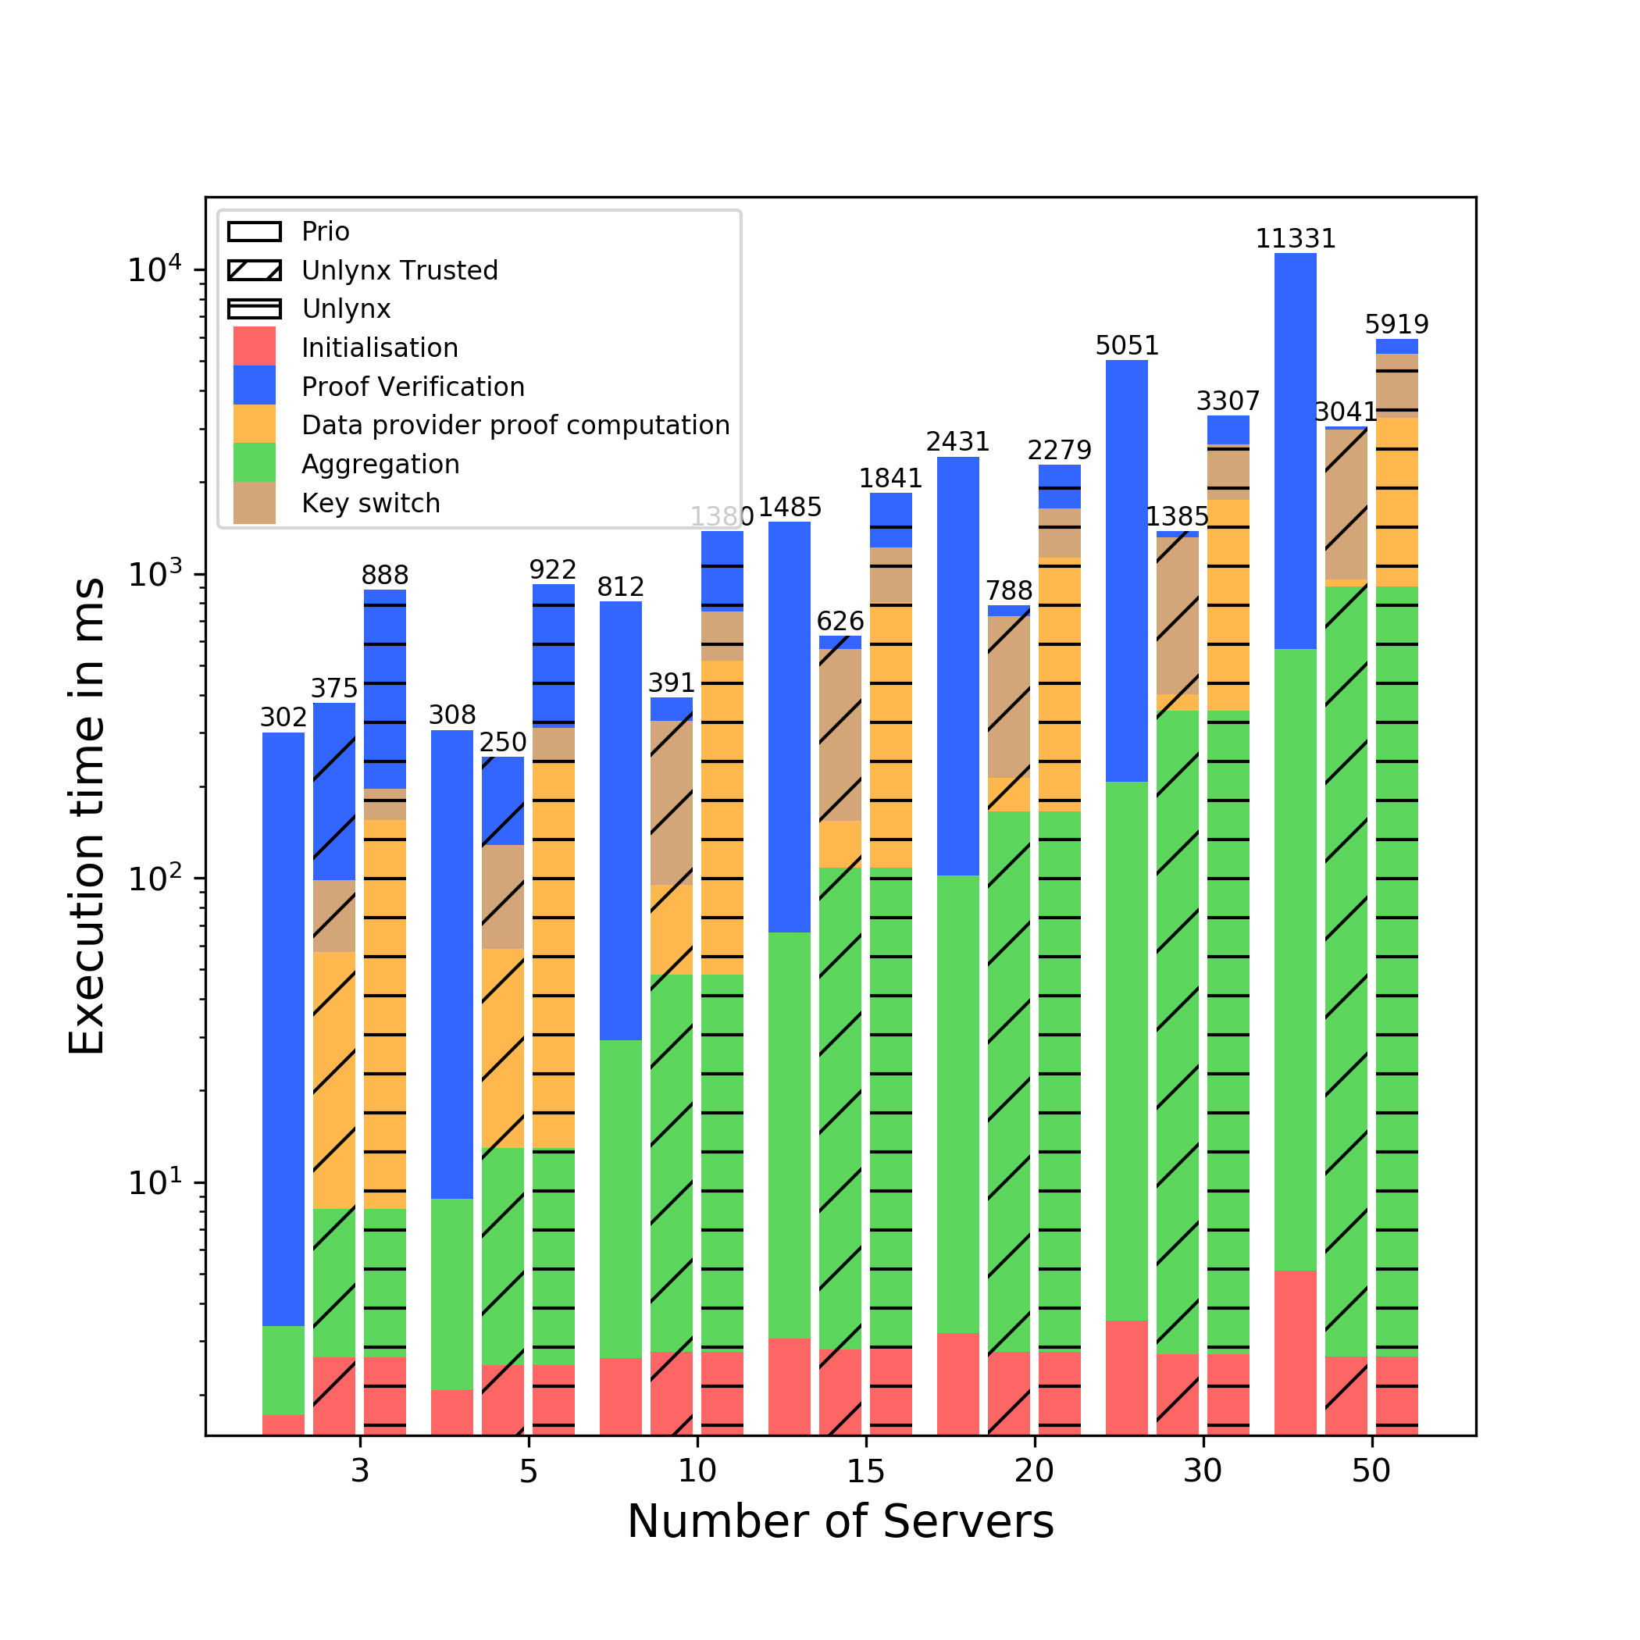

Slide 16

Conclusion
Input range designed is better with same threat model
MPC scales badly with number of servers
Prio still implements interesting ideas (AFEs)
What have been done:
Implement Prio into Unlynx’s framework.
Design and implement an input validation algorithm for Unlynx.
Compare both systems with same settings.
Discuss the guidelines to create a privacy-preserving data sharing protocol allying both systems advantages.
But Prio/trusted Unlynx threat model is too weak

Slide 17
Future work
Solutions based on Unlynx:
Offline verification, reject if too many inputs fail
Random number of servers validating the inputs
Change the signature algorithm to collectivelly build signatures
Solutions based on Prio:
Adapt Prio’s SNIP so that it can handle ciphertexts
Servers could publish the share of a ciphertext, to keep the Anytrust setting
AFEs can extend classical aggregation functions
https://github.com/lca1/unlynx/tree/max

Slide 18
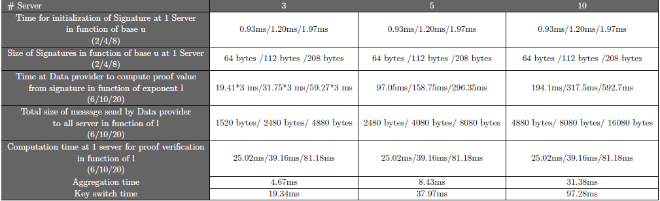

Range changes explanation
Why [${0,16}^{16})$? Traffic size !
Unlynx for 1 input data:

Slide 19
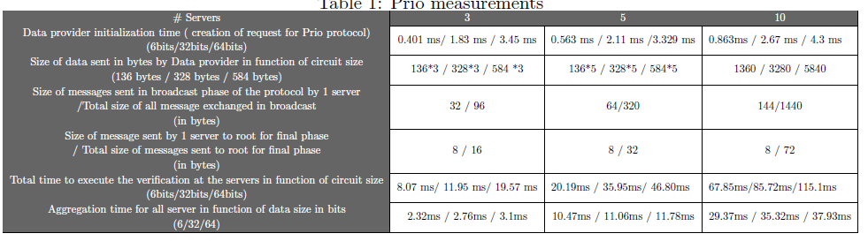
Prio Measurements
Prio for 1 DP:

Slide 20

Range [a,b)
Need to prove : $σ∈[a,a+u^{l})$ and $σ∈[b−u^{l},b)$
To do so :
$σ−b+u^{l} ∈[0,u^{l})$
$σ−a ∈\left[0,u^{l}\right)$
Send :
$D=Cc+B\left(−b+u^{l}\right)+P⋅Z_{r}$ + $\sum_{j}{(B⋅Z_{σ_{j}})}$
$D=Cc+B\left(−a\right)+P⋅Z_{r}+\sum_{j}{(B⋅Z_{σ_{j}})}$

Slide 21

Additional content on MPC Beaver triple.
MPC triple, $a∗b=c$shared into m shares ${\left[a\right]}_{i}∗{\left[b\right]}_{i}={\left[c\right]}_{i}$; each compute :
$d_{i}=f_{i}−a_{i}$
$e_{i}=g_{i}−b_{i}$
Broadcast these to reconstruct $d$ & $e$.
Calculate
$z_{i}=de∗m^{−1}+db_{i}+ea_{i}+c_{i}$
$∑z_{i}=de+db+ea+c$
$=f∗g=h$
$then z_{i}=h_{i}$

Slide 22
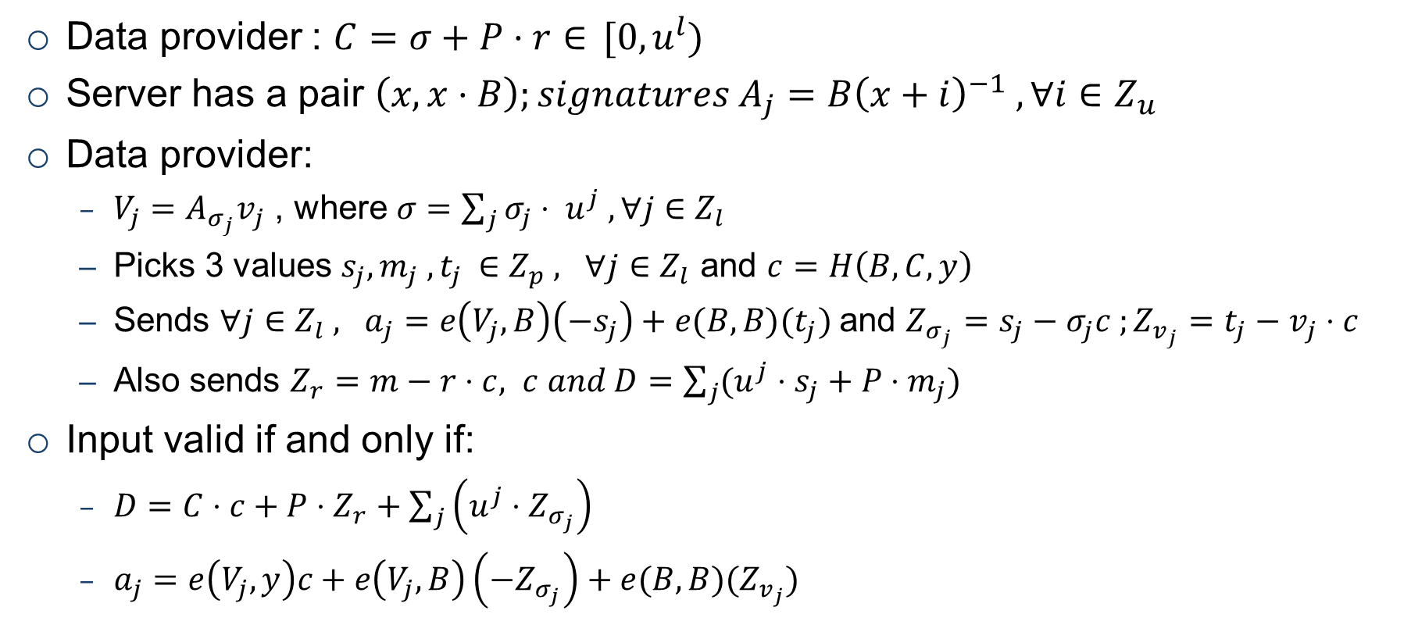
Additional content for Input range algorithm
Data provider : $C=σ+P⋅r{∈} [0,u^{l})$
Server has a pair $\left(x,x⋅B\right);signatures A_{j}=B{\left(x+i\right)}^{−1} , ∀i∈Z_{u}$
Data provider:
$V_{j}=A_{σ_{j}}v_{j}$ , where $σ=\sum_{j}{σ_{j}⋅ u^{j} , ∀j∈Z_{l}}$
Picks 3 values $s_{j}, m_{j} ,t_{j }∈Z_{p} , ∀j∈Z_{l}$ and $c=H\left(B,C,y\right)$
Sends $∀j∈Z_{l} , a_{j}=e\left(V_{j},B\right)\left(−s_{j}\right)+e(B,B)(t_{j})$and $Z_{σ_{j}}=s_{j}−σ_{j}c ;Z_{v_{j}}=t_{j}−v_{j}⋅c$
Also sends $Z_{r}=m−r⋅c, c and D=\sum_{j}{(u^{j}⋅s_{j}+P⋅m_{j})}$
Input valid if and only if:
$D=C⋅c+P⋅Z_{r}+\sum_{j}{\left(u^{j}{⋅Z}_{σ_{j}}\right)}$
$a_{j}=e\left(V_{j},y\right)c+e\left(V_{j},B\right)\left(−Z_{σ_{j}}\right)+e(B,B)(Z_{v_{j}})$
Notes:
Diagram again. \cdot everywhere consistency

Slide 23
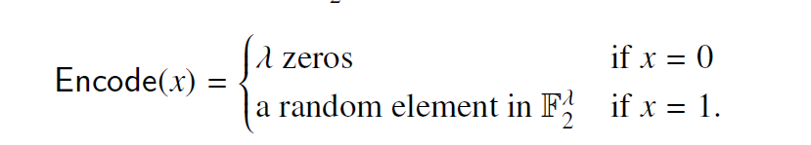
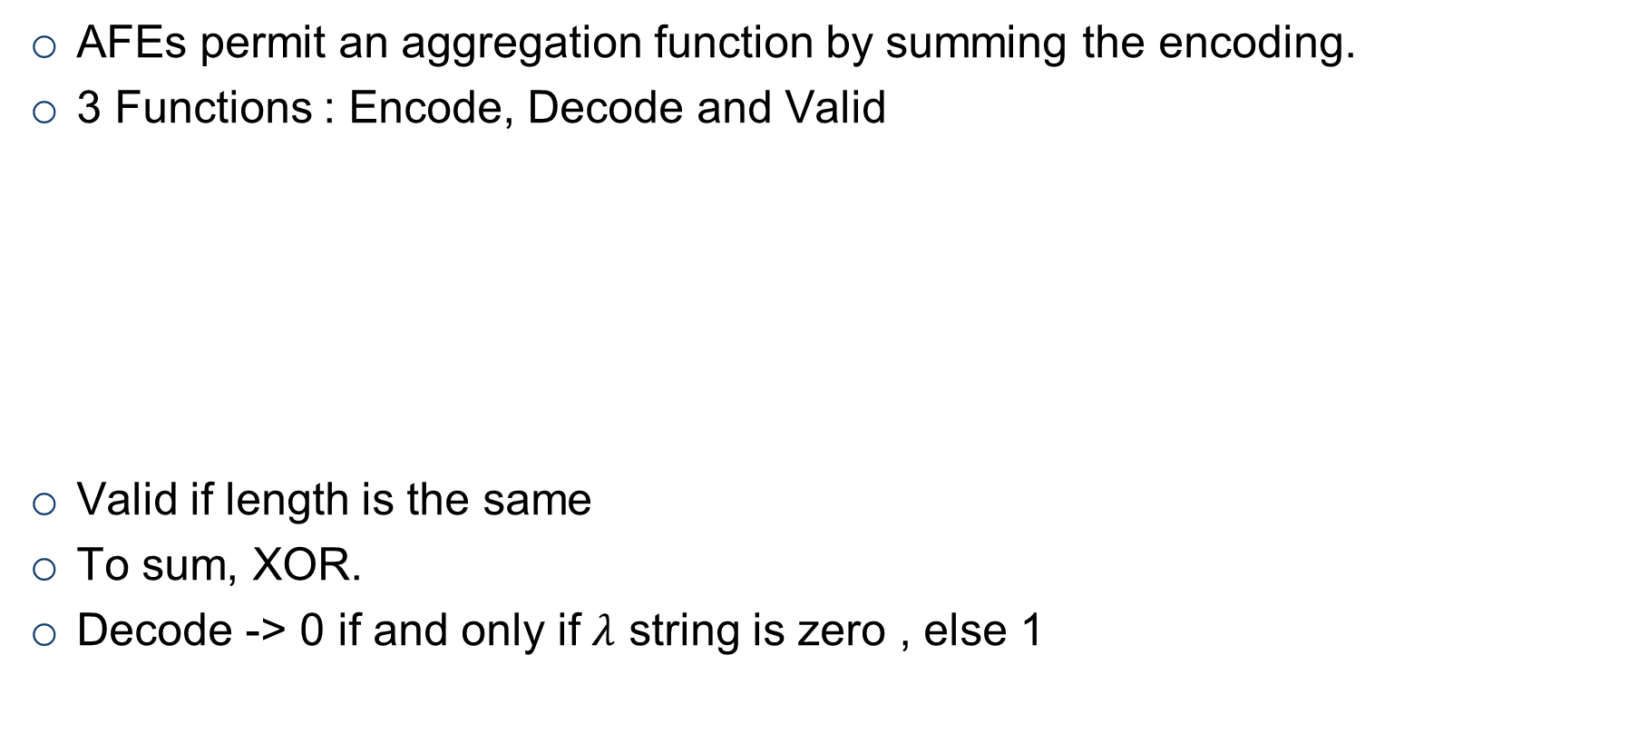
Additional content on AFE
AFEs permit an aggregation function by summing the encoding.
3 Functions : Encode, Decode and Valid
Valid if length is the same
To sum, XOR.
Decode -> 0 if and only if $λ$ string is zero , else 1

Slide 24
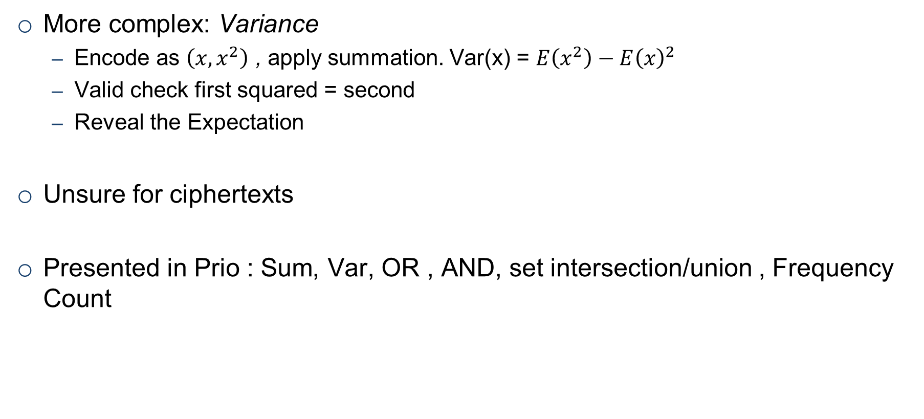
Additional content on AFE
More complex: Variance
Encode as $\left(x,x^{2}\right)$ , apply summation. Var(x) = $E\left(x^{2}\right)−E{\left(x\right)}^{2}$
Valid check first squared = second
Reveal the Expectation
Unsure for ciphertexts
Presented in Prio : Sum, Var, OR , AND, set intersection/union , Frequency Count

