Slide 1
Distributed Proof Verification using Distributed Ledger
Max Premi, Optional Master Semester Project (8 credits)
Supervised by: David Froelicher
and Juan Ramon Troncoso-Pastoriza
Professor: Jean-Pierre Hubaux

Slide 2
Outline
Goals of the project
UnLynx v2.0 System Design
Skipchain Overview
Skipchain Implementation
Proof processing
Block Insertion
Evaluation
Conclusion & Future Work

Slide 3
Goals of the Project
Create and maintain a Distributed Ledger containing all the information to verify the proofs computed by a Distributed Data Sharing system (UnLynx):
To guarantee correctness of results and robustness of computations. Verifiable by anyone via a Distributed Ledger (immutable insertion)
Propose a way to implement the blockchain in the data sharing system framework
Implement the Service that handles the Blockchain, based on the already existing implementation, Skipchain.
Implement the protocol that collects, verifies proof and creates a block.
Evaluate the performances of the implemented system.

Slide 4
What is UnLynx v2.0
A new decentralized based on UnLynx system offering:
A large set of possible SQL queries: where, group by, like, mean, variance, set intersection, …
Some machine learning: linear and logistic regression.
While ensuring:
Data confidentiality
Data providers privacy and end-result privacy
Correctness of the computations
Robustness of the results
Notes:
Make anim for Correctness an Robustennss circled an say by moving computation of proof verif toLedger

Slide 5
What is UnLynx v2.0
A new decentralized based on UnLynx system offering:
A large set of possible SQL queries: where, group by, like, mean, variance, set intersection, …
Some machine learning: linear and logistic regression.
While ensuring:
Data confidentiality
Data providers privacy and end-result privacy
Correctness of the computations
Robustness of the results
Notes:
Make anim for Correctness an Robustennss circled an say by moving computation of proof verif toLedger

Slide 6
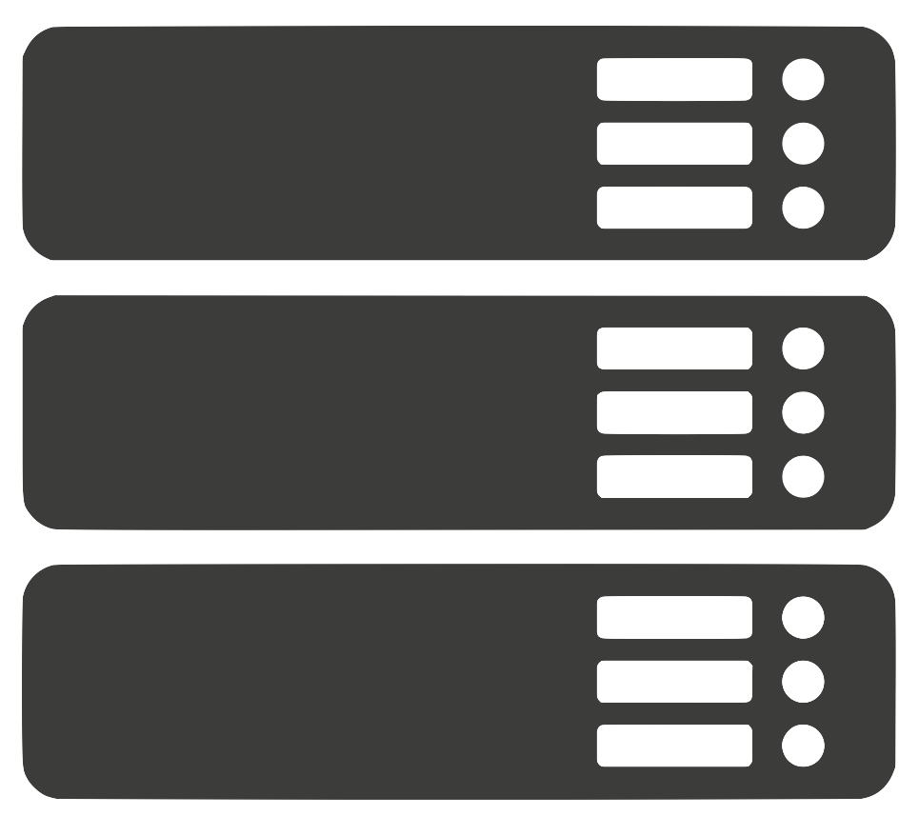
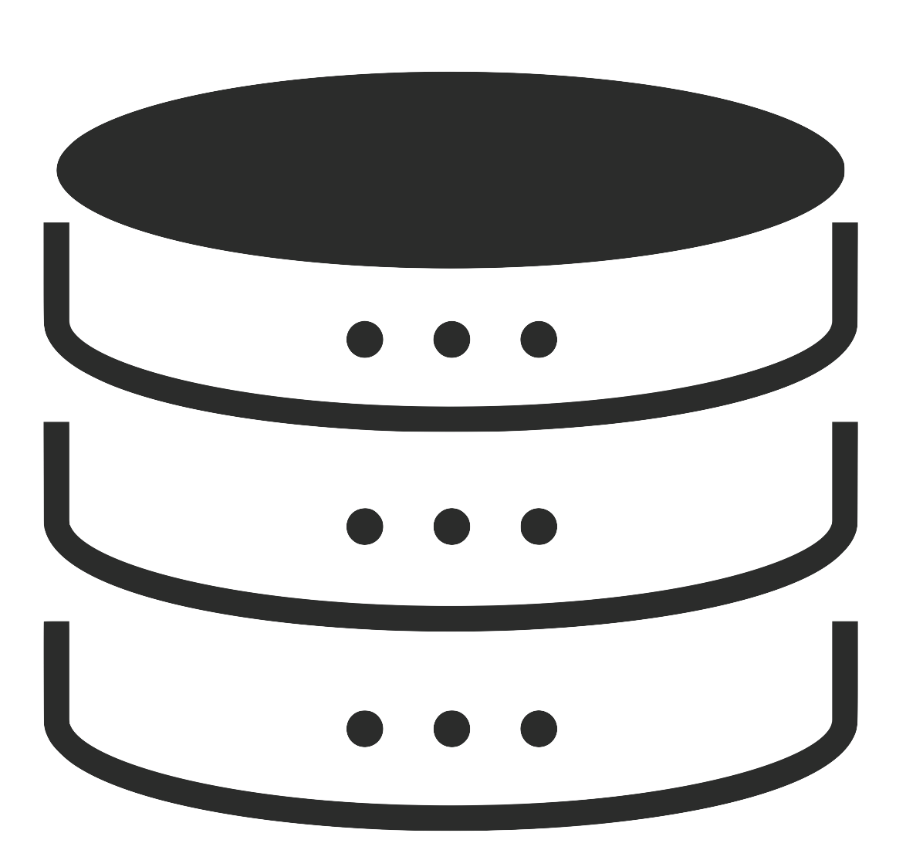

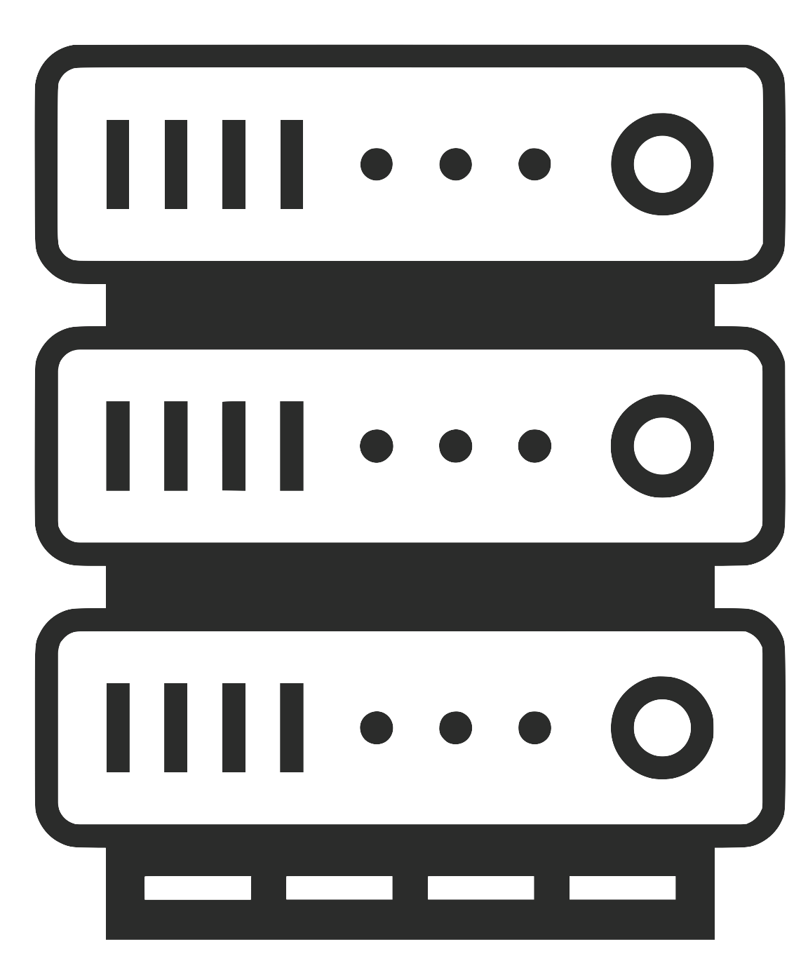
System design
Collective authority of m servers (CA servers), n data providers (DPs), 1 querier.
Verifying Nodes is a CA maintaining the
Blockchain. (VNs CA)
When a query has been processed by the VNs
they insert data inside the Skipkchain.
Q
Verifying Node
Data Provider
Q
Querier
Server
Notes:
Add slide like jon with step and step number

Slide 7
Step 1: Query
Q
Query

Slide 8
Step 2: Processing
Range Proof
Data at DPs
Q
Range Proof
Range Proof
Data at DPs
Data at DPs
Data at DPs
Data at DPs
Range Proof
Range Proof

Slide 9
Step 2: Processing
Range Proofs x5
Range Proofs x5
Q
Data at DPs
Range Proofs x5
Range Proof
Data at DPs
Data at DPs
Range Proof
Range Proof
Range Proof
Range Proof

Slide 10
Step 3: Proof Verification
Probabilistic Verification
Q
Proof Aggreg
Aggregation
Proof Aggreg
Proof Aggreg
Aggregation
Aggregation
Aggregation
Proof Aggreg

Slide 11
Step 3: Proof Verification
Probabilistic Verification
Q
Key Switch
Key Switch
Key Switch
Key Switch

Slide 12
Step 4: Block Insertion
Verified Data
Verified Data
Q
Verified Data

Slide 13
Step 4: Block Insertion
Block1
Q
New Block

Slide 14


Lemal Threat Model
Verifying Node
Q
Data Provider
Q
Querier
Server
Anytrust Model
Honest-Majority
14

Slide 15
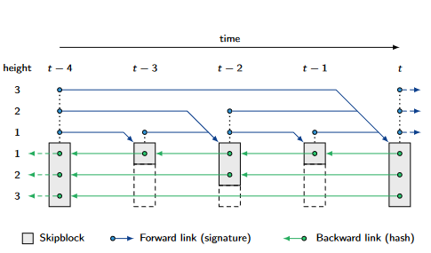
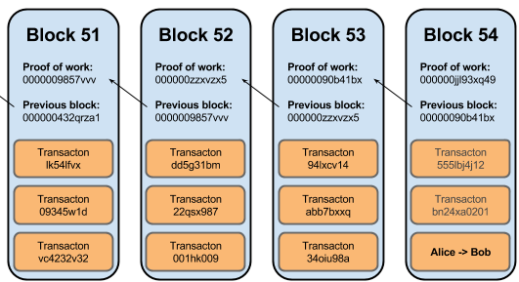
Blockchain/SkipChain Overview
Skipchain created by DeDis, mix Blockchain and Skiplist. [1]
Blockchain with forward link and hopping links (more than 1 block away)
A block usually contains hash of previous block.
Consensus using Byzantine Fault Tolerance (BFT).
[1] https://github.com/dedis/cothority/tree/master/skipchain

Slide 16
Lemal Skipchain
A block is the unit of the chain, containing here: the query ID, a timestamp, backward and forward links, a Threshold as well as a Bitmap
4 types of proofs: Range, Aggregation, Shuffle, Key Switch.
When a Query is received, the exact number of proof expected is known.
Example:
Query : ID = "Query1", Operation = Sum, #DPs = 2, #Servers = 3, Threshold = 0.6, Range = [0,16]
Bitmap initialized at each VN
Block
RangeDP1 | RangeDP2 | AggregationS1 | …
ID | Bitmap | TimeStamp | QueryID | Threshold | Forward | Backward
1 |  | 13:00:00 | Query1 | 0,6

Slide 17
Lemal Skipchain (2)
Each Verifying Node verifies, with its own Bitmap
When proofs are verified, insertion of information in the Bitmap:
Bitmap key: query ID, Proof issuer ID, type of proof, VN ID
Bitmap value : 0 false, 1 true, 2 not verified, 3 not received
Data of proofs not stored on the Skipchain!
Notes:
Merge this and previous

Slide 18
Example (1)
VNs of 3 nodes (Step 1):
First a query is broadcasted to the VNs CA
Coming from the CA servers (originally from querier)
Threshold is the probability that a proof is verified
Query, ID=”test”,
threshold = 0.6

Slide 19
Example (2)
R = Range Proof
A = Aggregation Proof
R | R | A | …
R | R | A | …
VNs of 3 nodes (Step 1):
First a query is broadcasted to the VNs CA
Coming from the CA servers (originally from querier)
Threshold is the probability that a proof is verified
Vns set the bitmap (Step1)
Query contains fields to set these values
Number of DPs by Server, total number of DPs, …
R | R | A | …

Slide 20
Example (3)
R | R | A | …
1
R | R | A | …
1
VNs of 3 nodes (Step 1):
First a query is broadcasted to the VNs CA
Coming from the CA servers (originally from querier)
Threshold is the probability that a proof is verified
Vns set the bitmap (Step1)
Query contains fields to set these values
Number of DPs by Server, total number of DPs, …
And VNs Handle proofs from DPs/Servers (Step3)
Each node receives proofs and handles it, in function of the type of proof
Signature verification to verify identity of proof issuer
Probabilistic Verification (0,6 here), and fill the bitmap
R | R | A | …
2
Range proof, p0

Slide 21
Proof Processing
Aggregation Proof
p1
If random < 0,6
Verify(p1)
Update Bitmap
R | R | A | …
1
R | R | A | …
1 |  | 1

Slide 22
How do we store the Proofs ?
Seen previously that only the verification is stored inside the bitmap
What about the proofs in itself ?
Too large to be stored inside a block
Solution : Local Database (DB) for each VN.
This way, anyone can retrieve all the proofs
To verify them by himself.

Slide 23
Proof Processing
Aggregation Proof
p1
If random < 0,6
Verify(p1)
Update Bitmap
R | R | A | …
1
R | R | A | …
1 |  | 1
Store the proof inside DB
(queryID+"typeOfProof"+identity(server)+identity(vn),p1)

Slide 24
Block Insertion
When all proofs are received or timeout reached:
(1) At the end of each proof, the VNs check if more are expected.
(2) If all have been processed, begin insertion process
(3) To do so root node, first collects the bitmaps from all VNs.

Slide 25
Block Insertion
When all proofs are received or timeout reached:
(1) At the end of each proof, the VNs check if more are expected.
(2) If all proofs have been verified, begin insertion process
(3) To do so root node, first collects the bitmaps from all VNs.

Slide 26
Block Insertion
When all proofs are received or timeout reached:
(1) At the end of each proof, the VNs check if more are expected.
(2) If all proofs have been verified, begin insertion process
(3) To do so root node, first collects the bitmaps from all VNs.
Bitmap 1
Bitmap 2
Bitmap 3

Slide 27
Block Insertion
When all proofs are received or timeout reached:
(1) At the end of each proof, the VNs check if more are expected.
(2) If all proofs have been verified, begin insertion process
(3) To do so root node, first collects the bitmaps from all VNs.
(4) Then, it calls the Skipchain service
(5) After fusing the bitmaps, creates a block and call Insertion
(6) A verification function is run by the VNs to check whether
its bitmap appears or not in the block that will be inserted
(7) If succesful, insertion of Genesis block or a Following block
Final Bitmap

Slide 28
Additional features
Several queries can be processed in parallel
Anyone can ask to any VN, proofs for a given query
VN fetches into its DB
Can ask to the VNs for the last block or a block given a query ID
Notes:
Remove first ansd pit previous slides

Slide 29
Evaluation
Simulations were done with Mininet, 5 Servers
1Gbps link , delay of 10ms. 2 two Intel Xeon E5-2680 v3 CPUs with a 2.5GHz frequency, 256GB RAM that supports 24 threads on 12 cores.
Variation of DPs, Servers, VNs and Threshold.
When parameters are fixed
5 Servers CA, 6 Verifying Nodes CA
10 DPs
Threshold = 1,0
2 Queries were executed, and a GetBlock at the end.
Aggregation of 5 ciphertexts
Shuffle of 8 ciphertexts
Key Switch on 2 ciphertexts
Range on 1 ciphertext [0,16^16]
Notes:
Add in a box the things taken as exemple

Slide 30
Variation with DPs
Linear growth
For 100 DPs by Server
No-Range = 11 seconds
1 Range = 13 seconds
3 Ranges = 17 seconds
Verification Efficiently
Parallelized
Notes:
BIGGER TITLES

Slide 31
Variation with Servers
Range time stays constant
Linear Growth
30 vs 50 servers
Shuffle 2 seconds vs 4 seconds
Key Switch 1 second vs 2 seconds
Util = Operation of Skipchain
Insertion
Bitmap Collection
Get Block
0,1 seconds, not a bottleneck

Slide 32
Variation with Verifying Nodes
VNs variation change the
Skipchain operations
Genesis Insertion grows linearly
Same for Collect Bitmap
Getblock almost constant
0,0112 for 6 vs 0,0125 for 10

Slide 33
Variation with Threshold
Linear growth for everything
Except Skipchain operations
0.2 vs 0.8 Threshold
0.704 vs 0.752 Range
0.346 vs 0.357 Aggregation
0.5 vs 1.5 Shuffle
Notes:
Put units

Slide 34
Proof sizes
Request contains the same information for all Proof
Signature always
96 bytes, some identity
(of the sender)
Range proof are large due to Pairing Points!
Request information small
(around 400 bytes).
Type of Proof | Size of Proof | Size of Request
Range Proof | 45 568 bytes | 45 976 bytes
Shuffling Poof | 8 518 bytes | 8 926 bytes
Aggregation Proof | 3 934 bytes | 4 386 bytes
Key Switch | 1 331 bytes | 1 739 bytes
Aggregation of 5 ciphertext
Shuffle of 8 ciphertexts
Key Switch on 2 ciphertexts
Range on 1 ciphertext [0,16^16]
Notes:
Again what based on

Slide 35

Conclusions
New decentralized data sharing system based on Unlynx
Stronger Threat Model
More Operations
What has been done:
Deploy a Ledger to ensure correctness and robustness of computations done by another CA.
Propose a way to insert the blockchain inside the data sharing system
Implement the Service that handles the Blockchain, based on the already existing implementation, Skipchain.
Implement the protocol that collects, verifies proof and creates a block.
Evaluate the performances of the implemented system.

Slide 36
Future Work
Parallelize the request sending, when an entity has several proofs
Look for another potential pairing, with a smaller size structure
Change proofs structures to optimize verification and remove redundancy
Redo the Simulations using protocols (more efficient than Services)

