Slide 1
Decentralized Data Sharing System based on Secure Multiparty Computation
Midterm presentation :
28th November 2017
Max Premi, Master Semester Project (12 credits)
David Froelicher, Juan Ramon Troncoso-Pastoriza

Slide 2
Goals of the project
Analyse Decentralized Privacy-Preserving data sharing systems
Unlynx [1] with Homomorphic Encryption
Prio [2] using Secret Sharing Scheme and Multiparty Computation (MPC)
Compare and evaluate what is the main difference and which protocol is most efficient/scalable ?
Design a solution that combines both of the solutions
[1] https://petsymposium.org/2017/papers/issue4/paper54-2017-4-source.pdf
[2] https://www.usenix.org/system/files/conference/nsdi17/nsdi17-corrigan-gibbs.pdf

Slide 3
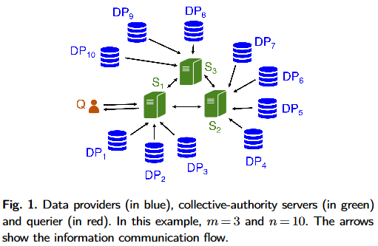
What is Unlynx ?
https://petsymposium.org/2017/papers/issue4/paper54-2017-4-source.pdf
Functionnality:
Collective Authority (arbitrary number of servers), answer a query Q with data from the Data Providers
Data encrypted with Elliptic Curve El-Gamal, and collectivelly aggregated
Privacy & Correctness:
Assured if at least one server is trusted
Properties :
Proof of correctness
No proof for input validation

Slide 4
What is Prio ?
https://www.usenix.org/systel/files/conference/nsdi17/ndsdi-17-corrigan-gib.pdf
Functionnality:
Each data provider holds a private value
Not encrypted, private values of data-provider splited into number of servers shares in Field F
Aggregation function over private values of data providers using MPC
Privacy & Correctness:
As Unlynx, assured if at least one server is trusted, but correctness only if all cothority trusted
Properties:
Proof of correctness and Input validation using SNIPs proof

Slide 5
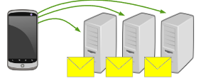
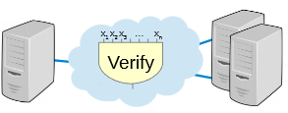
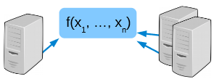

More about Secret shared Non Interactive Proofs
Client Evalutation
Each data providers evaluates its share in an arithmetic circuit with M multiplication gates
Client Transfer:
Construct 3 polynomials from wire (f,g and h)
Send Share h[i] of polynomial h along with share x[i] to server i
Server Computation:
Servers reconstruct from shares, do consistency check ; polynomial identity test. Detect fraudulous input
Use Beaver MPC to multiply shares and get aggregation f(.)
p$=\frac{(2M−2)}{|F|}$

Slide 6
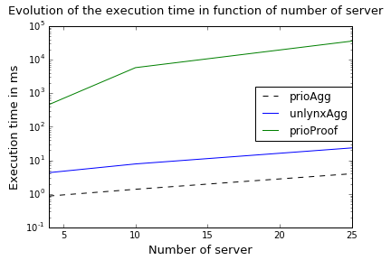
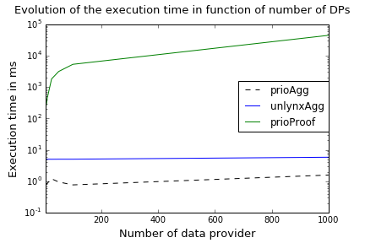
Preliminary Results
3 curves, one for aggregation with Prio method, the other for the aggregation with Unlynx ciphers, and the last one is the execution time for SNIPs proof
Test ran on VMWare, Ubuntu64 bits v17.10, 6.1 GB RAM, 2 cores intel I5-4590 @3.3Ghz, 10 runs
All the code on github, Unlynx repo, branch Max

Slide 7



Status & Next Steps :
Implement Verification and Aggregation protocol from Prio to Unlynx Framework
Design the simulation to have first results
Implement the service for Prio in the framework (in progress)
Implementing El Gamal Input range Validation [1]
Compare both systems with input validation and aggregation
Compare the bandwidth used by protocols
Design a hybrid solution
[1] https://www.iacr.org/archive/asiacrypt2008/53500238/53500238.pdf

Slide 8
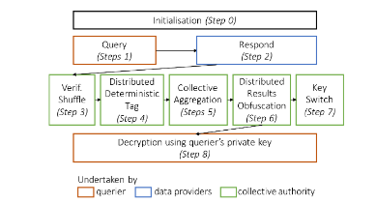
Technical Unlynx
Server i Pair private-public Key (ki,Ki), collective public key K sum of public from each server.
Zero knowledge proof, with discrete log y1, y2 by doing A1y1 + A2y2 = A, for DDT, publish for Agg.
Support Differentially private queries
Confidentiality, Unlikability,Corectness,
differential privacy

Slide 9

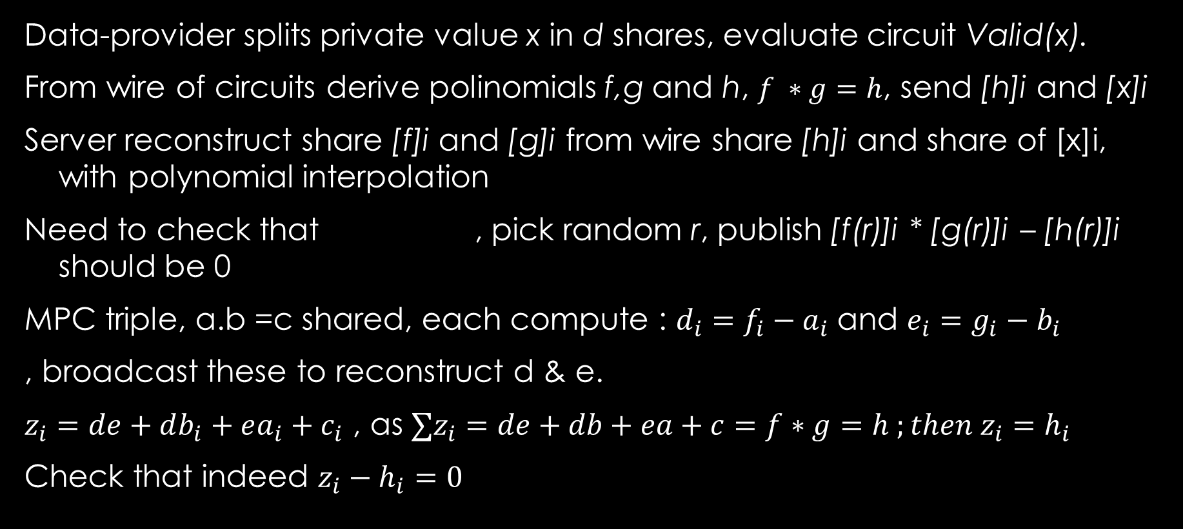
Technical Prio
Data-provider splits private value x in d shares, evaluate circuit Valid(x).
From wire of circuits derive polinomials f,g and h, $f ∗g=h$, send [h]i and [x]i
Server reconstruct share [f]i and [g]i from wire share [h]i and share of [x]i, with polynomial interpolation
Need to check that , pick random r, publish [f(r)]i * [g(r)]i – [h(r)]i should be 0
MPC triple, a.b =c shared, each compute : $d_{i}=f_{i}−a_{i}$and $e_{i}=g_{i}−b_{i}$
, broadcast these to reconstruct d & e.
$z_{i}=de+db_{i}+ea_{i}+c_{i}$ , as $∑z_{i}=de+db+ea+c=f∗g=h ;then z_{i}=h_{i}$
Check that indeed $z_{i}−h_{i}=0$
$$f ∗g=h$$

