Slide 1
Decentralized Data Sharing System based on Secure Multiparty Computation
Max Premi, Master Semester Project (12 credits)
Supervised by :David Froelicher
and Juan Ramon Troncoso-Pastoriza
Notes:
Master student in CS

Slide 2
Goals of the project
Implement a multi-party computation (MPC) system (Prio [1] ) into Unlynx’s [2] framework
Design and implement an input validation algorithm for Unlynx.
Compare both systems with the least significant differences in settings/model
Discuss the guidelines to create a privacy-preserving data sharing protocol allying both systems advantages
[1] H. Corrigan-Gibbs & D. Boneh. Prio: Private, Robust, and Scalable Computation of Aggregate Statistics. Stanford University
[2] D. Froelicher, P. Egger, J.S Sousa, J.L Raisaro, Z. Huang, C. Mouchet, B. Ford & J.P Hubaux. UnLynx: A Decentralized System for Privacy-Conscious Data Sharing.EPFL

Slide 3
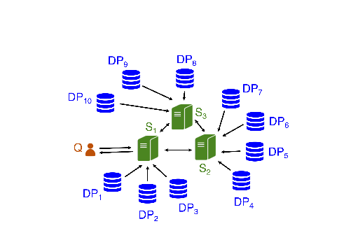
System design
Collective authority of m servers (CA), n data providers (DPs), querier for Unlynx.
Prio uses the same system except data
providers hold a single value.
Goal is to compute an aggregation
function over private datas
Lot of way to do so : MPC, Homomorphic
encryption, Distributed systems.
Collective authority with m = 3 servers, and n = 10 data providers

Slide 4
Systems comparison
But best solution is usually a combination of those.
Unlynx | Prio
Functionnality: Answer a query Q, either Sum, Count or Select and Where attributes (equality) Data encrypted with EC ElGamal. Privacy & Correctness: Anytrust model Assured if at least one server is trusted DPs honest but curious Properties: Proof of correctness via zero-knowledge proofs CA is non static No proof for input validation Data stored encrypted at DPs Support only Count and Sum | Functionnality: Each data provider holds a private value Not encrypted, data splited into m shares in Field F AFE’s used to extend classical operation (max/min, set intersections, least-square regression.) Privacy & Corectness: As Unlynx, Privacy ensured if at least one server is trusted Correctness is ensured if all servers are trusted Properties: Secret shared non-interactive proof = input validation Support more aggregation functions Threat model not real-world ideal CA is static

Slide 5
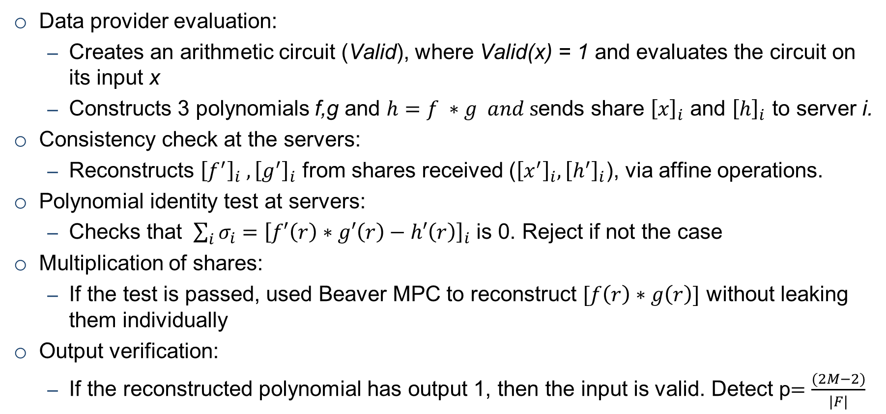
More about Secret shared Non Interactive Proof
Data provider evaluation:
Creates an arithmetic circuit (Valid), where Valid(x) = 1 and evaluates the circuit on its input x
Constructs 3 polynomials f,g and $h=f ∗g and s$ends share ${\left[x\right]}_{i}$ and ${\left[h\right]}_{i}$ to server i.
Consistency check at the servers:
Reconstructs ${\left[f^{′}\right]}_{i} , {\left[g^{′}\right]}_{i}$ from shares received (${\left[x^{′}\right]}_{i},{\left[h^{′}\right]}_{i}$), via affine operations.
Polynomial identity test at servers:
Checks that $\sum_{i}{σ_{i}}={\left[f′\left(r\right)∗g′\left(r\right)−h′\left(r\right)\right]}_{i}$ is 0. Reject if not the case
Multiplication of shares:
If the test is passed, used Beaver MPC to reconstruct $[f\left(r\right)∗g\left(r\right)]$ without leaking them individually
Output verification:
If the reconstructed polynomial has output 1, then the input is valid. Detect p$=\frac{(2M−2)}{|F|}$

Slide 6
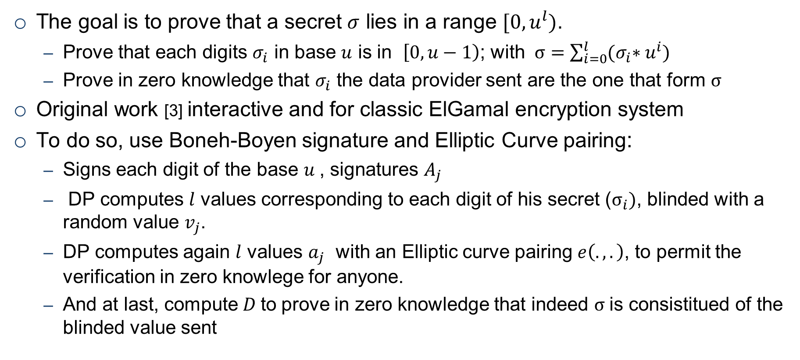
EC ElGamal Input range proof
The goal is to prove that a secret $σ$ lies in a range $[0, u^{l})$.
Prove that each digits $σ_{i}$ in base $u$ is in $\left[0,u−1\right)$; with $σ=\sum_{i=0}^{l}{{(σ}_{i}∗u^{i})}$
Prove in zero knowledge that $σ_{i}$ the data provider sent are the one that form $σ$
Original work [3] interactive and for classic ElGamal encryption system
To do so, use Boneh-Boyen signature and Elliptic Curve pairing:
Signs each digit of the base $u$, signatures $A_{j}$
DP computes $l$ values corresponding to each digit of his secret ($σ_{i})$, blinded with a random value $v_{j}$.
DP computes again $l$ values $a_{j}$ with an Elliptic curve pairing $e\left(.,.\right)$, to permit the verification in zero knowlege for anyone.
And at last, compute$D$to prove in zero knowledge that indeed $σ$is consistitued of the blinded value sent
[3] J. Camenish, R. Chaabouni and A.Shelat, Efficient Protocols for Set Membership and Range proofs

Slide 7
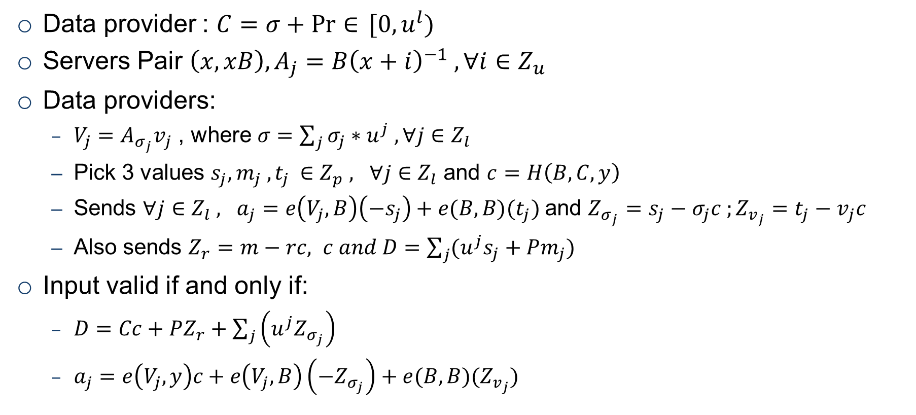
Additional content for Input range algorithm
Data provider : $C=σ+\operatorname{Pr}{∈} [0,u^{l})$
Servers Pair $\left(x,xB\right), A_{j}=B{\left(x+i\right)}^{−1} , ∀i∈Z_{u}$
Data providers:
$V_{j}=A_{σ_{j}}v_{j}$ , where $σ=\sum_{j}{σ_{j}∗u^{j} , ∀j∈Z_{l}}$
Pick 3 values $s_{j}, m_{j} ,t_{j }∈Z_{p} , ∀j∈Z_{l}$ and $c=H\left(B,C,y\right)$
Sends $∀j∈Z_{l} , a_{j}=e\left(V_{j},B\right)\left(−s_{j}\right)+e(B,B)(t_{j})$and $Z_{σ_{j}}=s_{j}−σ_{j}c ;Z_{v_{j}}=t_{j}−v_{j}c$
Also sends $Z_{r}=m−rc, c and D=\sum_{j}{(u^{j}s_{j}+Pm_{j})}$
Input valid if and only if:
$D=Cc+PZ_{r}+\sum_{j}{\left(u^{j}Z_{σ_{j}}\right)}$
$a_{j}=e\left(V_{j},y\right)c+e\left(V_{j},B\right)\left(−Z_{σ_{j}}\right)+e(B,B)(Z_{v_{j}})$

Slide 8
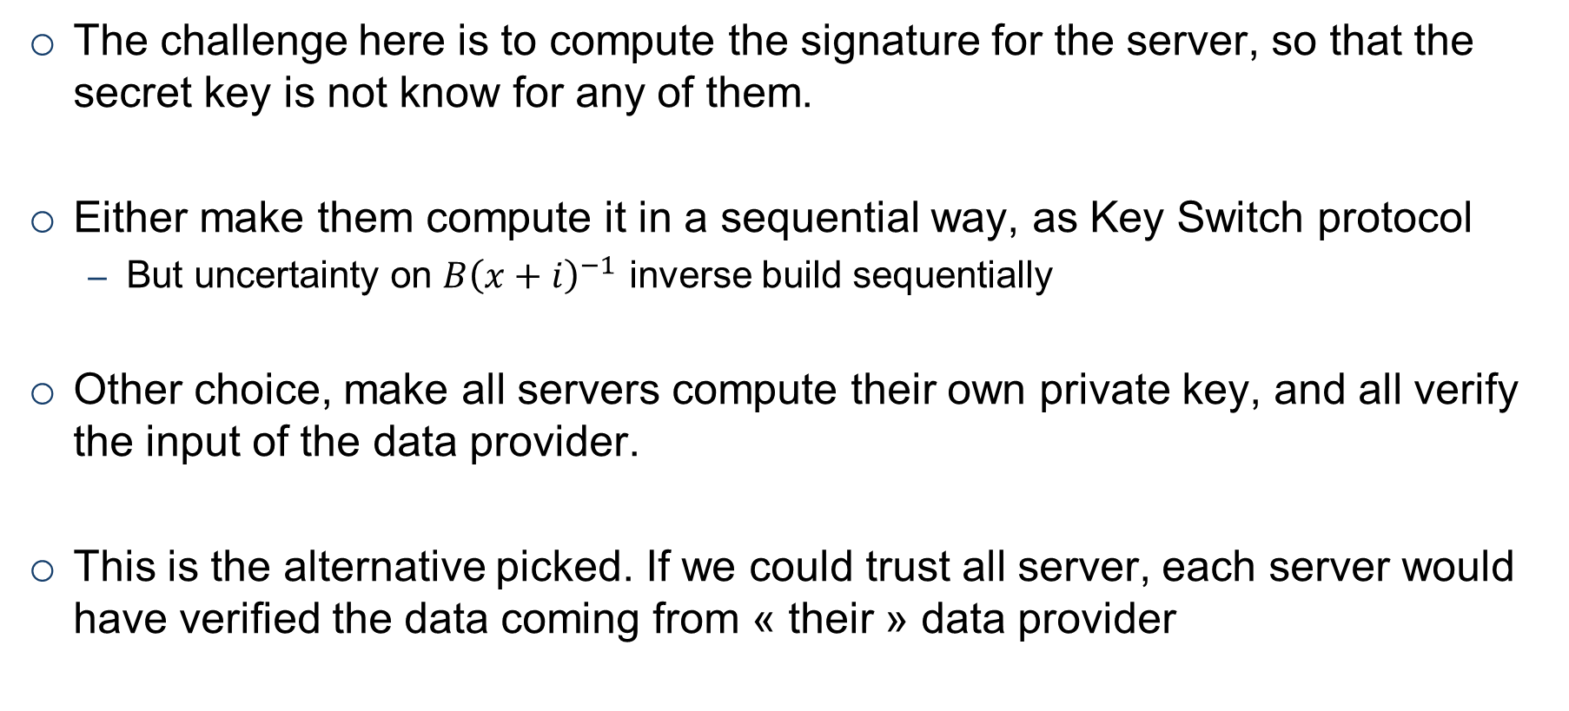
The problem with Unlynx threat model
The challenge here is to compute the signature for the server, so that the secret key is not know for any of them.
Either make them compute it in a sequential way, as Key Switch protocol
But uncertainty on $B{\left(x+i\right)}^{−1}$ inverse build sequentially
Other choice, make all servers compute their own private key, and all verify the input of the data provider.
This is the alternative picked. If we could trust all server, each server would have verified the data coming from « their » data provider

Slide 9
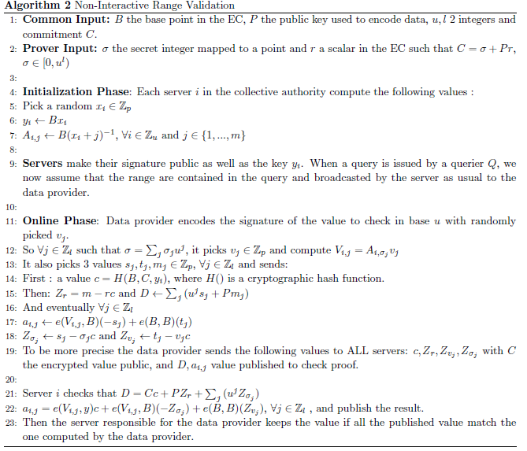
The algorihtm

Slide 10
Systems pipelines for comparison
Prio
UnLynx
Initialisation (Step 0)
Initialisation (Step 0)
Query
(Steps 1)
Response & Range Proofs Creation
(Step 2)
Query
(Steps 1)
Response & Range Proofs Creation
(Step 2)
Range Proofs Verification
(Step 3)
Collective Aggregation
(Step 4)
Range Proofs Verification
(Step 3)
Collective Aggregation
(Step 4)
Key Switch
(Step 7)
Decryption using querier’s private key
(Step 8)
Undertaken by
querier data providers collective authority

Slide 11
Setup to compare the systems
We define 3 systems to be compared in the following slides:
Prio with threat model presented previously
Trusted Unlynx : that represents the Unlynx system with the exact same threat model as Prio
Unlynx with threat model presented previously
In trusted Unlynx only need to prove to one server.
Also in both Unlynx systems, DP now send only one value.
This is done to compare Prio and Unlynx with the exact same settings.

Slide 12
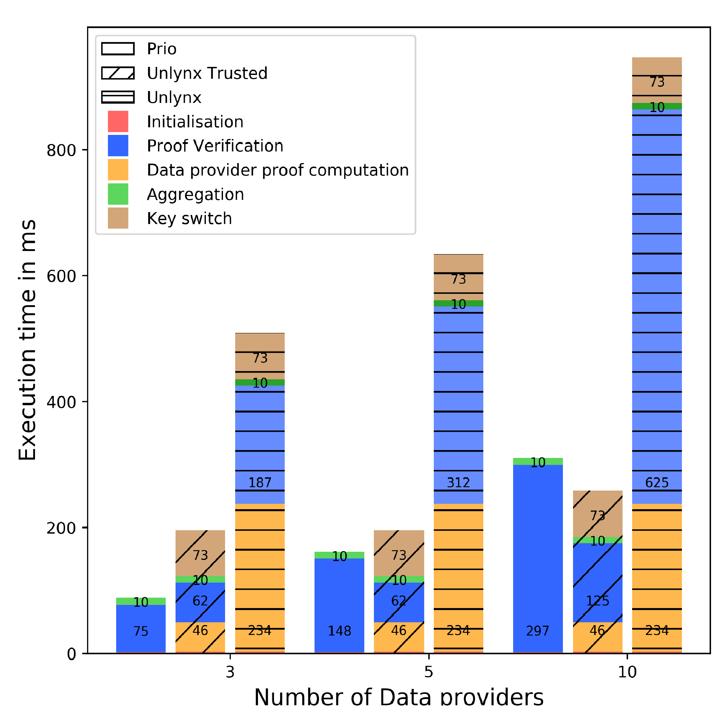
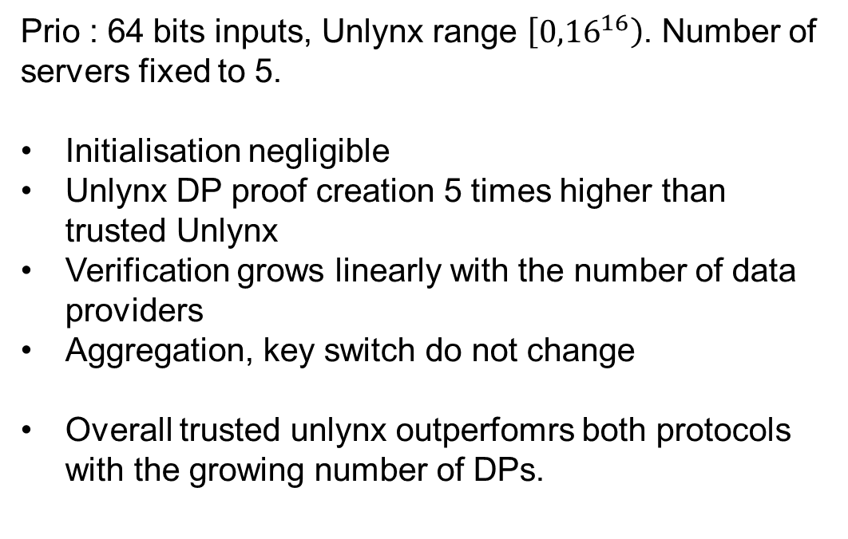
Scaling with number of data providers
Prio : 64 bits inputs, Unlynx range $\left[{0,16}^{16}\right)$. Number of servers fixed to 5.
Initialisation negligible
Unlynx DP proof creation 5 times higher than trusted Unlynx
Verification grows linearly with the number of data providers
Aggregation, key switch do not change
Overall trusted unlynx outperfomrs both protocols with the growing number of DPs.
Test ran on VMWare, Ubuntu64 bits v17.10, 6.1 GB RAM, 2 cores Intel I5-4590 @3.3Ghz.

Slide 13
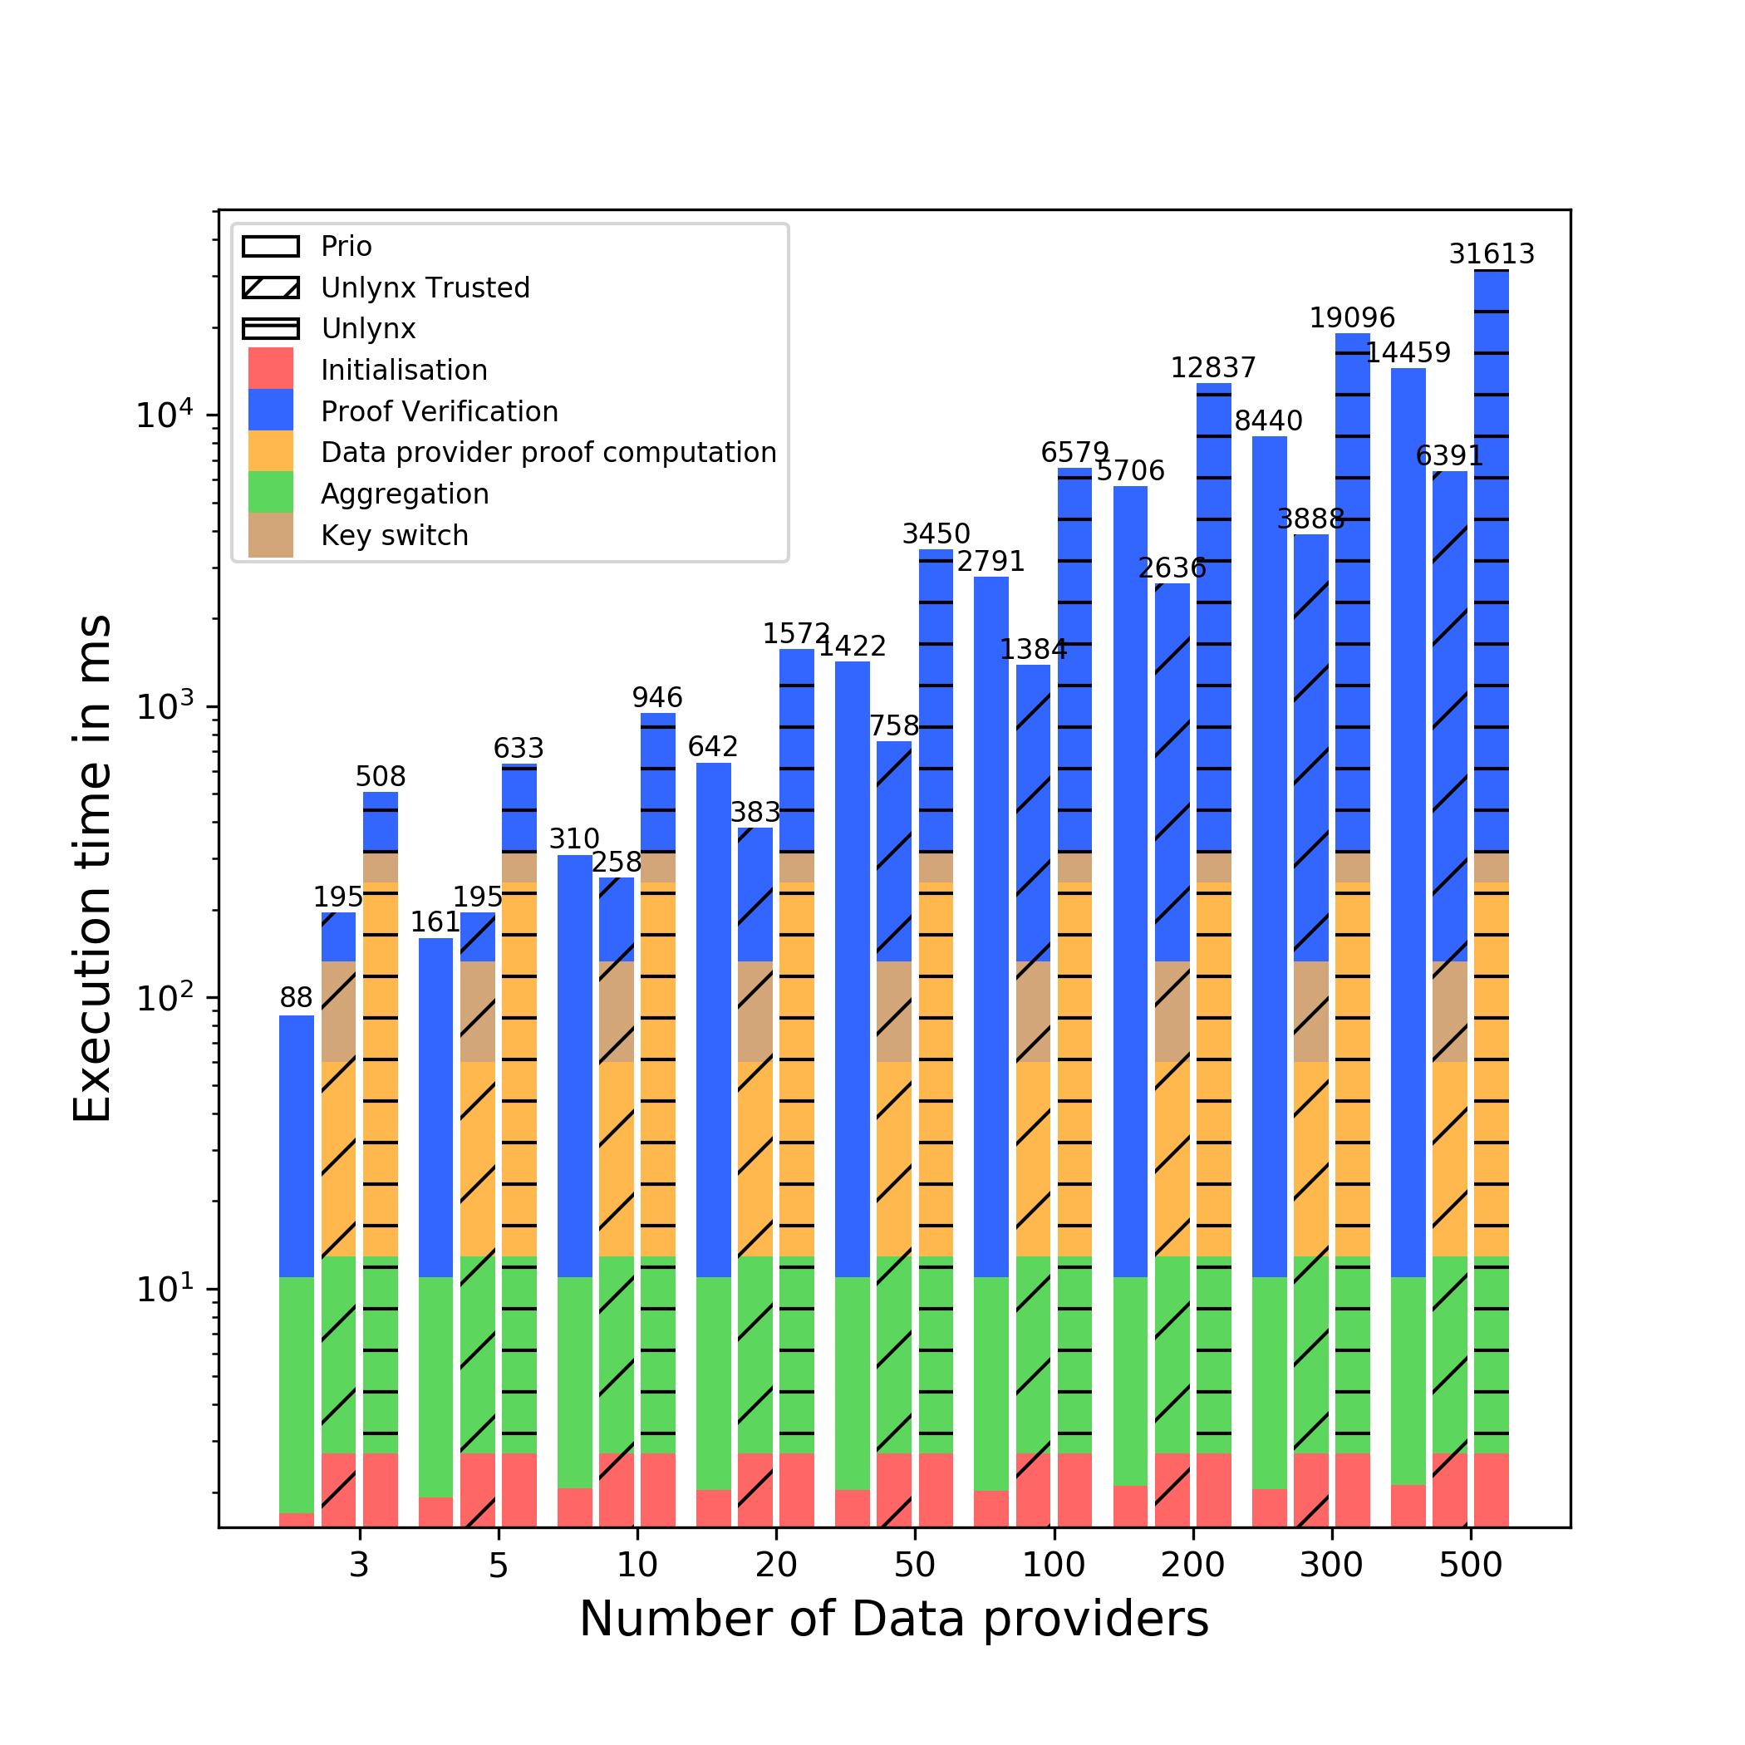
²

Slide 14
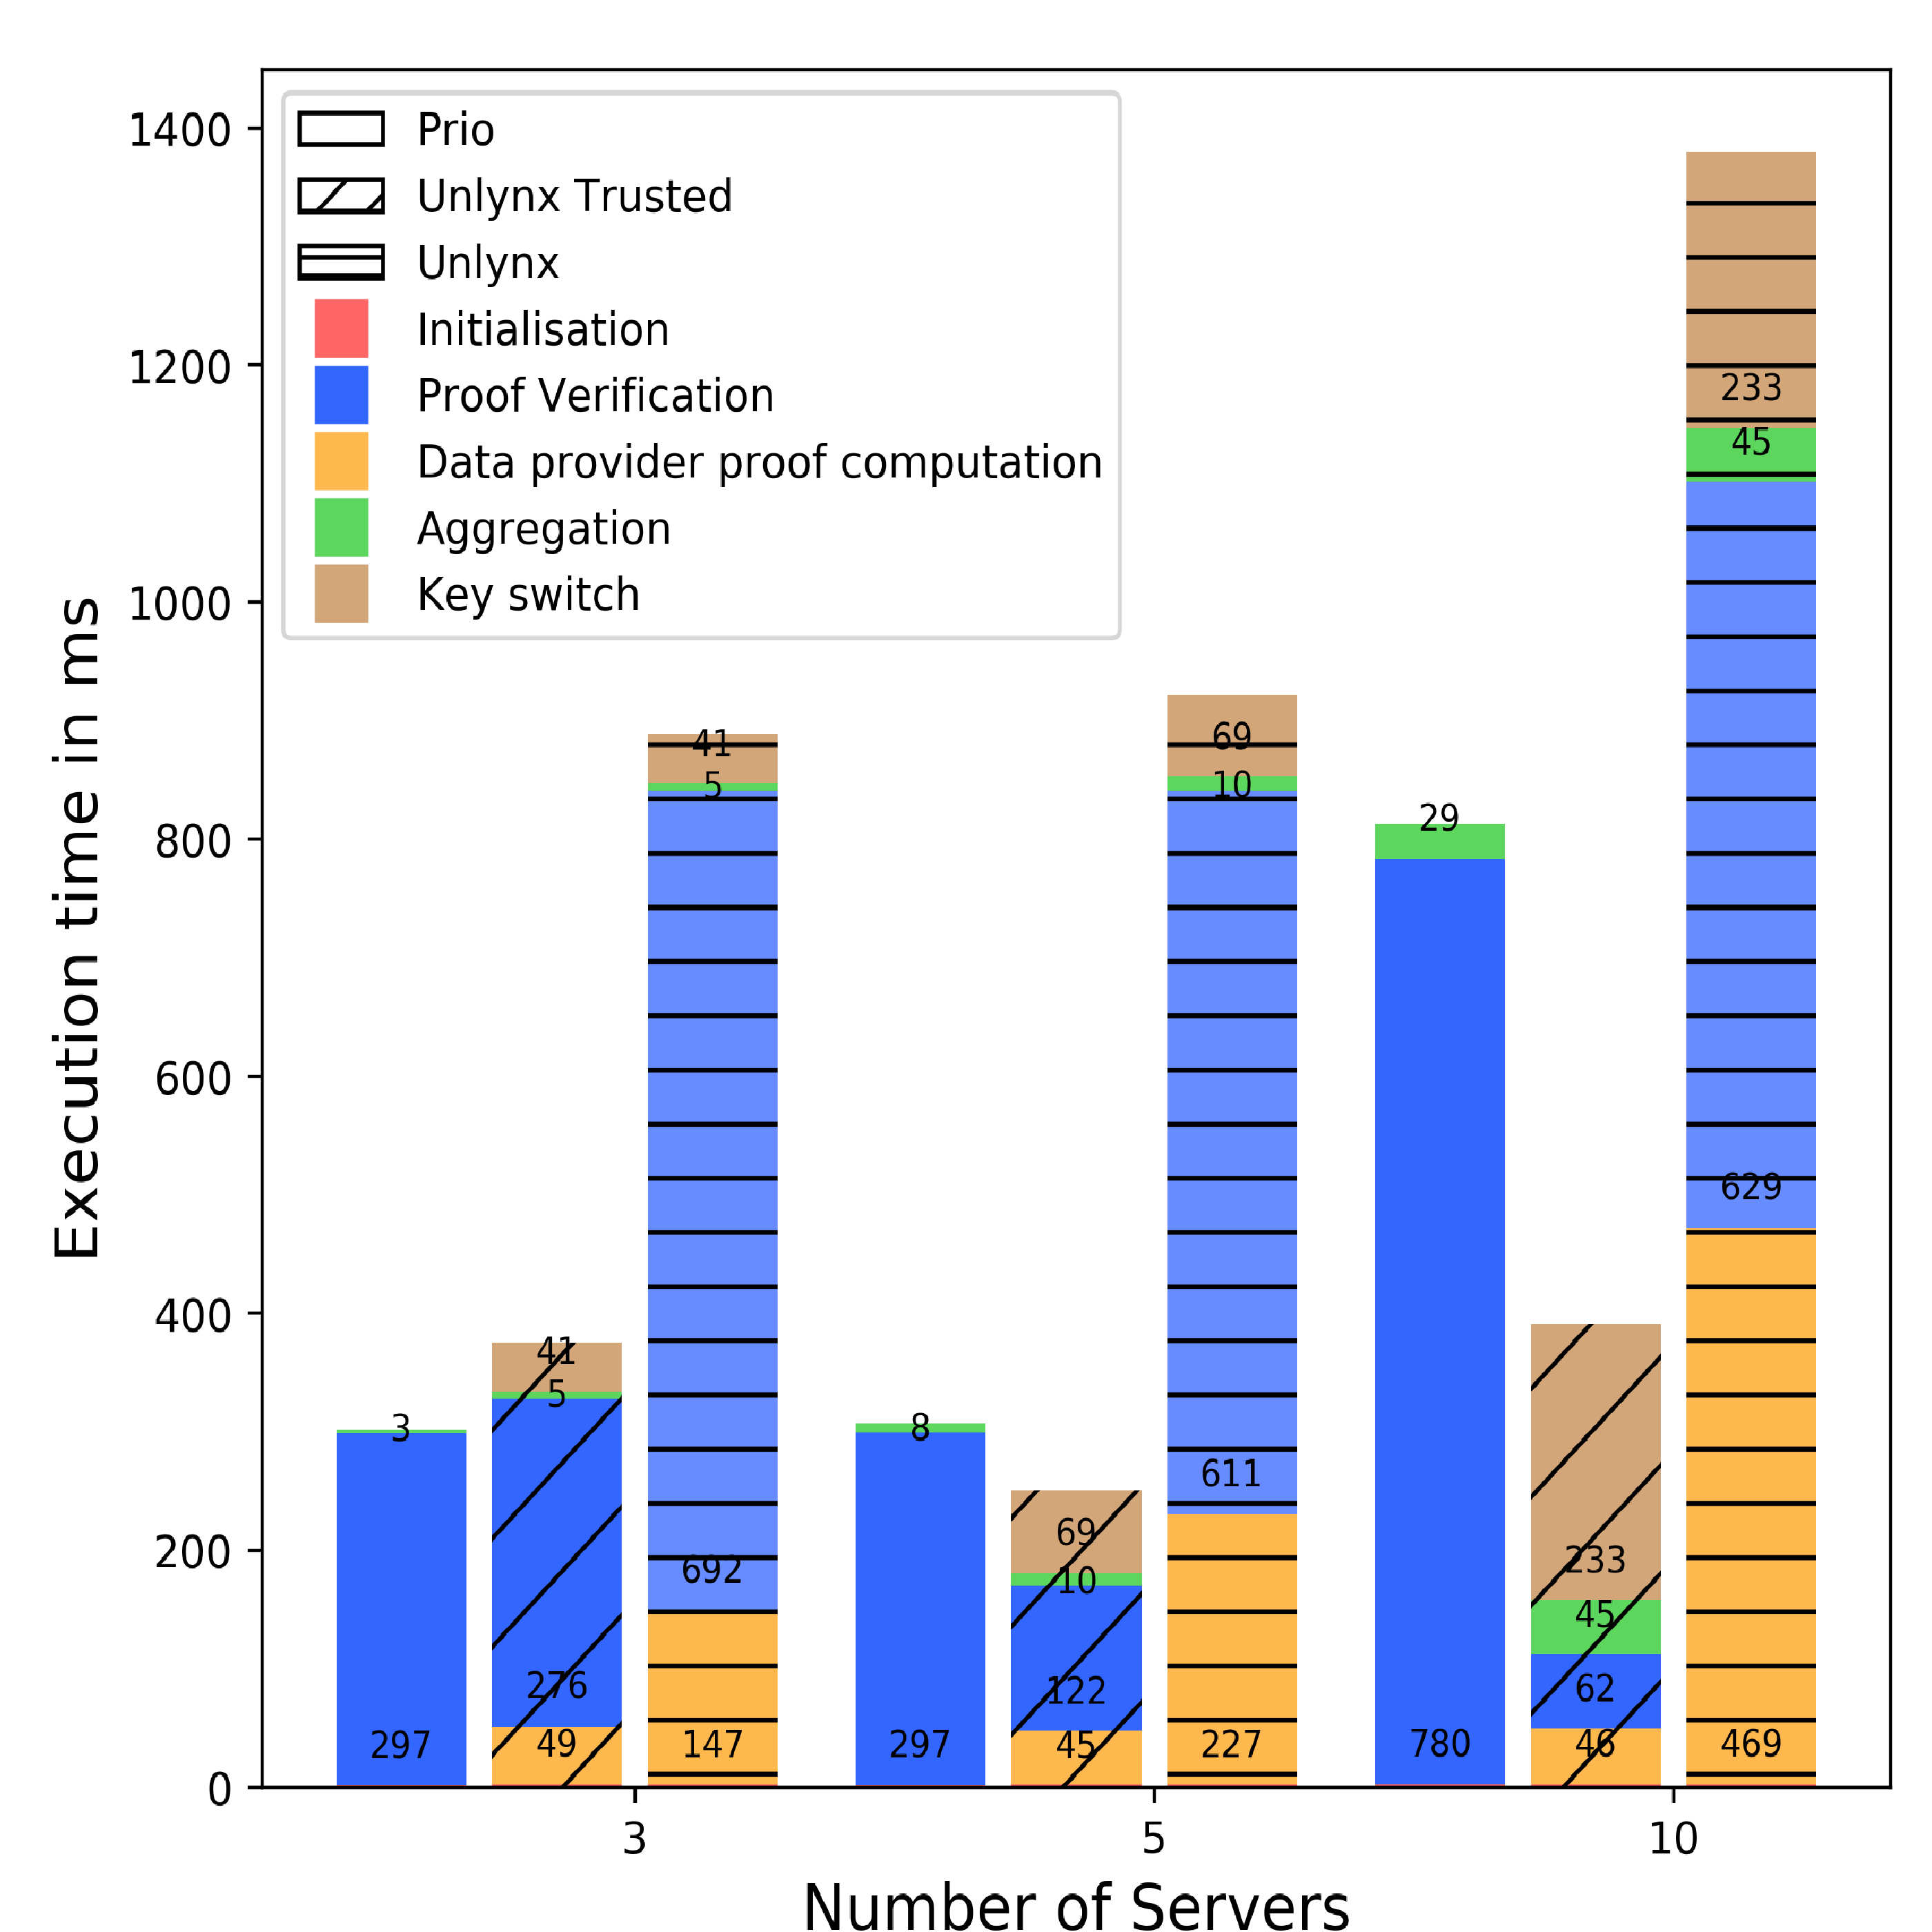
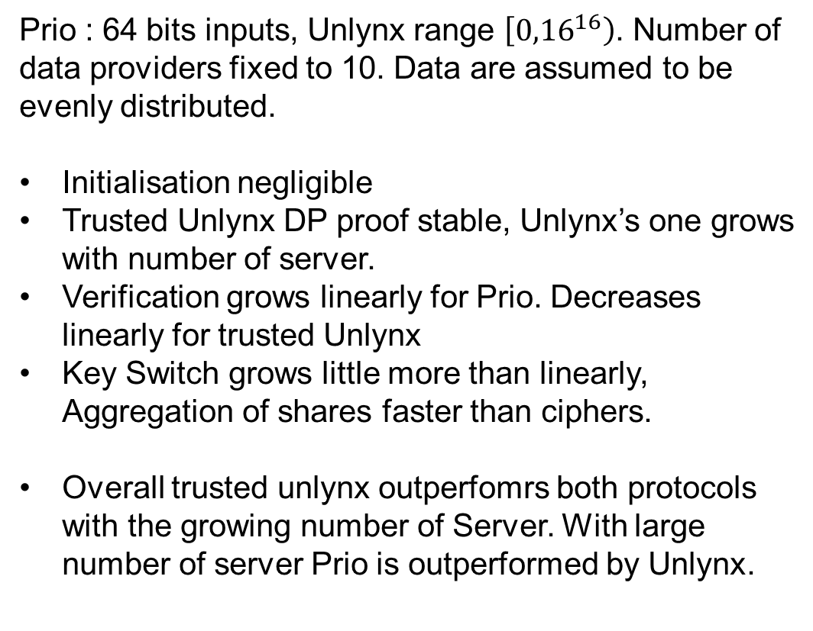
Scaling with number of servers
Prio : 64 bits inputs, Unlynx range $\left[{0,16}^{16}\right)$. Number of data providers fixed to 10. Data are assumed to be evenly distributed.
Initialisation negligible
Trusted Unlynx DP proof stable, Unlynx’s one grows with number of server.
Verification grows linearly for Prio. Decreases linearly for trusted Unlynx
Key Switch grows little more than linearly, Aggregation of shares faster than ciphers.
Overall trusted unlynx outperfomrs both protocols with the growing number of Server. With large number of server Prio is outperformed by Unlynx.

Slide 15
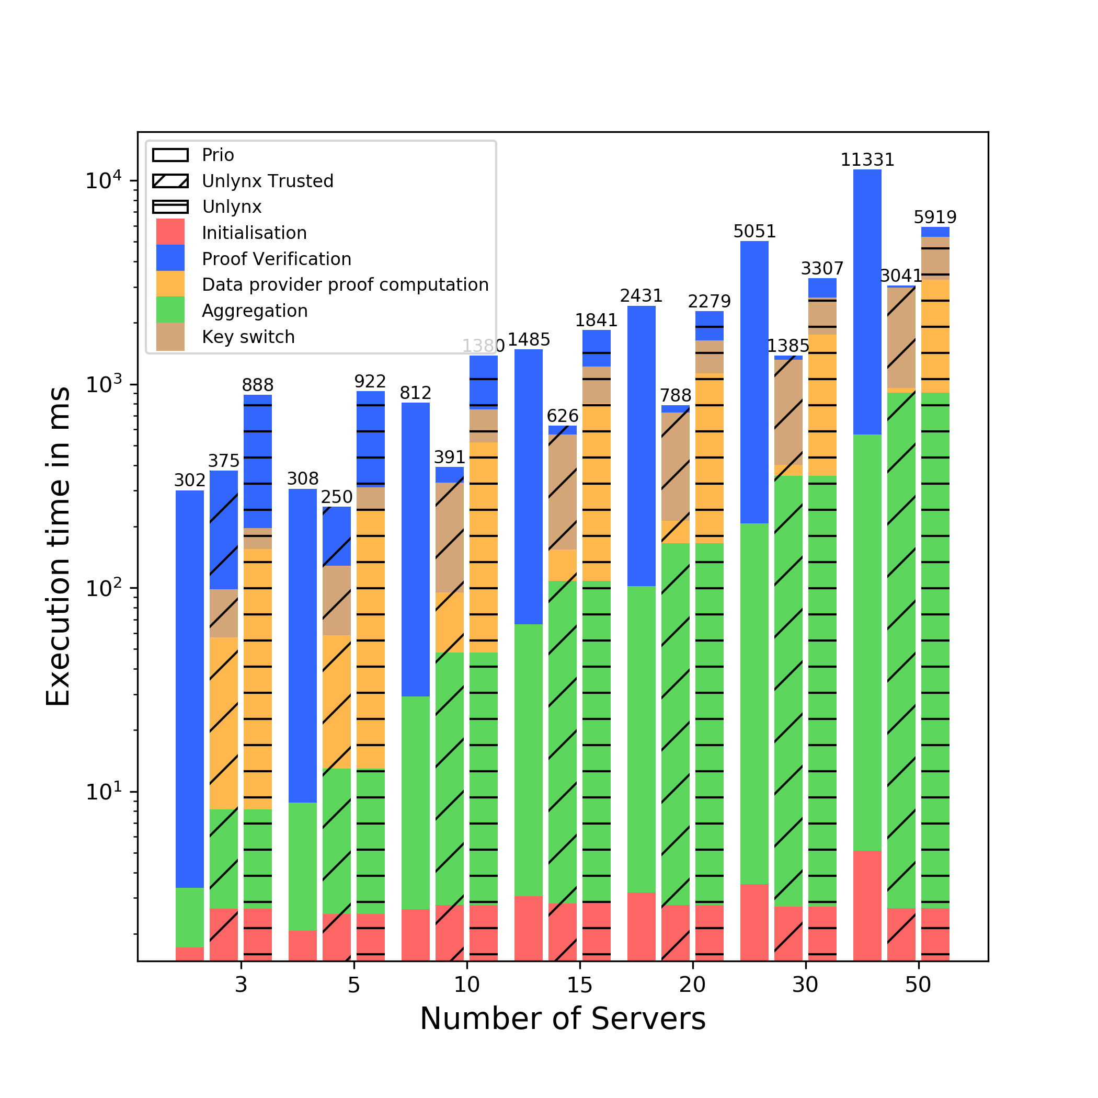

Slide 16
Conclusion & Future work
With same settings, trusted Unlynx outperforms Prio
But we do not want these settings for Unlynx
Solutions based on Unlynx:
Do the verification offline, reject if too much data do not pass the test
Choose random number of server that validate the input
Change the signature algorithm to collectivelly construct signatures.
Or:
Adapt Prio’s SNIP so that it can handle ciphertexts
Servers could potentially publish the share of a ciphertext, so keep the Anytrust setting
This allows extension of classical aggregation functions

Slide 17
Thank you !
Any questions ?

Slide 18

Additional content on MPC beaver triple.
MPC triple, $a∗b=c$shared into m shares ${\left[a\right]}_{i}∗{\left[b\right]}_{i}={\left[c\right]}_{i}$; each compute :
$d_{i}=f_{i}−a_{i}$
$e_{i}=g_{i}−b_{i}$
Broadcast these to reconstruct $d$ & $e$.
Calculate
$z_{i}=de∗m^{−1}+db_{i}+ea_{i}+c_{i}$
$∑z_{i}=de+db+ea+c$
$=f∗g=h$
$then z_{i}=h_{i}$

Slide 19
Proof of equality for Input Range

Slide 20
Additional content on EC pairing

Slide 21
Additional content on AFE

