Slide 1
Distributed Proof Verification using Distributed Ledger
Max Premi, Optional Master Semester Project (8 credits)
Supervised by: David Froelicher
and Juan Ramon Troncoso-Pastoriza
Professor: Jean-Pierre Hubaux

Slide 2
Outline
LeMal System
Skipchain Overwiew
System Design
Result
Future Work

Slide 3
Goals of the Project
Create and maintain a Distributed Ledger containing all the information to verify the Proof computed by the Collective Authority (CA):
For correctness and robustness of computation. Verifiable by anyone, thus Distributed Ledger (immutable)
Propose a system implementation (theoretical) to work in Lemal scenario.
Implement the Service that handles the Skipchain, based on the already existing implementation.
Implement the protocol that collects, verifies proof and creates a block.

Slide 4
LeMal System

Slide 6
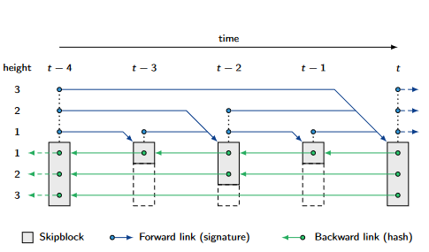
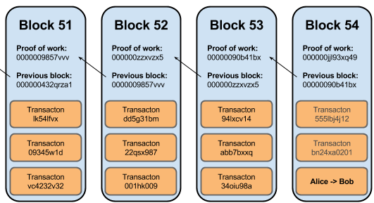
Blockchain/SkipChain Overview
Skipchain created by DeDis, mix Blockchain and Skiplist. [1]
Blockchain with forward link and hopping links (more thank 1 block away)
A block contains: File name, Time, Forward and Backward links, Threshold, Bitmap.
Consensus using Byzantine Fault Tolerance (BFT).
[1] https://github.com/dedis/cothority/tree/master/skipchain

Slide 7
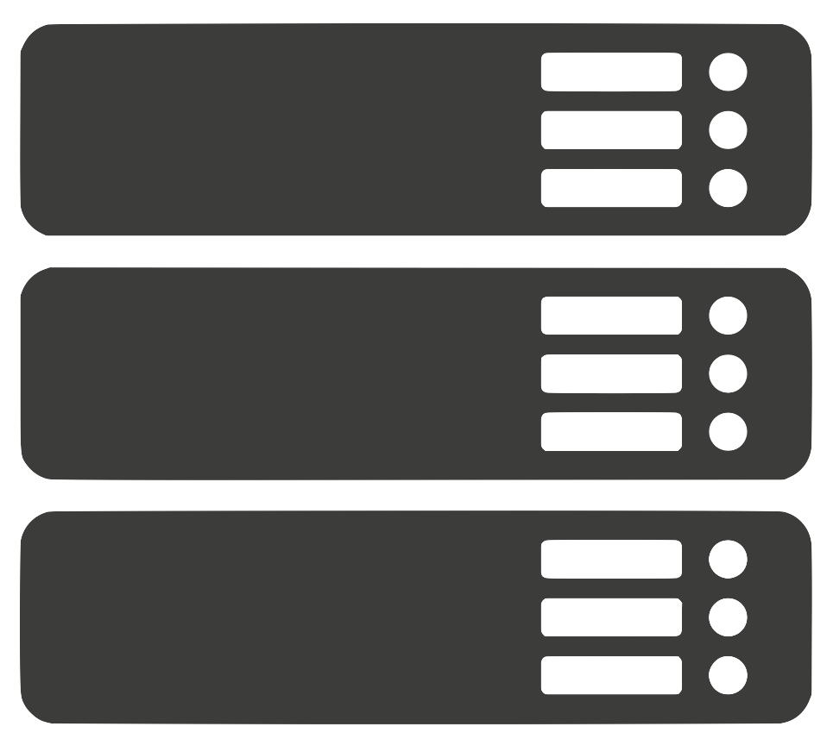


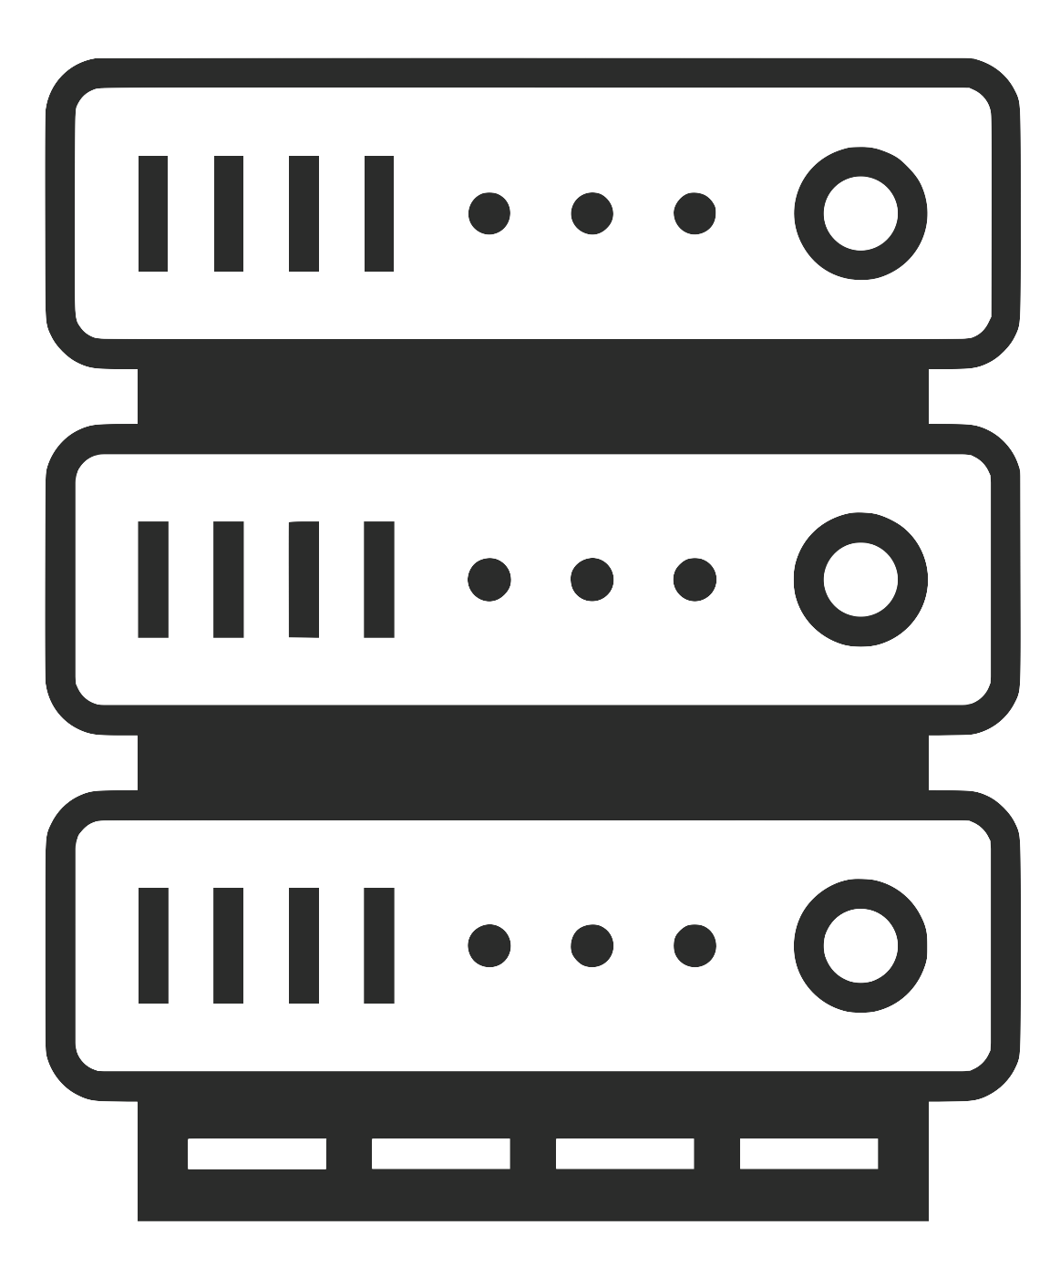
System design
Collective authority of m servers (CA), n data providers (DPs), 1 querier.
Verifying Nodes is a CA maintaining the
SkipChain
Majority is honest, thus the BFT to ensure
consistent unique timeline
Proof sending and Probabilistic Verification at each Verifying Node.
Block Creation and Insertion upon last proof receiving.
Q
Verifying Node
Data Provider
Q
Querier
Server
Notes:
SPLIT THIS SLIDE.

Slide 8

First Results
Adapt SkipChain for the desired scenario.
Bitmap, 2 if not verified and 0/1 if verified
Too much proof, stored on a file.
4 proofs, p=0,4

Slide 9
First Results
Verify p2
Verify p1, p3
Adapt SkipChain for the desired scenario.
Bitmap, 2 if not verified and 0/1 if verified
Too much proof, stored on a file.
Verify p1,p4

Slide 10

First Results
[2,0,2,2]
[1,2,1,2]
Adapt SkipChain for the desired scenario.
Bitmap, 2 if not verified and 0/1 if verified
Too much proof, stored on a file.
Implement the Service that handles the SkipChain, based on the already existing implementation.
CreateGenesis, AddBlock, GetLastBlock
Block to Bytes, Retrieve data from Bytes.
For the moment, only 1 server verify and send its Bitmap to SkipChain service.
[1,2,2,1]

Slide 11
First Results
[2,0,2,2]
[1,2,1,2]
Adapt SkipChain for the desired scenario.
Bitmap, 2 if not verified and 0/1 if verified
Too much proof, stored on a file.
Implement the Service that handles the SkipChain, based on the already existing implementation.
CreateGenesis, AddBlock, GetLastBlock
Block to Bytes, Retrieve data from Bytes.
For the moment, only 1 server verify and send its Bitmap to SkipChain service.
Implement the protocol that collect and verify proof, create a block and insert it in the chain.
[1,2,2,1]

Slide 12
Future Work
First, send to all Verifying nodes to make the probabilistic Verification robust and correct
Currently, 1 structure sent with all proofs. Later, receive proof asynchronously, and verify them on the go.
When last proofs (KeySwitch) are received and verified, gather Bitmap from each server, and launch Block Insertion.
Create a verification function inside SkipChain to verify the bitmap are the same, or same for majority.

