Slide 1
Decentralized Data Sharing System based on Secure Multiparty Computation
Max Premi, Master Semester Project (12 credits)
Supervised by :David Froelicher
and Juan Ramon Troncoso-Pastoriza
Notes:
Master student in CS

Slide 2
Goals of the project
Implement a multi-party computation (MPC) system (Prio [1] ) into Unlynx’s [2] framework
Design and implement an input validation algorithm for Unlynx.
Compare both systems with the least significant differences in settings/model
Discuss the guidelines to create a privacy-preserving data sharing protocol allying both systems advantages
[1] H. Corrigan-Gibbs & D. Boneh. Prio: Private, Robust, and Scalable Computation of Aggregate Statistics. Stanford University
[2] D. Froelicher, P. Egger, J.S Sousa, J.L Raisaro, Z. Huang, C. Mouchet, B. Ford & J.P Hubaux. UnLynx: A Decentralized System for Privacy-Conscious Data Sharing.EPFL

Slide 3
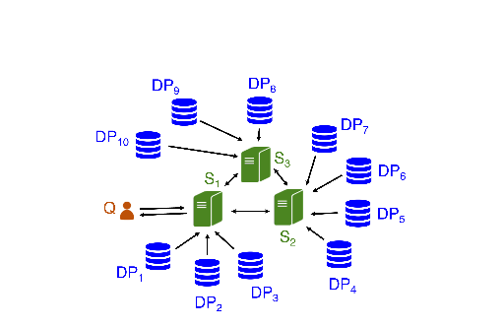
System design
Collective authority of m servers (CA), n data providers (DPs), querier for Unlynx.
Prio uses the same system (without the
querier)
Goal is to compute an aggregation
function over private datas
Lot of way to do so : MPC, Homomorphic
encryption, Distributed systems.
Collective authority with m = 3 servers, and n = 10 data providers

Slide 4
Systems pipelines

Slide 5
Systems comparison
But best solution is usually a combination of those.
Unlynx | Prio
Functionnality: Answer a query Q, either Sum, Count or Select and Where attributes (equality) Data encrypted with Elliptic Curve El-Gamal, and collectivelly processed with a defined pipeline. Privacy & Correctness: Anytrust model Assured if at least one server is trusted DPs honest but curious Properties: Proof of correctness at each step of the protocol via zero-knowledge proofs No proof for input validation Data stored encrypted at DPs | Functionnality: Each data provider holds a private value Not encrypted, private values of data-provider splited into m shares in Field F Affine-aggregatable encodings used to extend classical operation (max/min, set intersections, least-square regression.) Privacy & Corectness: As Unlynx, Privacy ensured if at least one server is trusted However, Correctness is ensured if all servers are trusted Properties: Secret shared non interactive proof (SNIP) used for input validation

