Slide 1



Final Presentation
Introduction to IT Systems
Gayathri Pichai & Maximilian Purk
1.12.2022

Slide 2
3 Parts
First.. summarize the midterm presentation and the basic idea
Second... what challenges did we face?
Third... ... live presentation and Introduction to Django (show pages and code)

Slide 3
Part 1
summarize the midterm presentation and the basic idea

Slide 4
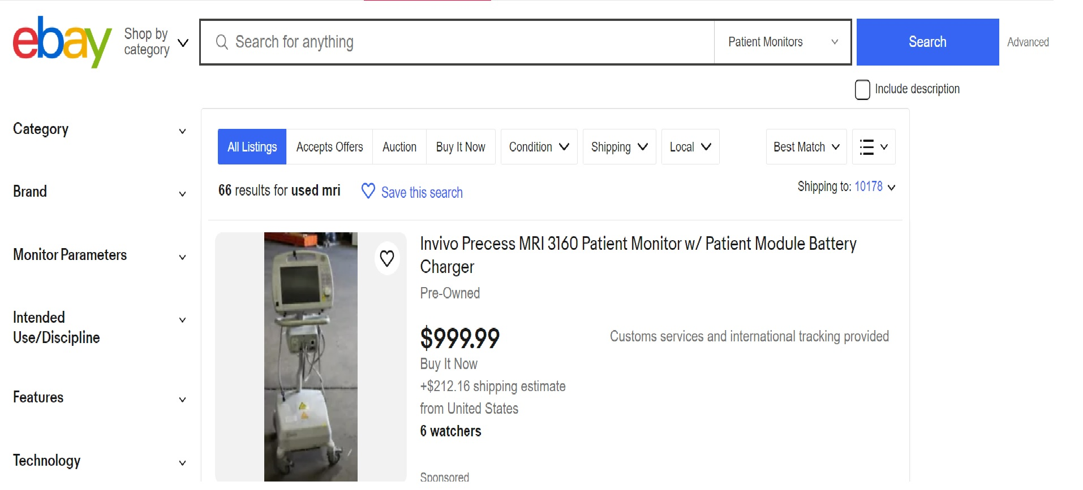
Introduction
Goal: Creating a website for buying and selling of used medical equipment

Slide 5

OLMEST.COM
Hospital Stretchers
X-Ray/CT
MRI
Defibrillators
Anesthesia Machines
Patient Monitors
Sterilizers
EKG/ECG Machines
Surgical Tables

Slide 6
What’s Olmest?
OLd MEdical STuff
Olmest focuses on the buying and selling of used medical equipment and devices
Offering a platform for connecting the buyer and seller

Slide 7
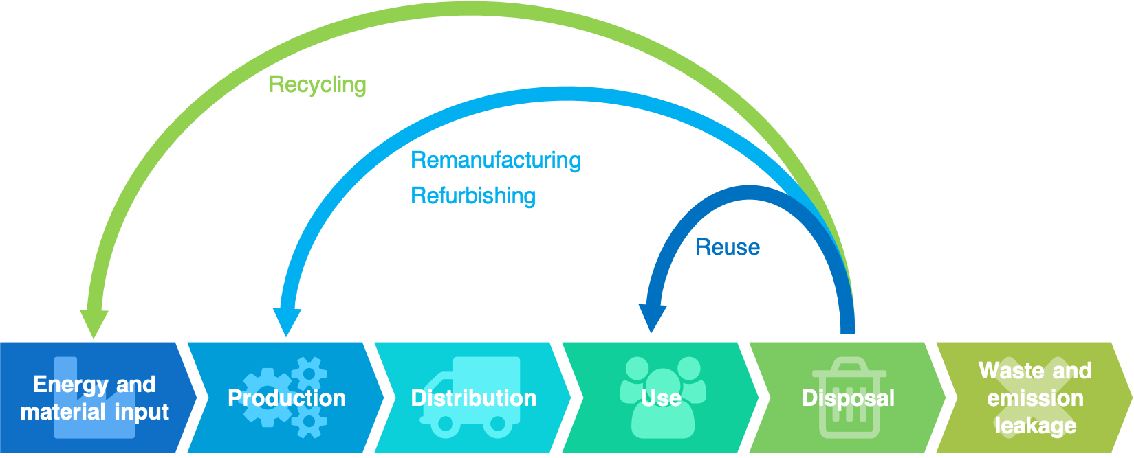
Why Olmest?
A lot of e-waste is produced in hospitals and labs
Medical instruments are expensive
Commitment to sustainability
Way to circular economy
https://en.wikipedia.org/wiki/Circular_economy

Slide 8
Why Olmest? – Technical Aspects
Platform aims on connecting buyer and seller
Transaction based on their convenience – Not through Olmest!
A Webpage where you have the typical elements
Login / Registration
Single User account (Buyer & Seller)
Database (Technical specifications, pictures, and details of seller)

Slide 9


List the items at OLMEST
Way of Working
OLMEST
Reseller Buyer
The buyer pays for the item directly

Slide 10
Which Language/Framework?
Python → We both have some experience
Django → We were interested in it.
Also, we had to learn about:
HTML
JavaScript
CSS
GitHub

Slide 11
Challenges
How to work in a team?
Using GitLab
Discussing and exchanging the ideas
Talk about the progress in meetings
How to learn about these new languages?
Lectures (HPI)
Tutorials (Youtube)
Documentation (Django)

Slide 12

Our ideas….

Slide 13
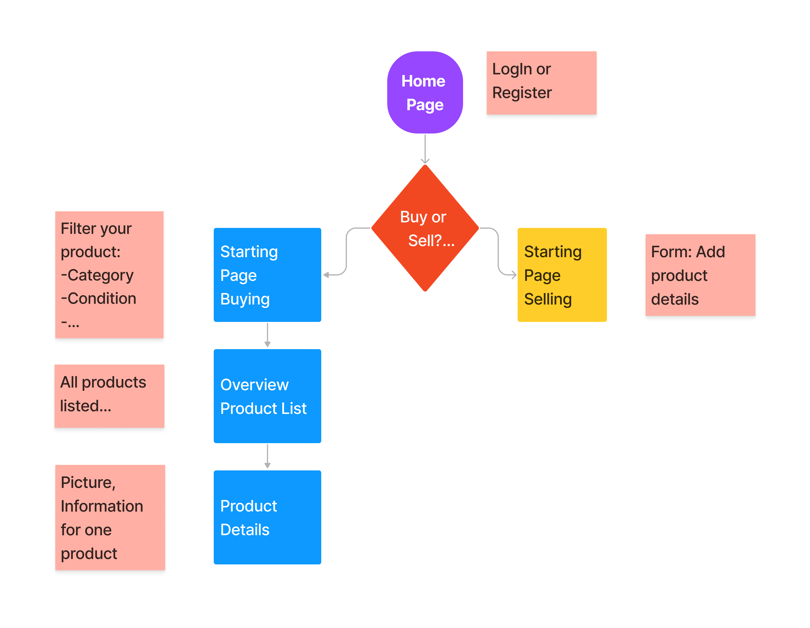

Slide 14
Part 2
what challenges did we face?

Slide 15
I. What is Django?

Slide 16
II. What is Github?

Slide 17
III. Whats an virtual environment?

Slide 18
Part 3
live presentation and Introduction to Django (show pages and code)

