Slide 1
Prediction of Future Sales in Walmart
Max Dong Qin

Slide 2


Background
Sales prediction in business is quite important:
to advance the theory and practice of forecasting.
be applied in various business areas, such as setting up appropriate inventory or service levels.
help distribute the tools and knowledge so others can achieve more accurate and better calibrated forecasts
reduce waste and be able to appreciate uncertainty and its risk implications.

Slide 3

Project aim
Overall goal of this project is to estimate, as precisely as possible, the point forecasts of the unit sales of various products sold in the USA by Walmart.
Specifically, we use hierarchical and historic sales data from Walmart, the world’s largest company by revenue, to forecast daily sales for the next days.

Slide 4
Data source
The Makridakis Open Forecasting Center (MOFC) at the University of Nicosia conducts cutting-edge forecasting research and provides business forecast training.

Slide 5
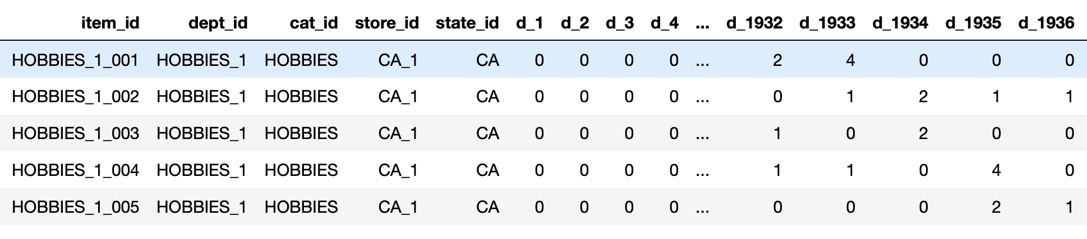
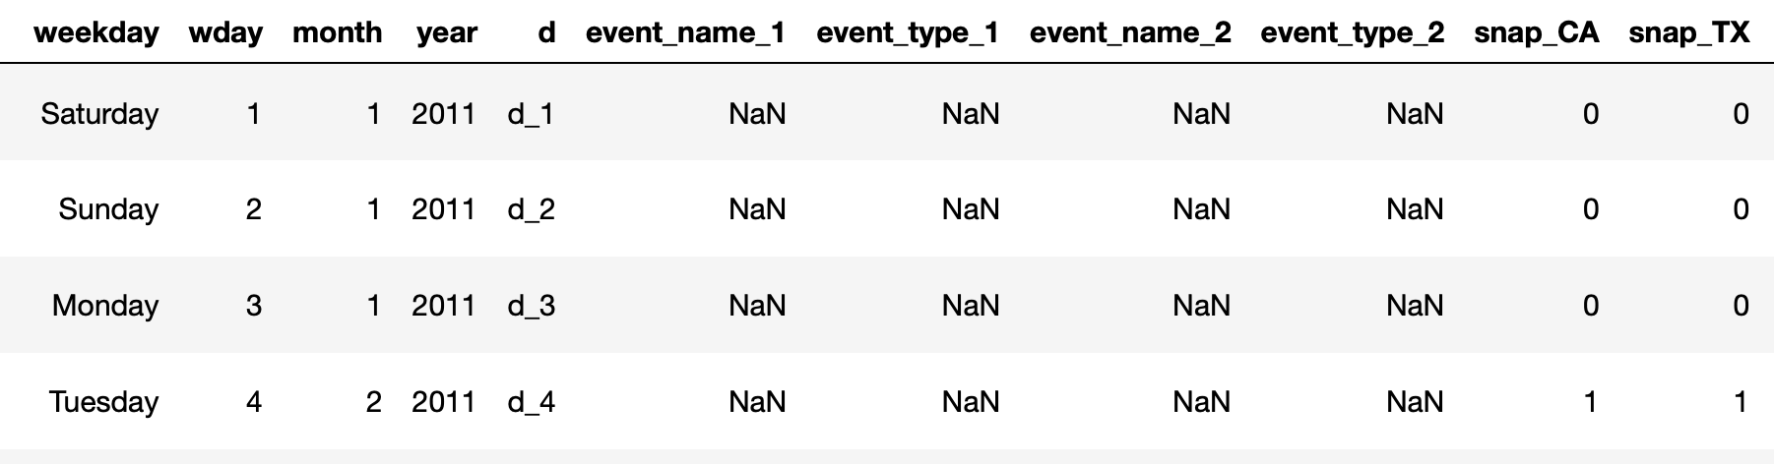

Slide 6

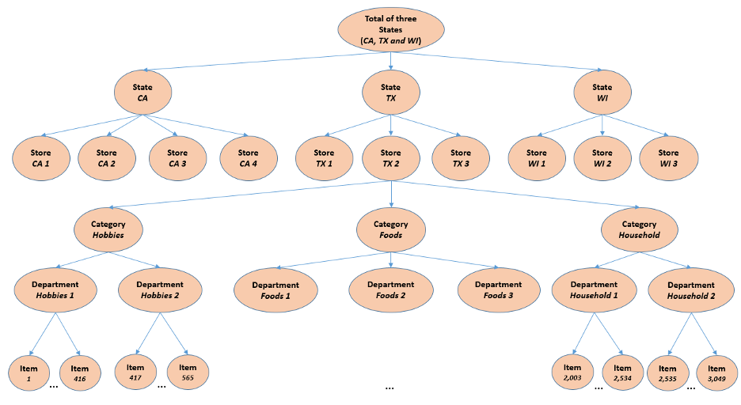

Slide 7
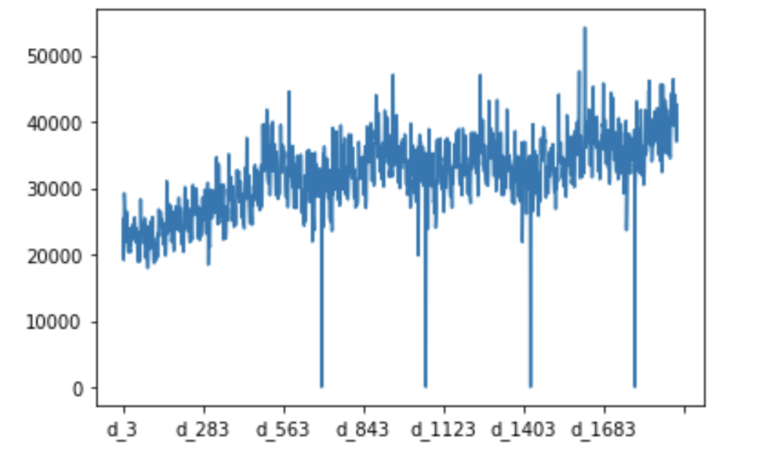
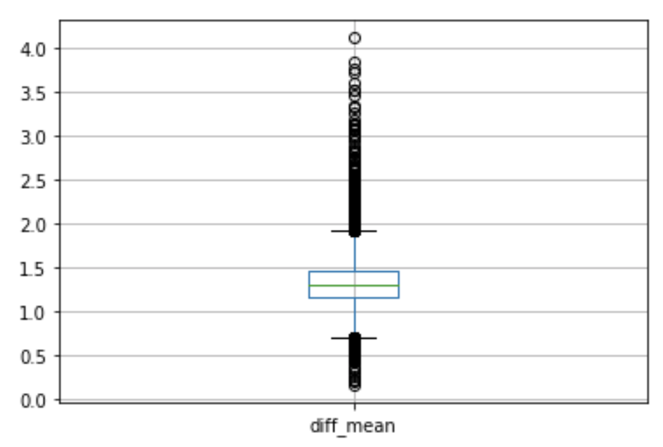
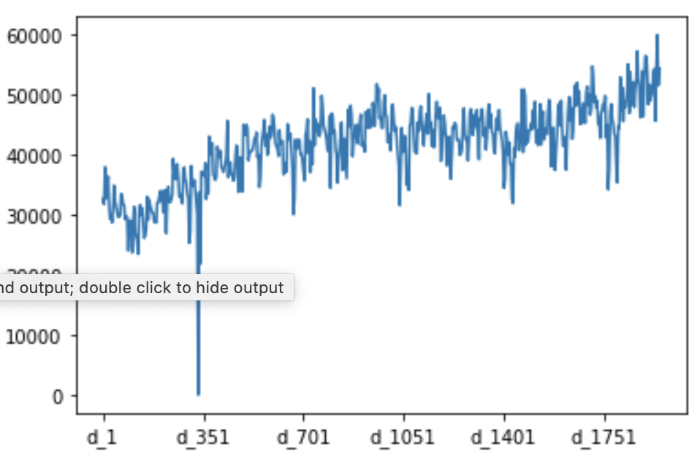
weekdays vs weekends (average sales)

Slide 8
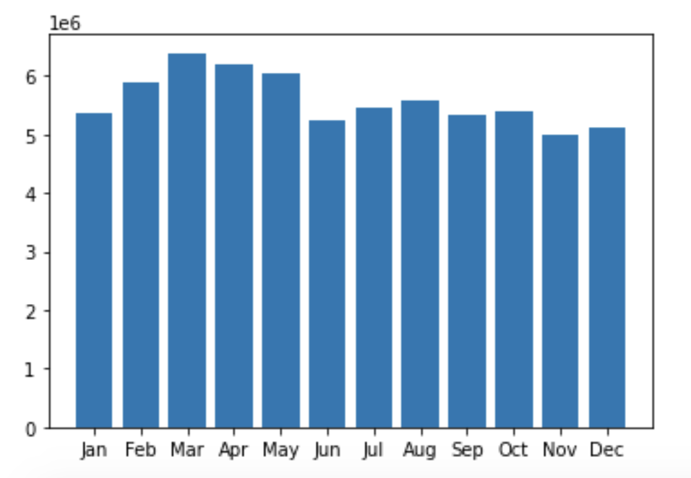
Average Sales in months
No obvious difference

Slide 9
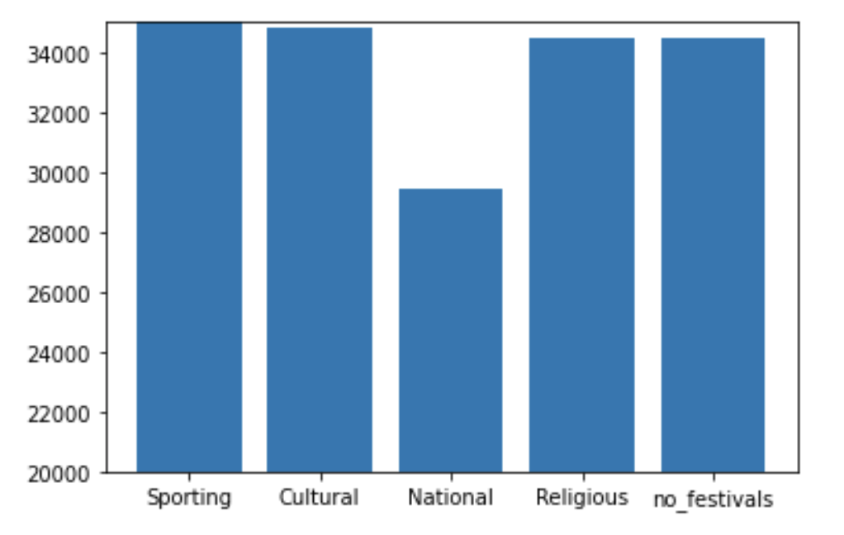
average sales in Festivals
National shows the lest sales

Slide 10
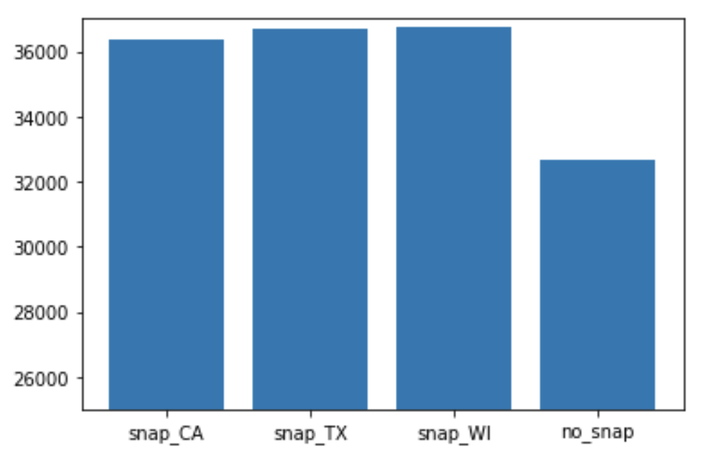
average sales on snap
The United States federal government provides a nutrition assistance benefit called the Supplement Nutrition Assistance Program (SNAP). SNAP provides low income families and individuals with an Electronic Benefits Transfer debit card to purchase food products.
obvious difference shows in snap and no_snap

Slide 11
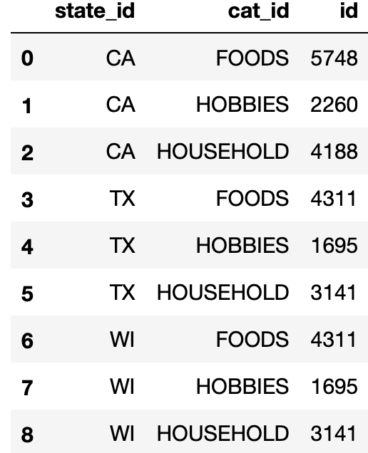
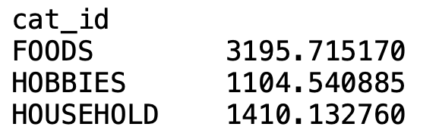
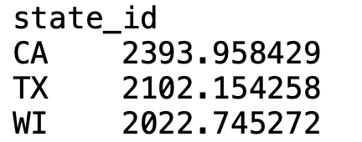
average sales on Cat/state
highest #: CA/FOODS
lowest #: TX/FOODS, WI/HOBBIES

Slide 12
Useful Features
Weekdays/weekend, Festivals snap and State/Category are treated as useful features.

Slide 13
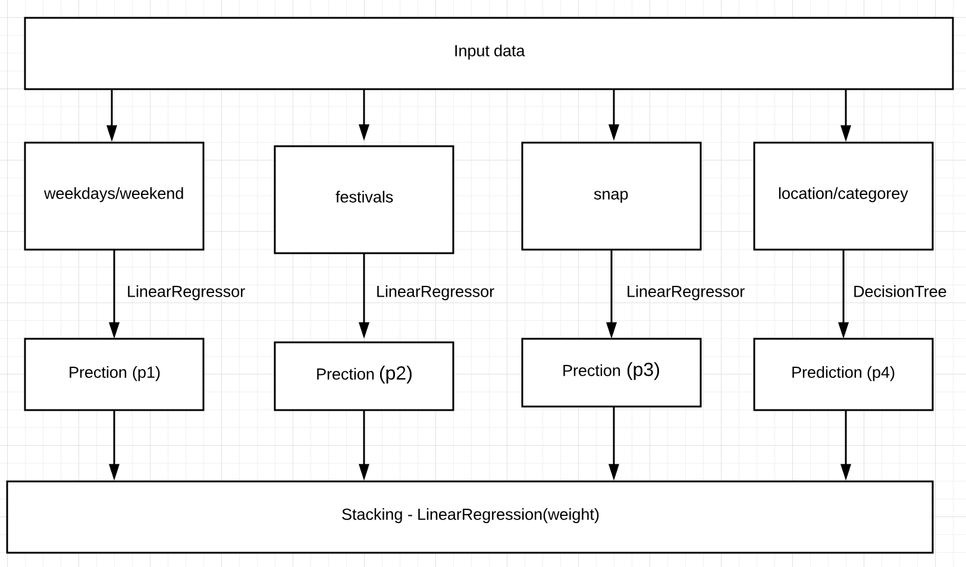
Model overview

Slide 14
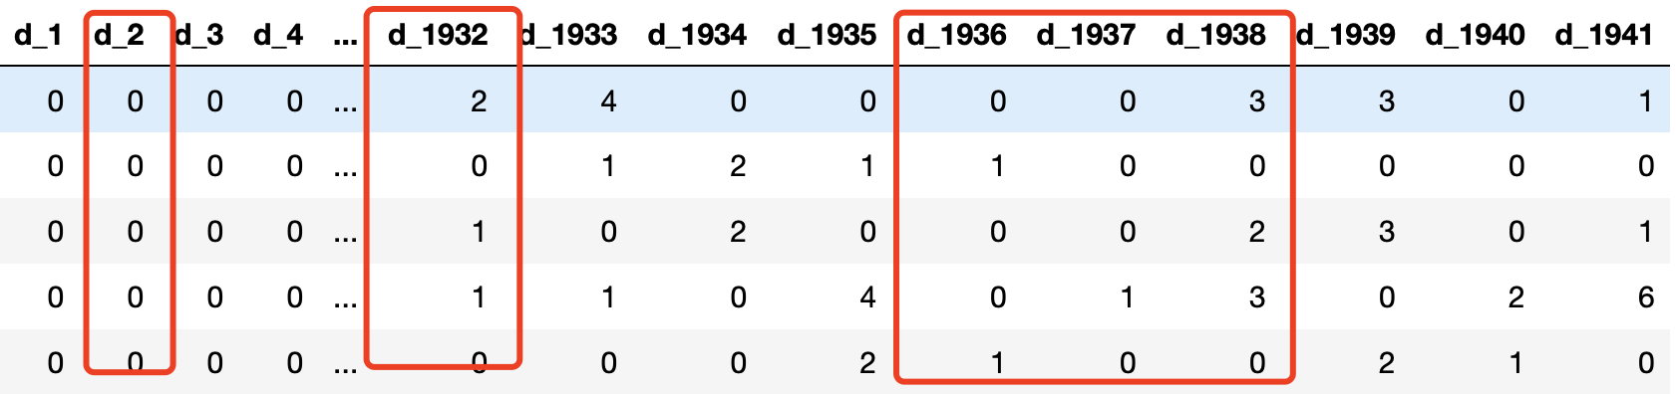

Slide 15
Outcome and conclusion
Prediction Model | R-Squared Train | R-squared Test
Weekdays (LinearRegression) | 0.831 | 0.656
Weekends (LinearRegression) | 0.805 | 0.715
Sporting (LinearRegression) | 0.542 | 0.475
Cultural (LinearRegression) | 0.714 | 0.675
National (LinearRegression) | 0.617 | 0.600
Religious (LinearRegression) | 0.697 | 0.687
No-festival (LinearRegression) | 0.864 | 0.677
Snap_CA (LinearRegression) | 0.764 | 0.637
Snap_TX (LinearRegression) | 0.806 | 0.695
Snap_WI (LinearRegression) | 0.813 | 0.686
No_snap (LinearRegression) | 0.827 | 0.702
Cat/State (DecisionTreeRegression) | 0.956 | 0.760
Stacking (LinearRegression) | 0.858 | 0.845
Conclusion:
Linear Regression works well on numerical features
Decision Tree Regression works well on categorical features
Stacking combines weak predictors to achieve a high regression performance.

Slide 16
Summary and future work
Analyzed the history sales in Walmart
Extracted useful features
Built a regression model via stacking
predict future sales with 0.845 accuracy
Consider the influence of latest sale history
prediction = a*long-term + (1-a) short-term

