Slide 1
Turkmenistan
Max 6-2

Slide 2
Part I: Physical geography
Geography

Slide 3
Climate
Much of Turkmenistan is occupied by the Karakum Desert, where the temperature in summer can reach as high as 50 °C . The coasts of the Caspian Sea are desert as well, but they are milder in winter, while they are a bit less hot but more humid in summer.

Slide 4
Resources
Natural Gas - sixth in terms of countries with the most proven natural gas reserves
Oil - 202,000 barrels of oil each and every day.
Cotton - The nation ranks as the ninth biggest cotton producer
Wheat - In 2017 the domestic supply of wheat in Turkmenistan was estimated to be 2,029 tonnes.

Slide 5
Part ii: History
History

Slide 6
History
Central Asia came under Arab control after a series of invasions in the late 7th and early 8th centuries
The origins of the Turkmen may be traced back to the Oghuz confederation of nomadic pastoral tribes of the early Middle Ages, who lived in present-day Mongolia and around Lake Baikal in present-day southern Siberia.
In the 11th century, Seljuk domains stretched from the delta of the Amu Darya delta into Iran, Iraq, the Caucasus region, Syria, and Asia Minor.

Slide 7
Continued
in 1221, central Asia suffered a disastrous invasion by Mongol warriors who swept across the region from their base in eastern Asia.
The history of Turkmenistan from the 16th until the 19th century is mostly known by the relations with the states of Iran, Khiva, Bukhara, and Afghanistan.

Slide 8
Continued
The Russian Empire began to move into the area in 1869 with the establishment of the Caspian Sea port of Krasnovodsk, present-day Turkmenbashy.
Turkmenistan became independent on October 27, 1991, amidst the dissolution of the Soviet Union.

Slide 9
Part iii: Modern times
Modern Turkmenistan

Slide 10
Newer leader
In an election on February 11, 2007, Gurbanguly Berdimuhamedow was elected president with 89% of the vote and 95% turnout,
However, Berdimuhamedow is criticized for building a personality cult of his own.
He is the only person whose first name is used in government press releases; other officials have their first names abbreviated to a single letter.

Slide 11
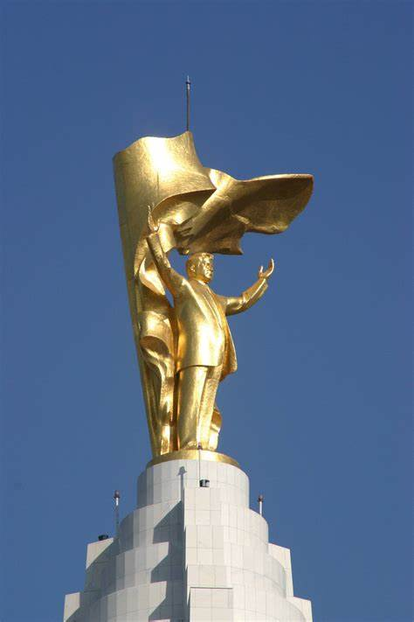
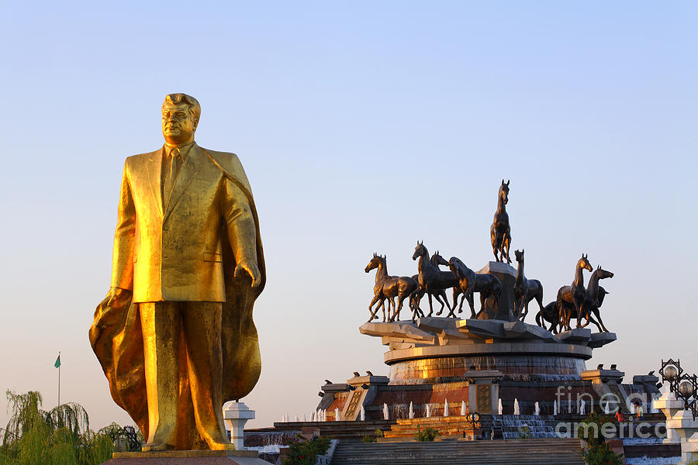
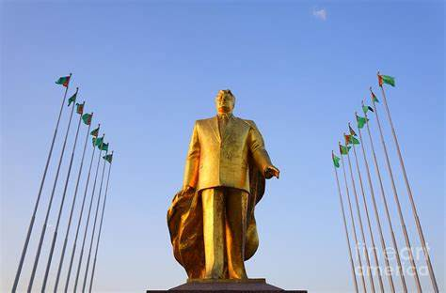
A new voting
Parliamentary elections under new constitution were held on December 14, 2008.
In February 2017, president Gurbanguly Berdymukhamedov was re-elected for a third term in office, after receiving 97.69 percent of all votes according to official results, following a tightly controlled and largely ceremonial election. He continued to rule.

Slide 12
Copyright
You may copy anything on the PPT, but you have to cite the author and give a link to this website. See [LICENSE](https://qqiumax.github.io/LICENSE) for more information. You HAVE to keep this message when copying or duplicating.
Copyright Max Qiu 2022. All Rights Reserved.

Slide 13

Thank You

