Slide 1

Hands on: Windsurf IDE
Software Development with Coding Agents

Slide 2
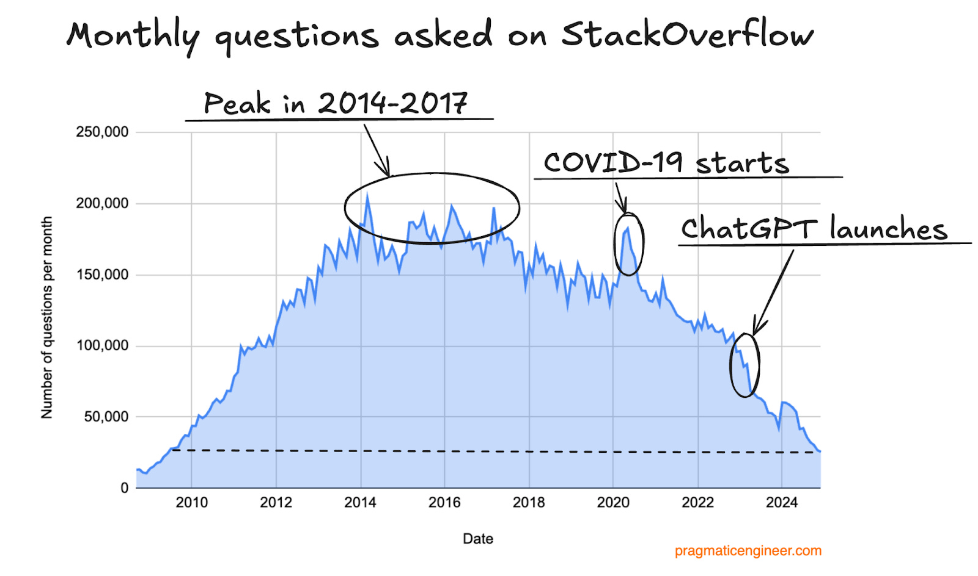
Motivation
Get to know Coding Agents
Collect experiences building a first small app
Motivate to further explore the topic yourself
From now on, coding without AI will increasingly feel like writing in assembly instead of C#—slow, inefficient, and outdated for most use cases.
https://newsletter.pragmaticengineer.com/p/the-pulse-119?utm_source=substack&utm_medium=email

Slide 3
Workshop overview
Short tutorial „Windsurf Editor“
Setup Windsurf
Create a simple Pokédex App
Optional: Create a Coffe Recipe Parameter Editor
Exchange of experience

Slide 4

Important Warning
Windsurf can upload any files from an opened folder to different servers. DO NOT open any folders or documents that are not public within the Windsurf Editor.
Windsurf Cascade can suggest to execute code or install libraries. Always check the proposed command and only execute if it is save to run.
Any questions ?

Slide 5
Windsurf Tutorial
Me
Please create a new .net 6 wpf app
Features:
Supercomplete
Cascade (LLM selection, edit modes)
Best model for Cascade: Claude 3.5 Sonnet
Works best for Python & Web Stack
Use Visual Studio or Rider for .Net Debugging
Cascade
I'll help you create a new .NET 6 WPF …
Me
Nice, now we want to create a small app that tracks my bowling performance. - It shows all my rolls in a list - It shows buttons 0-9 to add a roll to the list - It shows in larger font size the mean and standard deviation of my rolls
Cascade
I'll help you create a new .NET 6 WPF …

Slide 6
Windsurf IDE Setup
Get windsurf from https://codeium.com/windsurf
Install it
Create a free account
Clone the repository from https://github.com/maxbarnikol/ai-dev-workshop
Open the ai-dev-workshop repository folder in Windsurf

Slide 7
Excercises
Switch to branch ‘ pokedex‘
In the Data folder you find json files containing information on the first 151 Pokemon
Develop the Apps described in following tasks
Try to use Cascade for most things
You can also write code and experience Supercomplete
Hint: You can implemt both tasks without writing a single line of code

Slide 8

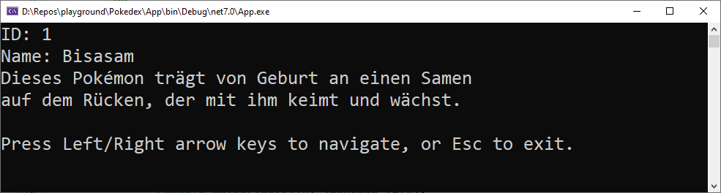
Ex 1: Create a simple Pokedex console app
Display id, name and flavor text
Left/ right arrow keys to switch pokemon

Slide 9
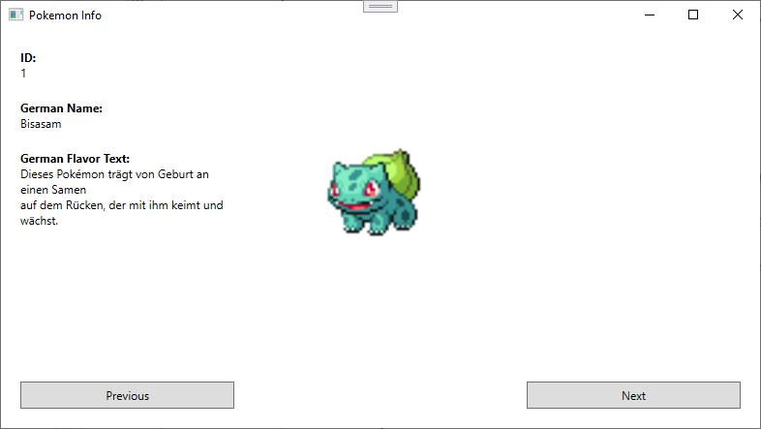
Ex 2: Pokedex WPF App
Build a simple Pokedex WPF UI
Image links are contained in JSON data

Slide 10
Ex 2: Pokedex WPF App bonus🏆
Improve the UI of your pokedex
More beautiful colors
Change layout
Remove the window border

Slide 11
How did it go?
How did it feel?
Did it work ?
Where were the difficulties?

Slide 12
Uninstall Windsurf
To prevent accidential data leak please now uninstall the Windsurf IDE

