Slide 1


Quantifying Influence
The Beatles vs. The Rolling Stones
DS4
Max Rose

Slide 2
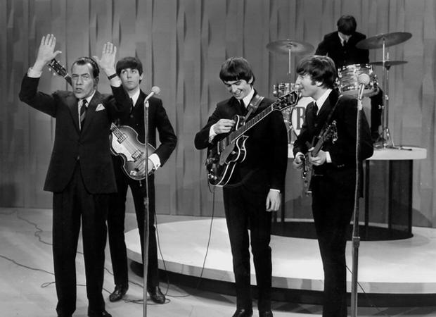
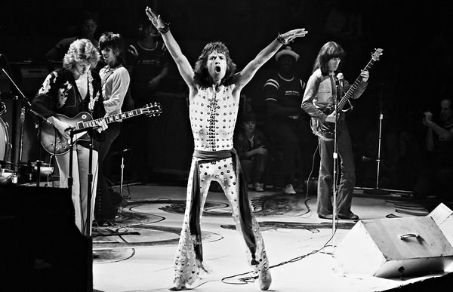
Influence, not popularity
Generations of musicians and fans have asked a question, so oft asked it has been reduced to “Beatles or Stones”. Perhaps you are not a fan of either, simply don’t care, or you wonder “who”. (Ask your parents…)
Regardless, the influence of both artists is undeniable, as is their enduring popularity over the years. And that popularity has been demonstrated via sales of their music and countless top N lists. And this is represented in the work of subsequent artist’s recordings
Can the data say which artist is “better” (more impactful)?

Slide 3
Demonstrating Influence with Data
The MusicBrainz database represents a comprehensive pool of information about recorded music. The two bands I have chosen represent a relatively small subset of this data yet between them exists large catalog of songs and recordings, with decades of history generating a significant data trail that may provide hidden insights demonstrating their impact on artists for over 5 decades.
By pulling key metrics from the source, can this influence be measured?

Slide 4
About the Data
MusicBrainz is a community-maintained open source encyclopedia of music information. Sim. Wikipedia
https://musicbrainz.org/
Schema Info
Developers/Users are encouraged to build applications on top of the platform.

Slide 5
Key Data Issues
Initial exploration of the Musicbrainz API proved challenging to parse the specific relationships I want to explore.
The entire database is open-source and can be run from a downloadable virtual server.
SQL queries against the server have been more successful, allowing me to pull a raw dataset with the desired data points for the two artists in question.
Generally there is too much data which, while clean requires continuing aggregation to reduce to a useful set of features and responses.

Slide 6
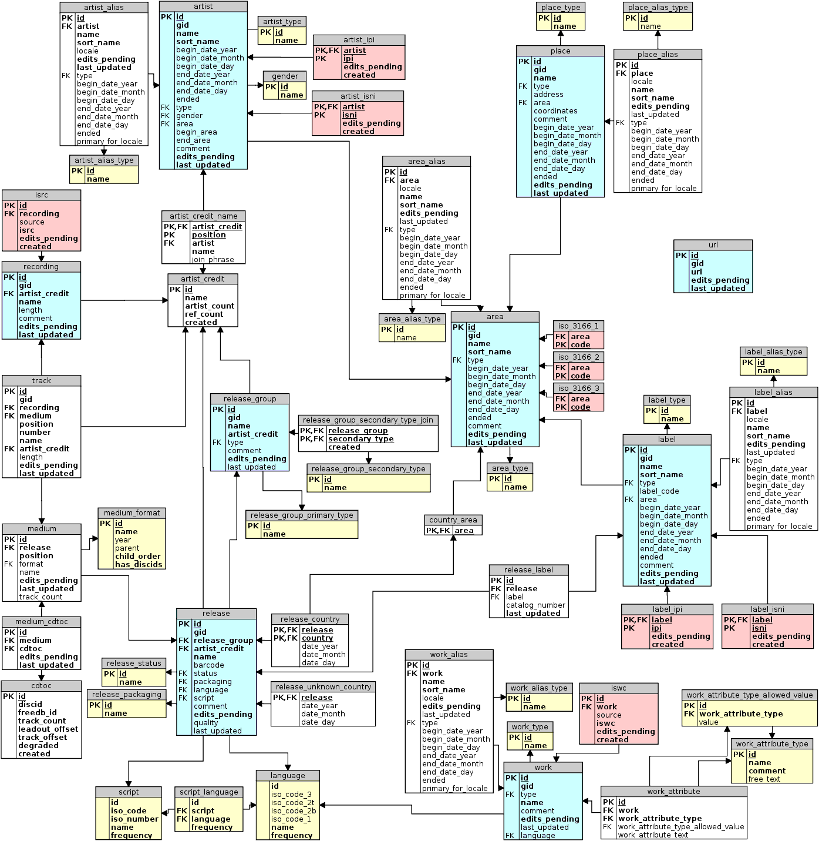

Slide 7
Metrics to Explore
# of works (songs) released
# of times released worldwide
# of cover recordings of each artist's respective catalog
# of times a given work is covered.
User ratings original and cover releases.
Time-based representation of the works and covers.
The goal is to build a relationship between the original work and the use by subsequent artists to show and quantify the influence.

