Slide 1

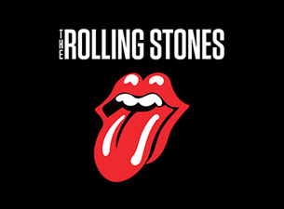
Quantifying Influence
The Beatles vs. The Rolling Stones
DS4
Max Rose

Slide 2
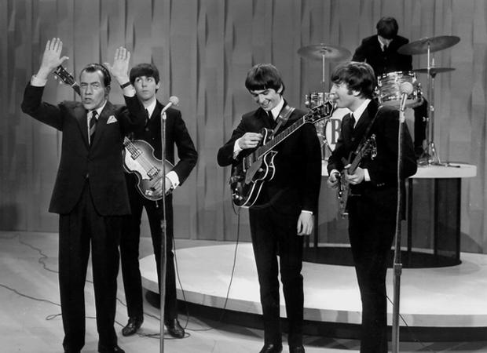
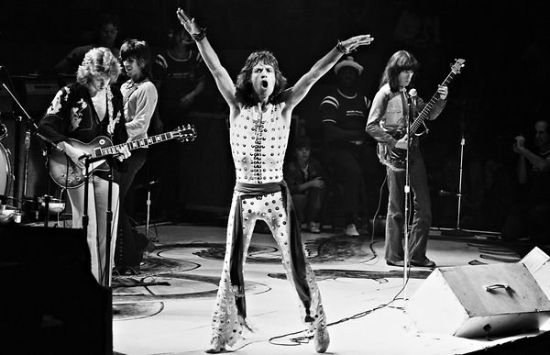
Influence, not popularity
Can we measure the influence or impact of an artist by correlating the original work (song) to later representations of the work by other artists?

Slide 3
Metrics Explored in the Project
# of works (songs) released.
# of times released worldwide.
# of countries in which the work was released.
# of times a given work is covered.
Is a work covered.
# of artists covering the work.
Ratings of the original and cover releases.
Release date (year) of the works and covers.
Sentiment Polarity of the song’s title & lyrics.

