Slide 1
CONTROL
Ffmpeg folder:
J:\Files2021_MaxoticsYouTube\20211224_PowerPointToWebmTransparentGraphics\GenClips2\ffmpeg
MP4 Export folder:
J:\Files2021_MaxoticsYouTube\20211224_PowerPointToWebmTransparentGraphics\GenClips2\mp4
Webm Export folder:
J:\Files2021_MaxoticsYouTube\20211224_PowerPointToWebmTransparentGraphics\GenClips2\webm
Which, If Export Only One Slide:
3

Slide 2
Dev NOTES
ActivePresentation.CreateVideo FileName:=sMP4FilNameAndPath, _
UseTimingsAndNarrations:=True, _
VertResolution:=2160, _
FramesPerSecond:=30, _
Quality:=100
sChromaSimilarity = ".2"
sChromaBlend = ".15"
' Get background color and use that to make transparent in ffmpeg
tmp = Hex(ActivePresentation.Slides(p).Background.Fill.ForeColor.RGB)
If tmp = "FF0000" Then sHEXColor = "0xFF0000"
If tmp = "00FF00" Then sHEXColor = "0x00FF00"
If tmp = "0000FF" Then sHEXColor = "0x0000FF"
'Generate ffmpeg command
sFFMPEG_config_1 = " -b:v 2M -vf " & Chr(34) & _
"chromakey=" & sHEXColor & ":" & _
sChromaSimilarity & ":" & _
sChromaBlend & ",format=rgba,scale=1920x1080" & Chr(34) & _
" -c:v libvpx-vp9 -auto-alt-ref 0 -y "

Slide 3
My Subject
My Thoughts On This Subject
Notes:
title

Slide 4
Jane Smith
Notes:
MaxMacro_lowerthirds

Slide 5

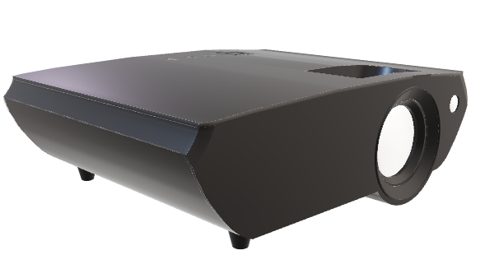
Notes:
subject

Slide 6
Thank You
Notes:
Thank_You

