Slide 1
CONFIG
Ffmpeg folder:
D:\Files2022_WMAW\ffmpeg
MP4 Export folder:
D:\Files2022_WMAW\mp4
WebM Export folder:
D:\Files2022_WMAW\webm
Mov Export folder:
D:\Files2022_WMAW\mov
Output Types (mov,webm)?:
mov
Output Scale:
1920x1080
JPG folder (thumbnails, etc):
D:\Files2022_WMAW\jpg
Slide Number If Only Process One:
3
Questions contact max@maxdatabook.com

Slide 2
Tech NOTES
VBA PP command to export as video (will do all enabled slides)
ActivePresentation.CreateVideo FileName:=sMP4FilNameAndPath, _
UseTimingsAndNarrations:=True, _
VertResolution:=2160, _
FramesPerSecond:=30, _
Quality:=100
sChromaSimilarity = ".2"
sChromaBlend = ".15"
' Get background color and use that to make transparent in ffmpeg
tmp = Hex(ActivePresentation.Slides(p).Background.Fill.ForeColor.RGB)
If tmp = "FF0000" Then sHEXColor = "0xFF0000"
If tmp = "00FF00" Then sHEXColor = "0x00FF00"
If tmp = "0000FF" Then sHEXColor = "0x0000FF"
Generate ffmpeg command *** WEBM / VP9 ***
sFFMPEG_config_webm = " -b:v 2M -vf " & Chr(34) & _
"chromakey=" & sHEXColor & ":" & _
sChromaSimilarity & ":" & _
sChromaBlend & ",format=rgba,scale=" & txt_output_scale & Chr(34) & _
" -c:v libvpx-vp9 -auto-alt-ref 0 -y "
Generate ffmpeg command *** MOV 4444 with Alpha ***
sFFMPEG_config_mov4444 = " -c:v prores_ks -profile:v 4 -vendor apl0 -bits_per_mb 8000 -vf " & Chr(34) & _
"chromakey=" & sHEXColor & ":" & _
sChromaSimilarity & ":" & _
sChromaBlend & ",format=rgba,scale=" & txt_output_scale & Chr(34) & _
" -pix_fmt yuva444p10le "

Slide 3
Does It Matter And Why?
Little Things
Matter
Notes:
title

Slide 4
Max Rottersman
Notes:
Max_L3rds

Slide 5
Craig Kelley
Notes:
Craig_L3rds

Slide 6
Thank You
Notes:
ThankYou

Slide 7

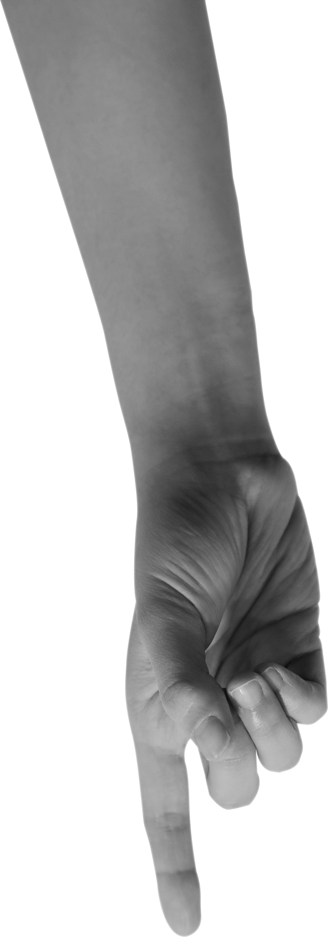


Little Things Matter
Notes:
Jpg for YouTube

