Slide 1


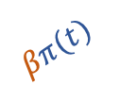






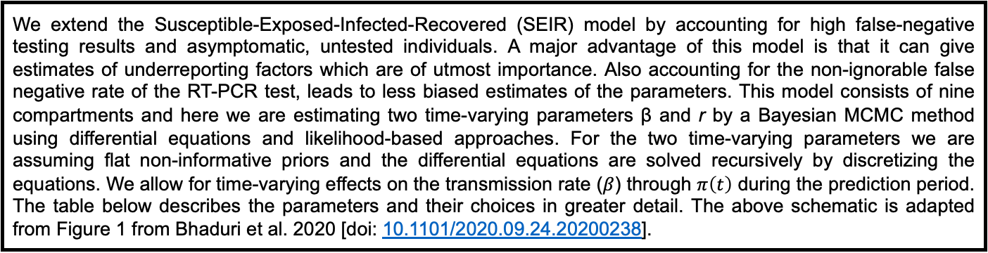


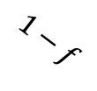

Description of compartmental model
and underlying transmission dynamics.
RU
$$α_{u}βπ(t)$$
$$\frac{1}{β_{1}D_{r}}$$
U
$$\frac{β_{2}}{D_{r}}$$
$$\frac{1−r}{D_{E}}$$
$$δ_{1}μ_{c}$$
DU
S
E
F
$$\frac{μ_{c}}{δ_{2}}$$
$$f$$
RR
$$\frac{r}{D_{E}}$$
T
$$\frac{1}{D_{R}}$$
$$βπ(t)$$
P
$$1−f$$
DR
$$μ_{c}$$
$$α_{p}βπ\left(t\right)$$
We extend the Susceptible-Exposed-Infected-Recovered (SEIR) model by accounting for high false-negative testing results and asymptomatic, untested individuals. A major advantage of this model is that it can give estimates of underreporting factors which are of utmost importance. Also accounting for the non-ignorable false negative rate of the RT-PCR test, leads to less biased estimates of the parameters. This model consists of nine compartments and here we are estimating two time-varying parameters β and r by a Bayesian MCMC method using differential equations and likelihood-based approaches. For the two time-varying parameters we are assuming flat non-informative priors and the differential equations are solved recursively by discretizing the equations. We allow for time-varying effects on the transmission rate ($β$) through $π\left(t\right)$ during the prediction period. The table below describes the parameters and their choices in greater detail. The above schematic is adapted from Figure 1 from Bhaduri et al. 2020 [doi: 10.1101/2020.09.24.20200238].

Slide 2



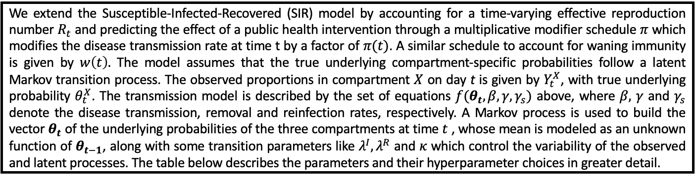

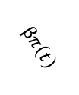









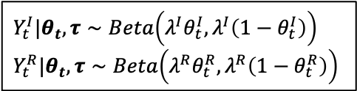




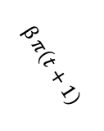

Description of compartmental model
and underlying transmission dynamics.
Observed layer
Model for observed proportions:
$$Y_{t}^{I}$$
$$Y_{t}^{R}$$
$$Y_{t}^{I}|θ_{t},τ∼Beta\left(λ^{I}θ_{t}^{I},λ^{I}\left(1−θ_{t}^{I}\right)\right)$$
$$Y_{t}^{R}|θ_{t},τ∼Beta\left(λ^{R}θ_{t}^{R},λ^{R}\left(1−θ_{t}^{R}\right)\right)$$
$$Y_{t+1}^{I}$$
$$Y_{t+1}^{R}$$
EXAMPLE
Latent layer
$$γ$$
$$γ$$
$$I$$
$$R$$
$$I$$
$$R$$
Set of equations: $f(θ_{t}, β, γ, γ_{s})$
$$βπ\left(t\right)$$
$$γ_{s}ω(t)$$
$$\frac{dθ_{t}^{S}}{dt}=−βπ\left(t\right)θ_{t}^{S}θ_{t}^{I}+w\left(t\right)γ_{s}θ_{t}^{R}$$
$$\frac{dθ_{t}^{I}}{dt}=βπ\left(t\right)θ_{t}^{S}θ_{t}^{I}−γθ_{t}^{I}$$
$$\frac{dθ_{t}^{R}}{dt}=γθ_{t}^{I}−w\left(t\right)γ_{s}θ_{t}^{R}$$
$$β π\left(t+1\right)$$
$$γ_{s}ω(t+1)$$
$$S$$
$$S$$
$$Day t$$
$$Day (t+1)$$
We extend the Susceptible-Infected-Recovered (SIR) model by accounting for a time-varying effective reproduction number $R_{t}$ and predicting the effect of a public health intervention through a multiplicative modifier schedule $π$ which modifies the disease transmission rate at time t by a factor of $π(t)$. A similar schedule to account for waning immunity is given by $w\left(t\right).$ The model assumes that the true underlying compartment-specific probabilities follow a latent Markov transition process. The observed proportions in compartment $X$ on day t is given by $Y_{t}^{X}$, with true underlying probability $θ_{t}^{X}$. The transmission model is described by the set of equations $f(θ_{t}, β, γ, γ_{s})$ above, where $β,$ $γ$ and $γ_{s}$ denote the disease transmission, removal and reinfection rates, respectively. A Markov process is used to build the vector $θ_{t}$ of the underlying probabilities of the three compartments at time $t$ , whose mean is modeled as an unknown function of $θ_{t−1}$, along with some transition parameters like $λ^{I}, λ^{R}$ and $κ$ which control the variability of the observed and latent processes. The table below describes the parameters and their hyperparameter choices in greater detail.

Slide 3
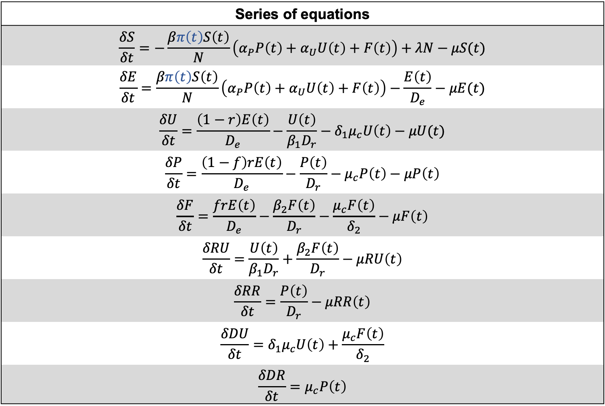
Series of equations
$$\frac{δS}{δt}=−\frac{βπ\left(t\right)S\left(t\right)}{N}\left(α_{P}P\left(t\right)+α_{U}U\left(t\right)+F\left(t\right)\right)+λN−μS(t)$$
$$\frac{δE}{δt}=\frac{βπ\left(t\right)S\left(t\right)}{N}\left(α_{P}P\left(t\right)+α_{U}U\left(t\right)+F\left(t\right)\right)−\frac{E\left(t\right)}{D_{e}}−μE(t)$$
$$\frac{δU}{δt}=\frac{\left(1−r\right)E\left(t\right)}{D_{e}}−\frac{U\left(t\right)}{β_{1}D_{r}}−δ_{1}μ_{c}U\left(t\right)−μU(t)$$
$$\frac{δP}{δt}=\frac{\left(1−f\right)rE\left(t\right)}{D_{e}}−\frac{P\left(t\right)}{D_{r}}−μ_{c}P\left(t\right)−μP\left(t\right)$$
$$\frac{δF}{δt}=\frac{frE\left(t\right)}{D_{e}}−\frac{β_{2}F\left(t\right)}{D_{r}}−\frac{μ_{c}F\left(t\right)}{δ_{2}}−μF\left(t\right)$$
$$\frac{δRU}{δt}=\frac{U\left(t\right)}{β_{1}D_{r}}+\frac{β_{2}F\left(t\right)}{D_{r}}−μRU\left(t\right)$$
$$\frac{δRR}{δt}=\frac{P\left(t\right)}{D_{r}}−μRR\left(t\right)$$
$$\frac{δDU}{δt}=δ_{1}μ_{c}U\left(t\right)+\frac{μ_{c}F\left(t\right)}{δ_{2}}$$
$$\frac{δDR}{δt}=μ_{c}P\left(t\right)$$

Slide 4
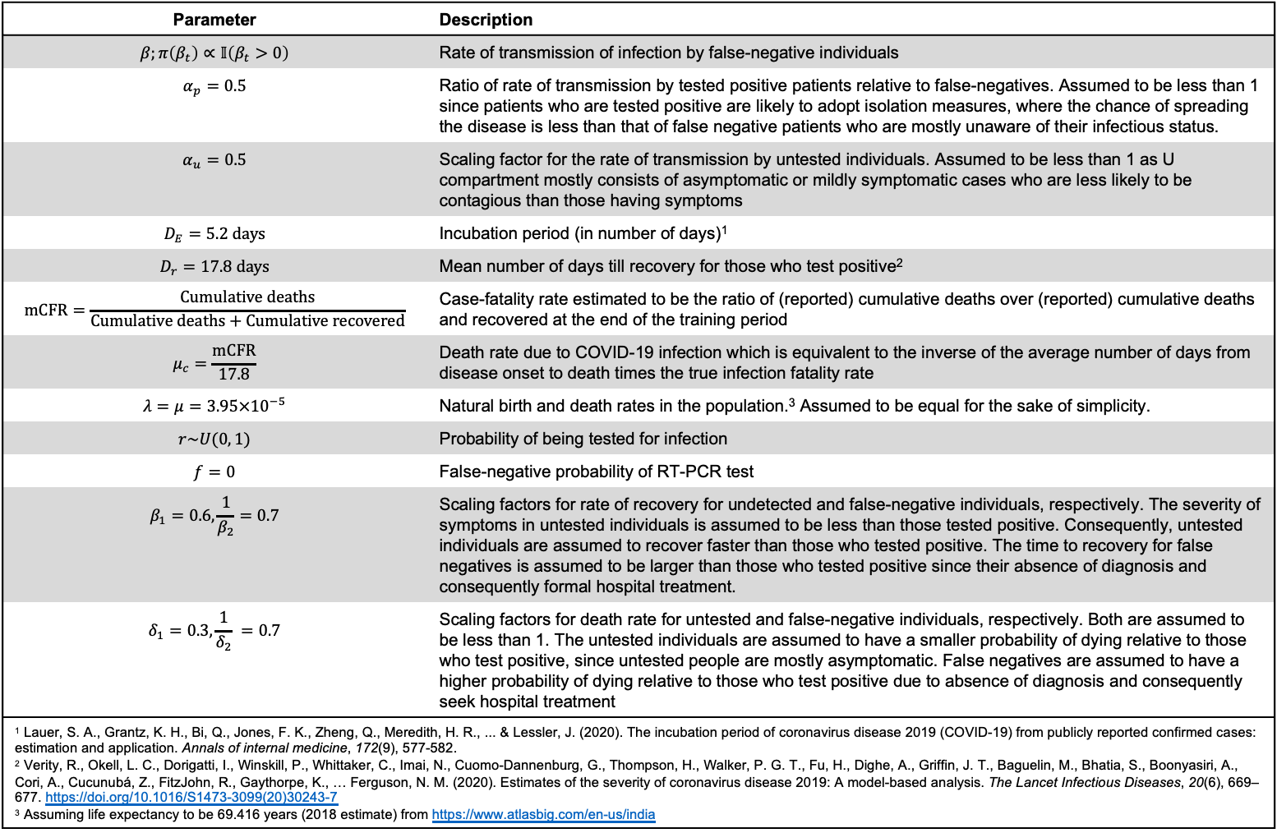
Parameter | Description
$$β;π\left(β_{t}\right)∝𝕀\left(β_{t}>0\right)$$ | Rate of transmission of infection by false-negative individuals
$$α_{p}=0.5$$ | Ratio of rate of transmission by tested positive patients relative to false-negatives. Assumed to be less than 1 since patients who are tested positive are likely to adopt isolation measures, where the chance of spreading the disease is less than that of false negative patients who are mostly unaware of their infectious status.
$$α_{u}=0.5$$ | Scaling factor for the rate of transmission by untested individuals. Assumed to be less than 1 as U compartment mostly consists of asymptomatic or mildly symptomatic cases who are less likely to be contagious than those having symptoms
$$D_{E}=5.2 days$$ | Incubation period (in number of days)¹
$$D_{r}=17.8 days$$ | Mean number of days till recovery for those who test positive²
$$mCFR=\frac{Cumulative deaths}{Cumulative deaths+Cumulative recovered}$$ | Case-fatality rate estimated to be the ratio of (reported) cumulative deaths over (reported) cumulative deaths and recovered at the end of the training period
$$μ_{c}=\frac{mCFR}{17.8}$$ | Death rate due to COVID-19 infection which is equivalent to the inverse of the average number of days from disease onset to death times the true infection fatality rate
$$λ=μ=3.95×{10}^{−5}$$ | Natural birth and death rates in the population.³ Assumed to be equal for the sake of simplicity.
$$r\sim U(0, 1)$$ | Probability of being tested for infection
$$f=0$$ | False-negative probability of RT-PCR test
$$β_{1}=0.6,\frac{1}{β_{2}}=0.7$$ | Scaling factors for rate of recovery for undetected and false-negative individuals, respectively. The severity of symptoms in untested individuals is assumed to be less than those tested positive. Consequently, untested individuals are assumed to recover faster than those who tested positive. The time to recovery for false negatives is assumed to be larger than those who tested positive since their absence of diagnosis and consequently formal hospital treatment.
$$δ_{1}=0.3, \frac{1}{δ_{2}} =0.7$$ | Scaling factors for death rate for untested and false-negative individuals, respectively. Both are assumed to be less than 1. The untested individuals are assumed to have a smaller probability of dying relative to those who test positive, since untested people are mostly asymptomatic. False negatives are assumed to have a higher probability of dying relative to those who test positive due to absence of diagnosis and consequently seek hospital treatment
¹ Lauer, S. A., Grantz, K. H., Bi, Q., Jones, F. K., Zheng, Q., Meredith, H. R., ... & Lessler, J. (2020). The incubation period of coronavirus disease 2019 (COVID-19) from publicly reported confirmed cases: estimation and application. Annals of internal medicine, 172(9), 577-582. ² Verity, R., Okell, L. C., Dorigatti, I., Winskill, P., Whittaker, C., Imai, N., Cuomo-Dannenburg, G., Thompson, H., Walker, P. G. T., Fu, H., Dighe, A., Griffin, J. T., Baguelin, M., Bhatia, S., Boonyasiri, A., Cori, A., Cucunubá, Z., FitzJohn, R., Gaythorpe, K., … Ferguson, N. M. (2020). Estimates of the severity of coronavirus disease 2019: A model-based analysis. The Lancet Infectious Diseases, 20(6), 669–677. https://doi.org/10.1016/S1473-3099(20)30243-7 ³ Assuming life expectancy to be 69.416 years (2018 estimate) from https://www.atlasbig.com/en-us/india

Slide 5
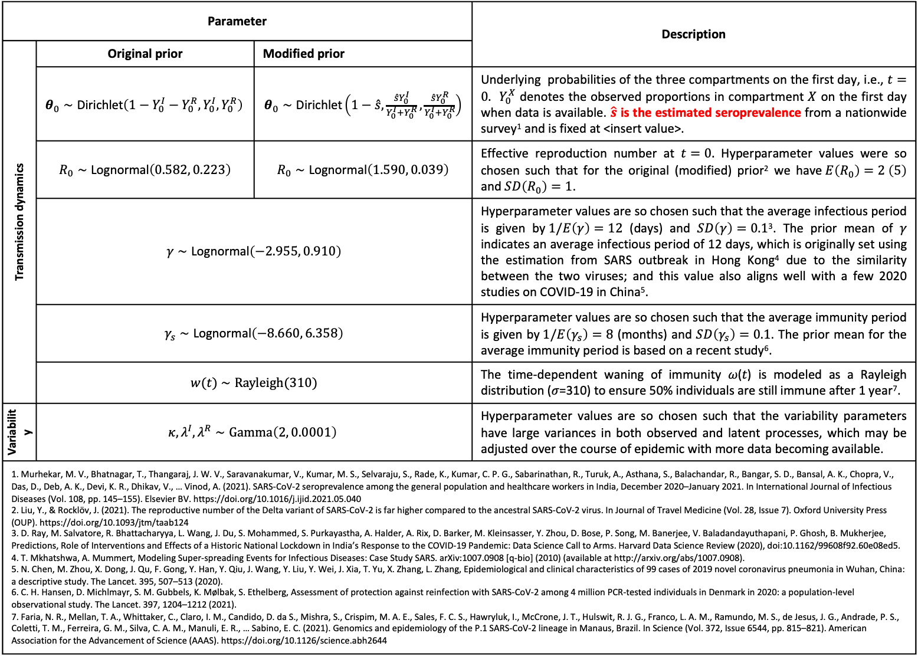
Parameter | Parameter |  | Description
Transmission dynamics | Original prior | Modified prior
Controls transmission dynamics | $$θ_{0}∼\text{Dirichlet}\left(1−Y_{0}^{I}−Y_{0}^{R},Y_{0}^{I},Y_{0}^{R}\right)$$ | $θ_{0}∼\text{Dirichlet}\left(1−\hat{s},\frac{{\hat{s}Y}_{0}^{I}}{Y_{0}^{I}+Y_{0}^{R}},\frac{{\hat{s}Y}_{0}^{R}}{Y_{0}^{I}+Y_{0}^{R}}\right)$ | Underlying probabilities of the three compartments on the first day, i.e., $t=0.$ $Y_{0}^{X}$ denotes the observed proportions in compartment $X$ on the first day when data is available. $\hat{s}$ is the estimated seroprevalence from a nationwide survey¹ and is fixed at <insert value>.
 | $R_{0}∼\text{Lognormal}\left(0.582, 0.223\right)$ | $R_{0}∼\text{Lognormal}\left(1.590, 0.039\right)$ | Effective reproduction number at $t=0.$ Hyperparameter values were so chosen such that for the original (modified) prior² we have$E\left(R_{0}\right)=2 \left(5\right)$ and $SD\left(R_{0}\right)=1$.
 | $γ∼\text{Log}\text{n}\text{ormal}\left(−2.955, 0.910\right)$ |  | Hyperparameter values are so chosen such that the average infectious period is given by$1/E\left(γ\right)=12$ (days) and $SD\left(γ\right)=0.1$³. The prior mean of 𝛾 indicates an average infectious period of 12 days, which is originally set using the estimation from SARS outbreak in Hong Kong⁴ due to the similarity between the two viruses; and this value also aligns well with a few 2020 studies on COVID-19 in China⁵.
 | $γ_{s}∼\text{Log}\text{n}\text{ormal}\left(−8.660, 6.358\right)$ |  | Hyperparameter values are so chosen such that the average immunity period is given by$1/E\left(γ_{s}\right)=8$ (months) and $SD\left(γ_{s}\right)=0.1$. The prior mean for the average immunity period is based on a recent study⁶.
 | $w(t)$ $∼Rayleigh(310)$ |  | The time-dependent waning of immunity 𝜔(𝑡) is modeled as a Rayleigh distribution (𝜎=310) to ensure 50% individuals are still immune after 1 year⁷.
Variability | $$κ, λ^{I}, λ^{R}∼Gamma\left(2, 0.0001\right)$$ |  | Hyperparameter values are so chosen such that the variability parameters have large variances in both observed and latent processes, which may be adjusted over the course of epidemic with more data becoming available.
1. Murhekar, M. V., Bhatnagar, T., Thangaraj, J. W. V., Saravanakumar, V., Kumar, M. S., Selvaraju, S., Rade, K., Kumar, C. P. G., Sabarinathan, R., Turuk, A., Asthana, S., Balachandar, R., Bangar, S. D., Bansal, A. K., Chopra, V., Das, D., Deb, A. K., Devi, K. R., Dhikav, V., … Vinod, A. (2021). SARS-CoV-2 seroprevalence among the general population and healthcare workers in India, December 2020–January 2021. In International Journal of Infectious Diseases (Vol. 108, pp. 145–155). Elsevier BV. https://doi.org/10.1016/j.ijid.2021.05.040 2. Liu, Y., & Rocklöv, J. (2021). The reproductive number of the Delta variant of SARS-CoV-2 is far higher compared to the ancestral SARS-CoV-2 virus. In Journal of Travel Medicine (Vol. 28, Issue 7). Oxford University Press (OUP). https://doi.org/10.1093/jtm/taab124 3. D. Ray, M. Salvatore, R. Bhattacharyya, L. Wang, J. Du, S. Mohammed, S. Purkayastha, A. Halder, A. Rix, D. Barker, M. Kleinsasser, Y. Zhou, D. Bose, P. Song, M. Banerjee, V. Baladandayuthapani, P. Ghosh, B. Mukherjee, Predictions, Role of Interventions and Effects of a Historic National Lockdown in India’s Response to the COVID-19 Pandemic: Data Science Call to Arms. Harvard Data Science Review (2020), doi:10.1162/99608f92.60e08ed5. 4. T. Mkhatshwa, A. Mummert, Modeling Super-spreading Events for Infectious Diseases: Case Study SARS. arXiv:1007.0908 [q-bio] (2010) (available at http://arxiv.org/abs/1007.0908). 5. N. Chen, M. Zhou, X. Dong, J. Qu, F. Gong, Y. Han, Y. Qiu, J. Wang, Y. Liu, Y. Wei, J. Xia, T. Yu, X. Zhang, L. Zhang, Epidemiological and clinical characteristics of 99 cases of 2019 novel coronavirus pneumonia in Wuhan, China: a descriptive study. The Lancet. 395, 507–513 (2020). 6. C. H. Hansen, D. Michlmayr, S. M. Gubbels, K. Mølbak, S. Ethelberg, Assessment of protection against reinfection with SARS-CoV-2 among 4 million PCR-tested individuals in Denmark in 2020: a population-level observational study. The Lancet. 397, 1204–1212 (2021). 7. Faria, N. R., Mellan, T. A., Whittaker, C., Claro, I. M., Candido, D. da S., Mishra, S., Crispim, M. A. E., Sales, F. C. S., Hawryluk, I., McCrone, J. T., Hulswit, R. J. G., Franco, L. A. M., Ramundo, M. S., de Jesus, J. G., Andrade, P. S., Coletti, T. M., Ferreira, G. M., Silva, C. A. M., Manuli, E. R., … Sabino, E. C. (2021). Genomics and epidemiology of the P.1 SARS-CoV-2 lineage in Manaus, Brazil. In Science (Vol. 372, Issue 6544, pp. 815–821). American Association for the Advancement of Science (AAAS). https://doi.org/10.1126/science.abh2644
EXAMPLE

