Slide 1


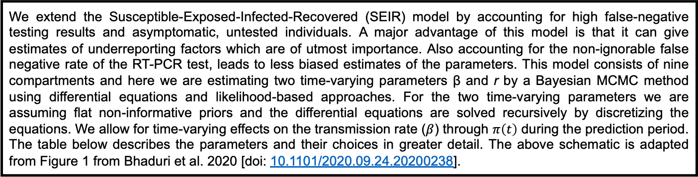
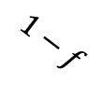

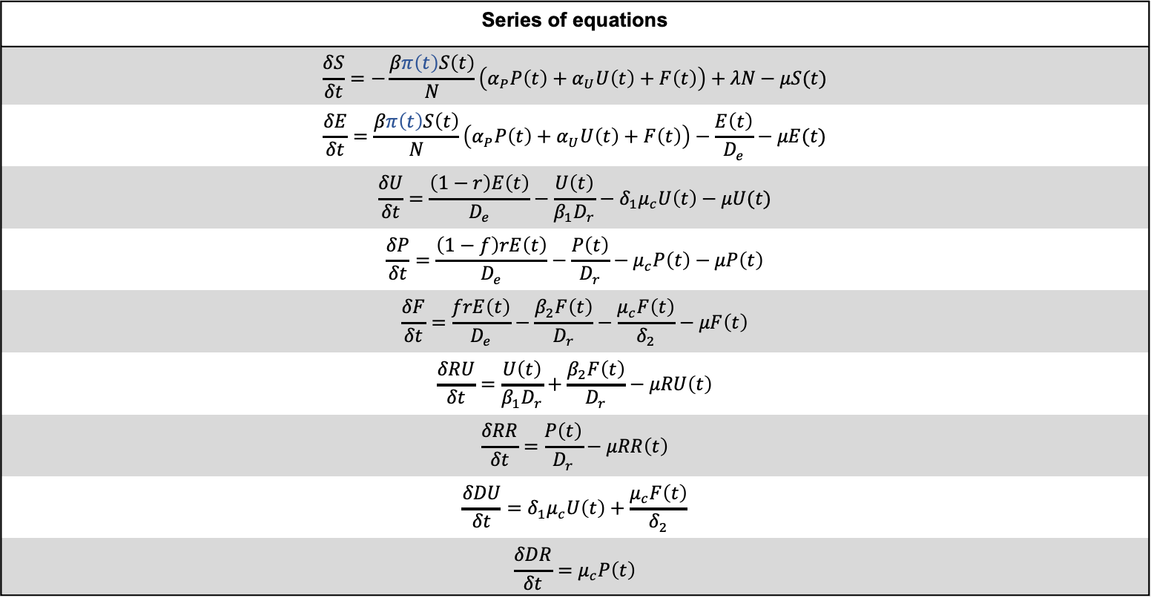
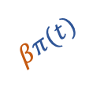
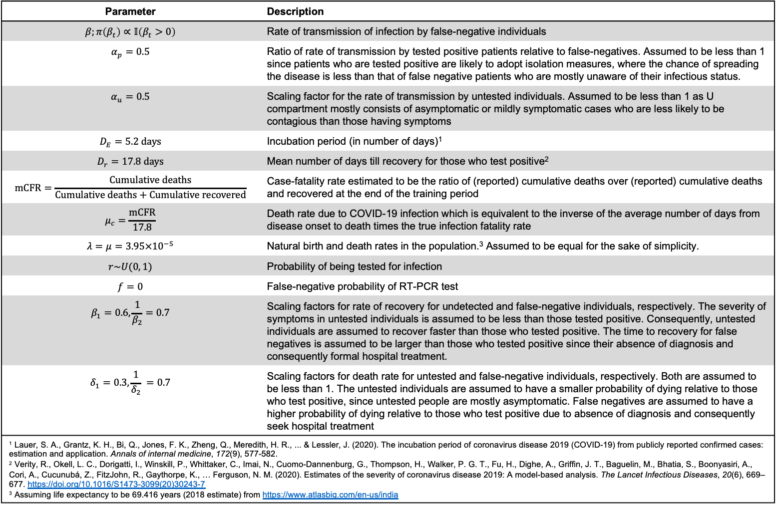








Description of compartmental model
and underlying transmission dynamics.
$$α_{u}βπ(t)$$
$$\frac{1}{β_{1}D_{r}}$$
RU
U
$$\frac{β_{2}}{D_{r}}$$
$$\frac{1−r}{D_{E}}$$
$$δ_{1}μ_{c}$$
DU
S
E
F
$$\frac{μ_{c}}{δ_{2}}$$
$$\frac{r}{D_{E}}$$
T
$$f$$
$$\frac{1}{D_{R}}$$
RR
$$βπ(t)$$
P
$$1−f$$
DR
$$α_{p}βπ\left(t\right)$$
$$μ_{c}$$
We extend the Susceptible-Exposed-Infected-Recovered (SEIR) model by accounting for high false-negative testing results and asymptomatic, untested individuals. A major advantage of this model is that it can give estimates of underreporting factors which are of utmost importance. Also accounting for the non-ignorable false negative rate of the RT-PCR test, leads to less biased estimates of the parameters. This model consists of nine compartments and here we are estimating two time-varying parameters β and r by a Bayesian MCMC method using differential equations and likelihood-based approaches. For the two time-varying parameters we are assuming flat non-informative priors and the differential equations are solved recursively by discretizing the equations. We allow for time-varying effects on the transmission rate ($β$) through $π\left(t\right)$ during the prediction period. The table below describes the parameters and their choices in greater detail. The above schematic is adapted from Figure 1 from Bhaduri et al. 2020 [doi: 10.1101/2020.09.24.20200238].
Series of equations
$$\frac{δS}{δt}=−\frac{βπ\left(t\right)S\left(t\right)}{N}\left(α_{P}P\left(t\right)+α_{U}U\left(t\right)+F\left(t\right)\right)+λN−μS(t)$$
$$\frac{δE}{δt}=\frac{βπ\left(t\right)S\left(t\right)}{N}\left(α_{P}P\left(t\right)+α_{U}U\left(t\right)+F\left(t\right)\right)−\frac{E\left(t\right)}{D_{e}}−μE(t)$$
$$\frac{δU}{δt}=\frac{\left(1−r\right)E\left(t\right)}{D_{e}}−\frac{U\left(t\right)}{β_{1}D_{r}}−δ_{1}μ_{c}U\left(t\right)−μU(t)$$
$$\frac{δP}{δt}=\frac{\left(1−f\right)rE\left(t\right)}{D_{e}}−\frac{P\left(t\right)}{D_{r}}−μ_{c}P\left(t\right)−μP\left(t\right)$$
$$\frac{δF}{δt}=\frac{frE\left(t\right)}{D_{e}}−\frac{β_{2}F\left(t\right)}{D_{r}}−\frac{μ_{c}F\left(t\right)}{δ_{2}}−μF\left(t\right)$$
$$\frac{δRU}{δt}=\frac{U\left(t\right)}{β_{1}D_{r}}+\frac{β_{2}F\left(t\right)}{D_{r}}−μRU\left(t\right)$$
$$\frac{δRR}{δt}=\frac{P\left(t\right)}{D_{r}}−μRR\left(t\right)$$
$$\frac{δDU}{δt}=δ_{1}μ_{c}U\left(t\right)+\frac{μ_{c}F\left(t\right)}{δ_{2}}$$
$$\frac{δDR}{δt}=μ_{c}P\left(t\right)$$
Parameter | Description
$$β;π\left(β_{t}\right)∝𝕀\left(β_{t}>0\right)$$ | Rate of transmission of infection by false-negative individuals
$$α_{p}=0.5$$ | Ratio of rate of transmission by tested positive patients relative to false-negatives. Assumed to be less than 1 since patients who are tested positive are likely to adopt isolation measures, where the chance of spreading the disease is less than that of false negative patients who are mostly unaware of their infectious status.
$$α_{u}=0.5$$ | Scaling factor for the rate of transmission by untested individuals. Assumed to be less than 1 as U compartment mostly consists of asymptomatic or mildly symptomatic cases who are less likely to be contagious than those having symptoms
$$D_{E}=5.2 days$$ | Incubation period (in number of days)¹
$$D_{r}=17.8 days$$ | Mean number of days till recovery for those who test positive²
$$mCFR=\frac{Cumulative deaths}{Cumulative deaths+Cumulative recovered}$$ | Case-fatality rate estimated to be the ratio of (reported) cumulative deaths over (reported) cumulative deaths and recovered at the end of the training period
$$μ_{c}=\frac{mCFR}{17.8}$$ | Death rate due to COVID-19 infection which is equivalent to the inverse of the average number of days from disease onset to death times the true infection fatality rate
$$λ=μ=3.95×{10}^{−5}$$ | Natural birth and death rates in the population.³ Assumed to be equal for the sake of simplicity.
$$r\sim U(0, 1)$$ | Probability of being tested for infection
$$f=0$$ | False-negative probability of RT-PCR test
$$β_{1}=0.6,\frac{1}{β_{2}}=0.7$$ | Scaling factors for rate of recovery for undetected and false-negative individuals, respectively. The severity of symptoms in untested individuals is assumed to be less than those tested positive. Consequently, untested individuals are assumed to recover faster than those who tested positive. The time to recovery for false negatives is assumed to be larger than those who tested positive since their absence of diagnosis and consequently formal hospital treatment.
$$δ_{1}=0.3, \frac{1}{δ_{2}} =0.7$$ | Scaling factors for death rate for untested and false-negative individuals, respectively. Both are assumed to be less than 1. The untested individuals are assumed to have a smaller probability of dying relative to those who test positive, since untested people are mostly asymptomatic. False negatives are assumed to have a higher probability of dying relative to those who test positive due to absence of diagnosis and consequently seek hospital treatment
¹ Lauer, S. A., Grantz, K. H., Bi, Q., Jones, F. K., Zheng, Q., Meredith, H. R., ... & Lessler, J. (2020). The incubation period of coronavirus disease 2019 (COVID-19) from publicly reported confirmed cases: estimation and application. Annals of internal medicine, 172(9), 577-582. ² Verity, R., Okell, L. C., Dorigatti, I., Winskill, P., Whittaker, C., Imai, N., Cuomo-Dannenburg, G., Thompson, H., Walker, P. G. T., Fu, H., Dighe, A., Griffin, J. T., Baguelin, M., Bhatia, S., Boonyasiri, A., Cori, A., Cucunubá, Z., FitzJohn, R., Gaythorpe, K., … Ferguson, N. M. (2020). Estimates of the severity of coronavirus disease 2019: A model-based analysis. The Lancet Infectious Diseases, 20(6), 669–677. https://doi.org/10.1016/S1473-3099(20)30243-7 ³ Assuming life expectancy to be 69.416 years (2018 estimate) from https://www.atlasbig.com/en-us/india

