Slide 1
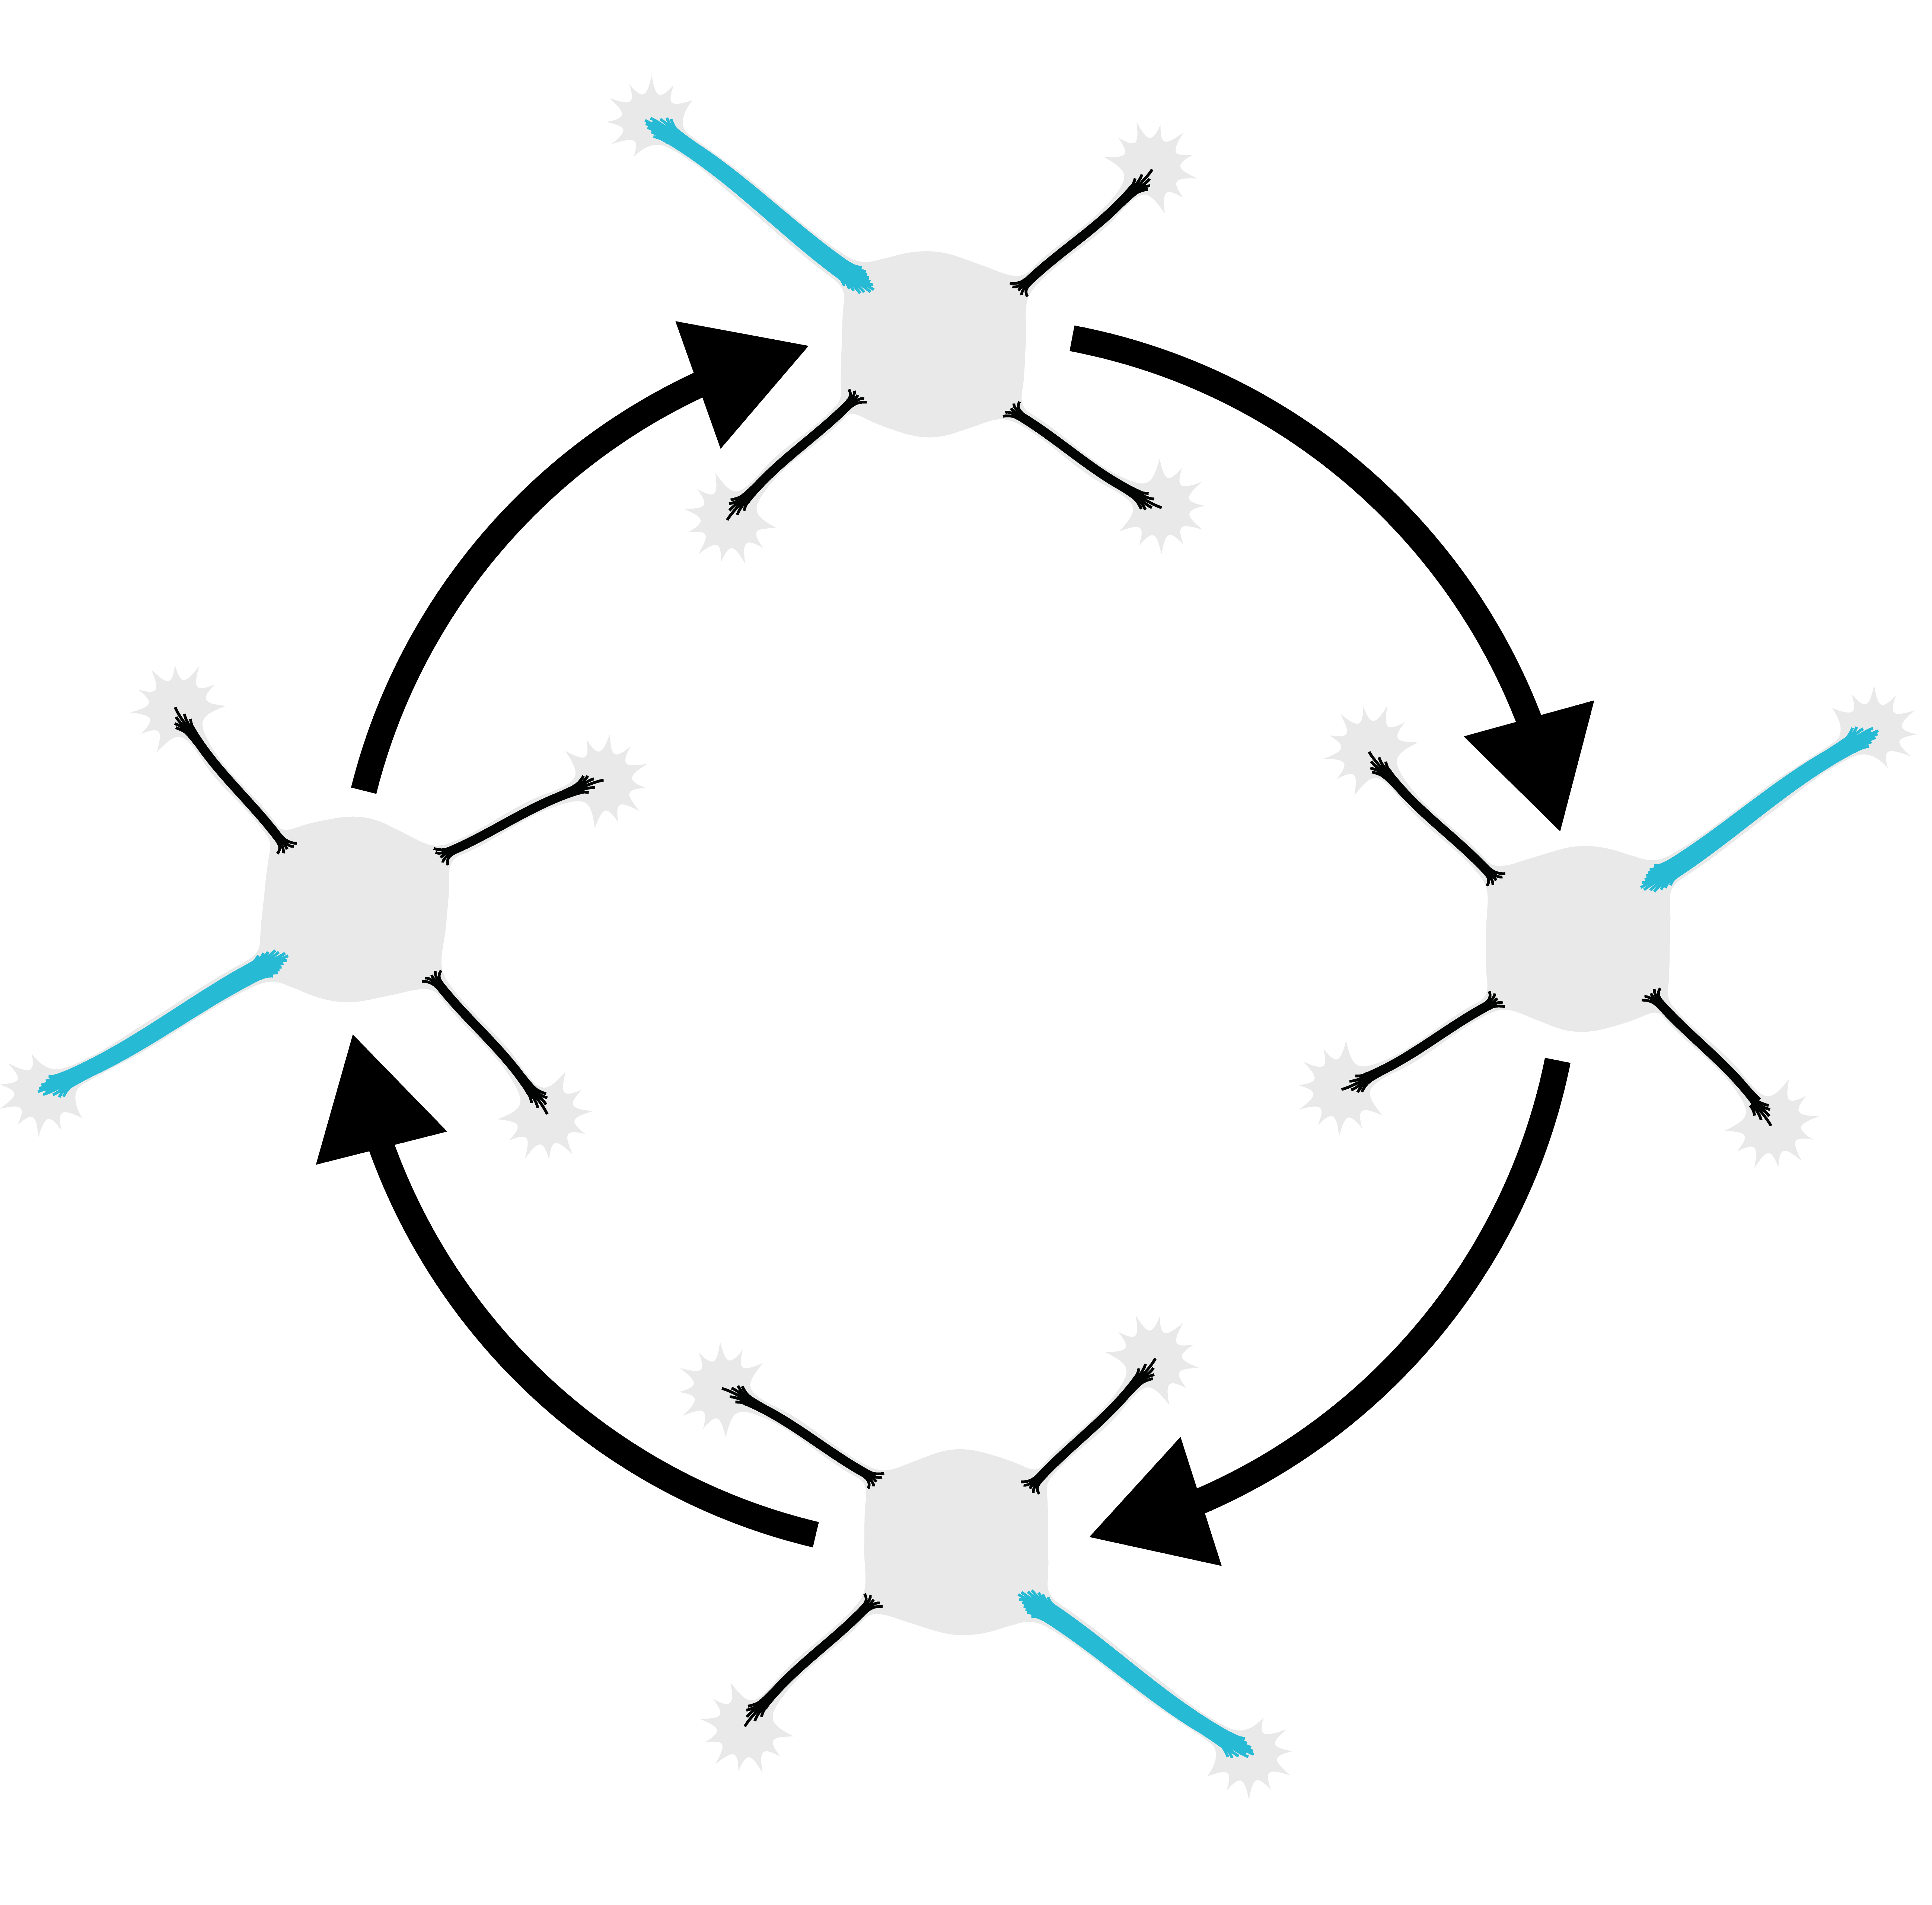
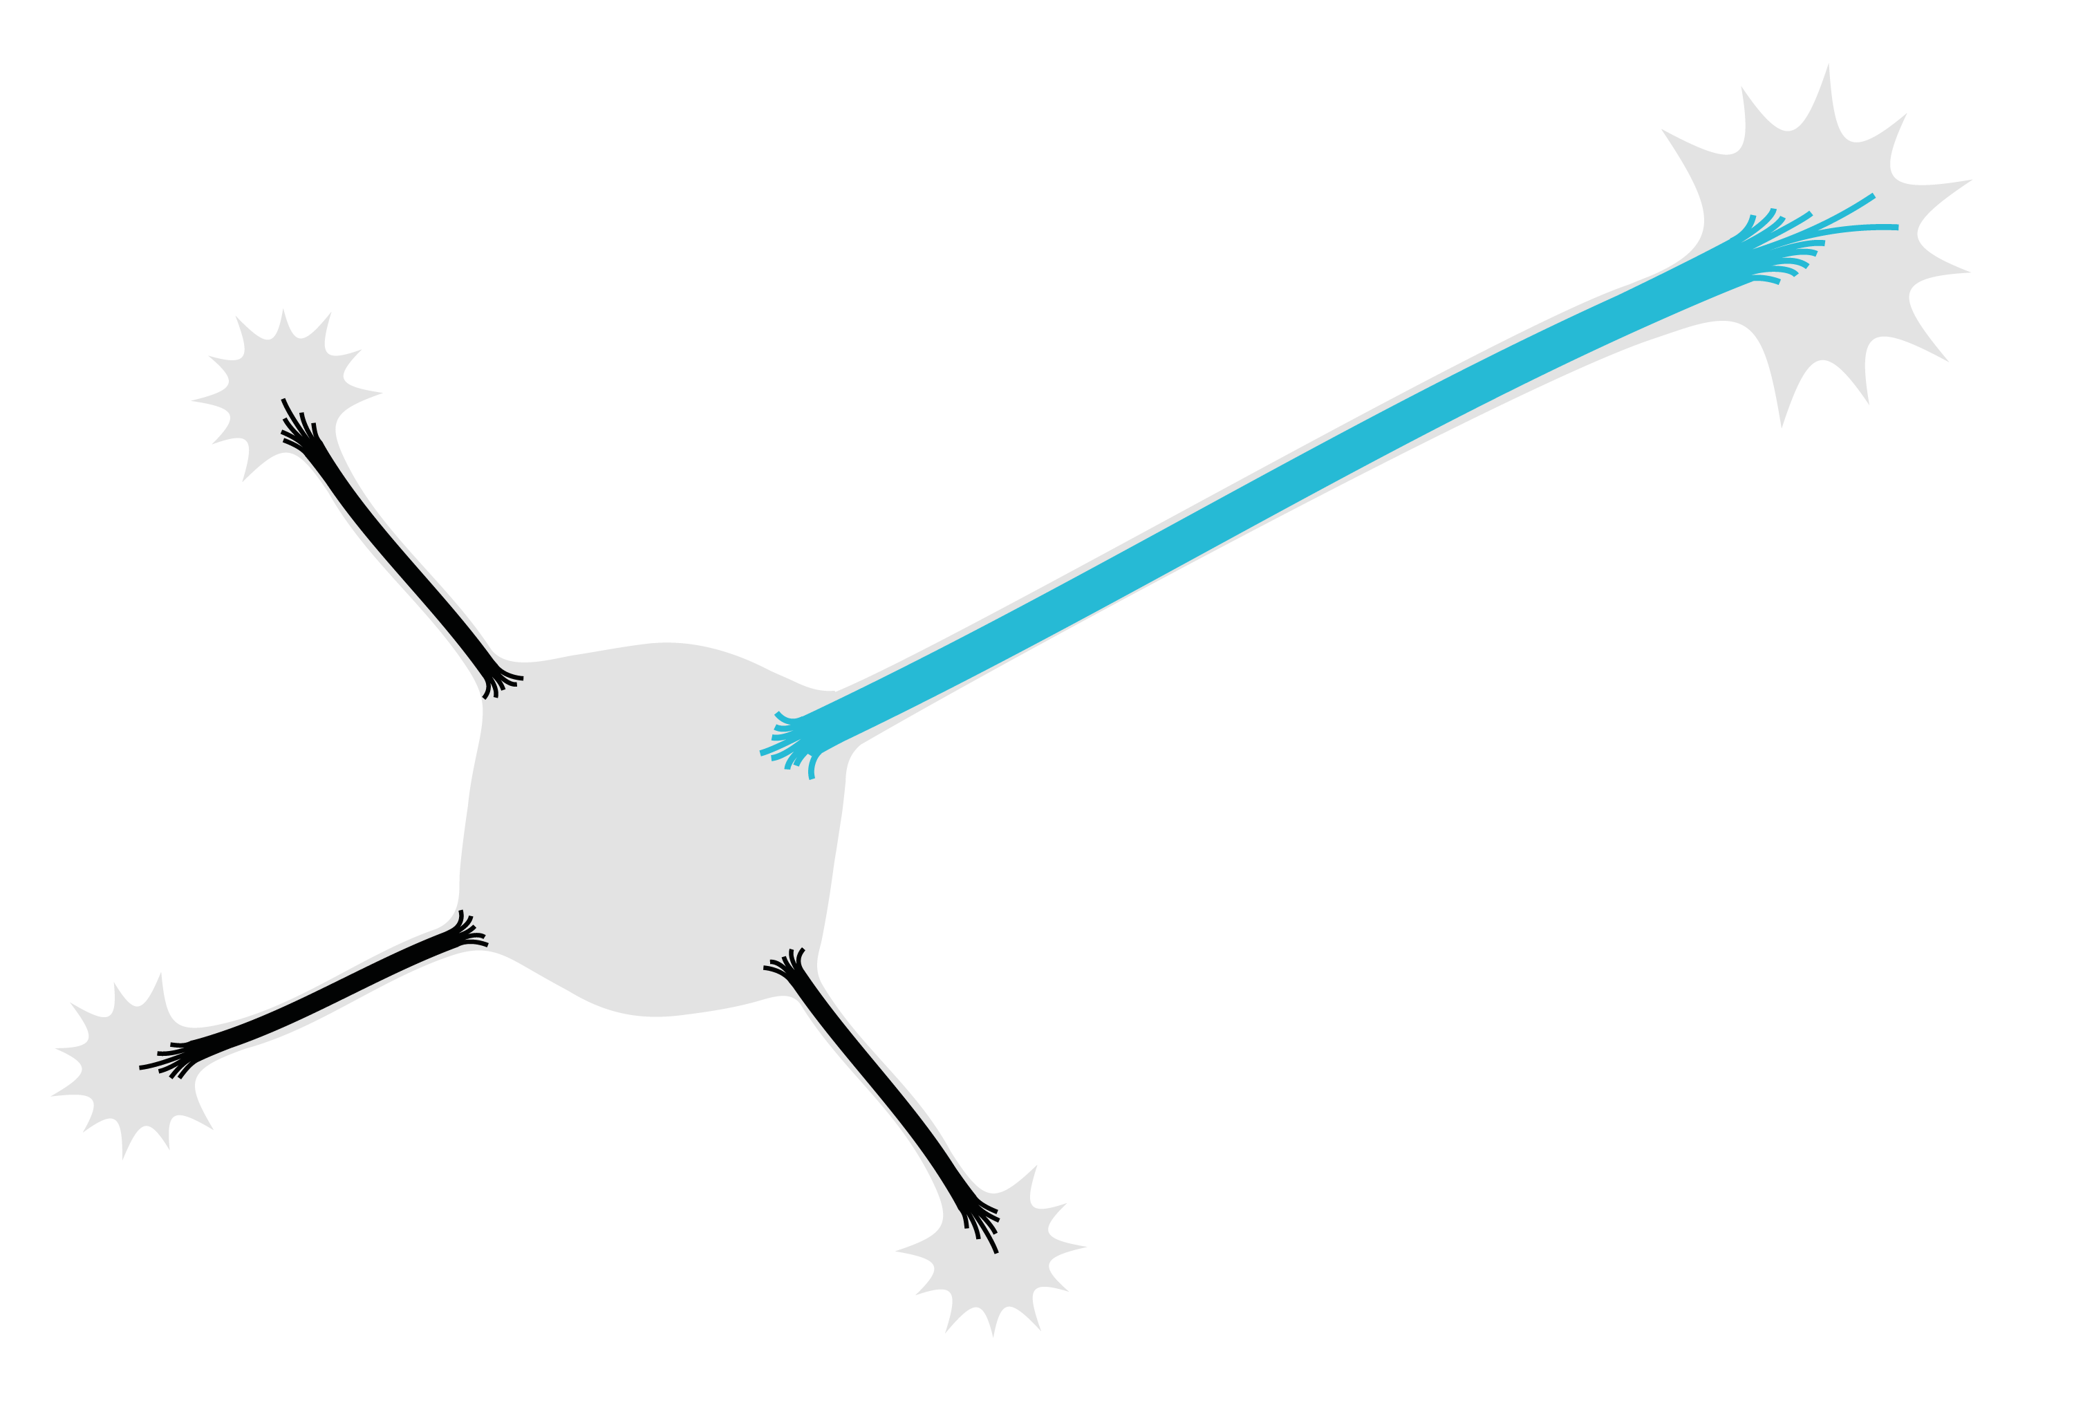

Plasma membrane
Dynein
Plus-end-in MTs
Plus-end-out MTs
Soma
Neurite tip
MT connections
MT-RF slows down in the axon
Axon growth
Neurites
with axon-like
properties
Fast
MT-RF
Slow
MT-RF
No
axon
Fast
MT-RF
Fluctuating
state
With
axon
Slow MT-RF
in the axon
Stable state
in the axon
Dynein

