Slide 1
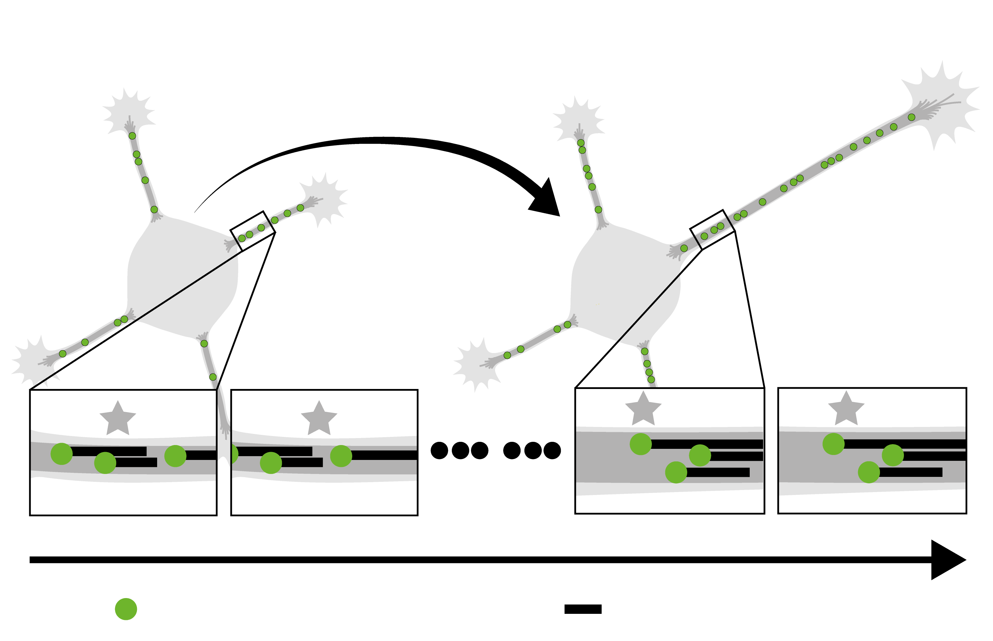
No axon
With axon
10 – 70 h imaging
Fluorescent
CAMSAP3
Non-fluorescent
single microtubules

