Slide 1
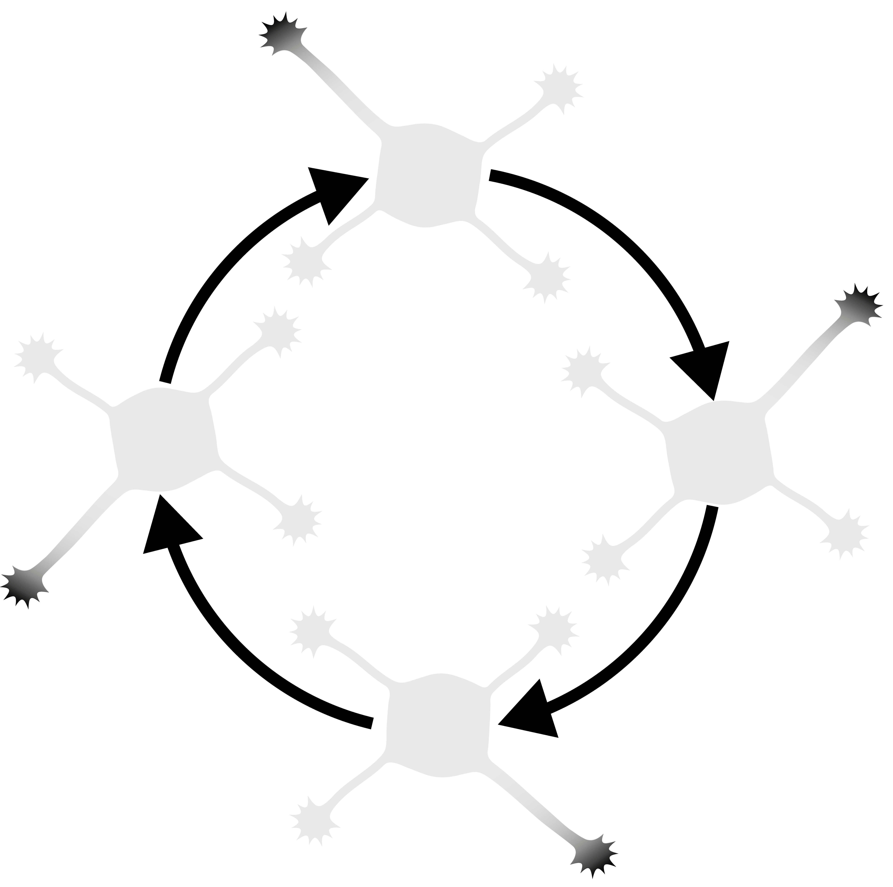
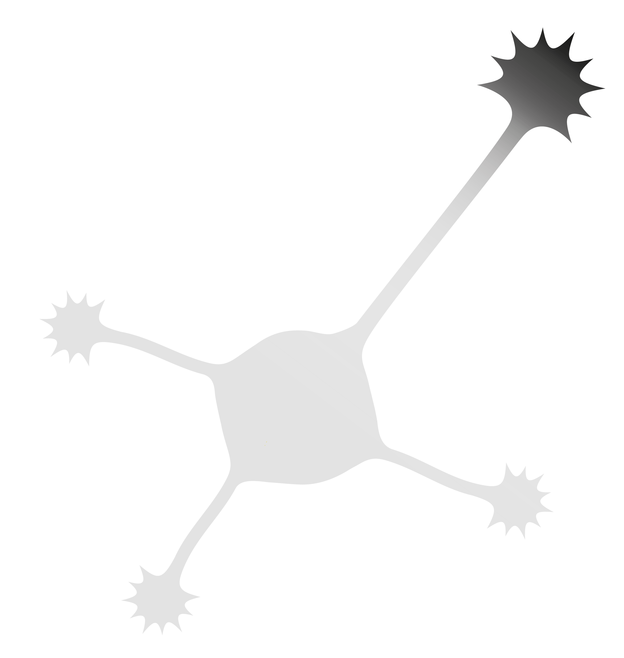
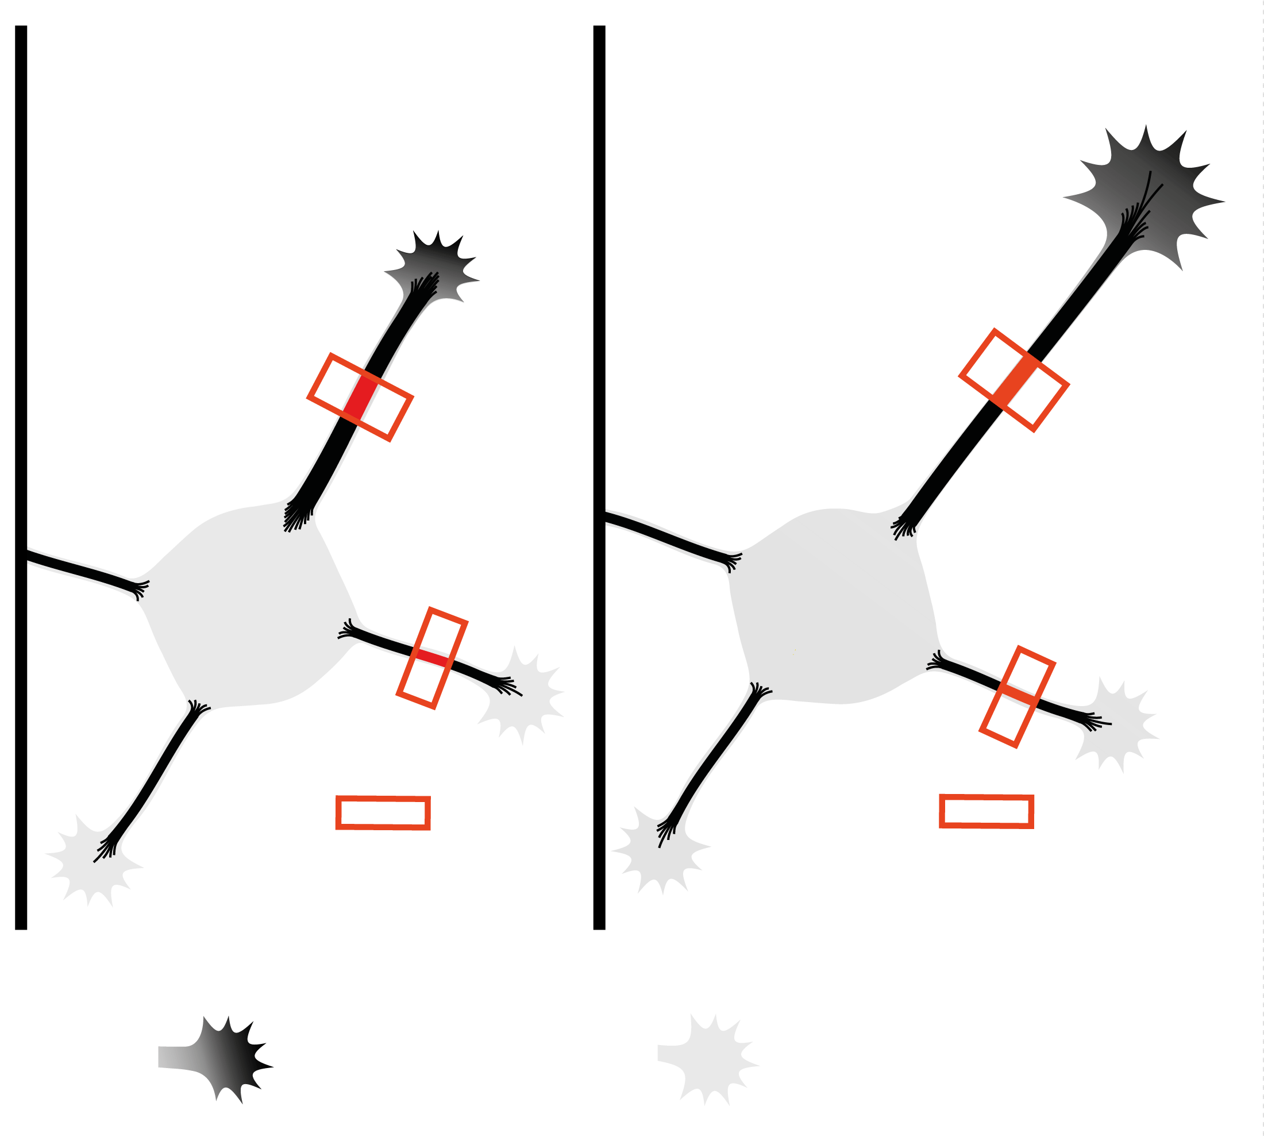
No axon – fluctuating state
With axon
Marker for
axon-like properties
No
caKIF5C
caKIF5C

