Slide 1
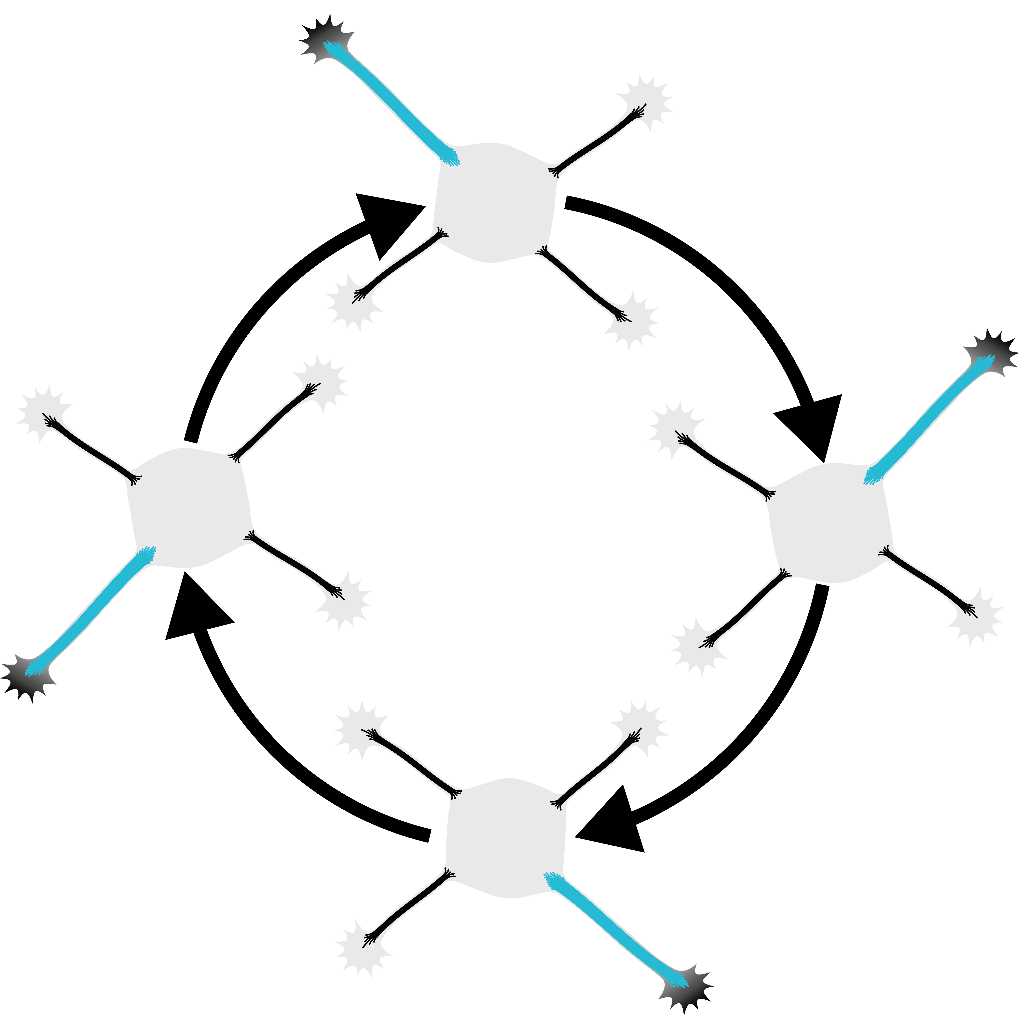
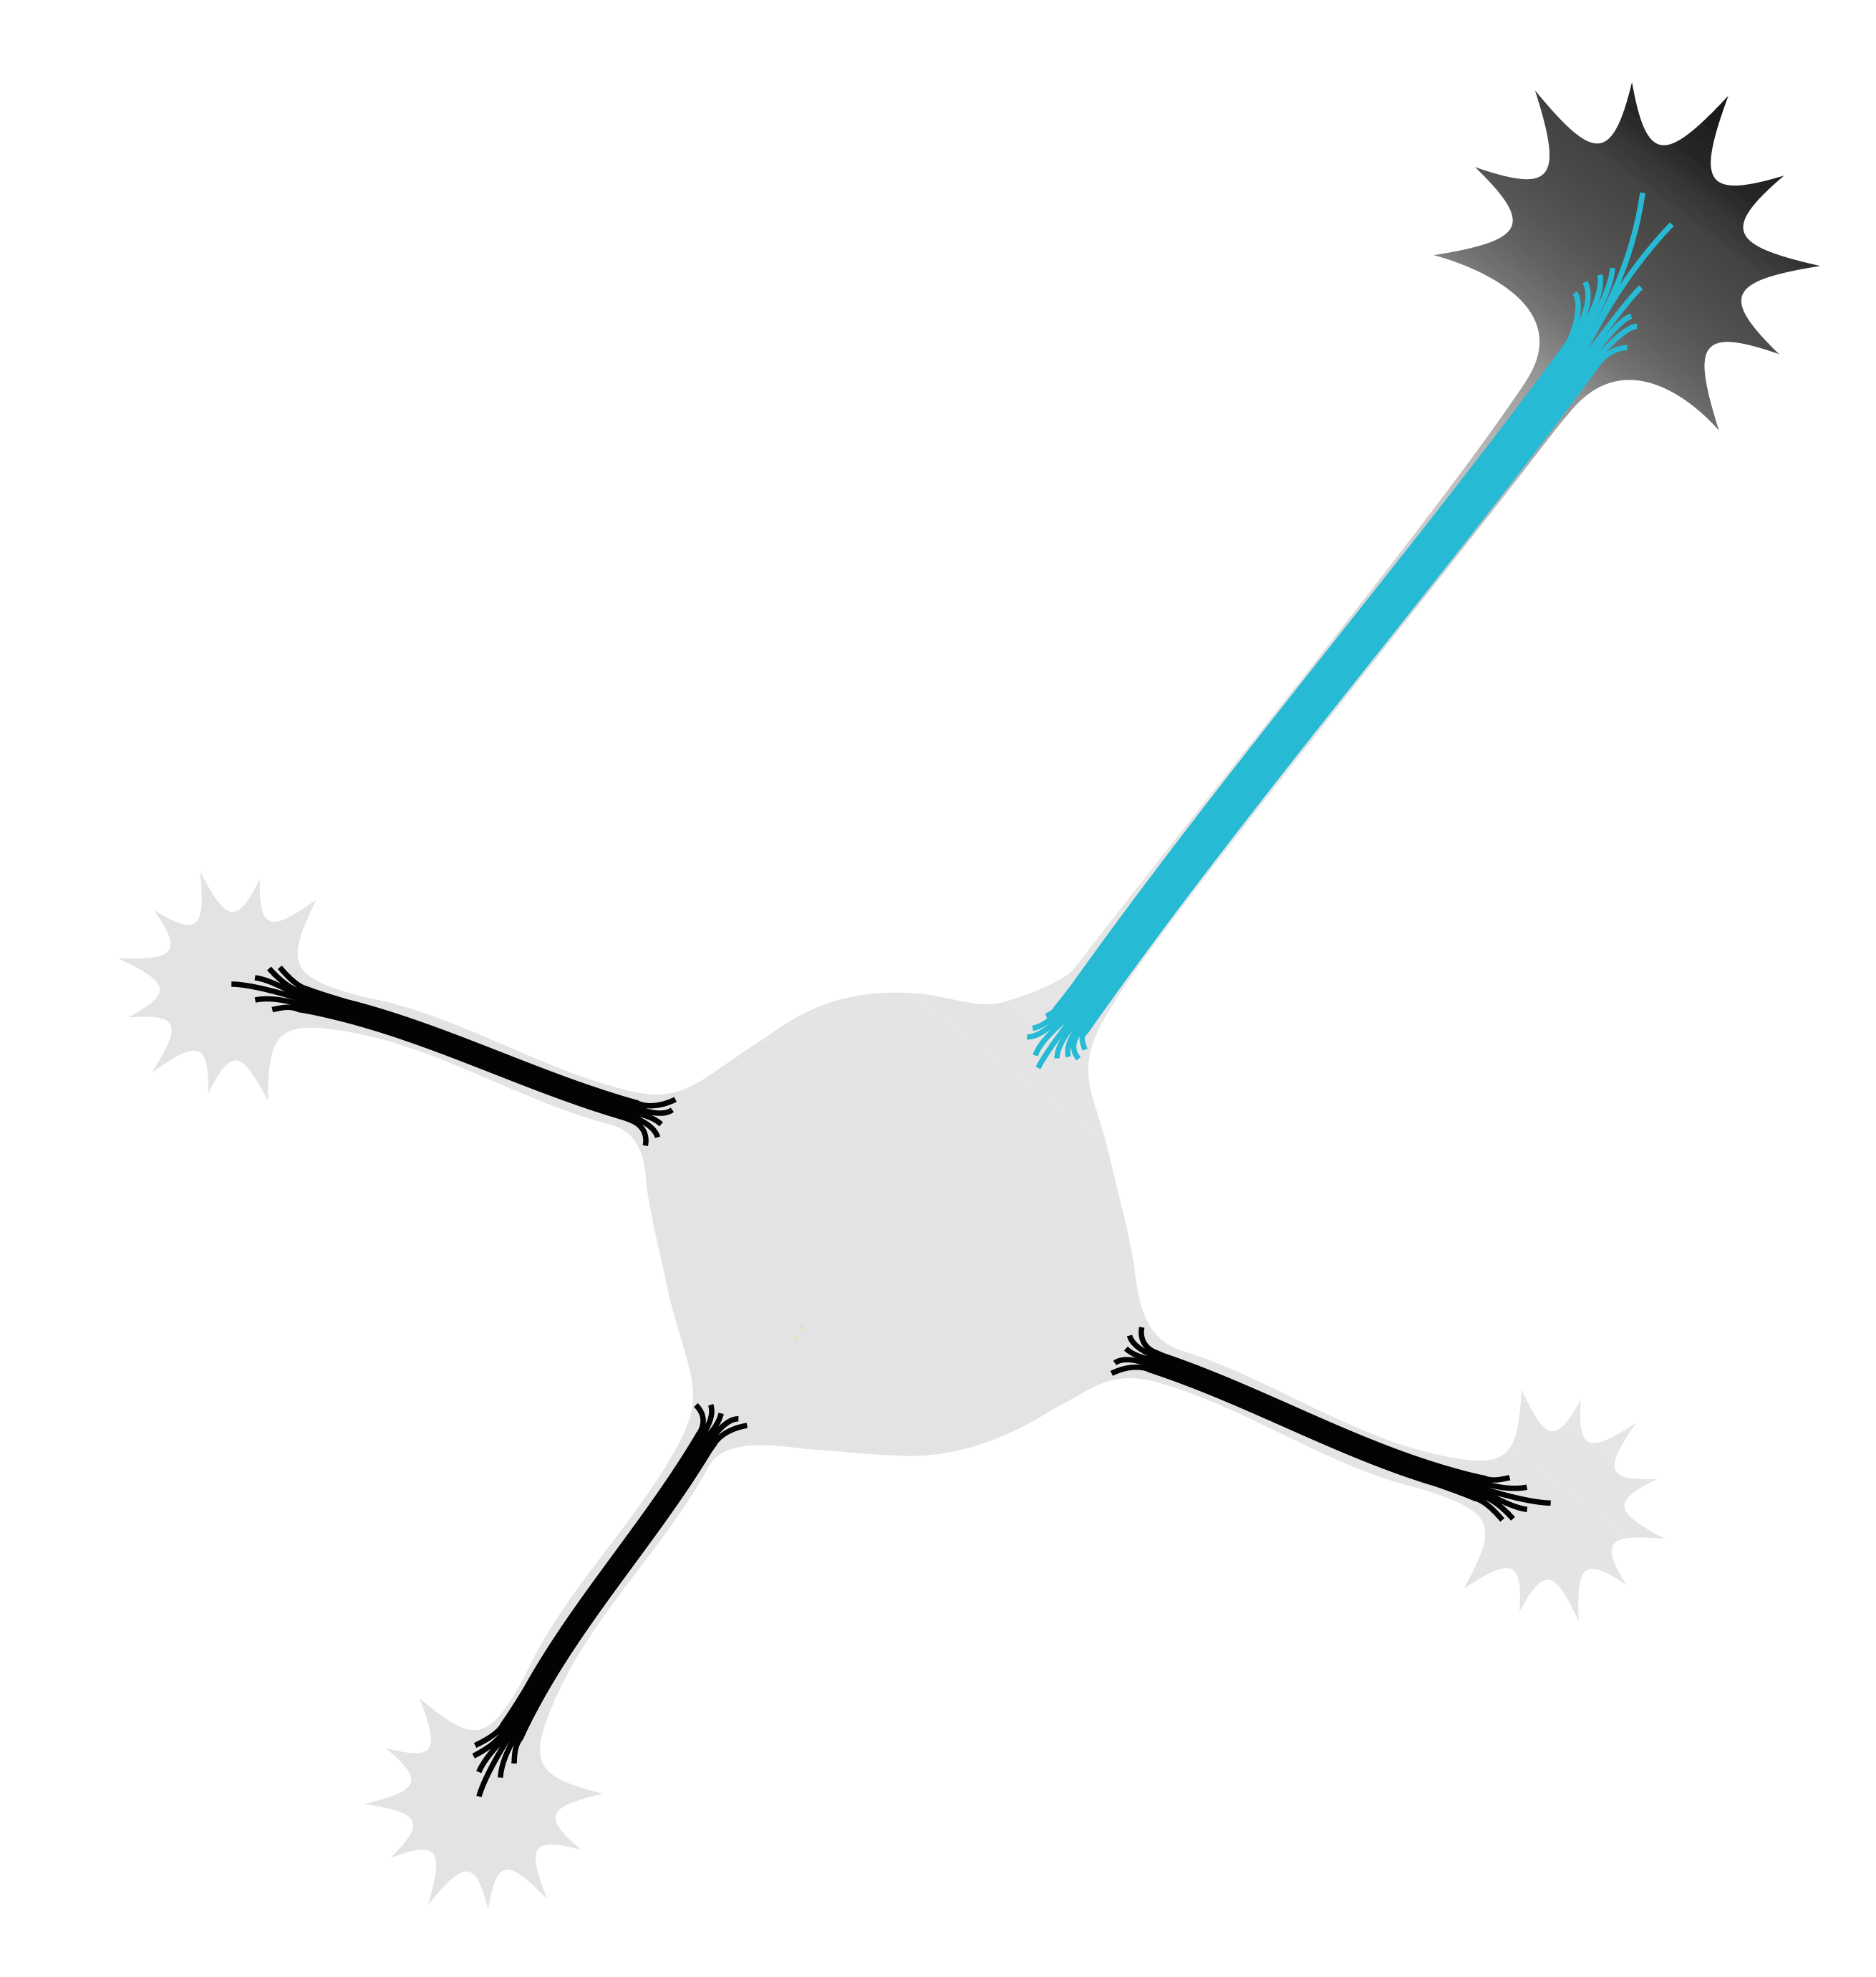

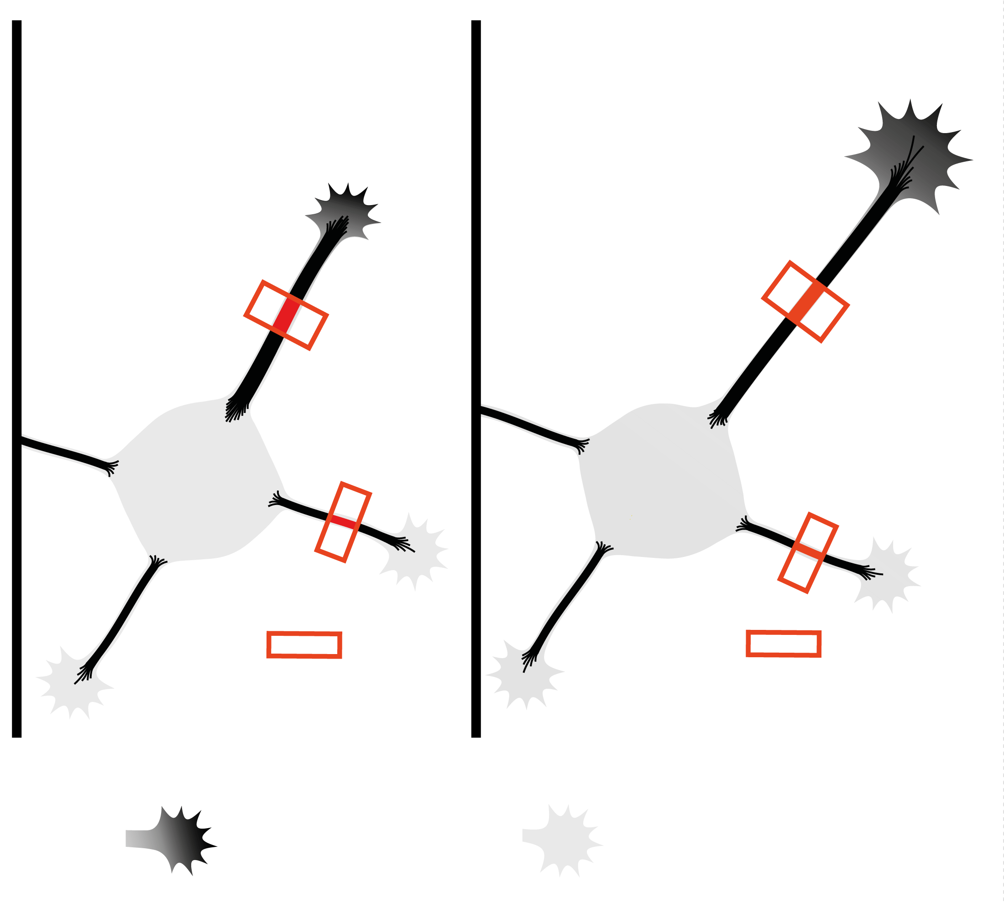
No axon – fluctuating state
With axon
Less dense
microtubules
No
caKIF5C
Microtubule
density cycles
More dense
microtubules
caKIF5C
Time

