Slide 1
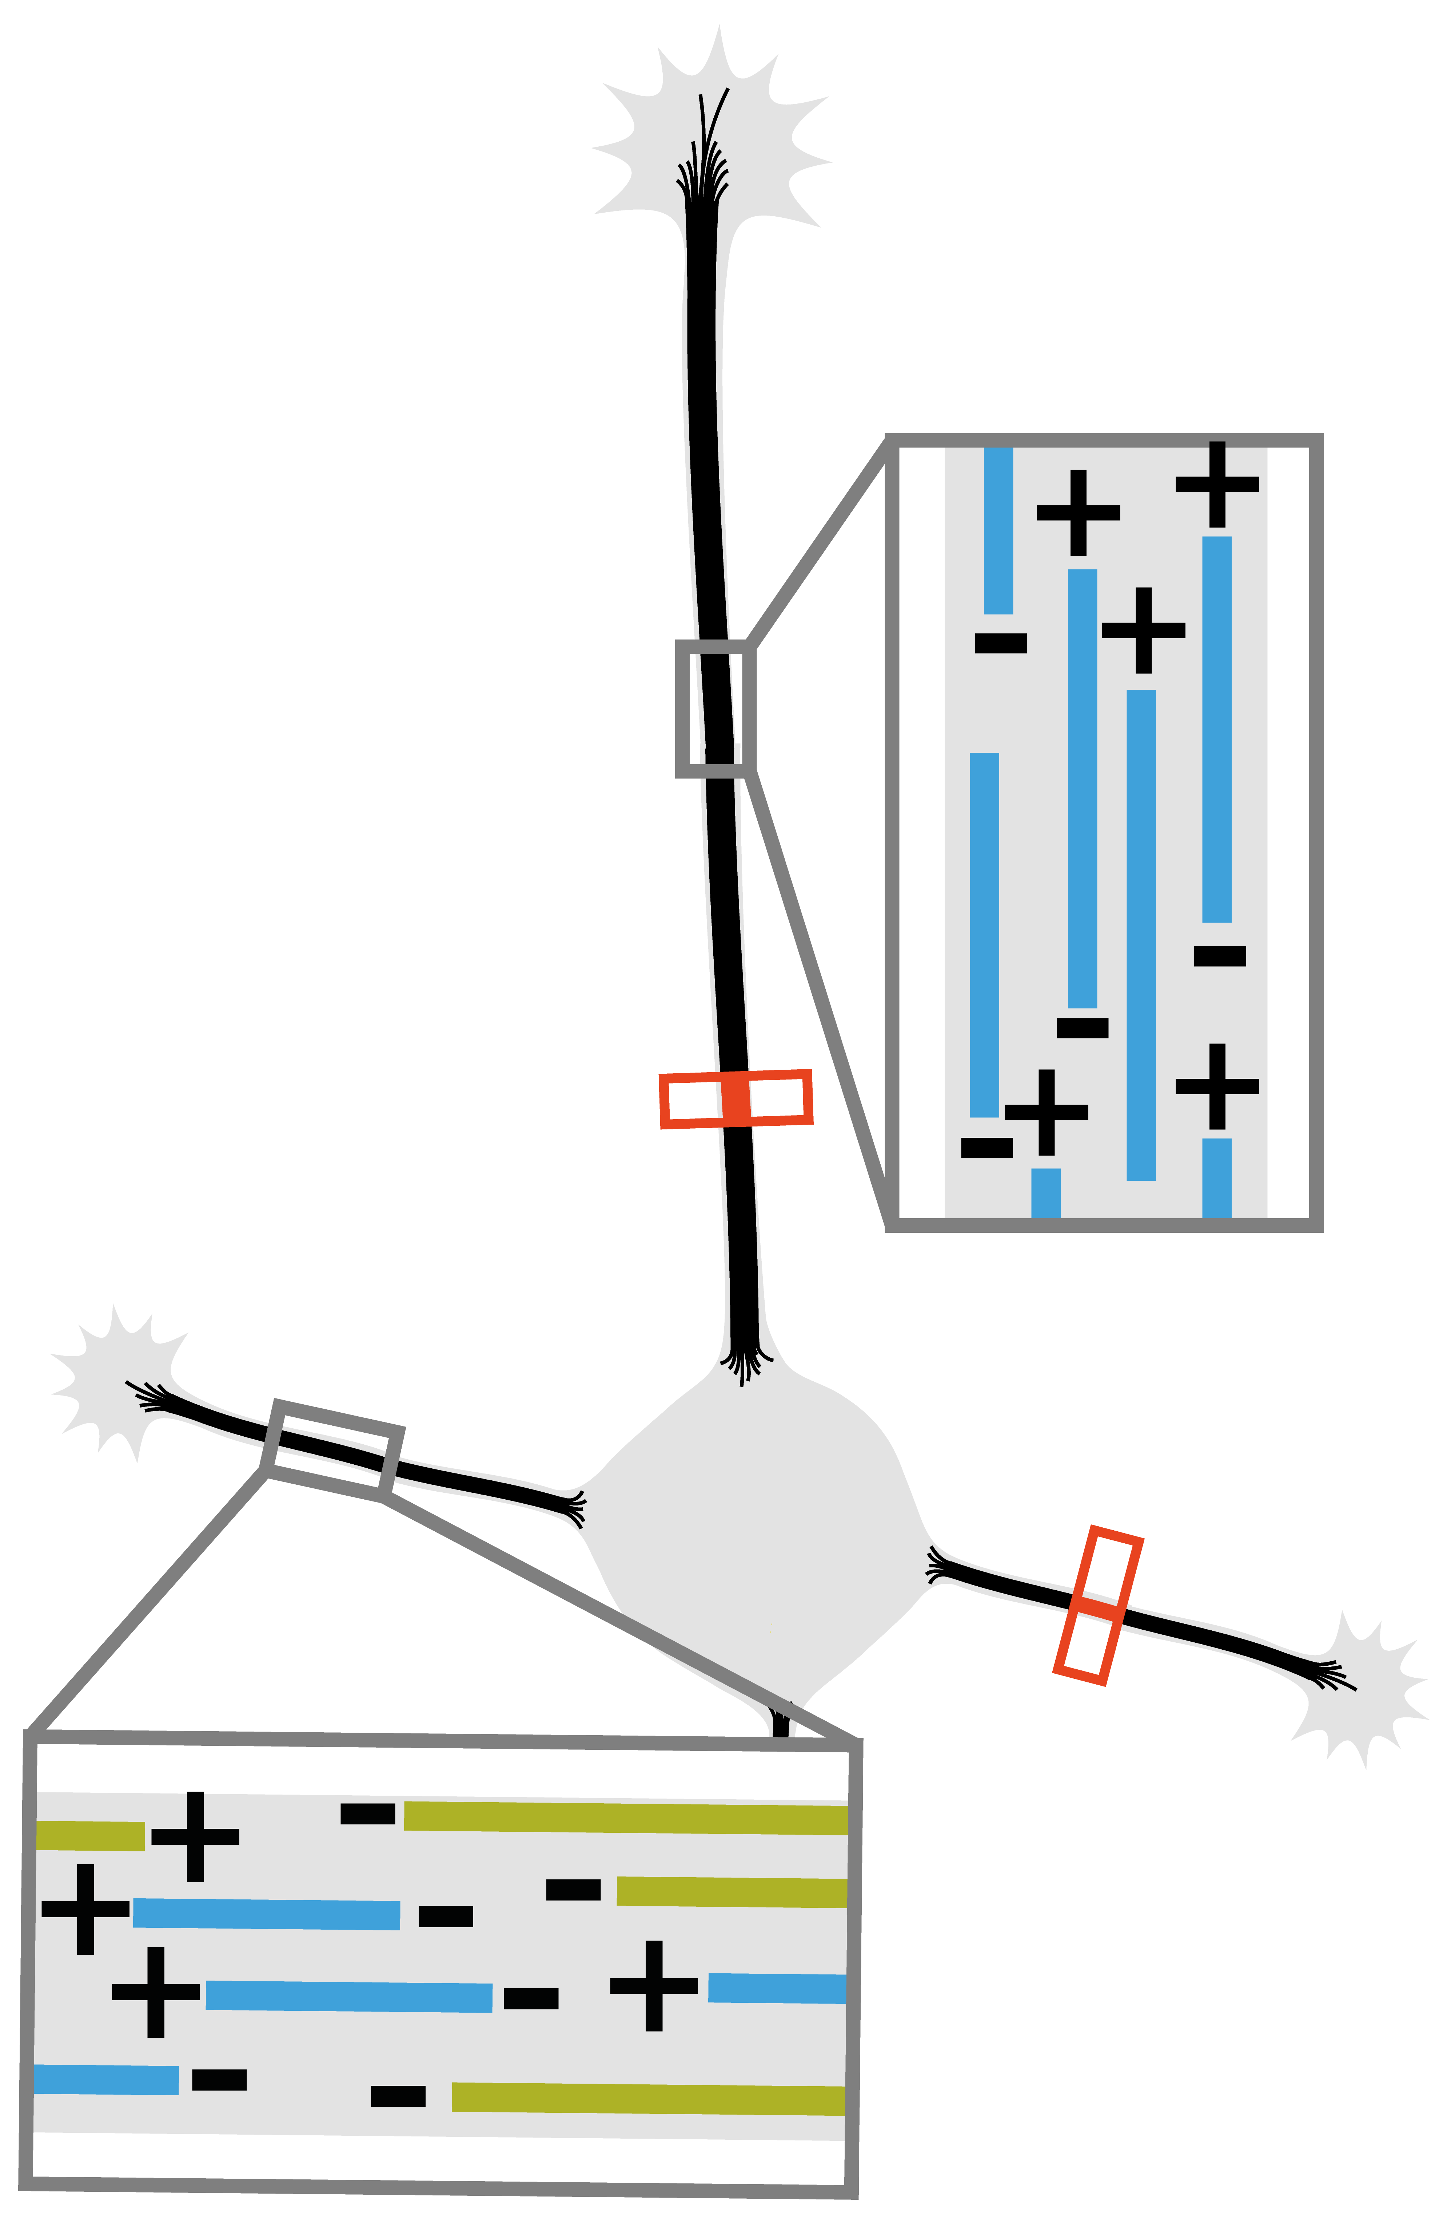
Microtubules
Plus-end-out
Plus-end-in
Photo-
conversion
Before
After
Dynein
motor
domain

