Slide 1
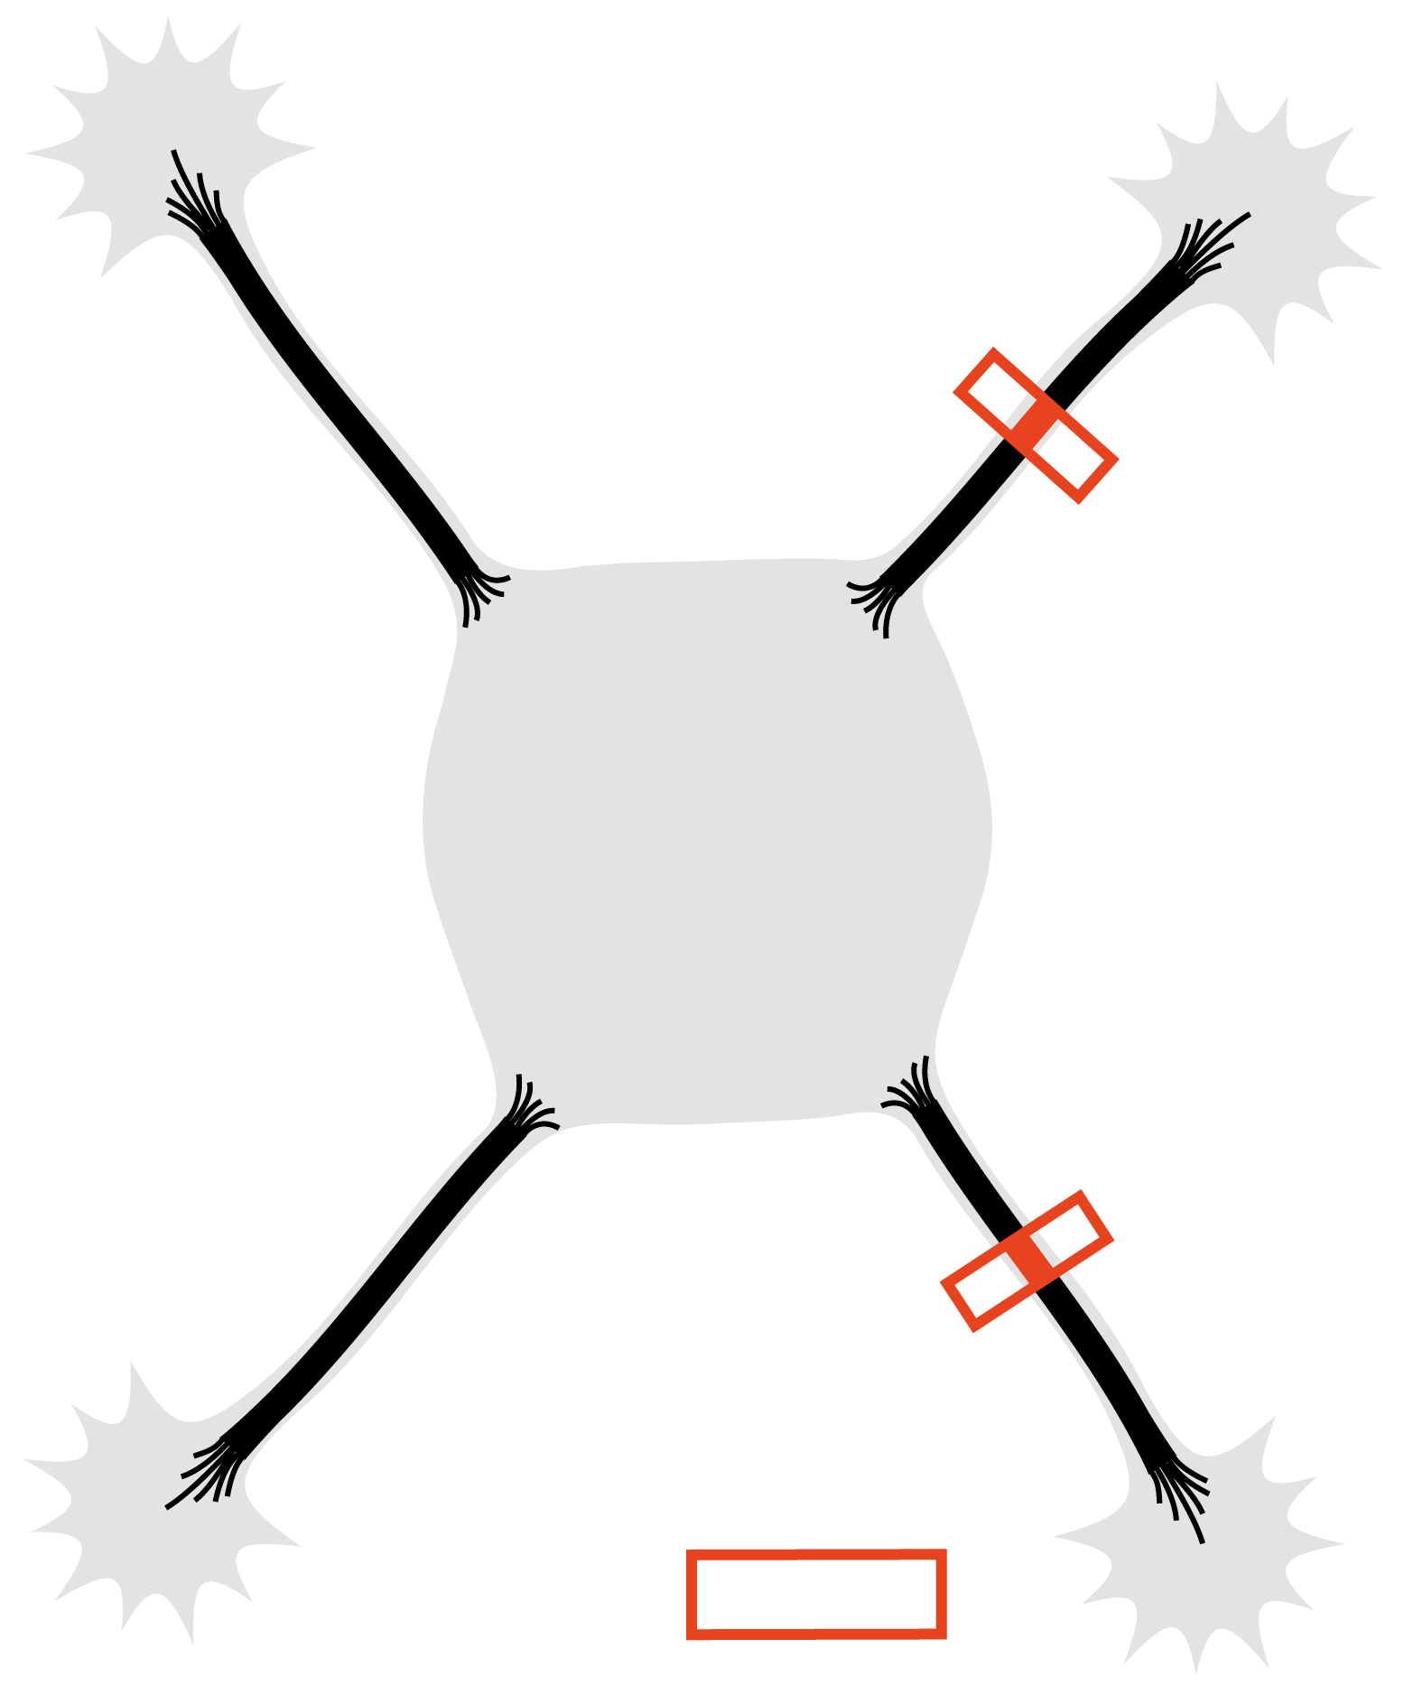
Actin
depolymerization
(LatA)
Photoactivation

