Slide 1
Comparative Genomics Final Project
Maximilian Senftleben
Zhong Hao Daryl Boey

Slide 2
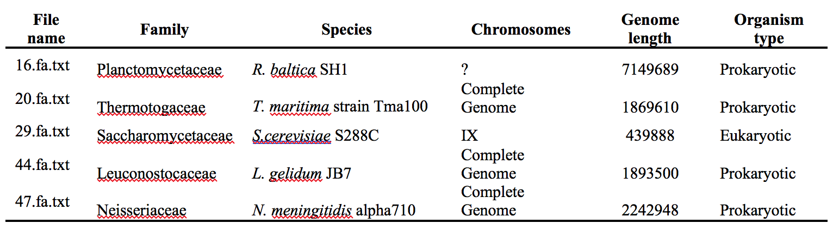
Summary of genomes
Notes:
D

Slide 3
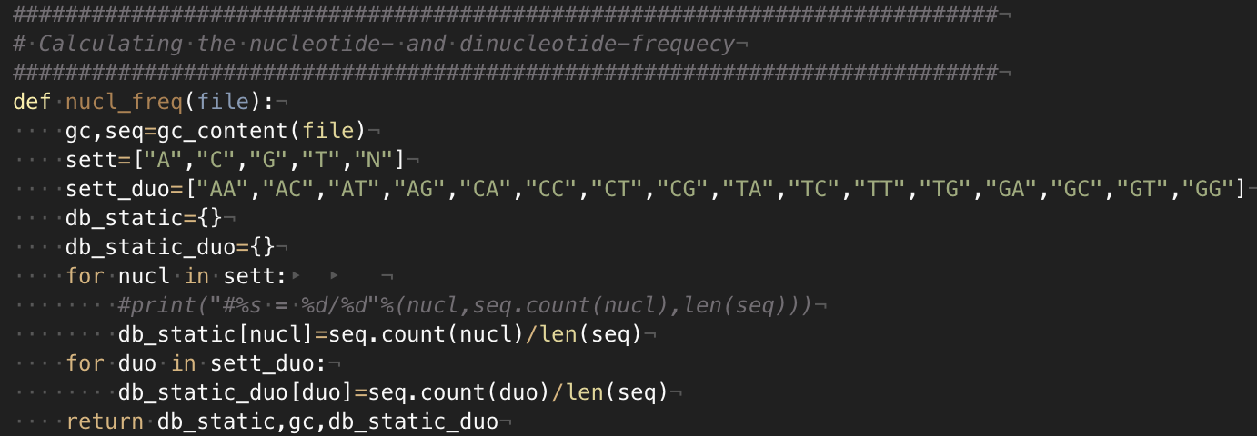
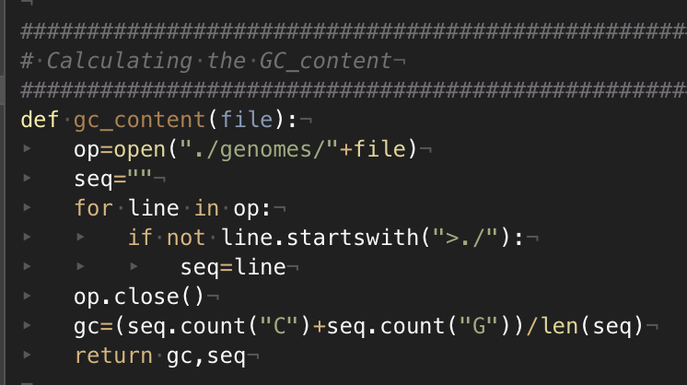
Nucleotide & amino acid frequency
Formula for amino acids
Formula for nucleotides
Formula for di amino acids
listofone=[(s.count(str(a)+str(b)))/len(s) for a in sett for b in sett]
Formula for dinucleotides
AGCGCGAGCG
Notes:
M
TO assess the different frequencies, python scripts were used. For the nucleotides the given genome was used and for the aminoacids the predicted proteomes derived from the predicted orfs were used.
The formula for single k-mers are probably pretty easy to understand, but the formula for the double molecules such as diaminoacids or dinucleotides was changed a bit. For a sequence of 10, this lower term
Is 9, because there are 9 possible positions for a k-mer of two.
This python one liner shows easily how the diamino frequency can be calculated

Slide 4
Nucleotide Frequencies
Notes:
D

Slide 5
Dinucleotide Frequencies
Notes:
D

Slide 6
ORF Finder
Principles of algorithm:
Stretch of DNA flanked by start & end codons
6 reading frames, 3 per strand
Prokaryotic ORFs > 300bp
Eukaryotic ORFs between 100 to 1500bp
Overlap removal using nested for loops
Notes:
M

Slide 7
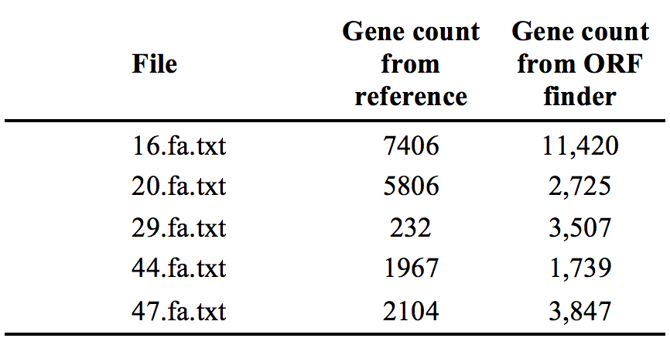
ORF Finder results
Notes:
M
Significantly different numbers from our ORF finder as compared to the reference (NCBI BLAST).

Slide 8
Performance analysis
Example: 44.fa.txt (L. gelidum)
Notes:
M
No True Negative due to database not including true negative references.

Slide 9
Performance analysis (F1-Score)

Slide 10
Distance Matrix
Distance method used
Show tree
Compare tree with older tree
Notes:
D

Slide 11
Distance Calculation methods
Screenshots
Notes:
D

Slide 12
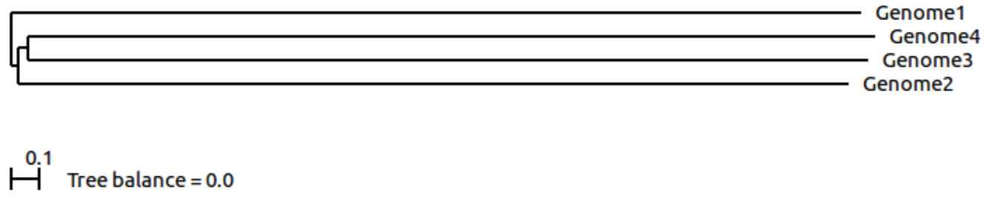
Distance Trees
ScoreDist phylogenic reconstruction calculated from dinucleotide frequencies.
ScoreDist phylogenic reconstruction calculated using GLIMMER (old method).
Notes:
D
Why scoredist, why dinucleotide frequencies

Slide 14
Thank you!

