Slide 1
Comparative Genomics Final Project
Maximilian Senftleben
Zhong Hao Daryl Boey

Slide 2
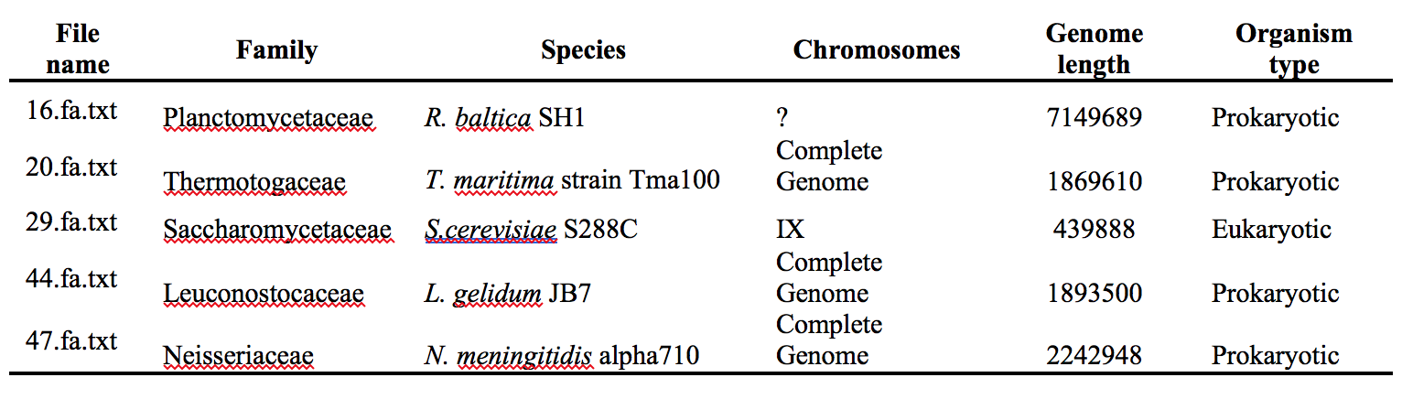
Summary of genomes

Slide 3
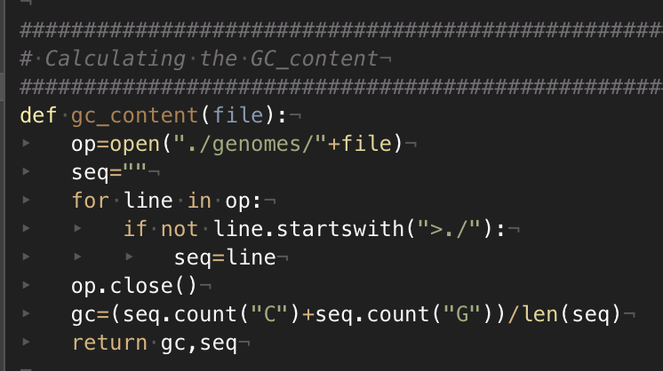
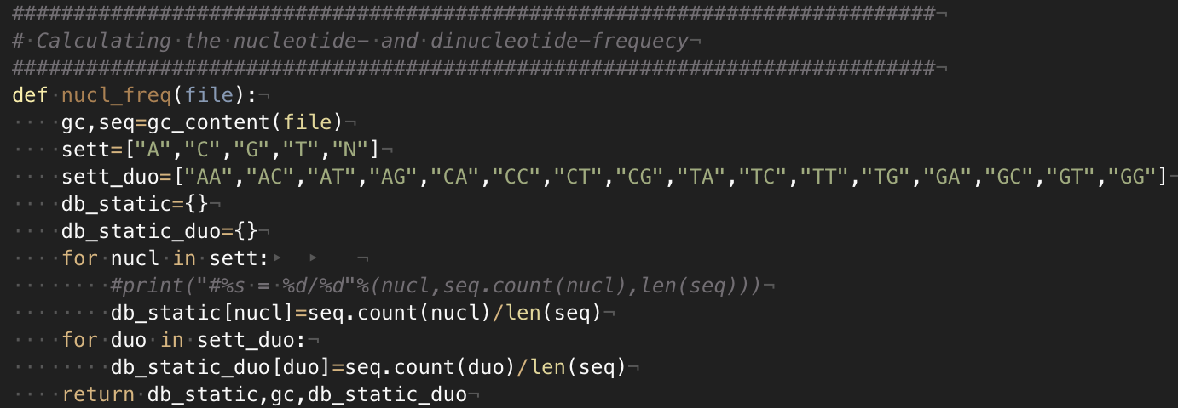
Nucleotide frequency

Slide 4
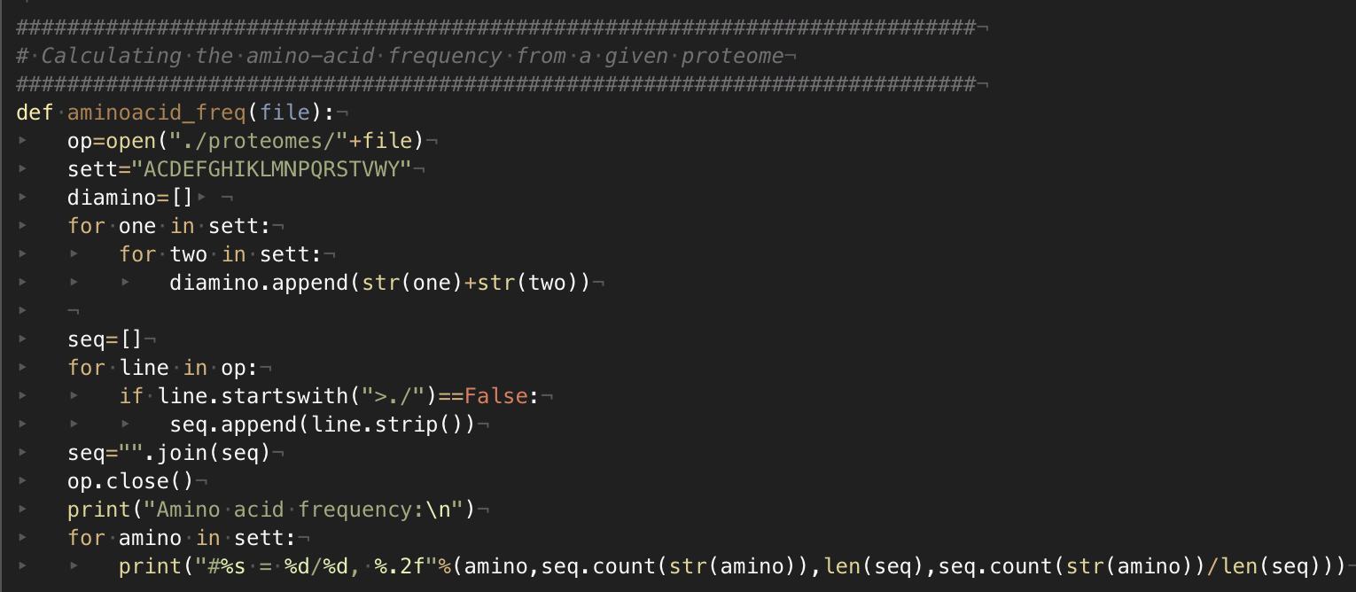
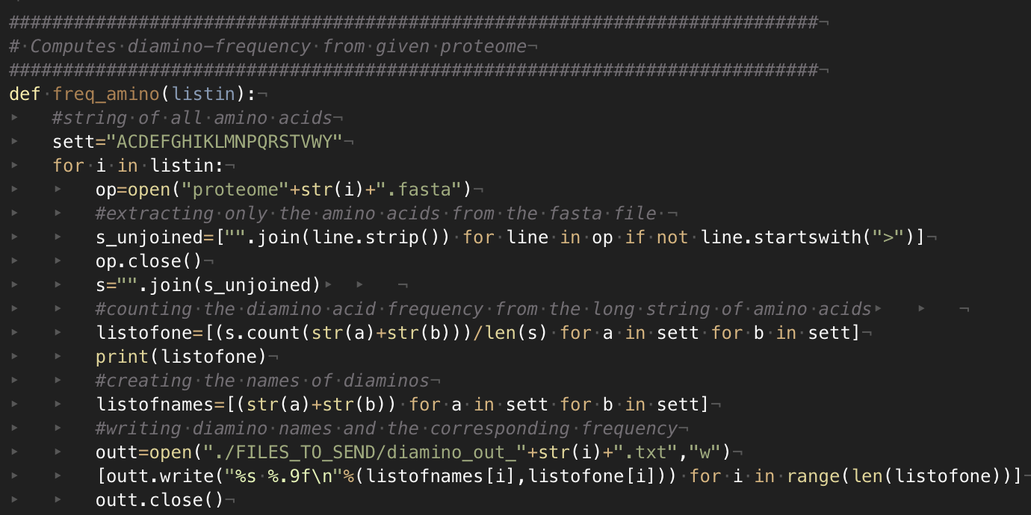
Amino acid frequency

Slide 5
Result of applying 3 scripts to 5 genomes
GC, nucleotide and dinucleotide frequencies
amino acid and diamino acid frequencies
Screenshots

Slide 6
Nucleotide Frequencies

Slide 7
Dinucleotide Frequencies

Slide 8
Predicted ORFs
Basic assumptions for ORFs
ORF count
Examples and statistics (f1 score) -> 44.fa.txt
Additional improvements

Slide 9
ORF Finder
Principles of algorithm:
Stretch of DNA flanked by start & end codons
6 reading frames, 3 per strand
Prokaryotic ORFs > 300bp
Eukaryotic ORFs between 100 to 1500bp
Overlap removal using Dynamic Programming (DP)

Slide 10
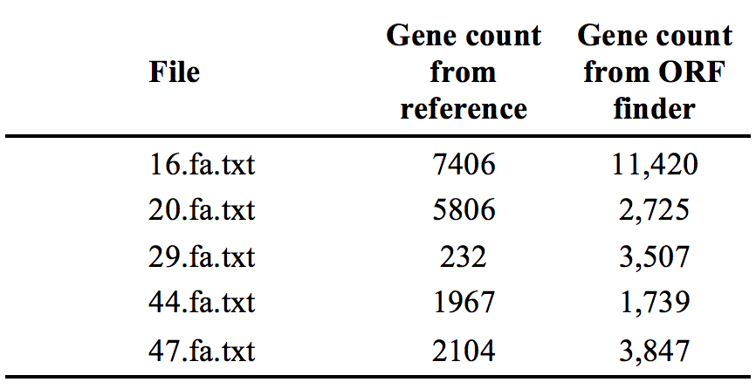
ORF Finder results
Notes:
Significantly different numbers from our ORF finder as compared to the reference (NCBI BLAST).

Slide 11
Performance analysis
Example: 44.fa.txt (L. gelidum)
Notes:
No True Negative due to database not including true negative references.

Slide 12
Performance analysis (F1-Score)

Slide 13
Distance Matrix
Distance method used
Show tree
Compare tree with older tree

Slide 14
Distance Calculation methods
Screenshots

Slide 15
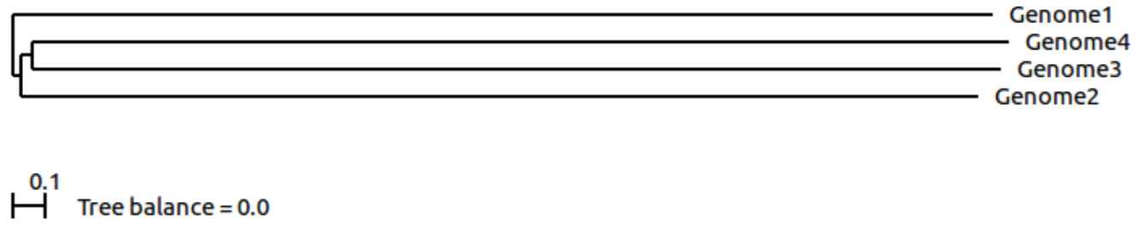
Distance Trees
ScoreDist phylogenic reconstruction calculated from dinucleotide frequencies.
ScoreDist phylogenic reconstruction calculated using GLIMMER (old method).
Notes:
Why scoredist, why dinucleotide frequencies

Slide 17
Thank you!

