Slide 1
Comparative Genomics Final Project
Maximilian Senftleben
Zhong Hao Daryl Boey

Slide 2
Summary of genomes
Notes:
D

Slide 3
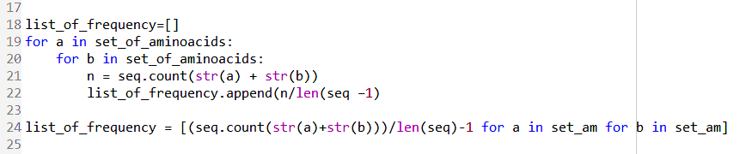
Nucleotide & amino acid frequency
Given genomes were used for (di)nucleotide handling
Predicted proteomes were used for (di)amino-acid handling
$$Frequency=\frac{count(nucleotide or aminoacid)}{len\left(total\right)}$$
$$Frequency=\frac{count(dinucl. or diaminoa.)}{len\left(total\right)−1}$$
Notes:
M
TO assess the different frequencies, python scripts were used. For the nucleotides the given genome was used and for the aminoacids the predicted proteomes derived from the predicted orfs were used.
The formula for single k-mers are probably pretty easy to understand, but the formula for the double molecules such as diaminoacids or dinucleotides was changed a bit. For a sequence of 10, this lower term
Is 9, because there are 9 possible positions for a k-mer of two.
This python one liner shows easily how the diamino frequency can be calculated

Slide 4
Nucleotide Frequencies
Notes:
D

Slide 5
Dinucleotide Frequencies
Notes:
D

Slide 6
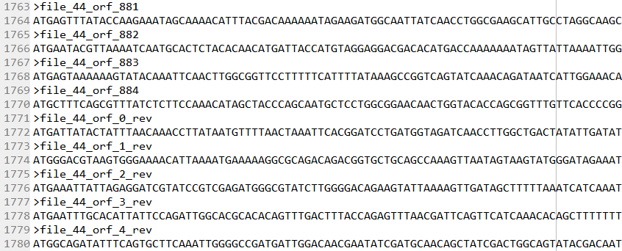
ORF Finder
Principles of algorithm:
ORF: from start- to stop-codon (ATG : TAG,TAA,TGA)
Prokaryotic ORFs > 300bp
Eukaryotic ORFs between 100 and 1500bp
6 different reading frames
Overlap removal using nested for-loops
Notes:
For the ORF-finder we used the basic assumption of that an ORF starts at a start codon and ends at a stop codon
The Prokaryotic ORFs were limited by size in a way that they had to be at least 300 bp long, which we found in a paper
The eukaryotic genome (which was basically only the S. cerevisiae) was limited by size between 100 bp and 1500 bp.
We applied three different reading frames for the template strand and three for the reverse strand.
We removed the overlaps with using nested for loops, so that always the longer sequence was taken, as it is more probable to be the actual gene.
The obtained ORFs were in 5` to 3´ direction

Slide 7
ORF Finder results
Notes:
Here are the results obtained from the ORF-finder.
We compared the results with the counted genes from Practical 1 derived from NCBI-BLAST
Significantly different numbers from our ORF finder as compared to the reference (NCBI BLAST), although there are some similarities for the L.gelidium (44) for example.

Slide 8
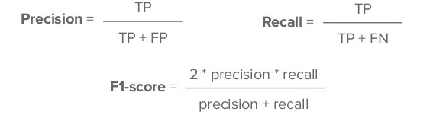
Performance analysis
Performance was assessed with the F1-score:
Example: 44.fa.txt (L. gelidum)
 |  | Predicted Class |  | F1-score | 0.7202
 | 44.fa.txt | P | N
Actual Class | P | 1273 | 523
 | N | 466 | NIL
Notes:
To assess the performance of the ORF-predictor, the F1-score was calculated for each genome.
For that, the proteomes were downloaded from Uniprot as reference.
Then the nucleotide orfs were translated with Biopython into amino-acid sequences to fasta format.
Then the True positives, the false postives and the false negatives could be calculated and with that the precision, recall and finally the f1-score.
The example from file 44 (Leuconostoc gelidum) showed an actually good F1score with 0.7202

Slide 9
Results of Performance (F1-Score)
Possible improvements:
Enhance size limitations
Apply search for consensus sequences (TATA, Pribnow, Shine-Dalgarno)
Notes:
Here are the general results of the ORFpredictor derived from the F1-score:
AS you can see, genome 16 and 47 have the worst f1-score, whereas genome 20 and 44 are the best. The f1 score for the eukaryotic genome (29) is with 0.30
Further there are some improvements possible

Slide 10
Distance Matrix
Distance method used
Show tree
Compare tree with older tree
Notes:
D

Slide 11
Distance Calculation methods
Screenshots
Notes:
D

Slide 12
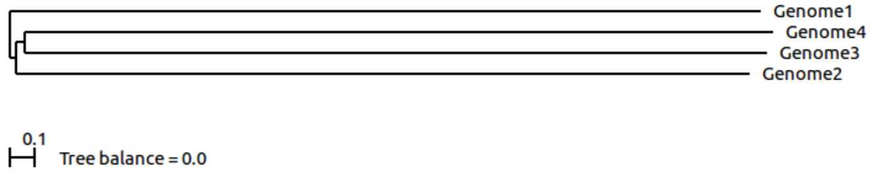
Distance Trees
ScoreDist phylogenic reconstruction calculated from dinucleotide frequencies.
ScoreDist phylogenic reconstruction calculated using GLIMMER (old method).
Notes:
D
Why scoredist, why dinucleotide frequencies

Slide 13
Thank you!

