Slide 1
Comparative Genomics Final Project
Maximilian Senftleben
Zhong Hao Daryl Boey

Slide 2
Summary of genomes
Notes:
D

Slide 3
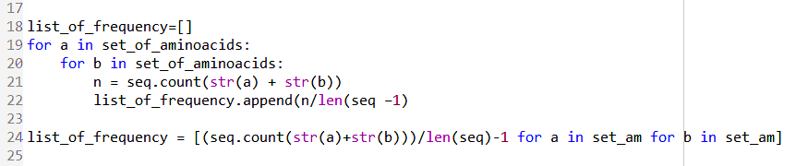
Nucleotide & amino acid frequency
Given genomes were used for (di)nucleotide handling
Predicted proteomes were used for (di)amino-acid handling
$$Frequency=\frac{count(nucleotide or aminoacid)}{len\left(total\right)}$$
$$Frequency=\frac{count(dinucl. or diaminoa.)}{len\left(total\right)−1}$$
Notes:
M
TO assess the different frequencies, python scripts were used.
For the nucleotides the given genome was used and for the aminoacids the predicted proteomes derived from the predicted orfs were used.
The formula for single characters are probably pretty easy to understand, but the formula for the double molecules such as diaminoacids or dinucleotides was changed a bit.
For a sequence of 10 characters there are 9 possible different dinucleotides or diaminoacids
This python one liner shows easily how the diamino frequency can be calculated

Slide 4
Nucleotide Frequencies
Notes:
D
Fairly even distribution across all the genomes, with 16 and 47 having slightly more enriched GC content compared to the others.

Slide 5
Dinucleotide Frequencies
Notes:
D
Same GC distribution visible here, apart from that fairly normal distribution.

Slide 6
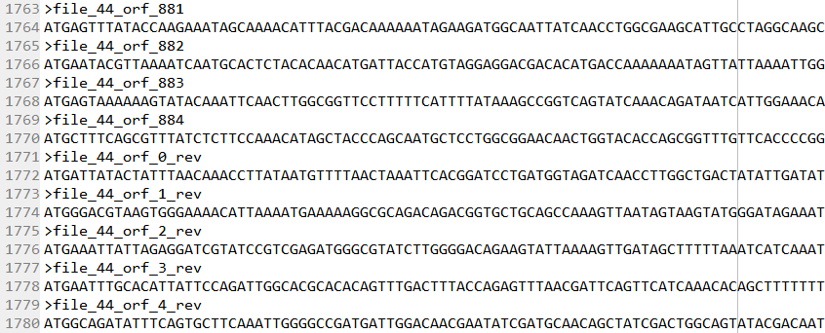
ORF Finder
Principles of algorithm:
ORF: from start- to stop-codon (ATG : TAG,TAA,TGA)
Prokaryotic ORFs > 300bp
Eukaryotic ORFs between 100 and 1500bp
6 different reading frames
Overlap removal using nested for-loops
Notes:
For the ORF-finder we used the basic assumption of that an ORF starts at a start codon and ends at a stop codon
The Prokaryotic ORFs were limited by size in a way that they had to be at least 300 bp long,
The eukaryotic genome (which was only the S. cerevisiae) was limited by size between 100 bp and 1500 bp.
We found informations about that in several papers
We applied three different reading frames for the template strand and three for the reverse strand.
Which resulted in 6 different reading frames
We removed the overlaps with using nested for loops, so that always the longer sequence was taken, as it is more probable to be the actual gene.
The obtained ORFs were in 5` to 3´ direction

Slide 7
ORF Finder results
Notes:
Here are the results obtained from the ORF-finder.
We compared the results with the counted genes from Practical 1 derived from NCBI-BLAST
Significantly different numbers from our ORF finder as compared to the reference (NCBI BLAST), although there are some similarities for the L.gelidium (44) for example.

Slide 8
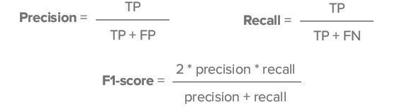
Performance analysis
Performance was assessed with the F1-score:
Example: 44.fa.txt (L. gelidum)
 |  | Predicted Class |  | F1-score | 0.7202
 | 44.fa.txt | P | N
Actual Class | P | 1273 | 523
 | N | 466 | NIL
https://towardsdatascience.com/rock-solid-predictions-predicting-rocks-c0138a8994f6
Notes:
To assess the performance of the ORF-predictor, the F1-score was calculated for each genome.
For that, the proteomes were downloaded from Uniprot as reference.
Then the nucleotide orfs were translated with Biopython into amino-acid sequences to fasta format.
Then the True positives, the false postives and the false negatives could be calculated and with that the precision, recall and finally the f1-score.
The example from file 44 (Leuconostoc gelidum) which had the best prediction showed an actually good F1score with 0.7202

Slide 9
Results of Performance (F1-Score)
Possible improvements:
Enhance size limitations
Apply search for consensus sequences (TATA, Pribnow, Shine-Dalgarno)
Notes:
Here are the general results of the ORFpredictor derived from the F1-score:
AS you can see, genome 16 and 47 have the worst f1-score, whereas genome 20 and 44 are the best.
The f1 score for the eukaryotic genome (29) is with 0.30 pretty low
Further there are some improvements possible:
Enhance size limitation, adjust it to the organism, do more research
Apply searching for consensus sequences (TATA, Pribnow, Shine-Dalgarno)
All these to narrow down the prediction of ORFs

Slide 10
3 Distance measures
Multiple distance measures used:
GC value distance
Nucleotide value distance &
Dinucleotide value distance
Notes:
D
Unsure which metric was going to be the most efficient, so produced distance matrices for all 3, followed by plotting and comparison.
Abs = absolute value, has the same effect as square followed by square root.

Slide 11
Best reconstructed phylogenic tree
Notes:
D
Dinucleotide frequency based distance
Important to note that the tree has been normalized, by multiplying all values by 1000, to make branch lengths more distinguishable. Prior attempts at normalizing using min/max or l1/l2 methods within scikitlearn were hard to implement due to inconsistent changes to values that should have been the same (16/20 and 20/16).

Slide 12
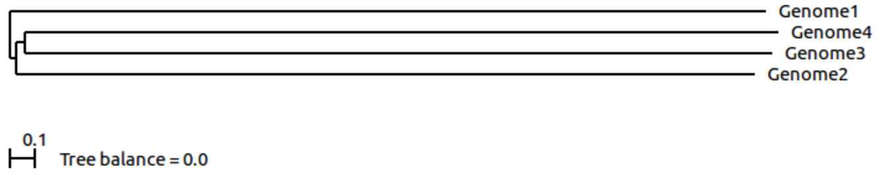
Distance Trees
ScoreDist phylogenic reconstruction calculated from dinucleotide frequencies.
ScoreDist phylogenic reconstruction calculated using GLIMMER (old method).
Notes:
D
Why scoredist -> default distance correction, was complicated to use more flags with “R” function required to feed distance matrices to Belvu.
Both nucleotide and dinucleotide distance measures gave the same tree structure, with slightly varying branch lengths.

Slide 13
Thank you!

