Slide 1
Comparative Genomics Final Project
Maximilian Senftleben
Zhong Hao Daryl Boey

Slide 2
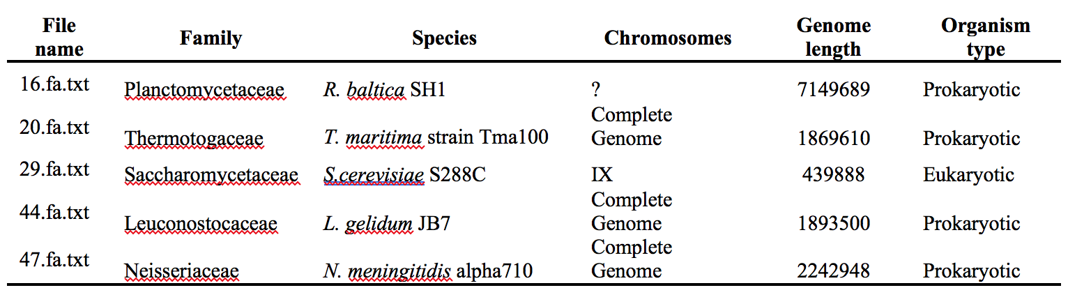
Summary of genomes
Notes:
D

Slide 3
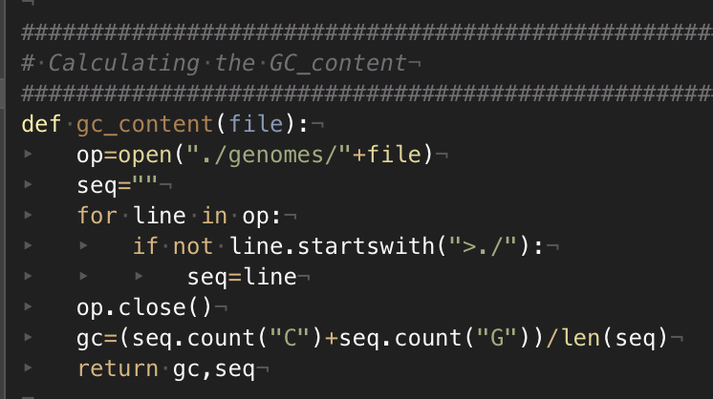
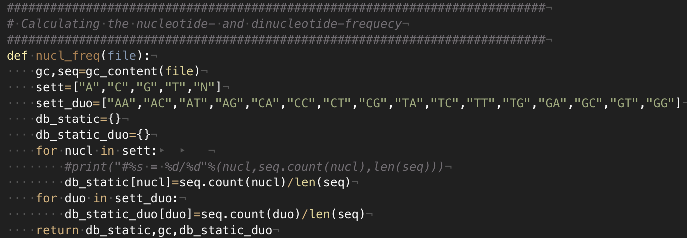
Nucleotide frequency
Notes:
M

Slide 4
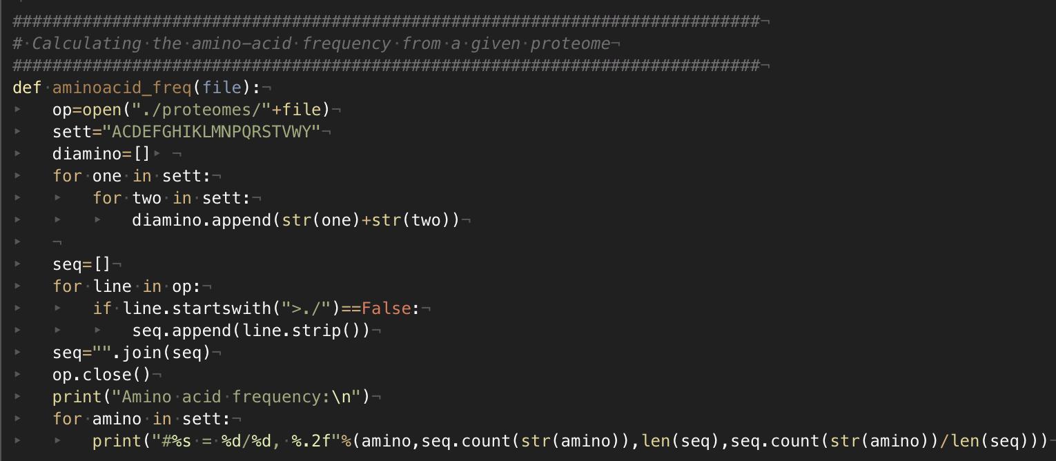
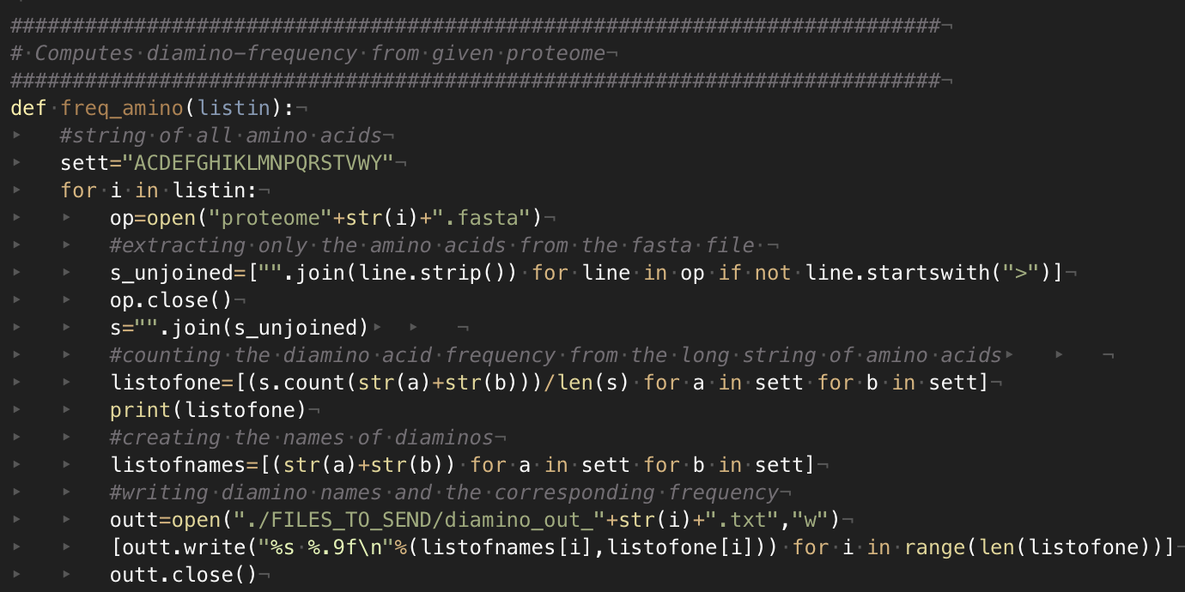
Amino acid frequency
Notes:
M

Slide 5
Nucleotide Frequencies
Notes:
D

Slide 6
Dinucleotide Frequencies
Notes:
D

Slide 7
ORF Finder
Principles of algorithm:
Stretch of DNA flanked by start & end codons
6 reading frames, 3 per strand
Prokaryotic ORFs > 300bp
Eukaryotic ORFs between 100 to 1500bp
Overlap removal using Dynamic Programming (DP)
Notes:
M

Slide 8
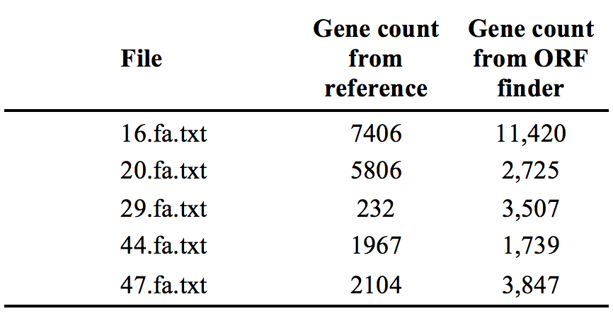
ORF Finder results
Notes:
M
Significantly different numbers from our ORF finder as compared to the reference (NCBI BLAST).

Slide 9
Performance analysis
Example: 44.fa.txt (L. gelidum)
Notes:
M
No True Negative due to database not including true negative references.

Slide 10
Performance analysis (F1-Score)

Slide 11
Distance Matrix
Distance method used
Show tree
Compare tree with older tree
Notes:
D

Slide 12
Distance Calculation methods
Screenshots
Notes:
D

Slide 13
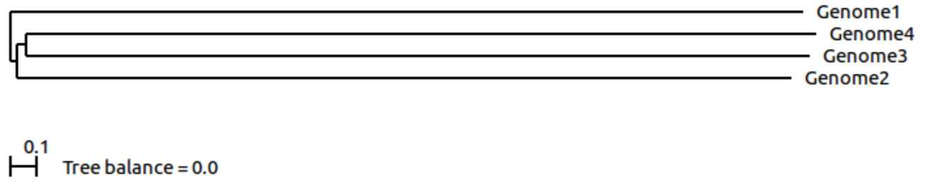
Distance Trees
ScoreDist phylogenic reconstruction calculated from dinucleotide frequencies.
ScoreDist phylogenic reconstruction calculated using GLIMMER (old method).
Notes:
D
Why scoredist, why dinucleotide frequencies

Slide 15
Thank you!

