Slide 1
Comparative Genomics Final Project
Maximilian Senftleben
Zhong Hao Daryl Boey

Slide 2
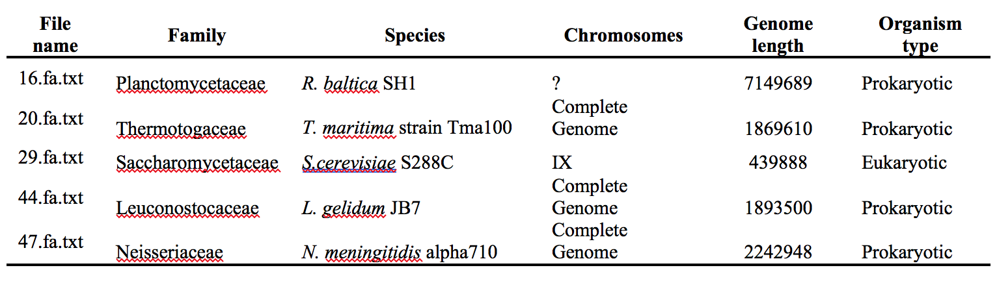
Summary of genomes
Notes:
D

Slide 3
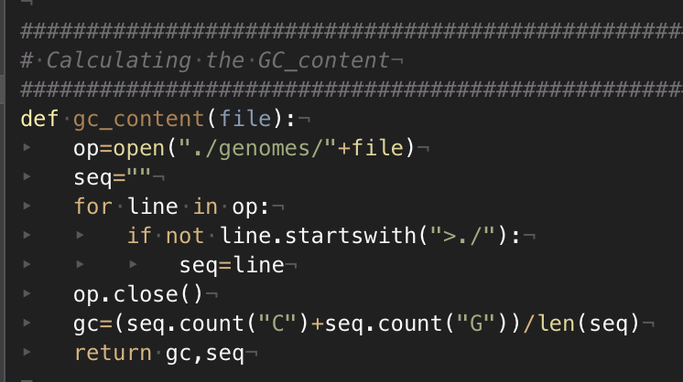
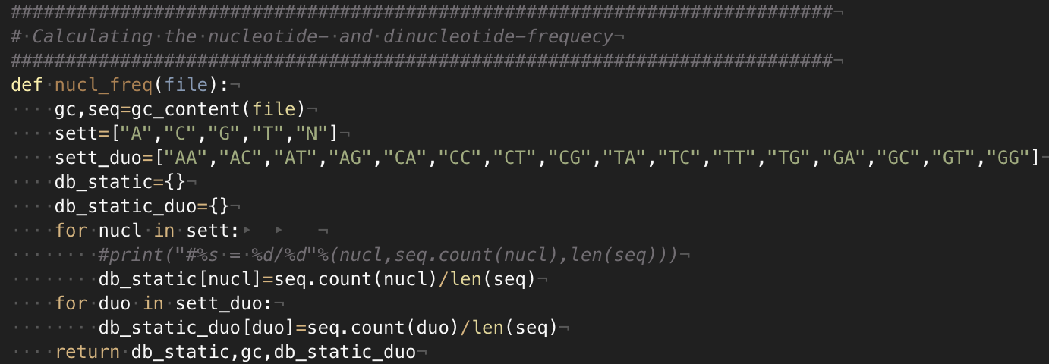
Nucleotide frequency
Notes:
M

Slide 4
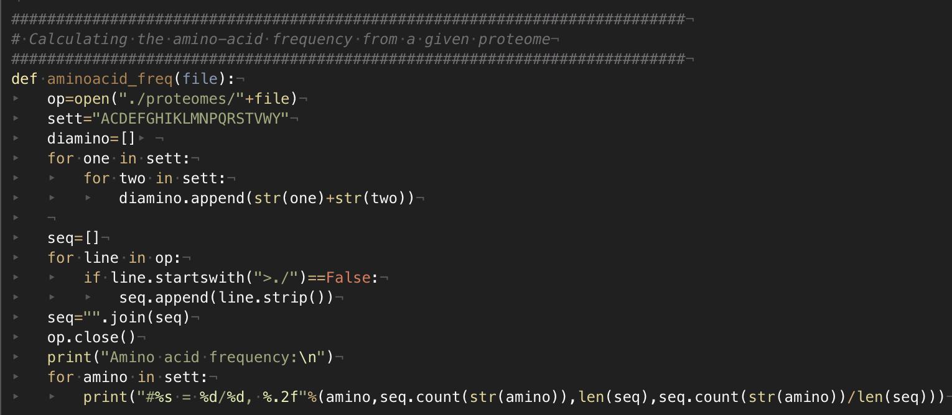
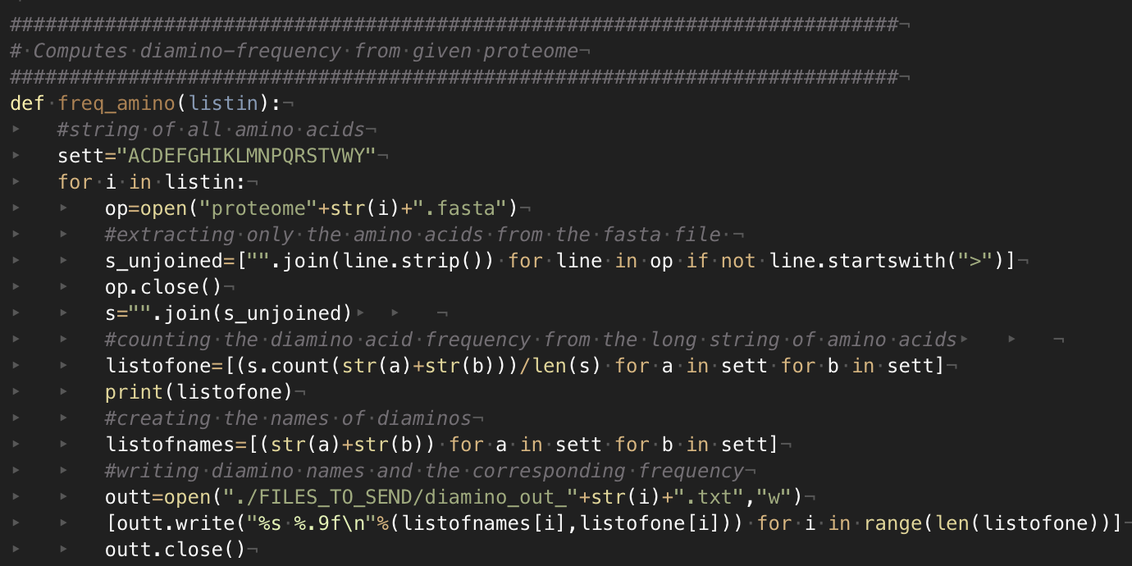
Amino acid frequency
Notes:
M

Slide 5
Nucleotide Frequencies
Notes:
D
Fairly even distribution across all the genomes, with 16 and 47 having slightly more enriched GC content compared to the others.

Slide 6
Dinucleotide Frequencies
Notes:
D
Same GC distribution visible here, apart from that fairly normal distribution.

Slide 7
ORF Finder
Principles of algorithm:
Stretch of DNA flanked by start & end codons
6 reading frames, 3 per strand
Prokaryotic ORFs > 300bp
Eukaryotic ORFs between 100 to 1500bp
Overlap removal using Dynamic Programming (DP)
Notes:
M

Slide 8
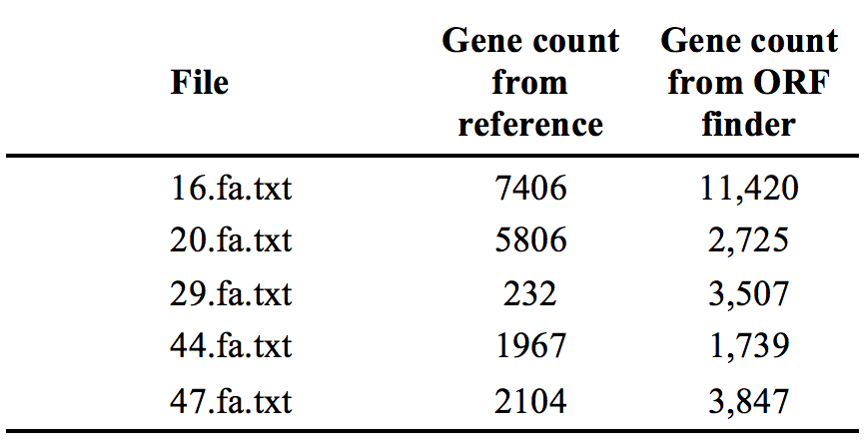
ORF Finder results
Notes:
M
Significantly different numbers from our ORF finder as compared to the reference (NCBI BLAST).

Slide 9
Performance analysis
Example: 44.fa.txt (L. gelidum)
Notes:
M
No True Negative due to database not including true negative references.

Slide 10
Performance analysis (F1-Score)

Slide 11
3 Distance measures
Multiple distance measures used:
GC value distance
Nucleotide value distance &
Dinucleotide value distance
Notes:
D
Unsure which metric was going to be the most efficient, so produced distance matrices for all 3, followed by plotting and comparison.
Abs = absolute value, has the same effect as square followed by square root.

Slide 12
Best reconstructed phylogenic tree
Notes:
D
Dinucleotide frequency based distance
Important to note that the tree has been normalized, by multiplying all values by 1000, to make branch lengths more distinguishable. Prior attempts at normalizing using min/max or l1/l2 methods within scikitlearn were hard to implement due to inconsistent changes to values that should have been the same (16/20 and 20/16).

Slide 13
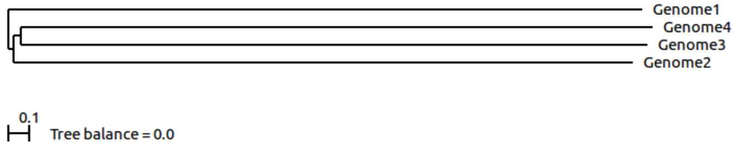
Distance Trees
ScoreDist phylogenic reconstruction calculated from dinucleotide frequencies.
ScoreDist phylogenic reconstruction calculated using GLIMMER (old method).
Notes:
D
Why scoredist -> default distance correction, was complicated to use more flags with “R” function required to feed distance matrices to Belvu.
Both nucleotide and dinucleotide distance measures gave the same tree structure, with slightly varying branch lengths.

Slide 14
Thank you!

