Slide 1

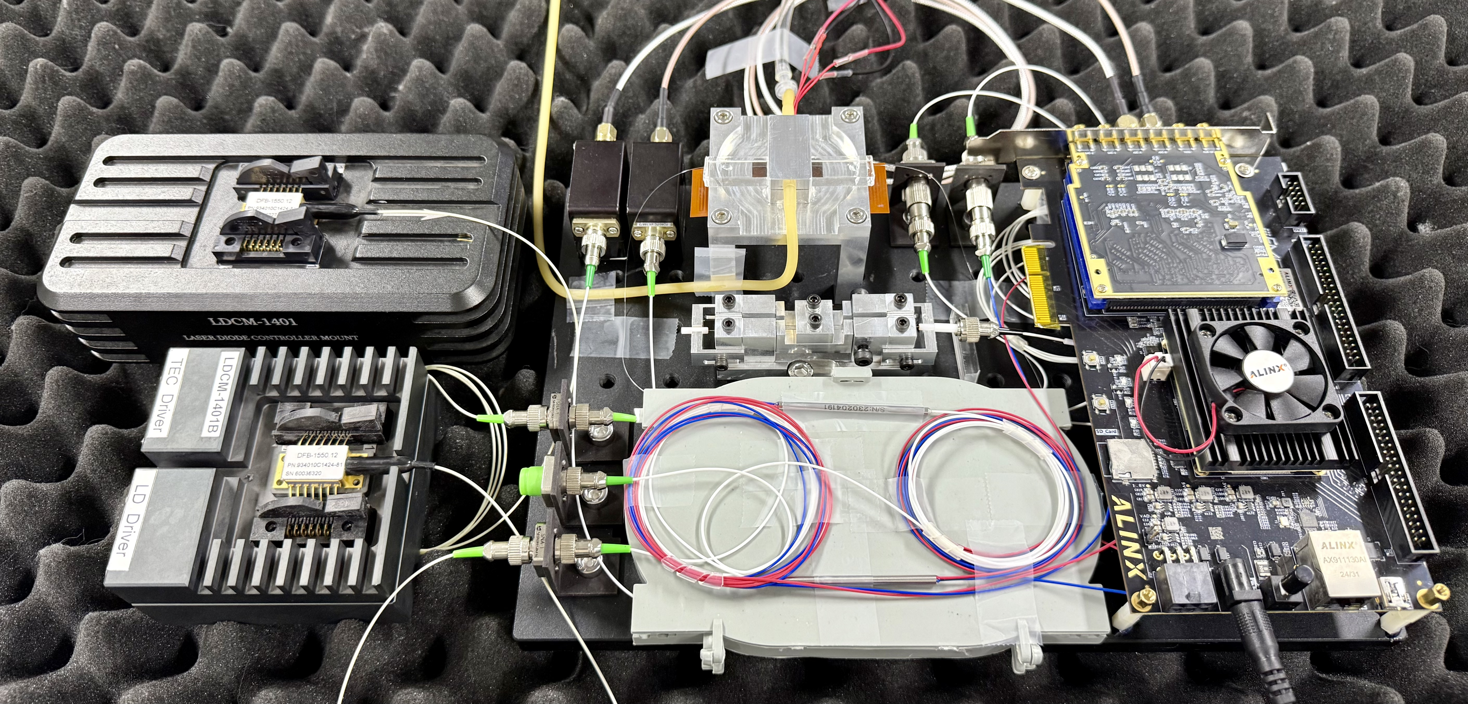

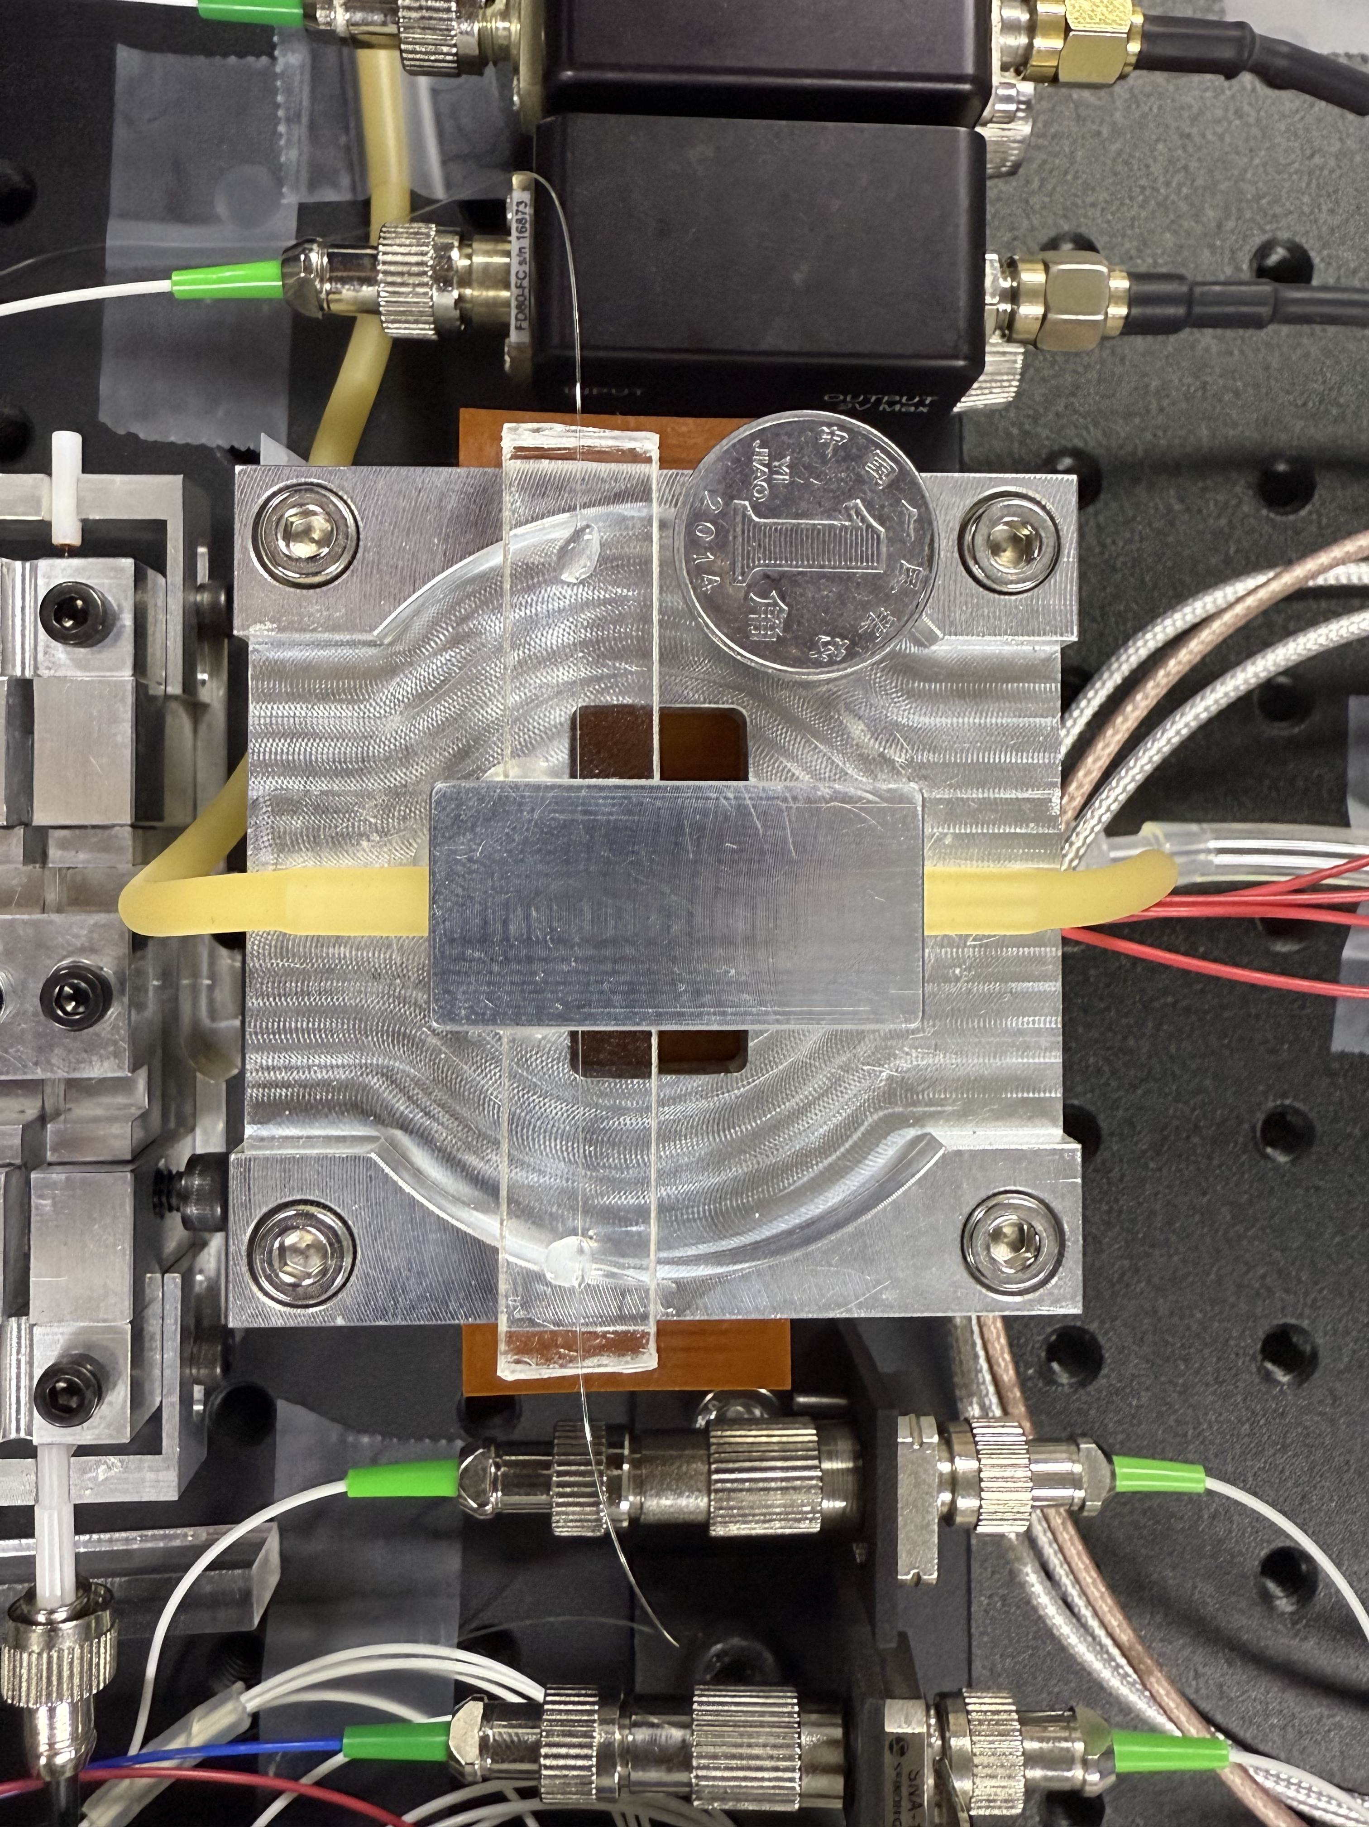
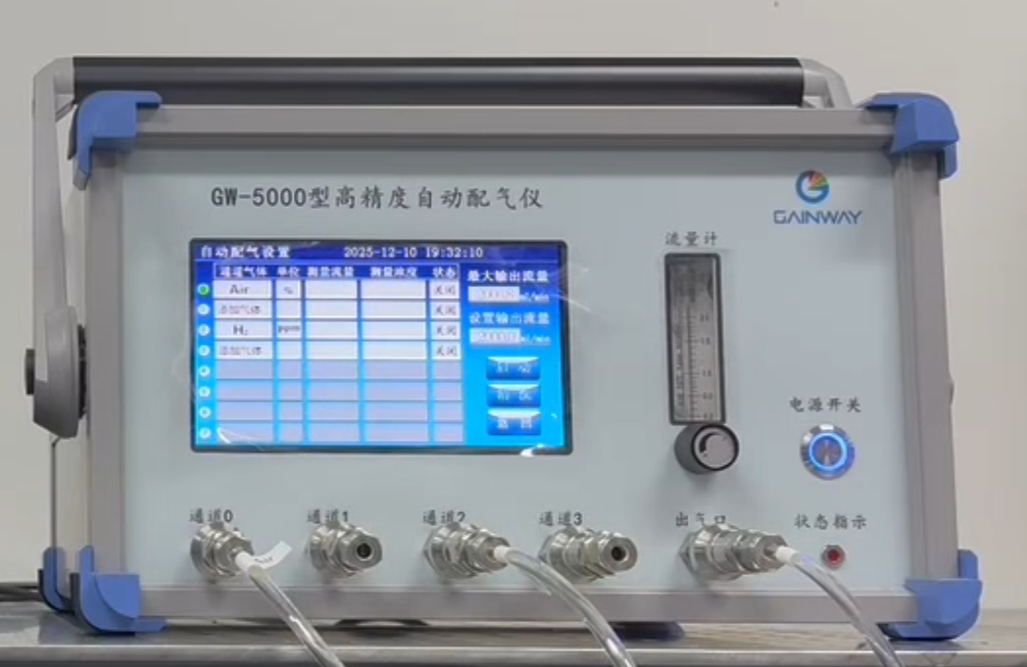
INTRODUCTION
FPGA-Based Adaptive High-Precision
Hydrogen Sensing System
Muyan Gao, Lina Ma, Xiaze Shu
University of Electronic Science
and Technology of China
FPGA · SYSTEM ARCHITECTURE
FPGA hardware and optical interfaces
For hydrogen-leak monitoring, this FPGA-based platform digitizes the resonance response of a hydrogen-sensitive microcavity and integrates digital laser locking, real-time beat readout, thermal management and UDP host visualization.
Digital laser lock
Beat readout
Thermal / UDP
PD1 → feedback loop
PD2 → ADC / FFT
Temperature → PID
C
Evidence across three core functions
R
R
Sweep / PI²D / DAC
Coarse / DDC / peak
Drift correction / UDP
E
E
① DIGITAL LOCKING | Digital validation
A
S
456 → 2.26–2.64
XCAU15P FPGA · 250 MSPS acquisition · 100 MHz processing · concurrency
T
U
I
L
Error RMS / ADC codes
FPGA architecture and three functions
V
T
Four slope and initial-error cases; scanning, acquisition, locking and reacquisition.
E
Sensing cavity and GW-5000 gas mixer
② BEAT READOUT | simulation + bench
1 NEW CAPABILITY | Digital laser servo
Three key technical challenges
FPGA finds the resonance slope; PI²D and DAC close the feedback loop, with automatic reacquisition.
D
5 kHz – 25 MHz
1 Stable laser-frequency locking
E
S
Selected tested frequencies
Analog servos are difficult to reconfigure; resonance drift and feedback noise impair long-term slope locking.
I
Crossover offsets ≤3 Hz at tested points; 3.76–4.00 ppm for 1–25 MHz; ~4.780-ms updates.
2 NEW TECHNIQUE | Real-time beat readout
G
2 Wideband, real-time beat readout
250-MSPS capture and 4096-point FFT locate the band; DDC/CIC, Hann window and interpolation refine the peak.
N
③ FPGA INTEGRATION | verification
Manual spectrum-analyzer readout limits online use; fast wideband capture must resolve small frequency changes.
17 checks · WNS +0.006 ns
3 Optoelectronic integration
3 NEW ARCHITECTURE | Integrated FPGA
Joint simulation / implementation
Concurrent locking, FFT and thermal PID with clock-domain handshakes, drift correction and UDP host exchange.
No setup violations (constrained paths); PID thermal model 25→40 °C; UDP dual-view host UI.
Separate servos, analyzers and thermal units add size and wiring, while multi-rate control and drift remain challenging.
Notes:
Data sources: fixed-tone bench readings 5 kHz to 25 MHz; digital closed-loop model RMS 456 to 2.26-2.64 ADC codes; final V4 routed timing WNS +0.006 ns, WHS +0.010 ns. Optical, model and electronic measurements retain their own conditions. See the submitted report and repository data.

Slide 2
背景介绍
基于FPGA的自适应高精度
氢气传感系统
高穆妍、马俪娜、舒夏泽
电子科技大学
FPGA · 系统总体架构
FPGA系统实物连接
面向氢能储运的泄漏监测，本作品以FPGA为核心，将氢敏微腔的谐振频移转化为数字测量结果，并集成激光全数字锁定、拍频实时测频、温度管理与UDP上位机交互。
数字激光锁定
实时拍频测频
温控与数据交互
PD1光强 → 反馈算法
PD2拍频 → ADC / FFT
温度采集 → PID / PWM
C
三项核心功能的验证结果
R
R
寻峰 / PI²D / DAC
粗测 / DDC / 插值
温漂修正 / UDP
E
E
① 激光全数字锁定｜数字闭环验证
A
S
456 → 2.26–2.64
XCAU15P FPGA：250 MSPS采样 · 100 MHz处理 · 并行运行
T
U
I
L
误差RMS / ADC码
FPGA三大核心功能与信号链路
V
T
4类斜边及初始偏差工况；自动扫描、捕获、锁定与失锁重搜。
氢敏微腔与自动配气仪
E
1 新能力｜全数字激光伺服锁定
② 拍频实时测频｜仿真及板测
三项关键技术难点
FPGA自动寻峰、捕获谐振斜边；PI²D经DAC反馈调谐，并在失锁后重搜。
D
5 kHz – 25 MHz
1 激光频率稳定锁定难
E
S
已测离散频点范围
传统模拟伺服器结构封闭、参数调节不灵活；谐振漂移与反馈噪声影响长期稳定锁定。
I
交叠区已测点偏差≤3 Hz；1–25 MHz相对偏差3.76–4.00 ppm；更新约4.780 ms。
2 新技术｜宽频拍频实时测频
G
2 宽频拍频实时分析难
250 MSPS采样和4096点FFT粗定位；DDC/CIC抽取、Hann窗与插值实现精细读频。
N
③ 系统一体集成｜联合验证
频谱仪人工读数不利于在线监测；宽频快速采集与细小频移分辨难以同时兼顾。
17项检查 · WNS +0.006 ns
3 光电系统一体集成难
3 新架构｜光电一体化集成
联合数字时序实现
锁定、测频和温控PID并行运行；跨时钟域交接、温漂修正与UDP上位机交互。
0建立违例（既定约束）；PID模型25→40 ℃；UDP双窗口上位机。
伺服器、频谱仪和温控设备分立，体积及接线复杂；多速率协同与温漂抑制困难。
Notes:
Data sources: fixed-tone bench readings 5 kHz to 25 MHz; digital closed-loop model RMS 456 to 2.26-2.64 ADC codes; final V4 routed timing WNS +0.006 ns, WHS +0.010 ns. Optical, model and electronic measurements retain their own conditions. See the submitted report and repository data.

