Slide 1

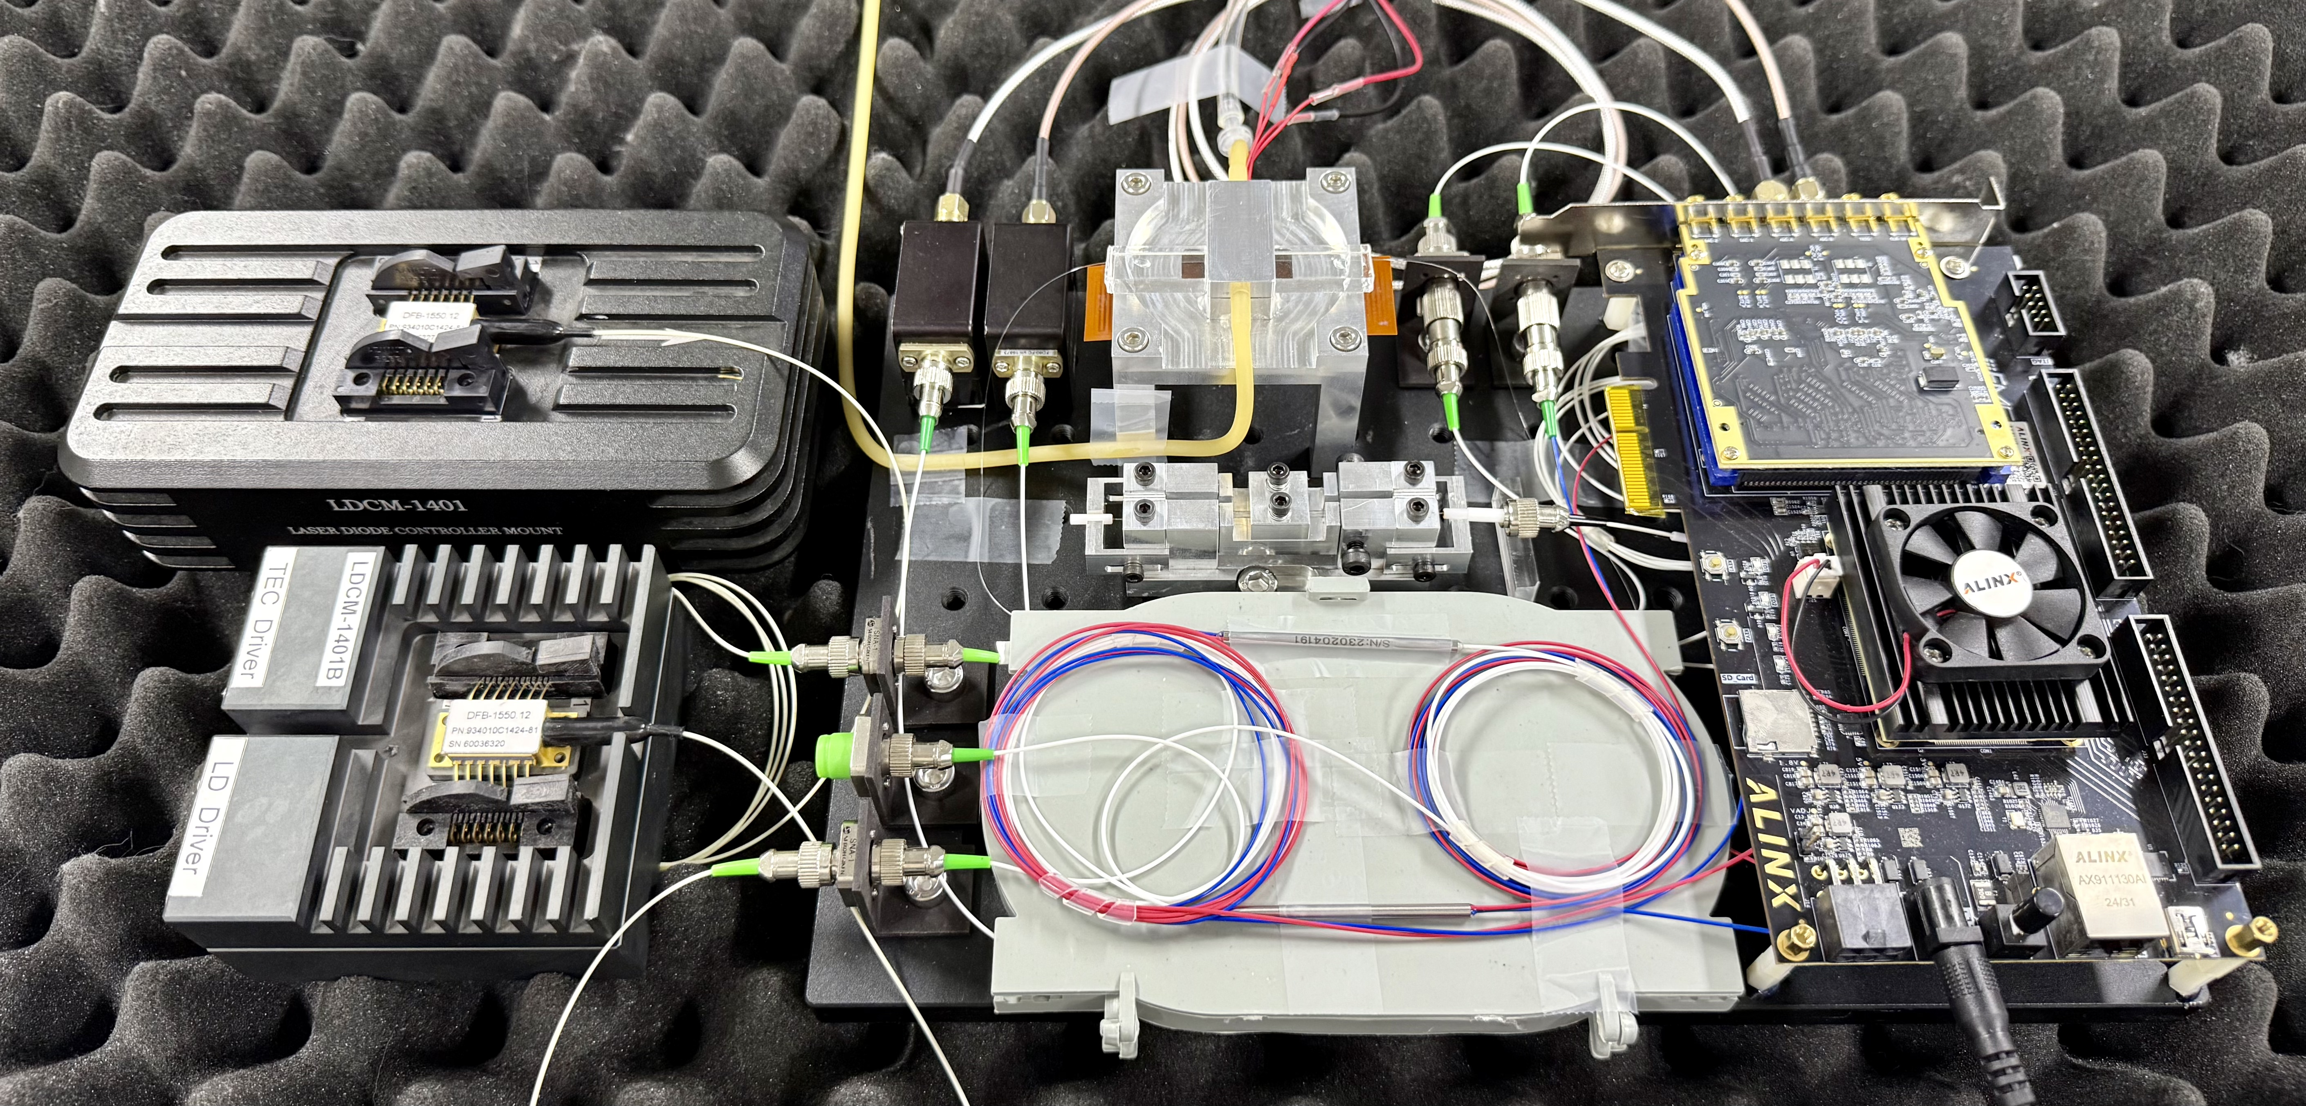

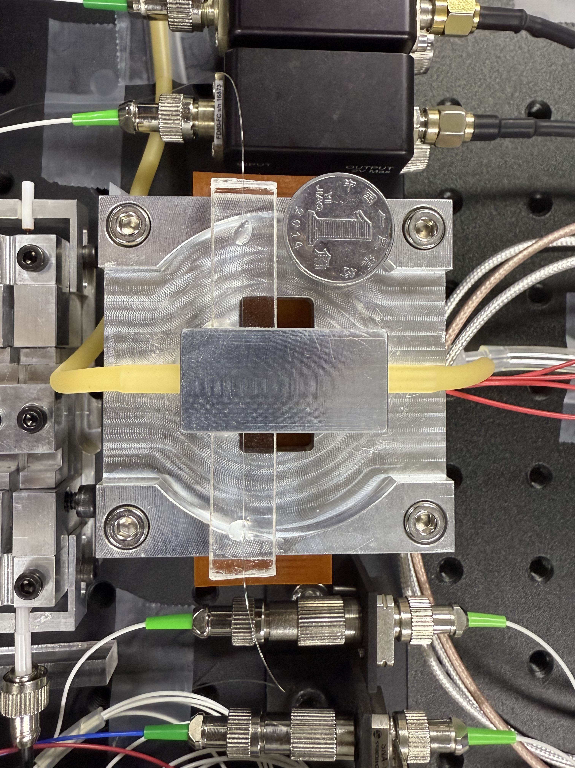
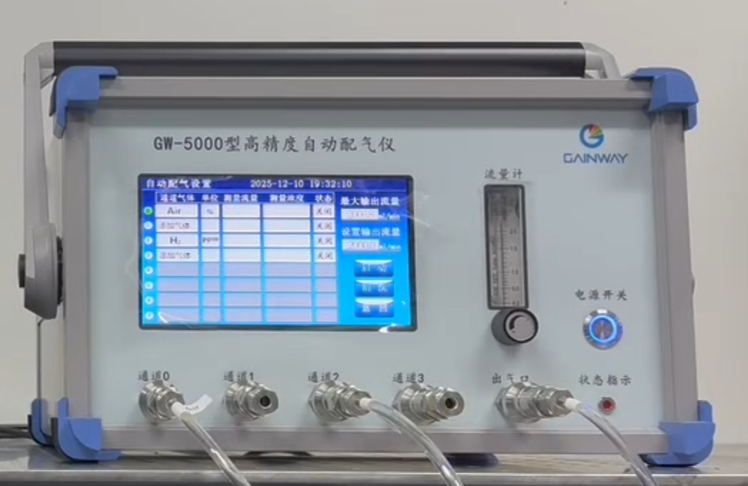
INTRODUCTION
FPGA-Based Adaptive High-Precision
Hydrogen Sensing System
Muyan Gao, Lina Ma, Xiaze Shu
University of Electronic Science
and Technology of China
FPGA · SYSTEM ARCHITECTURE
FPGA hardware and optical interfaces
For hydrogen-leak monitoring, this FPGA-based platform digitizes the resonance response of a hydrogen-sensitive microcavity and integrates digital laser locking, real-time beat readout, thermal management and UDP host visualization.
Digital laser lock
Beat readout
Thermal / UDP
PD1 → feedback loop
PD2 → ADC / FFT
Temperature → PID
C
Evidence across three core functions
R
R
Sweep / PI²D / DAC
Coarse / DDC / peak
Drift correction / UDP
E
E
① DIGITAL LOCKING | Digital validation
A
S
456 → 2.26–2.64
XCAU15P FPGA · 250 MSPS acquisition · 100 MHz processing · concurrency
T
U
I
L
Error RMS / ADC codes
FPGA architecture and three functions
V
T
Four slope and initial-error cases; scanning, acquisition, locking and reacquisition.
E
Sensing cavity and GW-5000 gas mixer
② BEAT READOUT | simulation + bench
1 NEW CAPABILITY | Digital laser servo
Three key technical challenges
FPGA finds the resonance slope; PI²D and DAC close the feedback loop, with automatic reacquisition.
D
5 kHz – 25 MHz
1 Stable laser-frequency locking
E
S
Selected tested frequencies
Analog servos are difficult to reconfigure; resonance drift and feedback noise impair long-term slope locking.
I
Crossover offsets ≤3 Hz at tested points; 3.76–4.00 ppm for 1–25 MHz; ~4.780-ms updates.
2 NEW TECHNIQUE | Real-time beat readout
G
2 Wideband, real-time beat readout
250-MSPS capture and 4096-point FFT locate the band; DDC/CIC, Hann window and interpolation refine the peak.
N
③ FPGA INTEGRATION | verification
Manual spectrum-analyzer readout limits online use; fast wideband capture must resolve small frequency changes.
17 checks · WNS +0.006 ns
3 Optoelectronic integration
3 NEW ARCHITECTURE | Integrated FPGA
Joint simulation / implementation
Concurrent locking, FFT and thermal PID with clock-domain handshakes, drift correction and UDP host exchange.
No setup violations (constrained paths); PID thermal model 25→40 °C; UDP dual-view host UI.
Separate servos, analyzers and thermal units add size and wiring, while multi-rate control and drift remain challenging.
Notes:
Data sources: fixed-tone bench readings 5 kHz to 25 MHz; digital closed-loop model RMS 456 to 2.26-2.64 ADC codes; final V4 routed timing WNS +0.006 ns, WHS +0.010 ns. Optical, model and electronic measurements retain their own conditions. See the submitted report and repository data.

