Slide 1
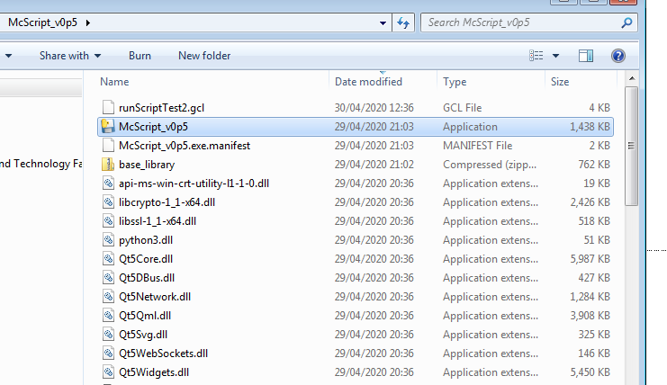
← Open this in Notepad++
Execute this →

Slide 2
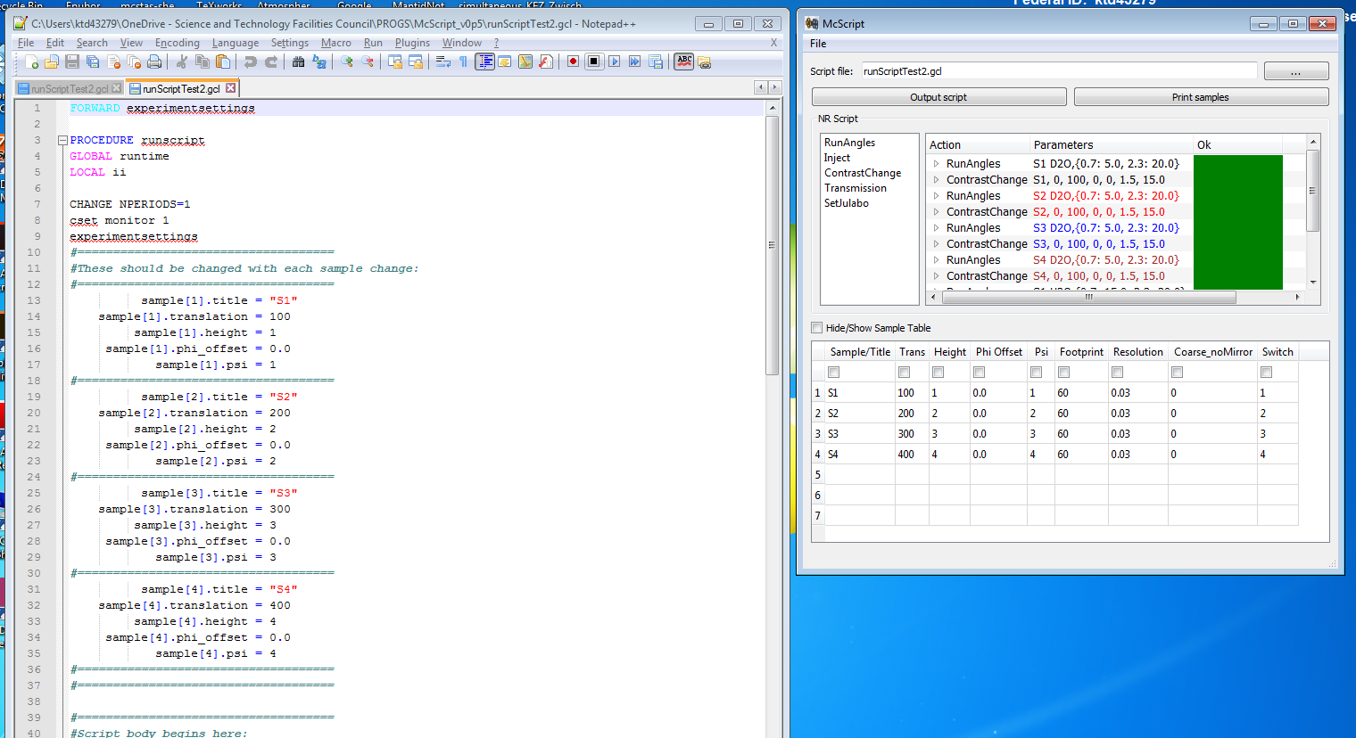
“Output script” updates the script file on the left and saves, so that it can be executed immediately
Please ignore this list→
Corresponding script (GCL in this case, but Python also easily possible)
define samples here

Slide 3
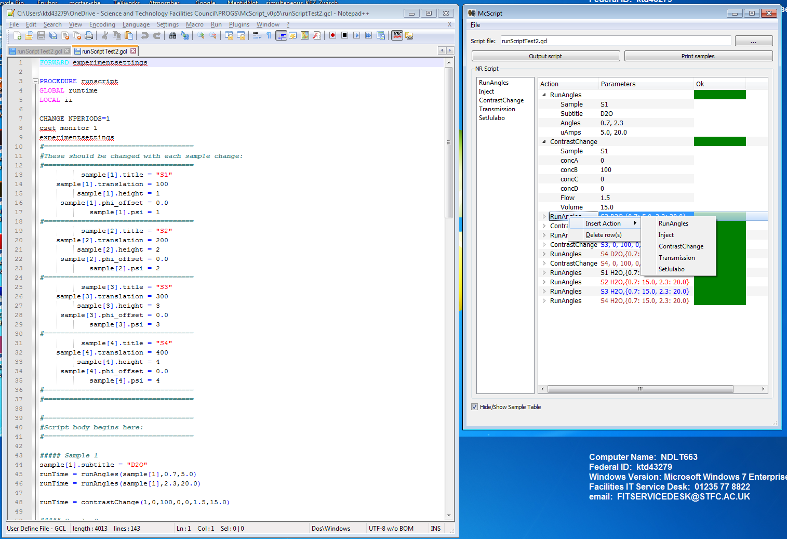
Tree structure for compact view
Right click for context menu (insert or delete rows/actions)
Samples available in drop down box
Colour coding by sample for readability
Drag&drop for re-arranging rows (hold Shift while dragging to move, rather than copy)
Table can be saved and loaded (File menu)

