Slide 1
Implementation so far

Slide 2
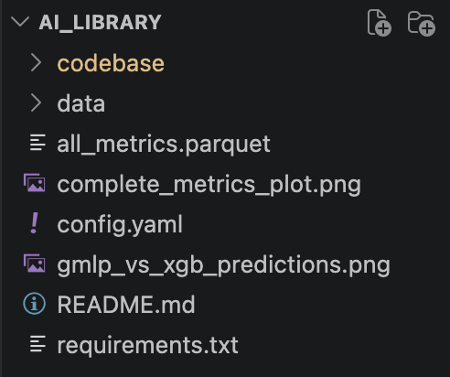
Folder structure:

Slide 3
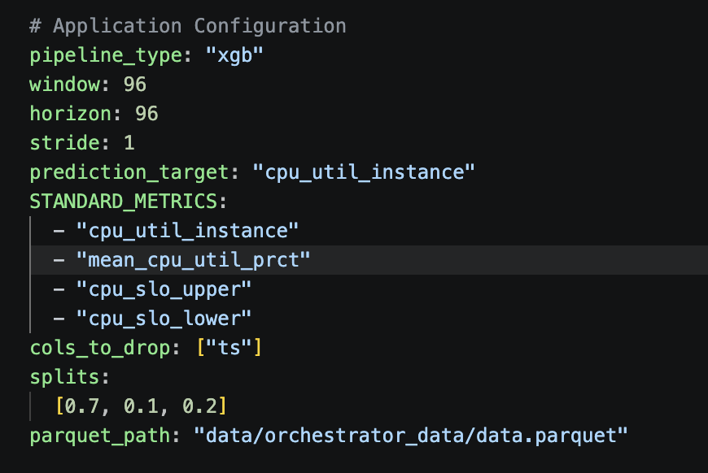
config.yaml
Can be xgb or gmlp right now
right now only allows for one target
StandardMetrics added for the recorder.py, not sure how this generalizes
cols to drop always includes the timestamp column name + other columns you might wanna drop
Parquet path (can be kept that way it shouldnt really change)

Slide 4
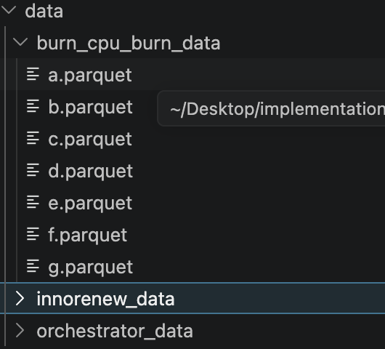
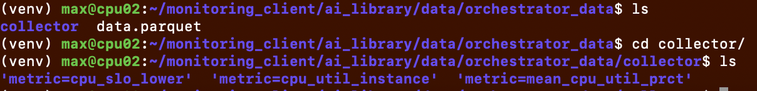
Data folder
Includes the datasets for burn cpu and inorrenew (didnt add inorrenew yet tbh but i will at some point)
Important part is orchestrator data:
-here the data.parquet is written to by reader
-recorder records data to orchestrator_data/collector

Slide 5
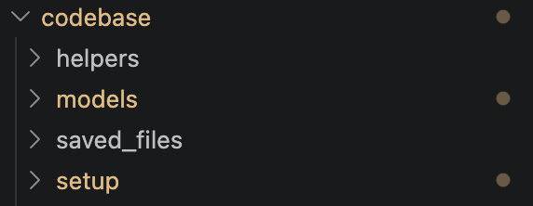
Codebase folder

Slide 6
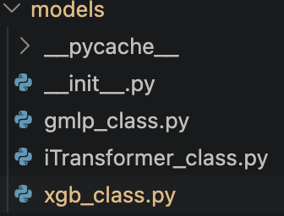
Codebase.models & codebase.saved_files
Model classes that include
-preprocessing train data function
-preprocessing infer data function
-train and infer functions with these data as input & model + rmse or predicitons as output
For each model
The train methods automatically save their outputs and params to saved_files where infer methods load them from

Slide 7
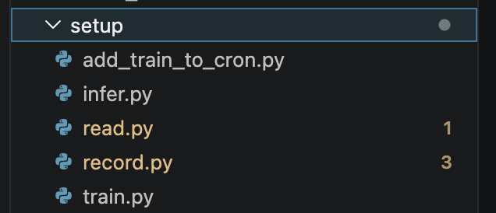
Codebase.setup
Includes read and record functions. Record must be started manually at this moment (probably should be automatic at some time)
Train.py calls read –> new parquet and trains on the entire parquet.
Infer.py calls read -> new parquet and infers the next horizon
Where to save inference to and how to test if it works correctly?
Saved files / data as infer.parquet or something like that?
Right now inference is just printed
Add_train_to_cron runs train each 30 min (hardcoded right now) by adding to cron jobs

Slide 8
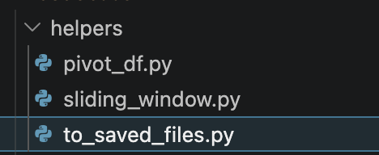
Codebase.helpers
-helper functions
-pivot df to pivot the parquet from recorder (it needs to be pivoted to shape timesteps rows x feature columns)
-a sliding window function for the model files
-to_saved_files is used to store trained models and params in the saved_files folder

