Slide 1
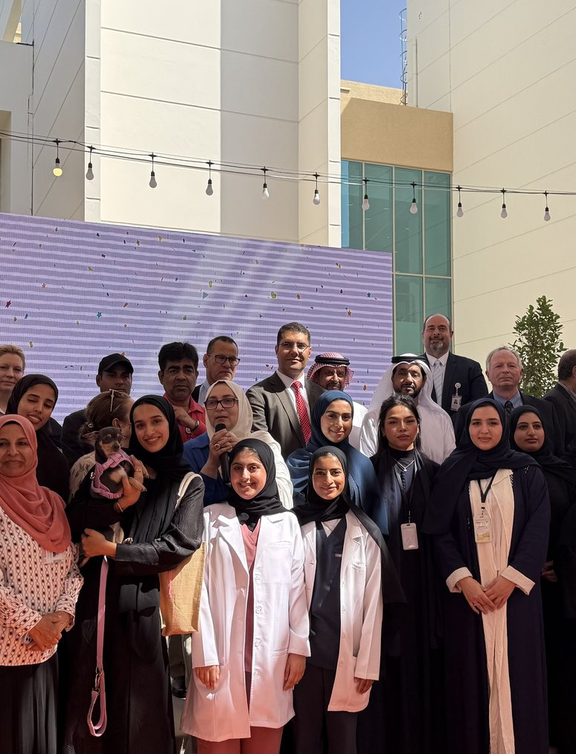

CAVM CLUB
Website Operating Guide
How to use the public website, admin dashboard, visitor forms, and content updates.
Live site: cavm-opportunity-hub-uaeu-2026.netlify.app
Prepared for CAVM Club

Slide 2
SITE PURPOSE
What the website is built to do
Public presence
Opportunity hub
Admin dashboard
- Show club history, achievements, media, events, members, alumni, and partners.
- Give CAVM Club a professional home beyond social media.
- Collect internships, volunteering, research, visits, scholarships, programs, and jobs.
- Help students find opportunities by sector and interest.
- Review visitor submissions.
- Add and edit events, opportunities, achievements, media, members, and alumni.
CAVM Club Website Operating Guide
02

Slide 3
VISITOR PATHS
Where visitors go and what they submit
1
Register Interest
3
Partner With Us
Students select sectors, opportunity types, locations, availability, and goals. Their form appears under Admin -> Registered students.
External partners submit organization details and opportunity information. These appear under Admin -> Partner submissions.
2
Event Registration
4
Contact and Opportunity Interest
On an event detail page, students submit name, email, student ID, phone, and notes. These appear under Admin -> Contact messages.
Questions, contact messages, and opportunity interest forms appear under Admin -> Contact messages.
CAVM Club Website Operating Guide
03

Slide 4
ADMIN ACCESS
How to sign in
Admin login link
Important security note
cavm-opportunity-hub-uaeu-2026.netlify.app
/admin/login
Only trusted committee/admin members should receive these credentials. If the site is shared broadly, change the admin password in Netlify environment variables.
Username: CAVM_ADMIN
Password: CAVM_ADMIN
CAVM Club Website Operating Guide
04

Slide 5
VISITOR SUBMISSIONS
Where each form appears in admin
Visitor form
Admin page
What to review
Register Interest
/admin/students
Student sectors, goals, availability, matches
Partner With Us
/admin/partner-submissions
Partner details, opportunity proposal, approval status
Contact form
/admin/contact-submissions
Questions, media requests, collaboration messages
Opportunity interest
/admin/contact-submissions
Student name, email, target opportunity, note
Event registration
/admin/contact-submissions
Event title, student details, phone, message
CAVM Club Website Operating Guide
05

Slide 6
CONTENT MANAGEMENT
How admins update the website
Opportunities
Events
Achievements, media, members
- Add student opportunities.
- Set type, sectors, deadline, contact, source, and status.
- Partner submissions can be approved into opportunities.
- Create events with date, time, location, image, and registration URL.
- Use statuses: upcoming, closing soon, completed, closed, cancelled.
- Upcoming and active events show first.
- Add achievements and public highlights.
- Use approved images only.
- Keep member/alumni details consent-based.
CAVM Club Website Operating Guide
06

Slide 7
EVENT WORKFLOW
From planned event to archive
1
Create or edit event
2
Collect registrations
3
Close after event
Go to Admin -> Events. Add title, date, time, location, category, status, image, and description.
Keep the event active as upcoming or closing soon. Visitors can register from the event detail page.
After the event passes, change the status to completed or closed so visitors understand registration is no longer open.
Tip: event registrations are saved as Contact messages because they are direct visitor requests for club follow-up.
CAVM Club Website Operating Guide
07

Slide 8
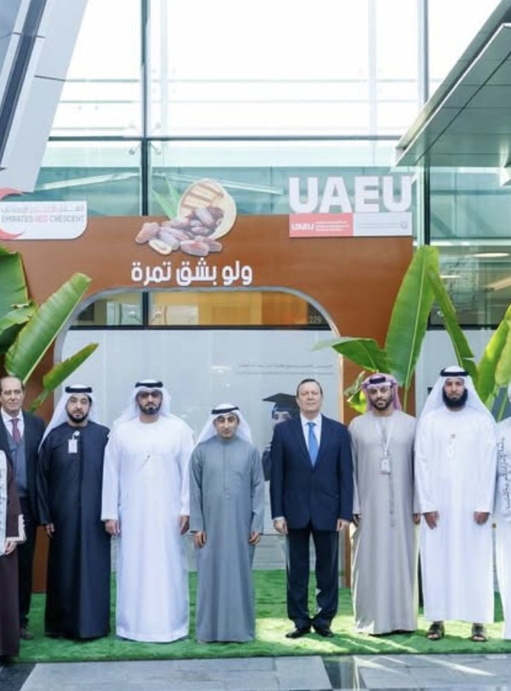
MEDIA AND ARCHIVE
Keep every photo in the right event album
The Media page groups supplied photos by event. When a new large album is added, keep the photos tied to that exact event so visitors can open the event and full album together.
For small public highlights, use Admin -> Media. For full albums, ask the site maintainer to import and optimize the source folder.
CAVM Club Website Operating Guide
08

Slide 9

CONTACT AND LINKS
How the official link hub works
Contact page
- Combines club email, official links, social pages, partner access, and the contact form.
- Every square now has a clear icon for faster scanning.
- Use this page as the link to share in groups.
Share this link
cavm-opportunity-hub-uaeu-2026.netlify.app
/contact
CAVM Club Website Operating Guide
09

Slide 10
ADMIN CHECKLIST
Before and after each update
1
Check public page
2
Check admin list
3
Check forms
Open the page visitors will see. Confirm title, image, date, status, and buttons.
Open the matching admin section and confirm the new entry is visible.
Submit a small test when needed and confirm it appears in the right admin inbox.
4
Keep status current
5
Use approved images
6
Share the right link
Move events from upcoming to completed or closed after they pass.
Photos should match the event and follow consent rules.
Use Contact & Links for groups and the specific event/opportunity page for targeted calls.
CAVM Club Website Operating Guide
10

