Slide 1
EcoJAX
A framework for non-episodic eco-evolutionary environments and agents

Slide 2




Reinforcement Learning Framework :
Agent
𝑡
$$a_{t}= π(s_{t})$$
$$s_{t}$$
$$r_{t}$$
$$a_{t}$$
𝑡
𝑡
𝑡
Environment

Slide 3


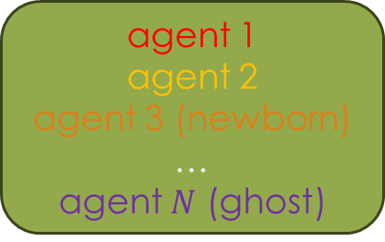


agents metrics
Agents Species
Species’ reproduction dynamics Agents Reactions
agent 1
agent 2
agent 3 (ghost)
…
agent $N$ (ghost)
agent 1
agent 2
agent 3 (newborn)
…
agent $N$ (ghost)
Agent $i$act : $a_{t}^{i}=π_{t}^{i}\left(o_{t}^{i}\right)$
Agent $i$learn
$∀ i≤ N$
$${\left(o_{t+1}^{i}\right)}_{i≤N}$$
$${\text{Reprod}}_{t}$$
$${\left(a_{t}^{i}\right)}_{i≤N}$$
Eco-Environment
env metrics
$${\text{Reprod}}_{t}= \{i : {\text{parents}}_{t}\text{(}\text{i}\text{) | }i∈ {\text{Newborns}}_{t}\}$$

