Slide 1
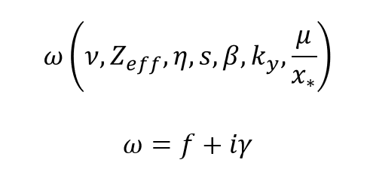
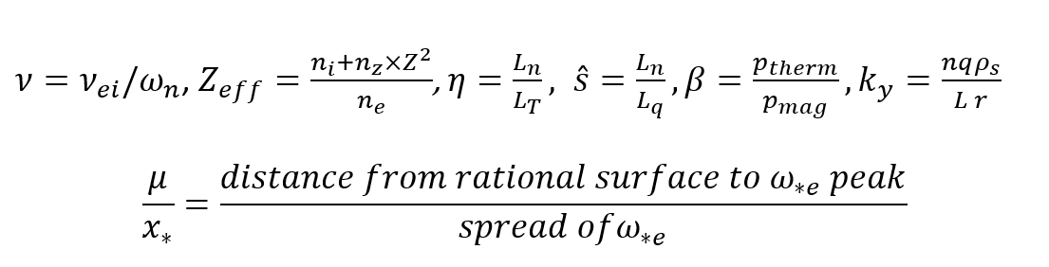
Parameter dependents
Where:

Slide 2

Dataset from CORI simulations
Unstable: 800,000
Stable: 2,300,000

Slide 4
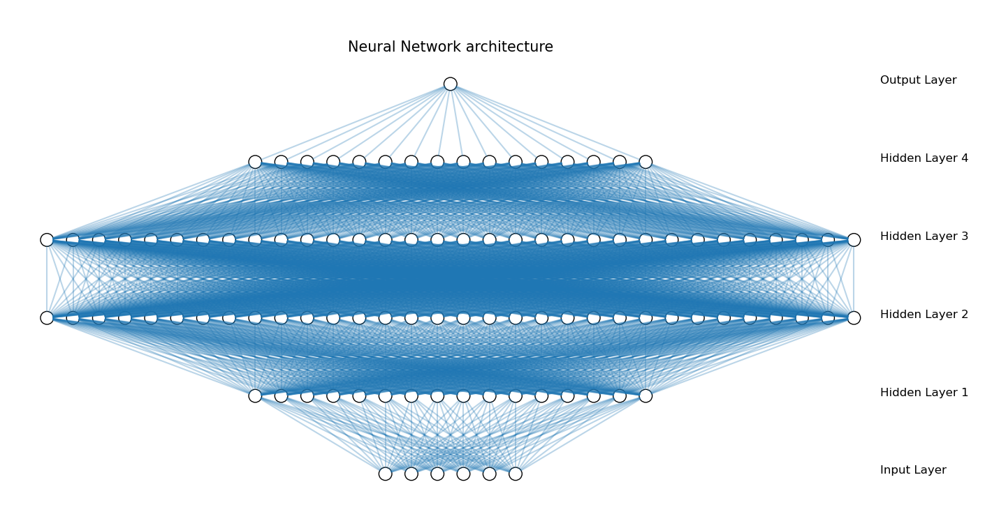
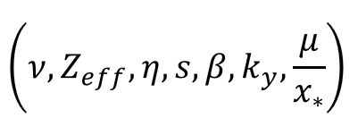

Slide 6
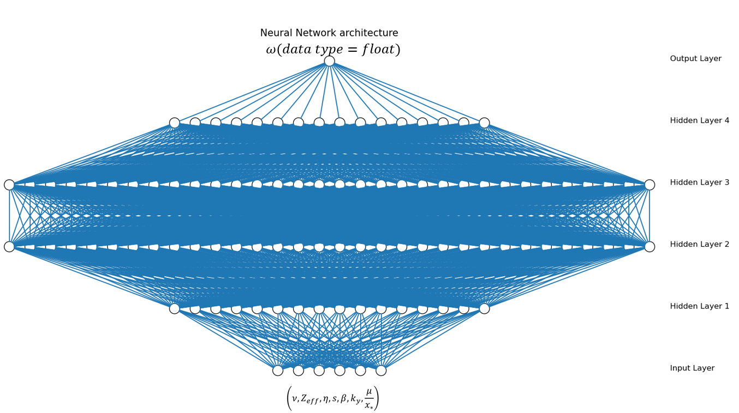
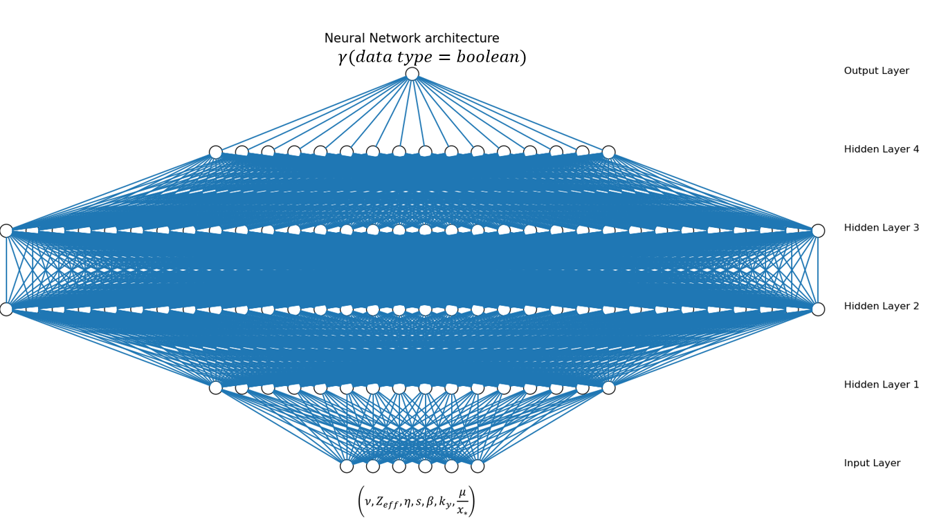
Stable/unstable

Slide 7
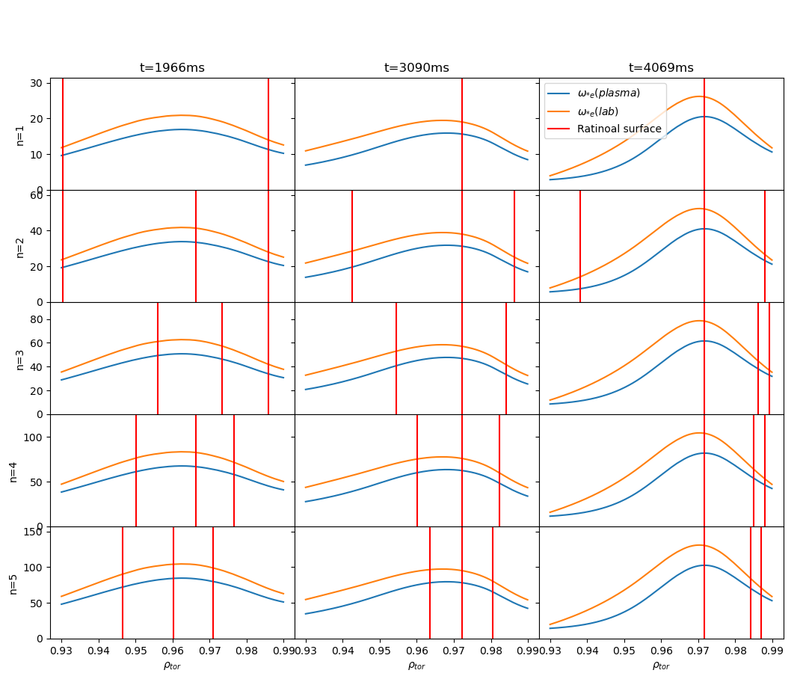
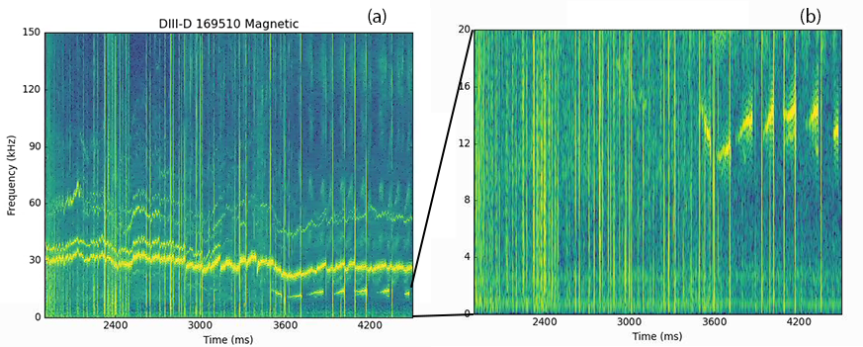
Vary profile
Match with experiment?
No
Yes
Ideal profile

Slide 8
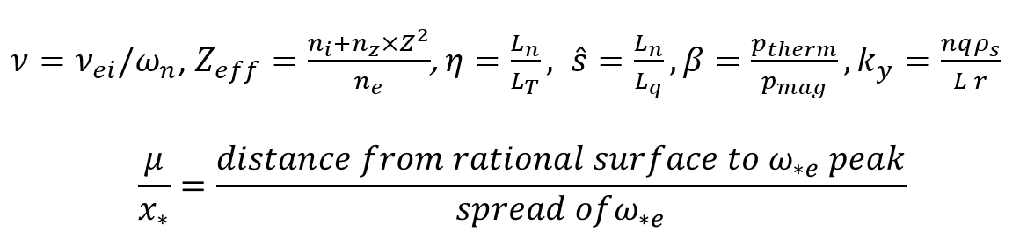
Vary profile
,

Slide 9
Questions
Normalization
Hyper-parameter tunning
output two different data type(float, bool)

Slide 10
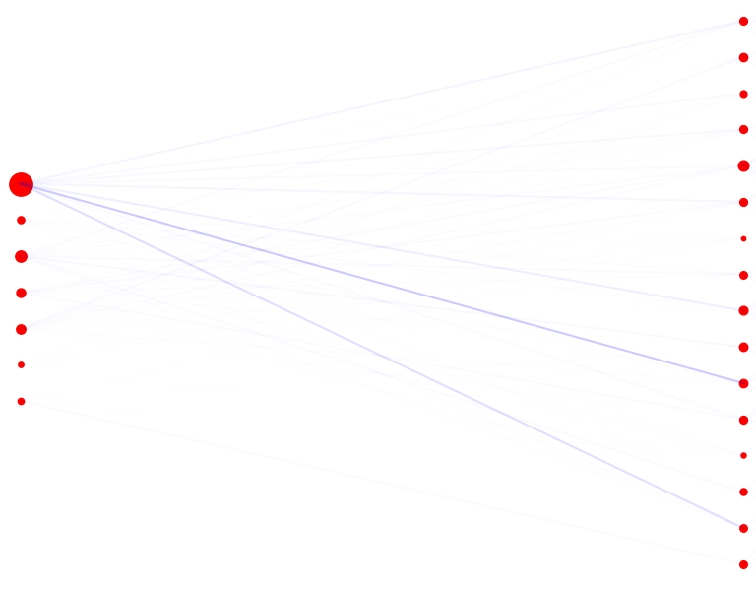
Top to bottom: nu, zeff,eta,shat,ky,mu_norm

Slide 11
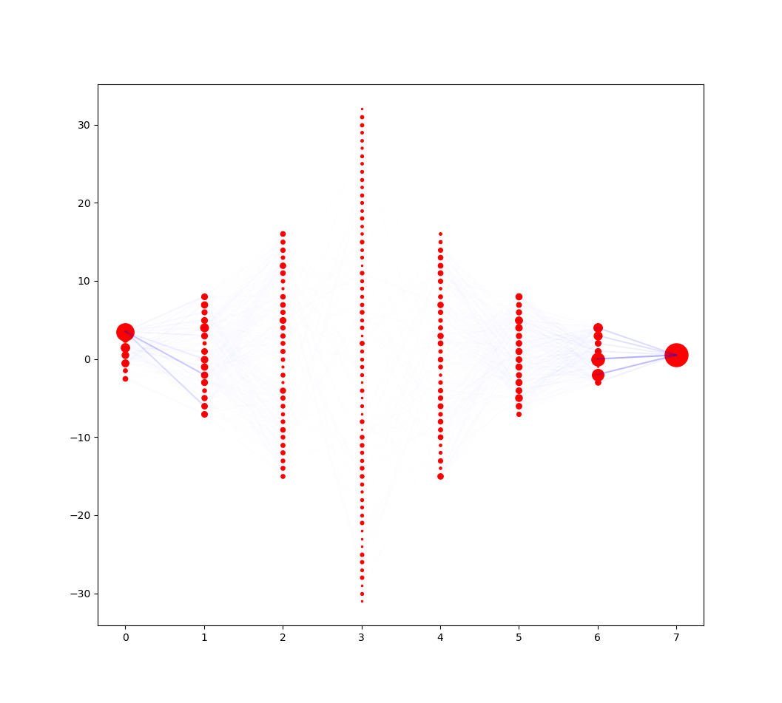

Slide 12
For stable unstable:
['nu', 'zeff', 'eta', 'shat', 'beta', 'ky', 'mu_norm'] =
[0.6086171 0.06476105 0.09443569 0.08774152 0.06328316 0.03368932 0.04747209]

Slide 13
https://stackoverflow.com/questions/43979449/higher-validation-accuracy-than-training-accurracy-using-tensorflow-and-keras

