Slide 2
Steps
1. vary q to find rational surfaces
2. vary ne, te to find stability
3. vary doppler to match frequency

Slide 3
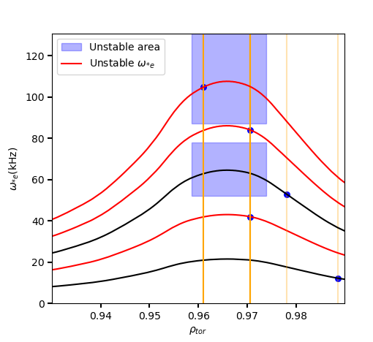
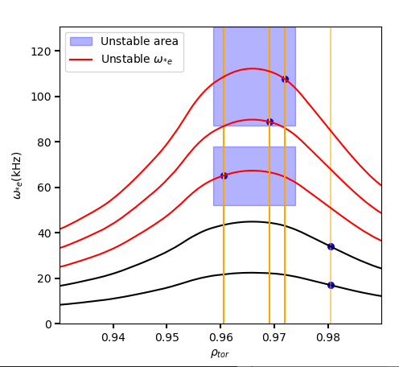
q_scale=1.05
q_scale=1.0

