Slide 1
Neural network accelerates the reduced model SLiM
Max Curie

Slide 2
Overview
Motivation
Data generation and distribution
Methods
Benchmark
Application

Slide 3
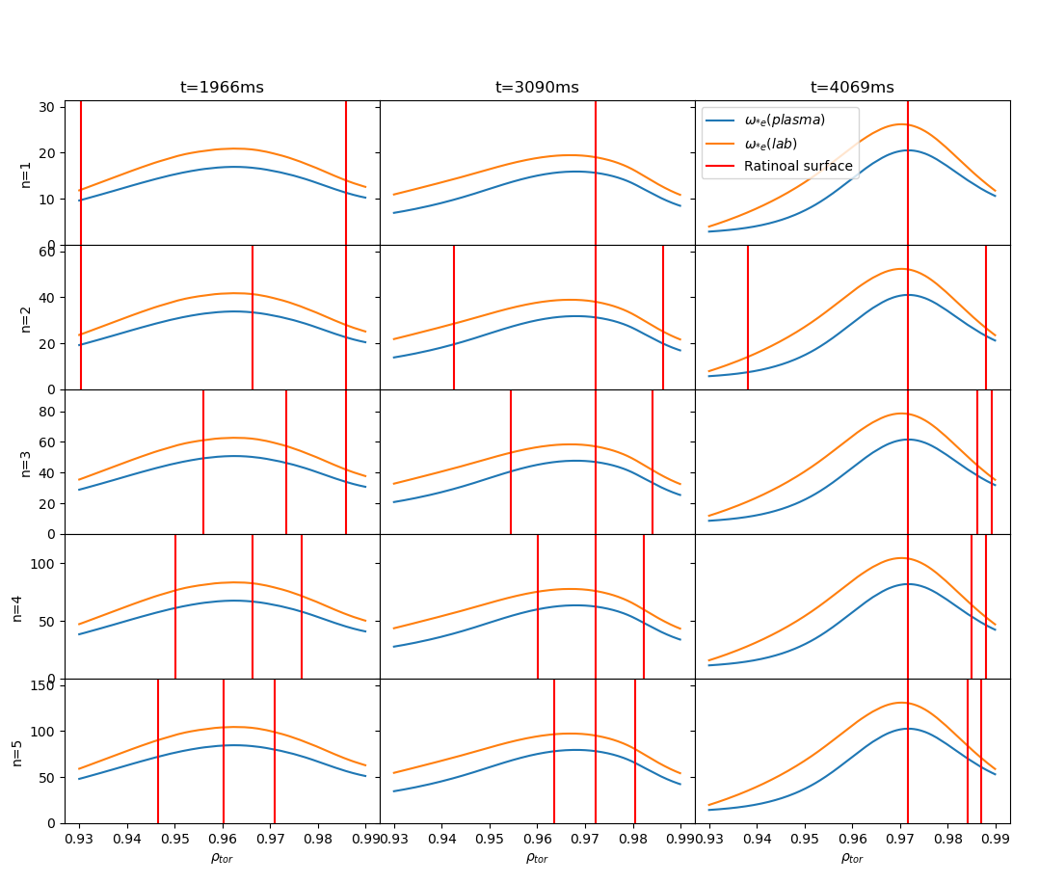
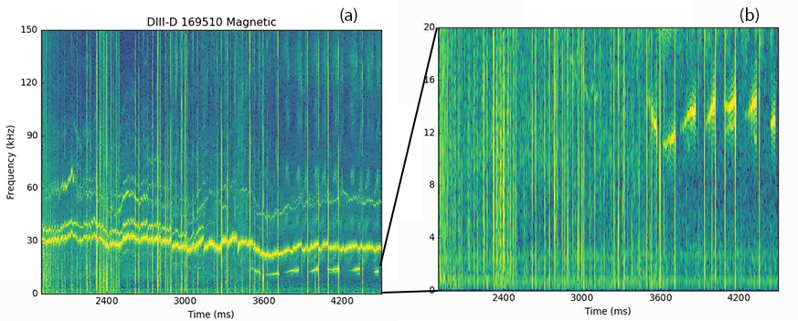
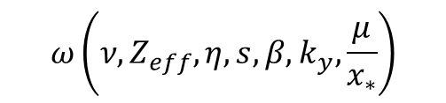
$$ω\left(ν,Z_{eff},η,s,β,k_{y},\frac{μ}{x_{∗}}\right)$$
Motivation
Vary profile
Match with experiment?
No
Yes
Ideal profile

Slide 4
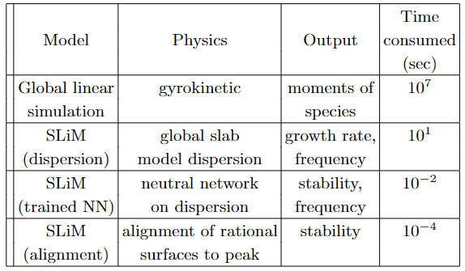
Updated list of models
Motivation
4

Slide 5
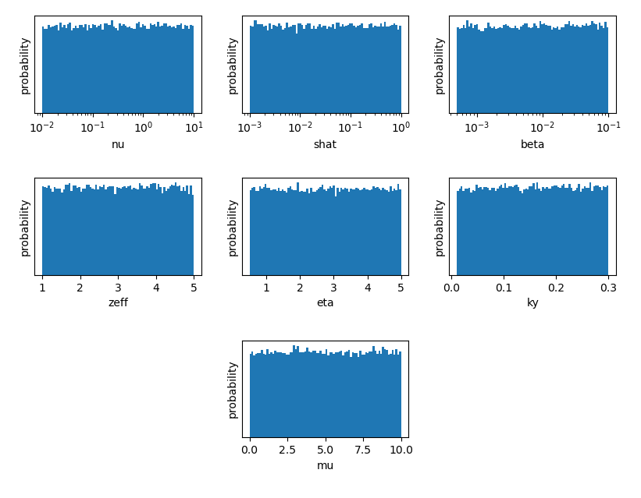
Data generation and distribution
Unstable: 845,238
Stable: 3,009,057
Even distribution
Log: nu, shat, beta
Linear: zeff, eta, ky, mu

Slide 6
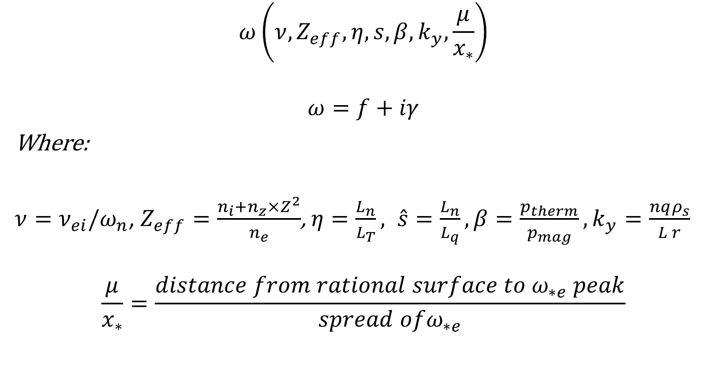
Method -- Parameter dependents
$$ω\left(ν,Z_{eff},η,s,β,k_{y},\frac{μ}{x_{∗}}\right)$$
$$ω=f+iγ$$
Where:
$ν=ν_{ei}/ω_{n}$, $Z_{eff}=\frac{n_{i}+n_{z}×Z^{2}}{n_{e}}$, $η=\frac{L_{n}}{L_{T}}, \hat{s}=\frac{L_{n}}{L_{q}}, β=\frac{p_{therm}}{p_{mag}}, k_{y}=\frac{nqρ_{s}}{L r}$
$$\frac{μ}{x_{∗}}=\frac{distance from rational surface to ω_{∗e} peak}{spread ofω_{∗e}}$$

Slide 7
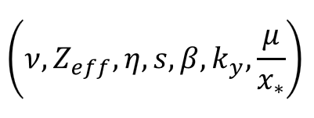
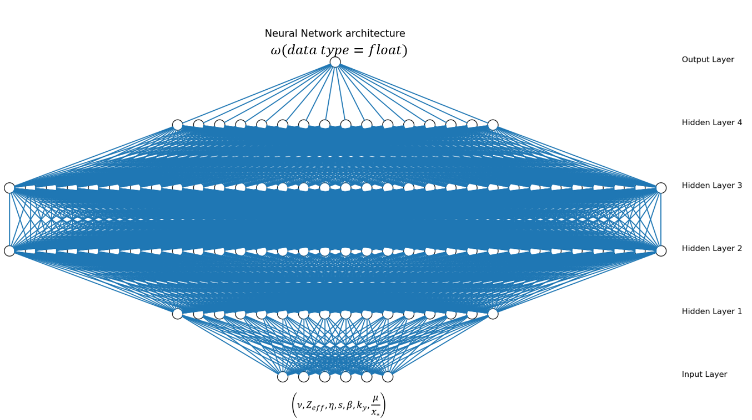
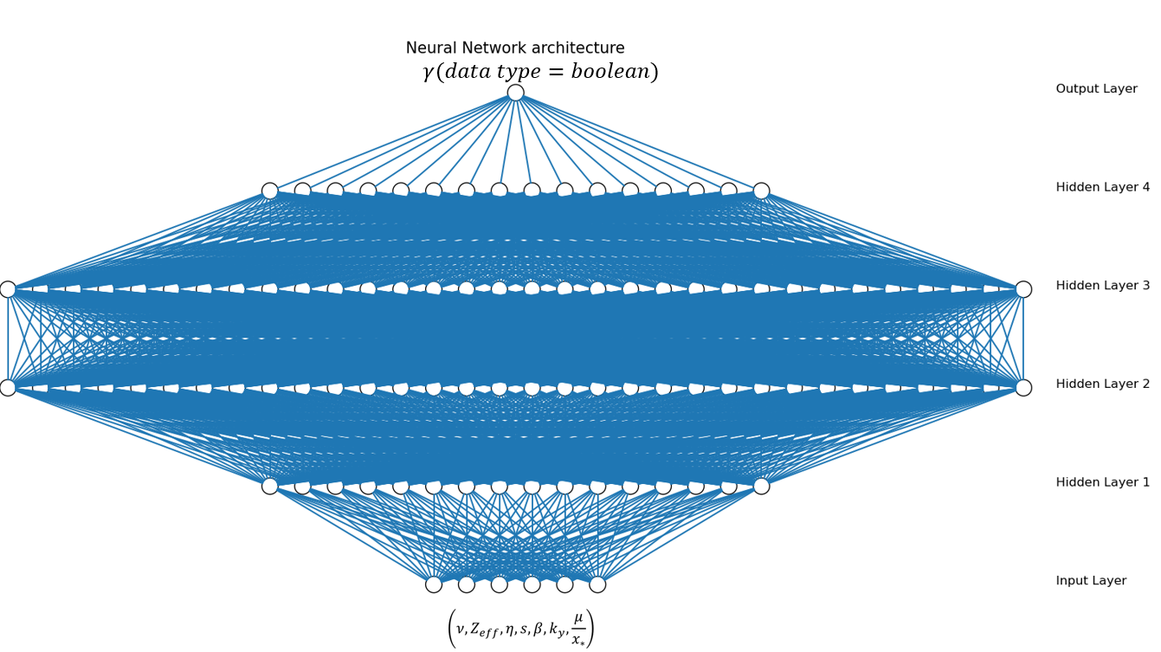


$$Frequency$$
Stable/unstable
$$unstable MTM frequencies$$

Slide 8
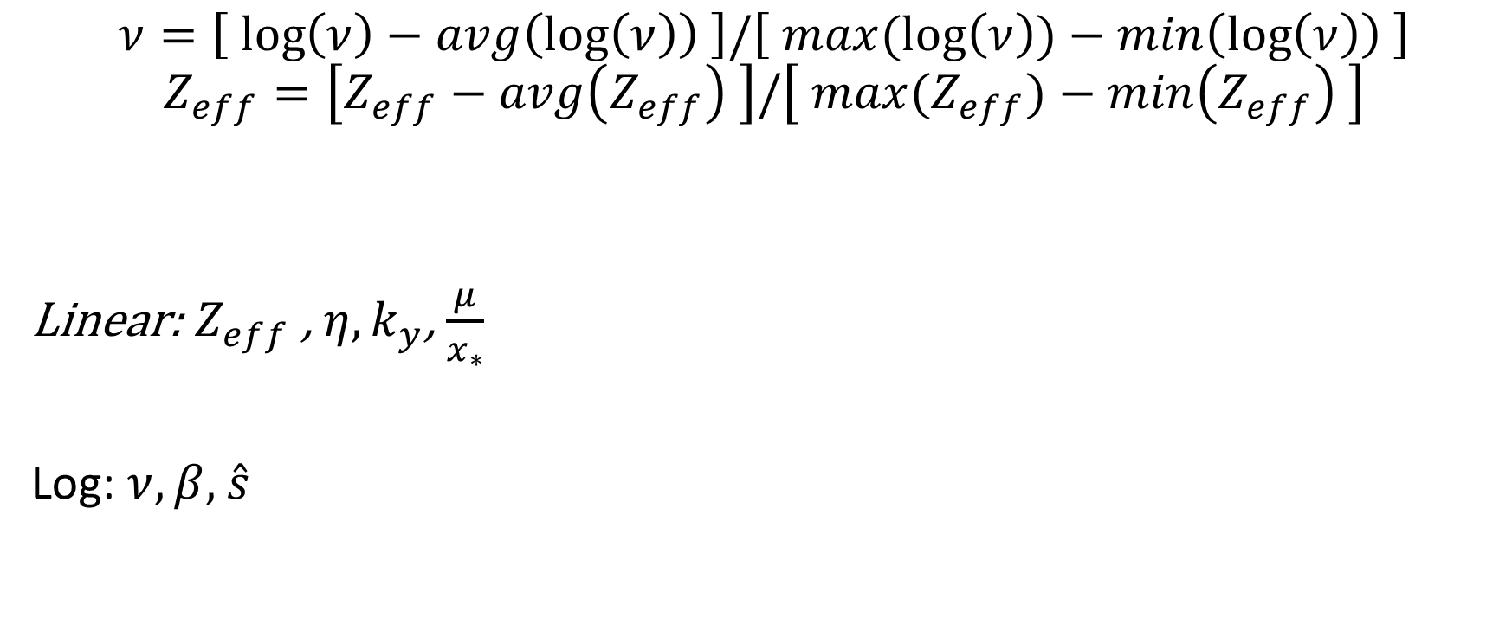
Normalization
$$ν=\left[ \log\left(ν\right)−avg\left(\log\left(ν\right)\right) \right]/\left[ max(\log\left(ν\right))−min\left(\log\left(ν\right)\right) \right]$$
$$Z_{eff}=\left[Z_{eff}−avg\left(Z_{eff}\right) \right]/\left[ max(Z_{eff})−min\left(Z_{eff}\right) \right]$$
Linear: $Z_{eff}$ , $η, k_{y}$, $\frac{μ}{x_{∗}}$
Log: $ν, β,$ $\hat{s}$

Slide 9
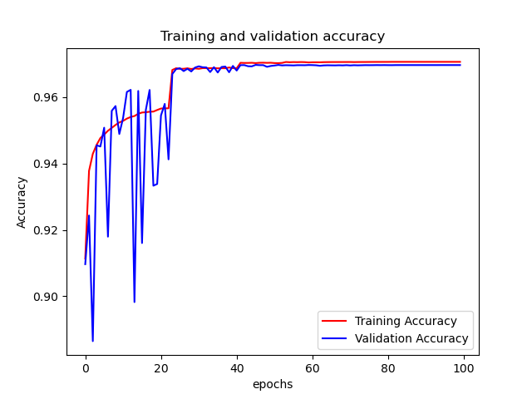
Stability NN
Accuracy: 97.05%
Valuation accuracy: 96.96%

Slide 10
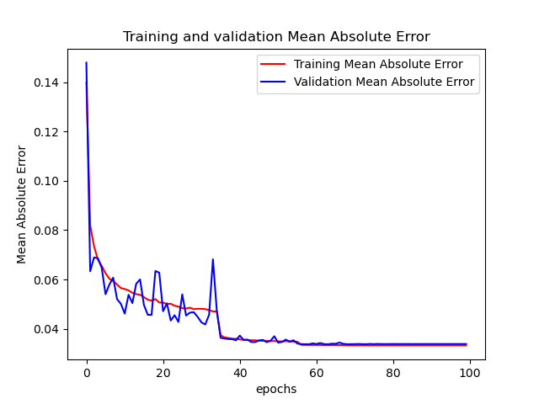
Omega NN
Mean absolute error(MAE): 0.0332
Valuation MAE: 0.0338
Accuracy: 98.6%

Slide 11
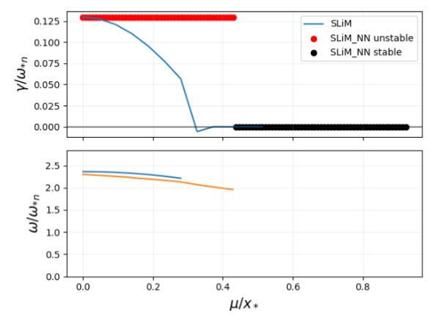
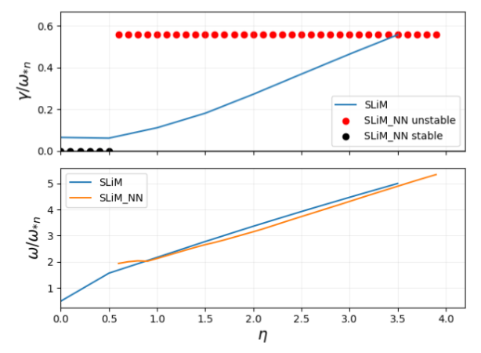
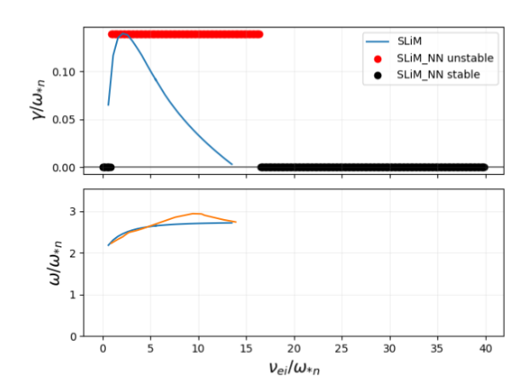
Benchmark

Slide 12
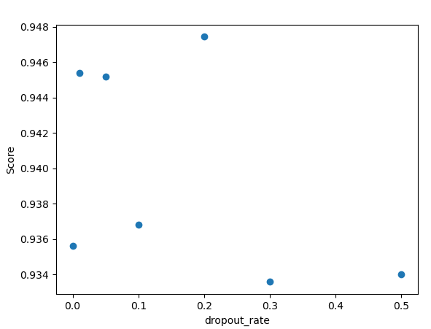
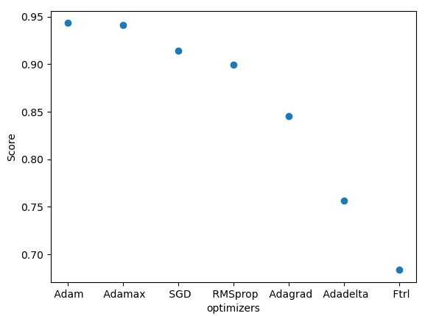
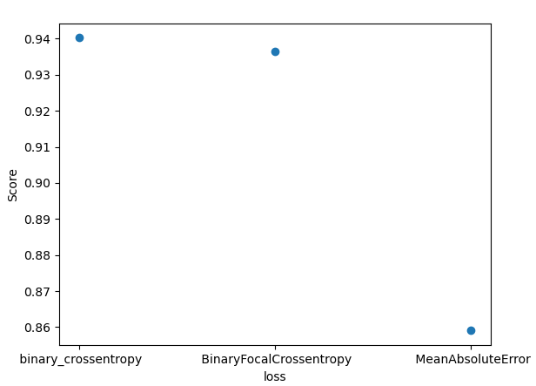
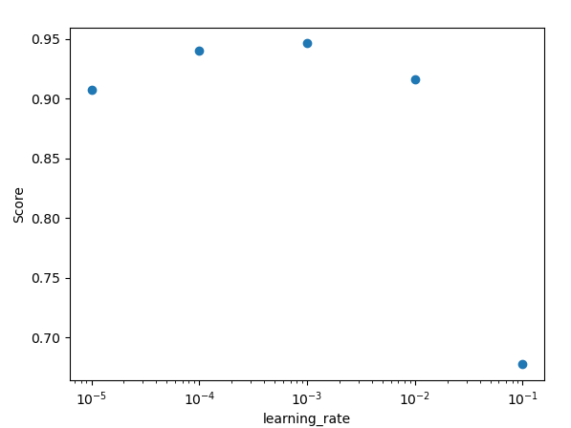
Hyper-parameter tunning

Slide 13
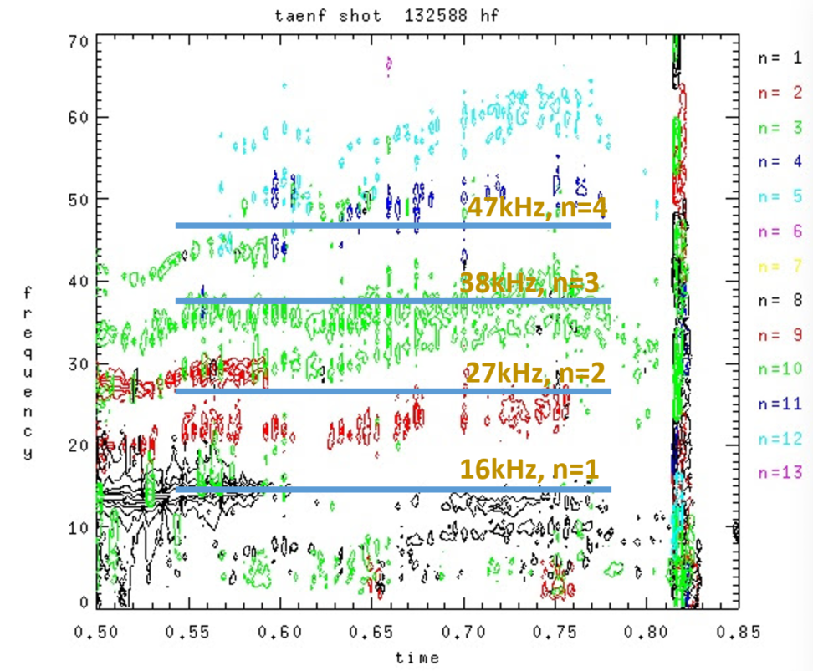
Application

Slide 14
Backup slides

Slide 15
Hyper-parameter tunning

Slide 19
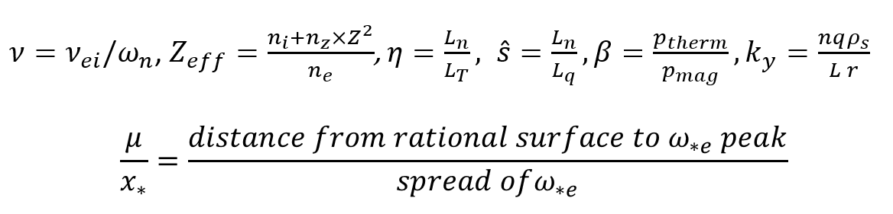

Vary profile
$n_{e}$, $T_{e}→β,x_{∗}, {η ,ω}_{n}$
$q→μ, {\hat{s},k}_{y}$
$v_{rot}→f_{Doppler}$

Slide 20
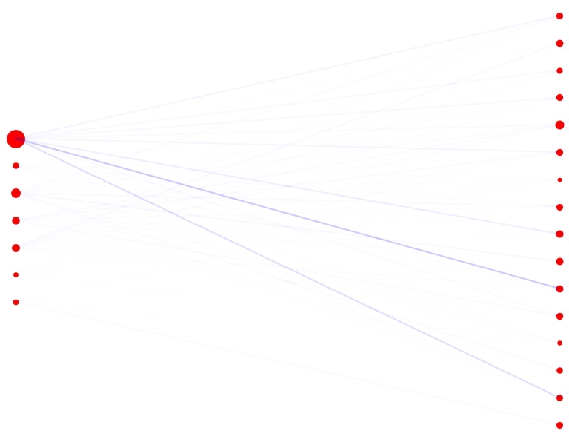
Top to bottom: nu, zeff,eta,shat,ky,mu_norm

Slide 21
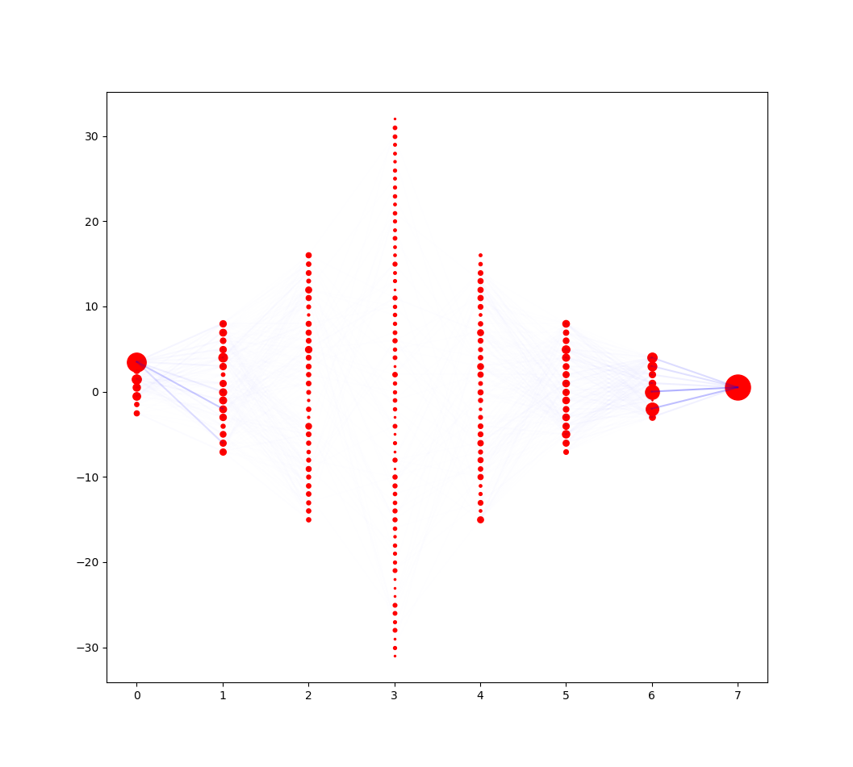

Slide 22
For stable unstable:
['nu', 'zeff', 'eta', 'shat', 'beta', 'ky', 'mu_norm'] =
[0.6086171 0.06476105 0.09443569 0.08774152 0.06328316 0.03368932 0.04747209]

Slide 23
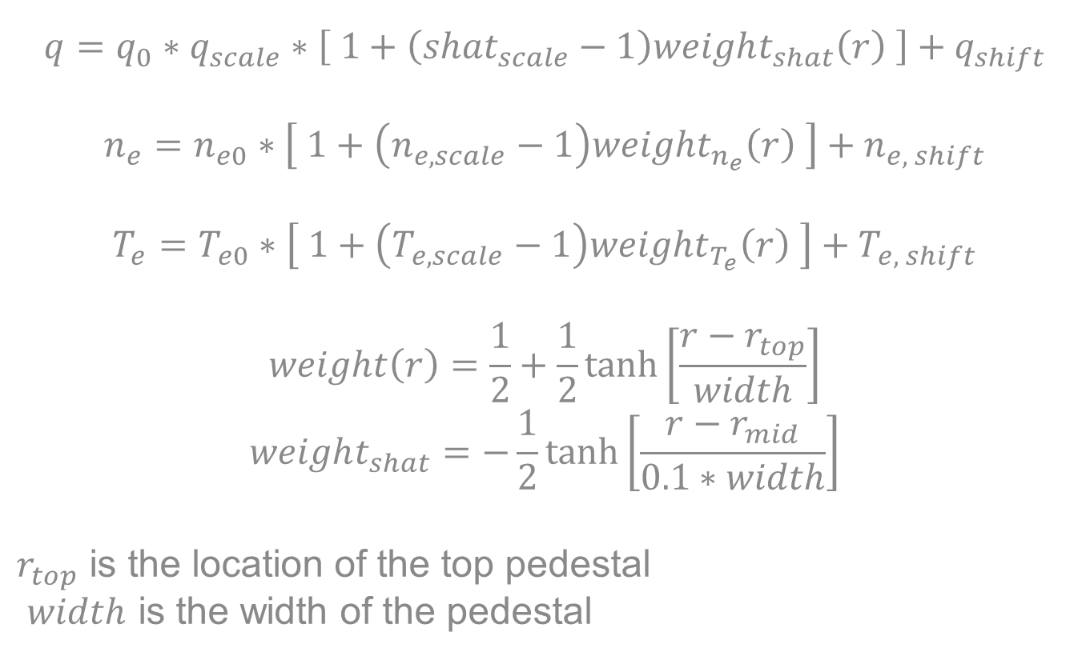
Experimental
$$q=q_{0}∗q_{scale}∗\left[ 1+\left({shat}_{scale}−1\right)weight_{shat}\left(r\right) \right]+q_{shift}$$
$$n_{e}=n_{e0}∗\left[ 1+\left(n_{e,scale}−1\right)weight_{n_{e}}\left(r\right) \right]+n_{e, shift}$$
$$T_{e}=T_{e0}∗\left[ 1+\left(T_{e,scale}−1\right)weight_{T_{e}}\left(r\right) \right]+T_{e, shift}$$
$$weight\left(r\right)=\frac{1}{2}+\frac{1}{2}tanh⁡\left[\frac{r−r_{top}}{width}\right]$$
$$weight_{shat}=−\frac{1}{2}tanh⁡\left[\frac{r−r_{mid}}{0.1∗width}\right]$$
$r_{top}$ is the location of the top pedestal
$width$ is the width of the pedestal
23

Slide 24
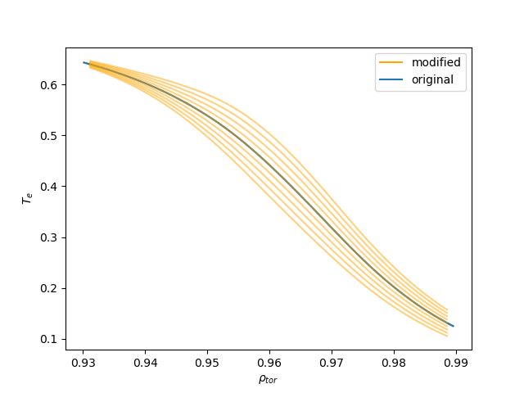
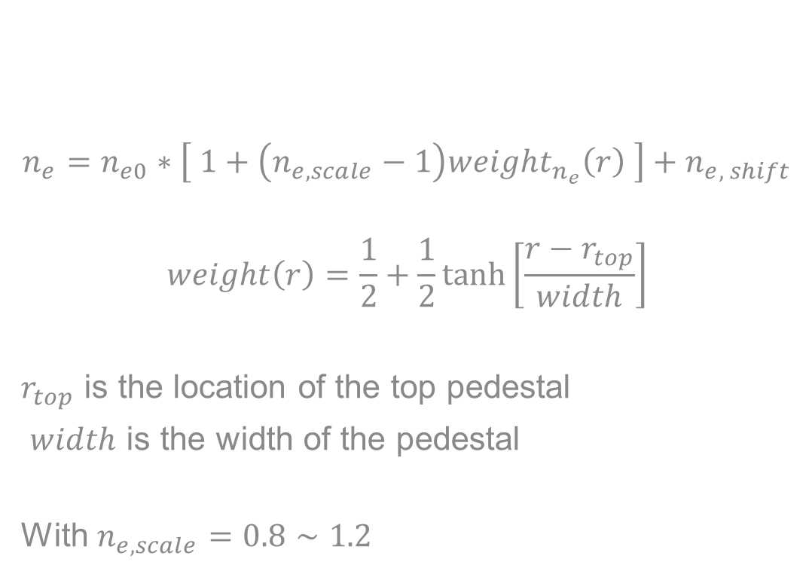
Experimental
$$n_{e}=n_{e0}∗\left[ 1+\left(n_{e,scale}−1\right)weight_{n_{e}}\left(r\right) \right]+n_{e, shift}$$
$$weight\left(r\right)=\frac{1}{2}+\frac{1}{2}tanh⁡\left[\frac{r−r_{top}}{width}\right]$$
$r_{top}$ is the location of the top pedestal
$width$ is the width of the pedestal
With $n_{e,scale}=0.8∼1.2$
24

Slide 25
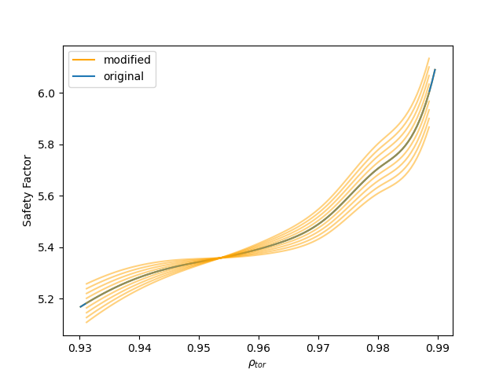
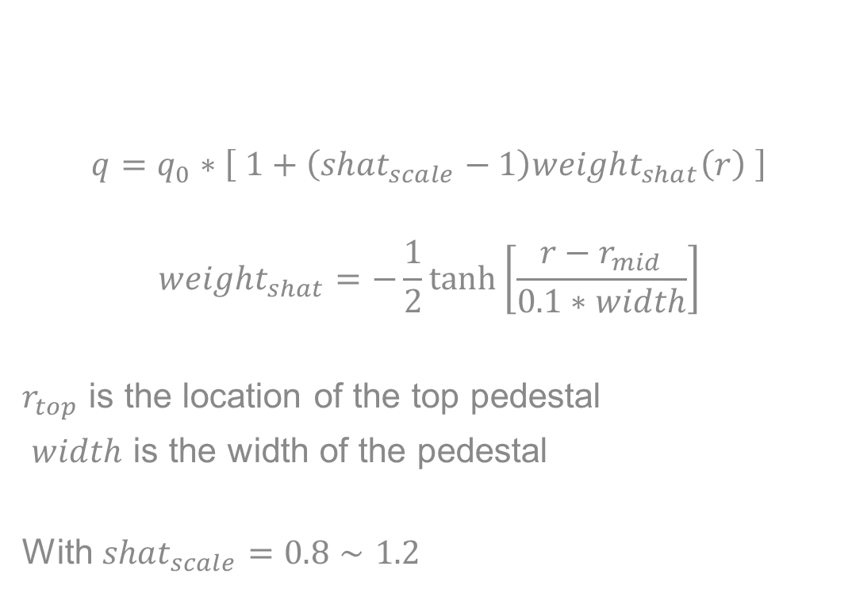
Experimental
$$q=q_{0}∗\left[ 1+\left({shat}_{scale}−1\right)weight_{shat}\left(r\right) \right]$$
$$weight_{shat}=−\frac{1}{2}tanh⁡\left[\frac{r−r_{mid}}{0.1∗width}\right]$$
$r_{top}$ is the location of the top pedestal
$width$ is the width of the pedestal
With ${shat}_{scale}=0.8∼1.2$
25

Slide 26
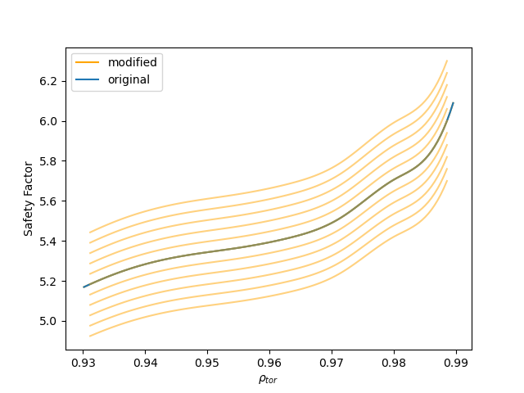

Experimental
$$q=q_{0}∗q_{scale}$$
26

Slide 27
np.random.choice(np.logspace(np.log10(para_min_log[j]),\
np.log10(para_max_log[j]), m), \
size=1, p=[1./m]*m)\

