Slide 1
UNIT-2

Slide 2
Relational Model
Relational model can represent as a table with columns and rows. Each row is known as a tuple. Each table of the column has a name or attribute.
Domain: It contains a set of atomic values that an attribute can take.
Attribute: It contains the name of a column in a particular table. Each attribute Ai must have a domain, dom(Ai)
Relational instance: In the relational database system, the relational instance is represented by a finite set of tuples. Relation instances do not have duplicate tuples.

Slide 3
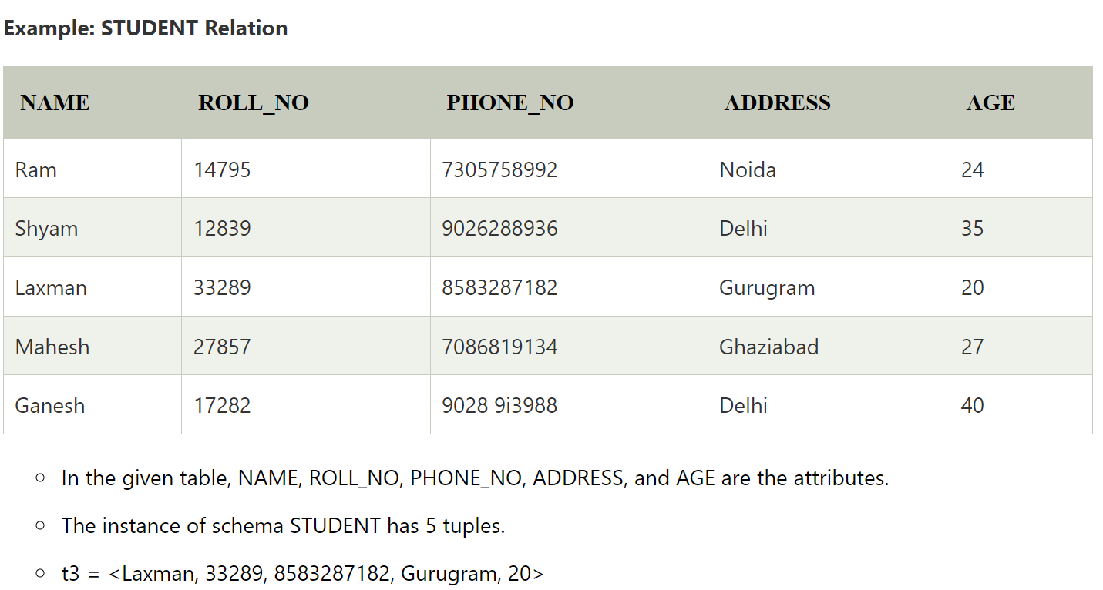
Relational schema: A relational schema contains the name of the relation and name of all columns or attributes.
Relational key: In the relational key, each row has one or more attributes. It can identify the row in the relation uniquely.

Slide 4
Properties of relation
Name of the relation is distinct from all other relations.
Each relation cell contains exactly one atomic (single) value
Each attribute contains a distinct name
Attribute domain has no significance
tuple has no duplicate value
Order of tuple can have a different sequence

Slide 5
Database schema
A database schema defines how data is organized within a relational database; this is inclusive of logical constraints such as, table names, fields, data types, and the relationships between these entities. Schemas commonly use visual representations to communicate the architecture of the database, becoming the foundation for an organization’s data management discipline. This process of database schema design is also known as data modeling.
These data models serve a variety of roles, such as database users, database administrators, and programmers. For example, it can help database administrators manage normalization processes to avoid data duplication.

Slide 6
Types of Database schemas
While the term schema is broadly used, it is commonly referring to three different schema types—a conceptual database schema, a logical database schema, and a physical database schema.
Conceptual schemas offer a big-picture view of what the system will contain, how it will be organized, and which business rules are involved. Conceptual models are usually created as part of the process of gathering initial project requirements.
Logical database schemas are less abstract, compared to conceptual schemas. They clearly define schema objects with information, such as table names, field names, entity relationships, and integrity constraints—i.e. any rules that govern the database. However, they do not typically include any technical requirements.
Physical database schemas provide the technical information that the logical database schema type lacks in addition to the contextual information, such as table names, field names, entity relationships, et cetera. That is, it also includes the syntax that will be used to create these data structures within disk storage.

Slide 7
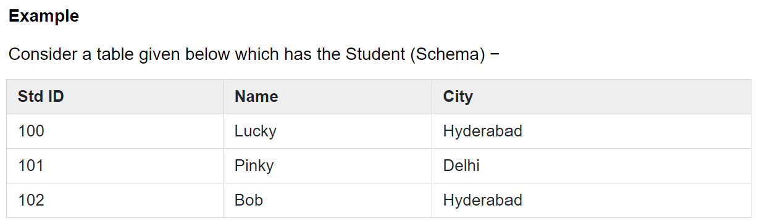
Database Instance
The situation where a data or information is stored in the database at a particular moment of time is called an instance. An instance is also called a current state or database state. The database schema that defines variables in tables which belong to a specific database, the records of these variables at a particular moment are called the instance of the database.

Slide 8
In the above table, rows are called instances.
Finally, we can say that the content of database at a point of time is called instance or database state.
There are three types of states present in database −
Empty state: When ever a new database is defined.
Initial state: first time data is loaded in database.
Current state: the present operation is applied to database.

Slide 9
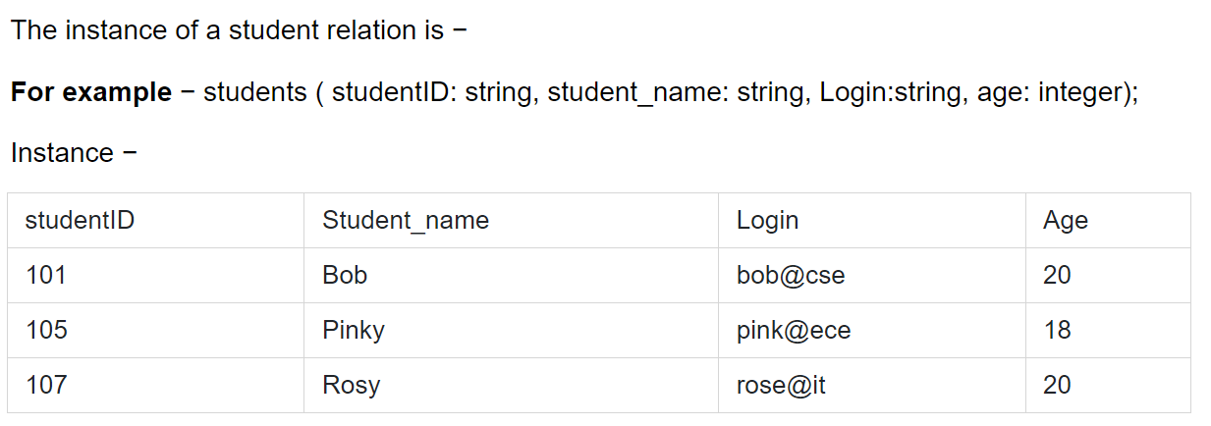

Slide 10
Database schema vs. database instance
A database schema is considered the “blueprint” of a database which describes how the data may relate to other tables or other data models. However, the schema does not actually contain data.
A sample of data from a database at a single moment in time is known as a database instance. It contains all the properties that the schema describes as data values. Since database instances are just a snapshot at a given moment, they’re likely to change over time, unlike database schemas.

Slide 11
Attributes
Attributes are the properties that define the entity type. For example, Roll_No, Name, DOB, Age, Address, Mobile_No are the attributes that define entity type Student. In ER diagram, the attribute is represented by an oval.
Key Attribute – The attribute which uniquely identifies each entity in the entity set is called key attribute.For example, Roll_No will be unique for each student. In ER diagram, key attribute is represented by an oval with underlying lines.
An attribute composed of many other attribute is called as composite attribute. For example, Address attribute of student Entity type consists of Street, City, State, and Country. In ER diagram, composite attribute is represented by an oval comprising of ovals. Eg. address

Slide 12
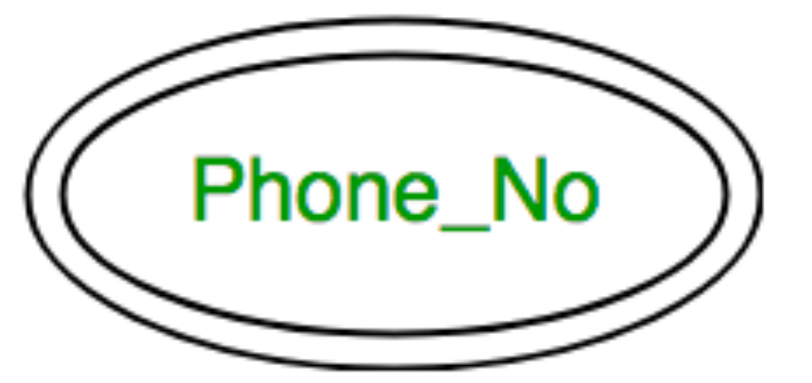
Multivalued Attribute – An attribute consisting more than one value for a given entity. For example, Phone_No (can be more than one for a given student). In ER diagram, a multivalued attribute is represented by a double oval. Eg. Phone number

Slide 13

An attribute that can be derived from other attributes of the entity type is known as a derived attribute. e.g.; Age (can be derived from DOB). In ER diagram, the derived attribute is represented by a dashed oval.

Slide 14
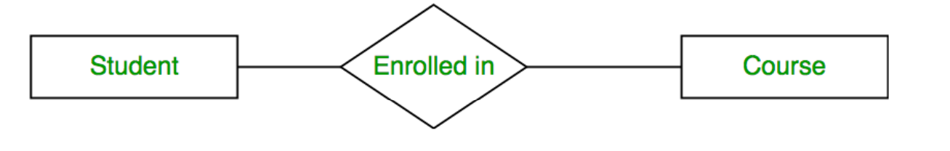
Relationship Type and Relationship Set
A relationship type represents the association between entity types. For example,‘Enrolled in’ is a relationship type that exists between entity type Student and Course. In ER diagram, the relationship type is represented by a diamond and connecting the entities with lines.

Slide 15
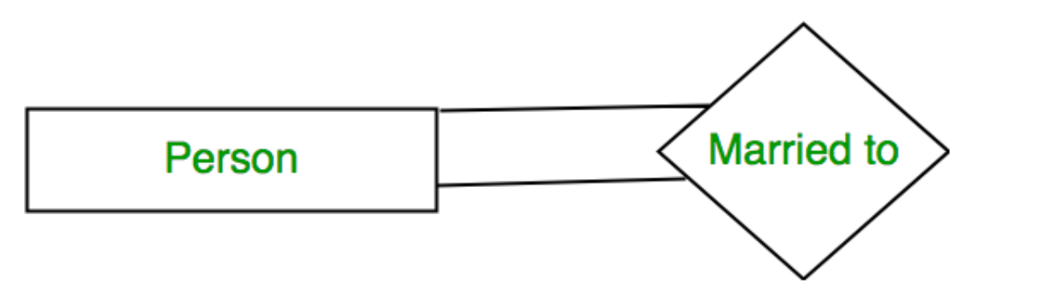
Degree of Relationship set
The number of different entity sets participating in a relationship set is called as the degree of a relationship set.
1. Unary Relationship – When there is only ONE entity set participating in a relation, the relationship is called a unary relationship. For example, one person is married to only one person.

Slide 16
Binary Relationship – When there are TWO entities set participating in a relationship, the relationship is called a binary relationship. For example, a Student is enrolled in a Course.
n-ary Relationship – When there are n entities set participating in a relation, the relationship is called an an n-ary relationship.

Slide 17
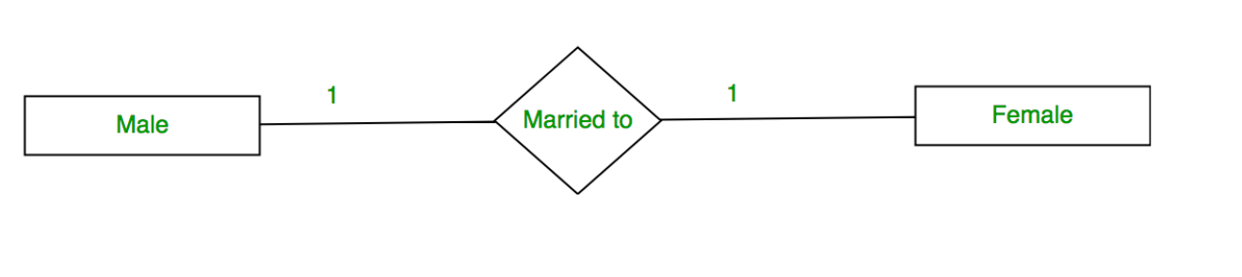
Cardinality:
The number of times an entity of an entity set participates in a relationship set is known as cardinality. Cardinality can be of different types:
1. One-to-one – When each entity in each entity set can take part only once in the relationship, the cardinality is one-to-one. Let us assume that a male can marry one female and a female can marry one male. So the relationship will be one-to-one.
the total number of tables that can be used in this is 2.

Slide 18
Many to one – When entities in one entity set can take part only once in the relationship set and entities in other entity sets can take part more than once in the relationship set, cardinality is many to one. Let us assume that a student can take only one course but one course can be taken by many students. So the cardinality will be n to 1. It means that for one course there can be n students but for one student, there will be only one course.
The total number of tables that can be used in this is 3.

Slide 19
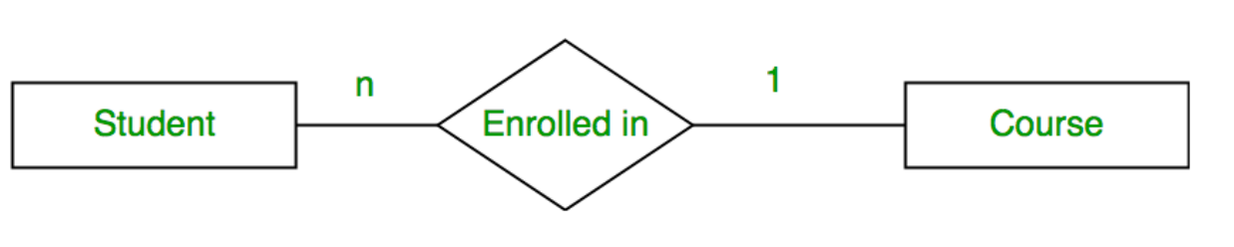

Slide 20
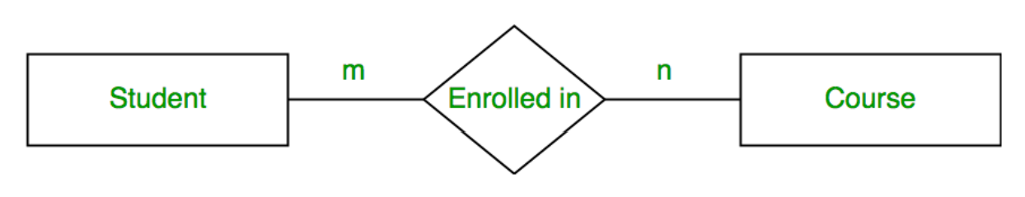
Many to many – When entities in all entity sets can take part more than once in the relationship cardinality is many to many. Let us assume that a student can take more than one course and one course can be taken by many students. So the relationship will be many to many.
the total number of tables that can be used in this is 3.

Slide 21
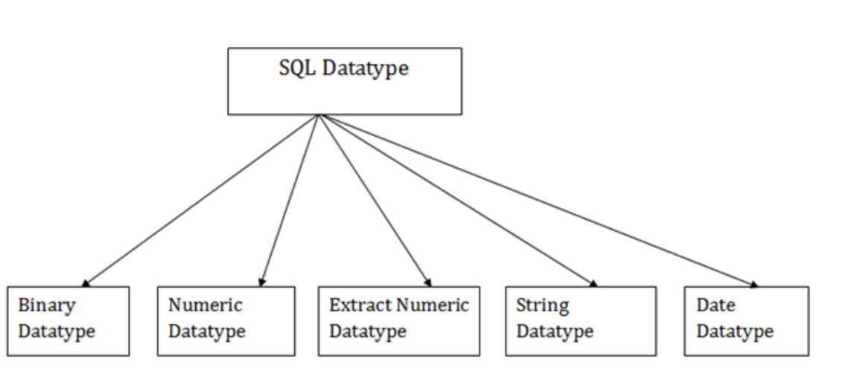
Data Types
SQL Datatype is used to define the values that a column can contain.
Every column is required to have a name and data type in the database table.

Slide 22
Constraints
In DBMS, constraints are the set of rules that ensures that when an authorized user modifies the database they do not disturb the data consistency and the constraints are specified within the DDL commands like “alter” and “create” command. There are several types of constraints available in DBMS and they are:
Domain constraints
Entity Integrity constraints
Referential Integrity constraints
Key constraints

Slide 23
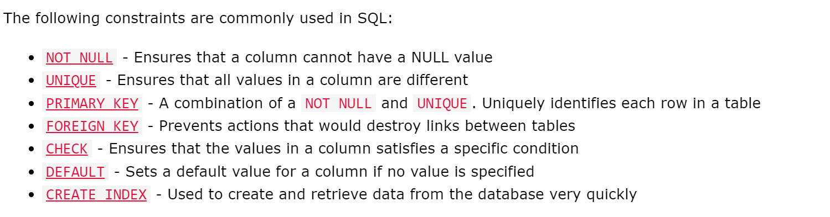

Slide 24
Relational Algebra

