Slide 1
Data Link Layer
Unit - 2

Slide 2
DATA LINK LAYER DESIGN ISSUES
Uses the services of the physical layer to send and receive bits over communication channels.
Function of the Data Link Layer
Providing a well-defined service interface to the network layer.
Dealing with transmission errors.
Regulating the flow of data so that slow receivers are not swamped by fast senders.
The data link layer takes the packets it gets from the network layer and encapsulates them into frames for transmission.

Slide 3
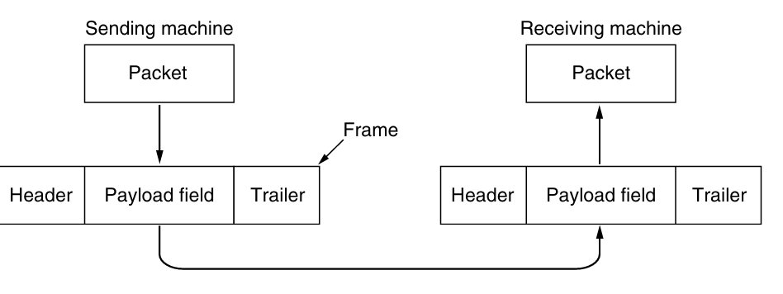
DATA LINK LAYER DESIGN ISSUES
Framing is the heart of Data Link Layer
Figure 3-1. Relationship between packets and frames.

Slide 4
DATA LINK LAYER DESIGN ISSUES
Framing is the heart of Data Link Layer
Figure 3-1. Relationship between packets and frames.

Slide 5
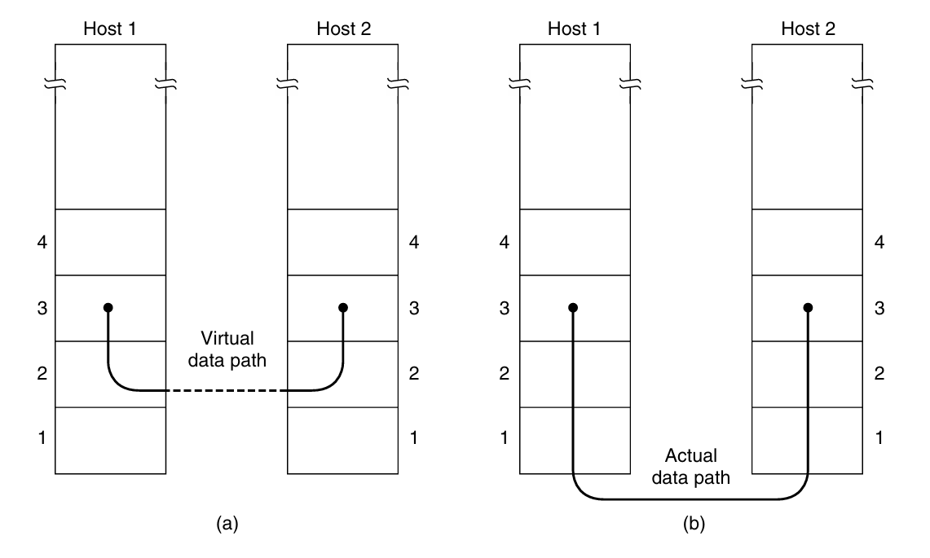
DATA LINK LAYER DESIGN ISSUES
Receive Data from the Network Layer of Sending Machine and Sends to the Network Layer of Receiving Machine.
Figure 3-2. (a) Virtual communication. (b) Actual communication.

Slide 6
Date Link Layer Services
Data link layer can be designed to offer various services which may vary from protocol to protocol.
Unacknowledged connectionless service.
Acknowledged connectionless service.
Acknowledged connection-oriented service

Slide 7
Framing
Accept Bit Stream from Physical Layer
Receive the raw bit stream from the physical layer.
Identify if the bit stream contains errors introduced due to noise in the channel.
Frame Construction
Divide the incoming bit stream into discrete frames.
Compute a checksum for each frame using an error-detection algorithm.
Append the checksum to the frame before transmission.
Frame Transmission
Send the framed data to the destination over the physical layer.

Slide 8
Framing
Frame Reception and Error Detection
At the receiver’s end, extract the received frame.
Recompute the checksum based on the received data.
Compare the computed checksum with the checksum included in the received frame.
Error Handling
If the checksum matches:
The frame is considered error-free and is passed to the network layer.
If the checksum does not match:
The frame is considered corrupted.
The frame is considered corrupted.
The receiver discards the erroneous frame.
Optionally, the receiver sends an error report or a request for retransmission.

Slide 9
Framing
Frame Synchronization
Ensure proper framing by using techniques to detect frame boundaries (e.g., byte stuffing, bit stuffing, or synchronization patterns).
Continue processing the next frames.
Methods for Frame Synchronization
1. Byte count.
2. Flag bytes with byte stuffing.
3. Flag bits with bit stuffing.
4. Physical layer coding violations.

Slide 10
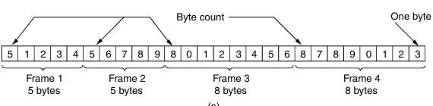
Byte count.
Uses a header field to specify the number of bytes in a frame.
The destination reads the byte count to determine the end of the frame.
Example: Frames of sizes 5, 5, 8, and 8 bytes are transmitted sequentially.

Slide 11
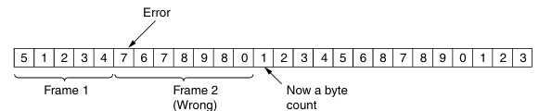
Problem with Byte Count Method
If the byte count is altered due to a bit error, the receiver loses synchronization.
Example: A byte count of 5 changes to 7, causing misalignment.
The receiver cannot determine the correct start of the next frame.
Even if the checksum detects an error, the receiver:
Does not know where the next frame begins.
Cannot request a proper retransmission.
Lack of error recovery mechanisms.
Alternative framing methods (e.g., flag-based framing, bit stuffing) are preferred.
Ensuring reliable synchronization is crucial for efficient communication.

Slide 12
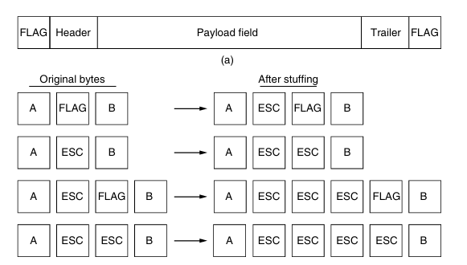
Flag byte
Overcomes the resynchronization problem in the Byte Count Method.
Uses special bytes to mark the start and end of a frame.
Each frame begins and ends with a flag byte (e.g., FLAG).
Two consecutive flag bytes indicate: End of one frame, Start of the next frame.
The Problem with Flag Byte Framing
The flag byte used for framing may appear in the actual data.
This can cause misinterpretation of frame boundaries.
Common when transmitting binary data (e.g., images, audio files).

Slide 13
Byte Stuffing
Insert a special Escape (ESC) byte before any flag byte in the data.
At the receiver’s end, the Escape byte is removed, restoring the original data.
Sender’s Data Link Layer:
Scans data for accidental flag bytes.
Inserts an ESC byte before them.
Receiver’s Data Link Layer:
Detects ESC before a flag byte.
Removes ESC and processes data normally.

Slide 14
Byte Stuffing
What if the Escape (ESC) byte itself appears in the data?
Similar to the flag byte issue, it can disrupt framing if not handled properly.
If an ESC byte appears in the data, an extra ESC byte is added before it.
At the receiver’s end: The first ESC is removed, restoring the original sequence.
This ensures that the data remains unchanged after processing.

Slide 15
Byte Stuffing

Slide 16
Bit Stuffing
Bit stuffing is an alternative to byte stuffing for frame delimitation.
Used in protocols like HDLC (High-Level Data Link Control) and USB (Universal Serial Bus).
Works at the bit level, allowing frames of arbitrary length.
Each frame starts and ends with a flag pattern:
01111110 (Hex: 0x7E)
If sender detects 5 consecutive 1s in the data, it inserts a 0 bit to prevent confusion with flag patterns.
This prevents accidental frame boundary misinterpretation.

Slide 17
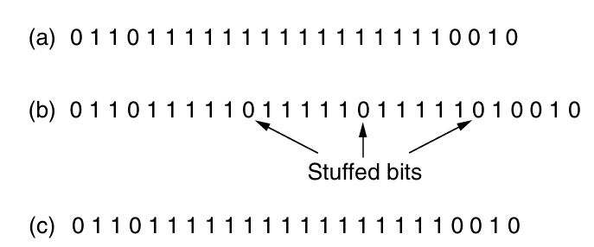
Example
Notes:
This pattern is a flag byte. When ever the sender’s data link layer encounters five consecutive 1s in the data, it automatically stuffs a 0 bit into the outgoing bit stream. This bit stuffing is anal ogous to byte stuffing, in which an escape byte is stuffed into the outgoing charac ter stream before a flag byte in the data. It also ensures a minimum density of transitions that help the physical layer maintain synchronization. USB (Universal Serial Bus) uses bit stuffing for this reason. When the receiver sees five consecutive incoming 1 bits, followed by a 0 bit, it automatically destuffs (i.e., deletes) the 0 bit. Just as byte stuffing is completely transparent to the network layer in both computers, so is bit stuffing. If the user data contain the flag pattern, 01111110, this flag is transmitted as 011111010 but stored in the receiver’s memory as 01111110. Figure 3-5 gives an example of bit stuffing. With bit stuffing, the boundary between two frames can be unambiguously recognized by the flag pattern. Thus, if the receiver loses track of where it is, all it has to do is scan the input for flag sequences, since they can only occur at frame boundaries and never within the data

Slide 18
Physical Layer Coding Violations for Framing
Uses reserved signals from the physical layer to mark the start and end of frames.
Eliminates the need for bit stuffing or byte stuffing.
Commonly used in Ethernet and IEEE 802.11 (Wi-Fi).
Many encoding schemes, like 4B/5B line coding, introduce extra (unused) signal patterns.
Some of these unused signals can be assigned as frame delimiters.
Example: In 4B/5B coding, only 16 out of 32 possible signals are used for data.

Slide 19
Example – Framing via Coding Violations
Data bits → Encoded signals
1010 → 11010 (Valid signal)
1101 → 10111 (Valid signal)
Unused signal (e.g., 00000) is assigned as a frame boundary.
Receiver detects this signal → Marks frame start/end.

Slide 20
Preamble-Based Framing in Ethernet & Wi-Fi
Ethernet and 802.11 use a preamble to indicate frame start.
Example: IEEE 802.11 preamble72-bit preamble prepares receiver for incoming data
Followed by length field to determine frame end.

Slide 21
Error Control
The receiver must determine if a frame contains errors.
This is crucial for connection-oriented services, where reliability is mandatory.
In unacknowledged connectionless service, frames are sent without confirmation of proper arrival.
Acknowledgment Mechanism:
Positive Acknowledgment (ACK): Confirms that a frame was received correctly.
Negative Acknowledgment (NACK): Indicates an error, requiring retransmission.

Slide 22
Error Control
Lost Frames Problem:
Frames can be lost due to hardware issues or noise interference.
If a frame disappears, the receiver does not respond, leaving the sender uncertain.
Lost acknowledgment frames can also cause confusion.
Timers for Retransmission:
A timer starts when a frame is sent.
If no acknowledgment is received before the timer expires, the frame is resent.

Slide 23
Error Control
Avoiding Duplicate Frames:
Retransmission can lead to duplicate frames being processed by the receiver.
Solution: Assign sequence numbers to frames so the receiver can differentiate between new and retransmitted frames.
Ensuring Reliable Delivery:
Combination of timers and sequence numbers ensures that each frame is delivered exactly once to the network layer.
Managing these mechanisms is a key responsibility of the data link layer.

Slide 24
Flow Control Issue
Occurs when the sender transmits data faster than the receiver can process.
This leads to buffer overflow, causing data loss.
Without regulation, the receiver may lose data due to an inability to keep up.
A mechanism is needed to control the data transmission rate.

Slide 25
Two Approaches to Flow Control
Feedback-Based Flow Control:
The receiver sends feedback to the sender about how much data it can handle.
Example: The receiver grants permission for the sender to continue sending frames.
Rate-Based Flow Control:
The transmission rate is limited by a predefined protocol rule.
No direct feedback from the receiver is required.
Common in transport layer protocols rather than the data link layer.

Slide 26
Focus on Feedback-Based Flow Control
More common in the data link layer and higher layers.
The sender must follow specific rules on when to transmit frames.
Example: “You may send me n frames now, but after they have been sent, do not send any more until I have told you to continue.”
Hardware Considerations:
Network Interface Cards (NICs) are designed to run at wire speed, meaning they can handle frames as fast as they arrive.
If data loss occurs, it is usually handled by higher layers rather than the link layer.

Slide 27
ERROR DETECTION AND CORRECTION
Error Rates in Different Channels
Some channels (e.g., fiber optic) have low error rates.
Wireless links and aging local loops have high error rates.
Transmission errors cannot be completely avoided at a reasonable cost.
Strategies for Handling Errors
Error-Detecting Codes:
Add redundancy to detect errors.
Receiver can only identify an error but not correct it.
Requires retransmission of faulty data.

Slide 28
ERROR DETECTION AND CORRECTION
Error-Correcting Codes (FEC - Forward Error Correction):
Add enough redundancy to correct errors without retransmission.
Useful for noisy channels (e.g., wireless links) where retransmissions may also fail.
Choosing Between Error Detection & Correction
Error detection with retransmission is preferred for reliable channels (e.g., fiber optics).
FEC (error correction) is better for high-error environments (e.g., wireless networks).

Slide 29
ERROR DETECTION AND CORRECTION
Types of Errors
Single-bit errors: Caused by brief noise spikes.
Burst errors: Occur in clusters due to channel conditions (e.g., deep fades, electrical interference).
Advantage: Affects fewer blocks overall.
Disadvantage: Harder to correct than isolated errors.
Erasure errors: Known locations of errors, making them easier to correct.

Slide 30
Examples
Single-bit Errors (Caused by brief noise spikes)
Example:
Suppose the binary data being transmitted is: 10110010
Due to a brief noise spike, the 3rd bit flips from 1 to 0: 10010010
Only one bit is affected, and error-detecting codes (like parity bits) can easily identify this.

Slide 31
Examples
Burst Errors (Occur in clusters due to channel conditions)
Example:
Original transmitted data: 1101011010111101
A deep fade in a wireless channel affects multiple consecutive bits:1101000000001101 (middle section corrupted)
Since multiple bits in a row are changed, burst errors are harder to correct than single-bit errors.

Slide 32
Examples
Advantages:
If errors are in bursts, fewer overall data blocks may be affected.
Example: If errors affect groups of 100 bits at a time in a 1000-bit block, only 1 block in 10 is impacted rather than errors randomly distributed across all blocks.
Disadvantages:
Correcting large burst errors requires more advanced error-correcting codes (e.g., Reed-Solomon codes).

Slide 33
Examples
Erasure Errors (Known locations of errors, making them easier to correct)
Example:
Transmitted data: 10111001
If the receiver detects weak signal strength or distortion for the 5th bit, it marks it as an erasure:
1011?001 (? represents an identified missing/uncertain bit)
Since the position of the error is known, it is easier to correct by referring to redundant information in the message (e.g., using FEC or interpolation techniques).

Slide 34
ERROR DETECTION AND CORRECTION
Error Codes in Networking
Link Layer: First line of defense against transmission errors.
Physical Layer: Often uses FEC for noisy channels.
Higher Layers: Real-time media and content distribution use error correction.
Importance of Standardized Error Codes
Error codes rely on advanced mathematics (e.g., Galois fields, sparse matrices).
Standardized codes should be used instead of designing custom solutions.
Many protocol standards reuse well-tested error-correcting codes.

Slide 35
Error-Correcting Codes
Error-correcting codes add redundancy to transmitted information to detect and correct errors.
Four types of codes are examined:
Hamming Codes
Binary Convolutional Codes
Reed-Solomon Codes
Low-Density Parity Check (LDPC) Codes

Slide 36
Error-Correcting Codes
Each code consists of:
m data bits (message)
r check bits (redundancy)
Total length n = m + r
A transmitted n-bit codeword consists of both data and check bits.
Code word = (n, m)
Notes:
In a block code, the r check bits are computed solely as a function of the m data bits with which they are associated, as though the m bits were looked up in a large table to find their corresponding r check bits. In a systematic code, the m data bits are sent directly, along with the check bits, rather than being encoded themselves be fore they are sent. In a linear code, the r check bits are computed as a linear function of the m data bits. Exclusive OR (XOR) or modulo 2 addition is a popular choice. This means that encoding can be done with operations such as matrix multiplications or simple logic circuits. The codes we will look at in this section are linear, systematic block codes unless otherwise noted.

Slide 37
Block Codes and Properties
Block Codes : r check bits are computed solely as a function of the m data bits with which they are associated, as though the m bits were looked up in a large table to find their corresponding r check bits.
Systematic Codes: Message bits are sent directly with check bits.
Linear Codes: Check bits are a linear function of message bits (e.g., using XOR).
Code Rate: Defined as m/n, representing the fraction of non-redundant bits.
Hamming Distance: The number of bit positions in which two codewords differ.
Denoted as d, it determines error detection and correction capability.
A code with distance d+1 can detect d errors.
A code with distance 2d+1 can correct d errors.

Slide 38
Hamming Distance
10001001
10110001
------------------
00111000
------------------
Hamming Distance (d) : The number of bit positions in which two code words differ
Notes:
To understand how errors can be handled, it is necessary to first look closely at what an error really is. Given any two codewords that may be transmitted or received—say, 10001001 and 10110001—it is possible to determine how many corresponding bits differ. In this case, 3 bits differ. The number of bit positions in which two code words differ is called the Hamming distance. all 2m possible data messages are legal, but due to the way the check bits are computed, not all of the 2n possible code words are used. Infact, when there are r check bits, only the small fraction of 2m/2n or 1/2r of the possible messages will be legal codewords.

Slide 39
Hamming Code
A type of block code with Hamming distance 3, allowing single-bit error correction.
Construction:
Codeword bits are numbered sequentially.
Bits at positions that are powers of 2 (1, 2, 4, 8, etc.) are check bits.
Other positions contain message bits.
Each check bit ensures even parity over a subset of bits.
Error Detection and Correction:
If all check bits are correct, the received codeword is valid.
If some check bits are incorrect, an error syndrome is formed.
The syndrome pinpoints the erroneous bit, which is then flipped to correct the error.
Example: A (11,7) Hamming code can detect and correct single-bit errors.

Slide 40
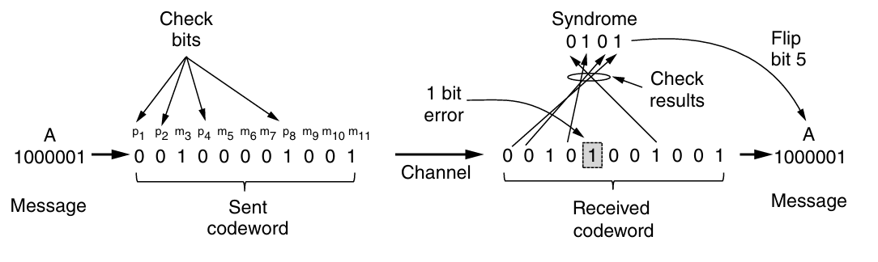
Example
0000000000, 0000011111, 1111100000, and 1111111111 are valid codewords with hamming distance of 5.
The codeword arrives is : 0000000111
Notes:
Here we, expect that error of one or two bits only. the task of decoding by finding the legal codeword that is closest to the received codeword can be done by inspection. Unfortunately, in the
most general case where all codewords need to be evaluated as candidates, this task can be a time-consuming search. Instead, practical codes are designed so that they admit shortcuts to find what was likely the original codeword.

Slide 41
Table for Hamming (11,7) Bit Positions
Bit Position (1-11) | Type | Parity Covers
1 (p1) | Parity | 3, 5, 7, 9, 11
2 (p2) | Parity | 3, 6, 7, 10, 11
3 (m1) – 1+2 | Message | -
4 (p4) | Parity | 5, 6, 7
5 (m2) – 1+4 | Message | -
6 (m3) – 2+4 | Message | -
7 (m4) – 1+2+4 | Message | -
8 (p8) | Parity | 9, 10, 11
9 (m5) – 1+8 | Message | -
10 (m6) – 2+8 | Message | -
11 (m7) – 1+ 2 + 8 | Message | -
Notes:
Check error from error syndrome

Slide 42
General Error Correction Strategy
Code must satisfy the inequality:
(𝑚+𝑟+1)≤2^{𝑟}
This determines the minimum number of check bits needed for single-error correction.
Tradeoff: More redundancy (lower code rate) allows better error correction.

Slide 43
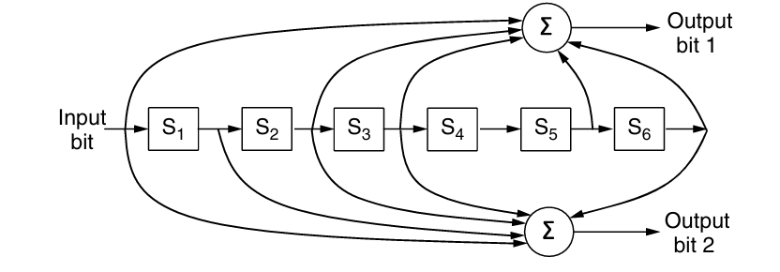
Convolutional code
Unlike block codes, which encode fixed-size blocks of bits, convolutional codes encode a continuous stream of bits.
The encoding process depends not just on the current bit but also on a few previous bits (this is called the constraint length).
The encoder has memory and generates output based on a combination of past and current bits.
Figure 3-7. The NASA binary convolutional code used in 802.11

Slide 44
NASA Convolutional Code (Rate = 1/2, Constraint Length = 7)
The NASA Convolutional Code is a widely used error-correcting code with:
Rate (r) = 1/2 → Each input bit produces two output bits
Constraint Length (k) = 7 → The encoder uses the current bit and the past 6 bits to generate output
Encoding Process
Shift Register:
The encoder has a 7-bit shift register that stores the current and past 6 bits.
Two generator polynomials determine the output.

Slide 45
NASA Convolutional Code (Rate = 1/2, Constraint Length = 7)
Generator Polynomials:
NASA's constraint length 7 code uses:
G1 = 1111001 (Octal: 133)
G2 = 1011011 (Octal: 171)
These define how each bit contributes to the two output bits.
Input Bit | Shift Register (7 Bits) | Output (G1, G2)
1 | 0000001 | (1, 1)
0 | 0000010 | (1, 0)
1 | 0000101 | (0, 1)
1 | 0001011 | (1, 1)
0 | 0010110 | (1, 0)
1 | 0101101 | (0, 1)
Final Encoded Output: 👉 11 10 01 11 10 01
Notes:
For small values of k, this is done with a widely used algorithm developed by Viterbi (Forney, 1973).
Convolutional codes have been popular in practice because it is easy to factor the uncertainty of a bit being a 0 or a 1 into the decoding. For example, suppose −1V is the logical 0 level and +1V is the logical 1 level, we might receive 0.9V and −0.1V for 2 bits. Instead of mapping these signals to 1 and 0 right away, we would like to treat 0.9V as ‘‘very likely a 1’’ and −0.1V as ‘‘maybe a 0’’ and correct the sequence as a whole. Extensions of the Viterbi algorithm can work with these uncertainties to provide stronger error correction. This approach of working with the uncertainty of a bit is called soft-decision decoding. Conversely, decid ing whether each bit is a 0 or a 1 before subsequent error correction is called hard-decision decoding.

Slide 46
Reed-Solomon code
Reed-Solomon (RS) codes work by treating groups of bits as symbols and using polynomials for error correction.
Reed-Solomon codes are linear block codes, and they are often systematic too.
Reed-Solomon codes are actually defined as polynomials that operate over finite fields
For m bit symbols, the codewords are 2m−1 symbols long.
A codeword is then 255 bytes long. The (255, 233) code is widely used; it adds 32 redundant symbols to 233 data symbols.
They are used for DSL, data over cable, satellite communications, and perhaps most ubiquitously on CDs, DVDs, and Blu-ray discs.

Slide 47
Example: Correcting Errors on a Line
Suppose we want to send two data points that lie on a straight line:
Data Points: (1,3) and (2,5)
The equation of the line: y = 2x + 1
We add two extra points for error correction: (3,7) and (4,9)
So, we send (1,3), (2,5), (3,7), (4,9).
Now, suppose the receiver gets: (1,3), (2,5), (3,8), (4,9) → The third point is wrong!

Slide 48
LDPC (Low-Density Parity Check)
LDPC codes are linear block codes designed for efficient error correction.
Unlike Hamming or Reed-Solomon codes, they are sparse in structure, making them practical for large block sizes.
Part of the standard for digital video broadcasting, 10 Gbps Ethernet, power-line networks, and the latest version of 802.11.

Slide 49
Key Features of LDPC
Sparse Parity-Check Matrix
LDPC codes are represented using a parity-check matrix with mostly 0s and a few 1s.
This makes encoding and decoding computationally efficient.
Iterative Decoding Algorithm
Errors are corrected using an approximation algorithm that iteratively refines the received data to match the closest legal codeword.
This process is called belief propagation or message passing.
Superior Error-Correction Performance
LDPC codes outperform many traditional codes, especially for large block sizes.
They work well in low signal-to-noise ratio (SNR) environments, making them ideal for communication systems.

Slide 50
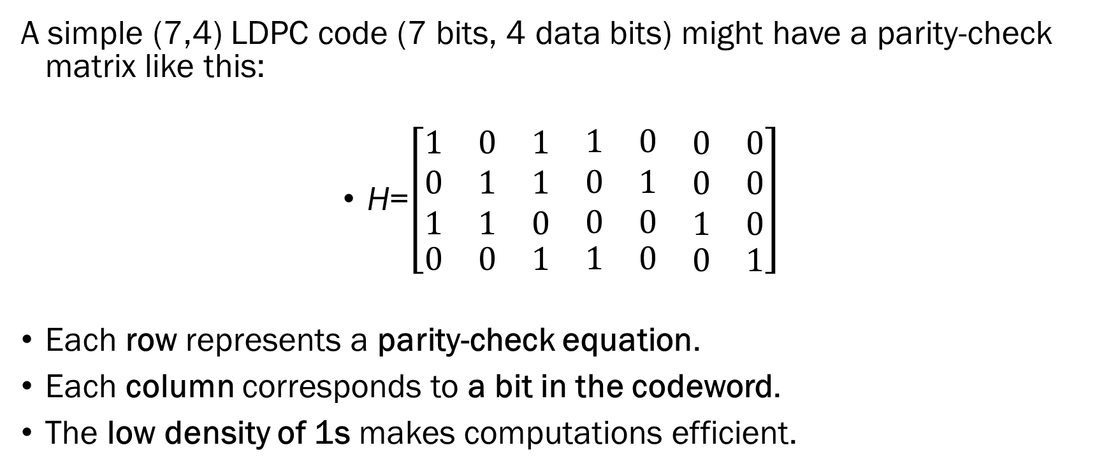
Example: LDPC Parity-Check Matrix
A simple (7,4) LDPC code (7 bits, 4 data bits) might have a parity-check matrix like this:
H=$\left[\begin{matrix}\begin{matrix}1 & 0 & 1 \\ 0 & 1 & 1 \\ 1 & 1 & 0\end{matrix} & \begin{matrix}1 & 0 & \begin{matrix}0 & 0\end{matrix} \\ 0 & 1 & \begin{matrix}0 & 0\end{matrix} \\ 0 & 0 & \begin{matrix}1 & 0\end{matrix}\end{matrix} \\ \begin{matrix}0 & 0 & 1\end{matrix} & \begin{matrix}1 & 0 & \begin{matrix}0 & 1\end{matrix}\end{matrix}\end{matrix}\right]$
​​Each row represents a parity-check equation.
Each column corresponds to a bit in the codeword.
The low density of 1s makes computations efficient.

Slide 51
Error-Detecting Codes
1. Parity.
2. Checksums.
3. Cyclic Redundancy Checks (CRCs).

Slide 52
Parity
A single parity bit is appended to the data.
Bit is chosen so that the number of 1 bits in the codeword is even (or odd)
Doing this is equivalent to computing the (even) parity bit as the modulo 2 sum or XOR of the data bits.
When 1011010 is sent in even parity : 10110100
When 1011010 is sent in odd parity : 10110101
Single parity bit has a distance of 2

Slide 53
Difficulty in Parity
A single parity bit can detect a single-bit error in a data block reliably. However, if a block experiences a "long burst error" (multiple errors in a sequence), the chance of detecting it drops to 50%, which is insufficient for reliable error detection.
Matrix-Based Parity Improvement: To enhance error detection, data can be organized into a rectangular matrix (n bits wide and k bits high). By calculating and sending a parity bit for each row:
Up to k bit errors can be detected reliably.
This works as long as no more than one error occurs per row.

Slide 54
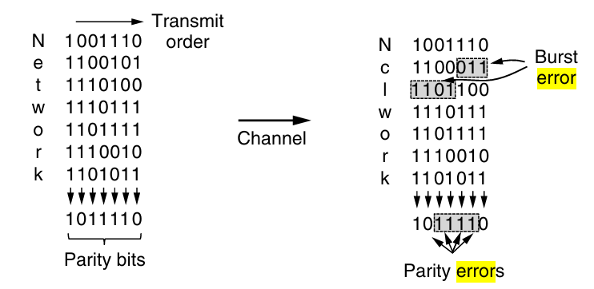
Interleaving
Notes:
we can compute the parity bits over the data in a different order than the order in which the data bits are transmitted. we will compute a parity bit for each of the n columns and send all the data bits as k rows, sending the rows from top to bottom and the bits in each row from left to right in the usual manner.

Slide 55
Checksum
Closely related to groups of parity bits.
A group of check bits associated with a message, regardless of how are calculated.
A group of parity bits is one example of a checksum.
However, there are stronger checksum methods based on a running sum of the data bits in a message.
The checksum is typically placed at the end of the message as the complement of the sum function.
To detect errors, the receiver sums the entire received codeword, including both the data bits and the checksum.
If the result is zero, no errors are detected.

Slide 56
Example: 16-bit Internet Checksum Calculation
Step 1: Divide the Data into 16-bit Words
1100 1010 (0xCA)
1011 0111 (0xB7)
0110 1100 (0x6C)
0001 1110 (0x1E)
1100 1010 1011 0111 (0xCAB7)
0110 1100 0001 1110 (0x6C1E)
Step 2: Compute the Sum (Ones' Complement Arithmetic)
CAB7 + 6C1E = 136D5
8-bit data blocks
Since the checksum operates on 16-bit words, we pair them:

Slide 57
Example: 16-bit Internet Checksum Calculation
Since the sum is greater than 16 bits
136D5
+ 0001 (carry)
---------
36D6 (final sum after carry addition)
Step 3: Take the One’s Complement of the Sum
Checksum = 1100 1001 0010 1001 (0xC929)

Slide 58
Example: 16-bit Internet Checksum Calculation
Step 4: Transmit the Data with the Checksum
Data: 1100 1010 1011 0111 0110 1100 0001 1110
Checksum: 1100 1001 0010 1001
The Internet checksum is efficient and simple but offers weak protection in certain cases because it is merely a simple sum.
It fails to detect the deletion or addition of zero-value data, swapping of message segments, and message splicing, where parts of two packets are combined.
While these errors may seem unlikely to occur randomly, they are precisely the types of issues that can arise due to faulty hardware.

Slide 59
Fletcher’s checksum
It includes a positional component, adding the product of the data and its position to the running sum.
This provides stronger detection of changes in the position of data.
How Fletcher’s Checksum Works
Initialize two sums:
sum1 = 0 ; sum2 = 0
Process each byte (or word) of data sequentially:
sum1 = (sum1 + data_byte) mod 255
sum2 = (sum2 + sum1) mod 255
At the end of the message, combine both sums into a final checksum.
The two sums are concatenated to form a 16-bit (or 32-bit) checksum.

Slide 60
CRC (Cyclic Redundancy Check)
Also known as a polynomial code
Polynomial codes are based upon treating bit strings as representations of polynomials with coefficients of 0 and 1 only.
A k-bit frame is regarded as the coefficient list for a polynomial with k terms, ranging from x^{k−1} to x⁰.
For example, 110001 has 6 bits and thus represents a six-term polynomial with coefficients 1, 1, 0, 0, 0, and 1:
1x⁵ + 1x⁴ + 0x³ + 0x² + 0x¹ + 1x⁰.
Polynomial arithmetic is done modulo 2, according to the rules of algebraic field theory.
Notes:
It does not have carries for addition or borrows for subtraction. Both addition and subtraction are identical to exclusive OR. Long division is carried out in exactly the same way as it is in binary except that the subtraction is again done modulo 2. A divisor is said ‘‘to go into’’ a dividend if the dividend has as many bits as the divisor.

Slide 61
CRC (Cyclic Redundancy Check)
The sender and receiver must agree upon a generator polynomial, G(x), in advance.
Both the high-and low order bits of the generator must be 1.
The algorithm for computing the CRC is as follows:
1. Let r be the degree of G(x). Append r zero bits to the low-order end of the frame so it now contains m + r bits and corresponds to the polynomial x^{r}M(x).
2. Divide the bit string corresponding to G(x) into the bit string corresponding to x^{r}M(x), using modulo 2 division.
3. Subtract the remainder (which is always r or fewer bits) from the bit string corresponding to x^{r}M(x) using modulo 2 subtraction. The result is the checksummed frame to be transmitted. Call its polynomial T(x)

Slide 62
Example
The calculation for a frame 1101011111 using the generator G(x) = x⁴ + x +1.
Step 1: Append 4 Zero as r = 4 in G(X). So codeword will be x^{r}M(x) = 11010111110000
Step : 2 Perform Division using Module 2 Subtraction, it will give remainder 10.
Step 3 : Subtract remainder from x^{r}M(x) for the code to transmit 11010111110010

Slide 63
Example
The calculation for a frame 1101011111 using the generator G(x) = x⁴ + x +1.
Step 1: Append 4 Zero as r = 4 in G(X). So codeword will be x^{r}M(x) = 11010111110000
Step : 2 Perform Division using Module 2 Subtraction, it will give remainder 10.
Step 3 : Subtract remainder from x^{r}M(x) for the code to transmit 11010111110010

Slide 64
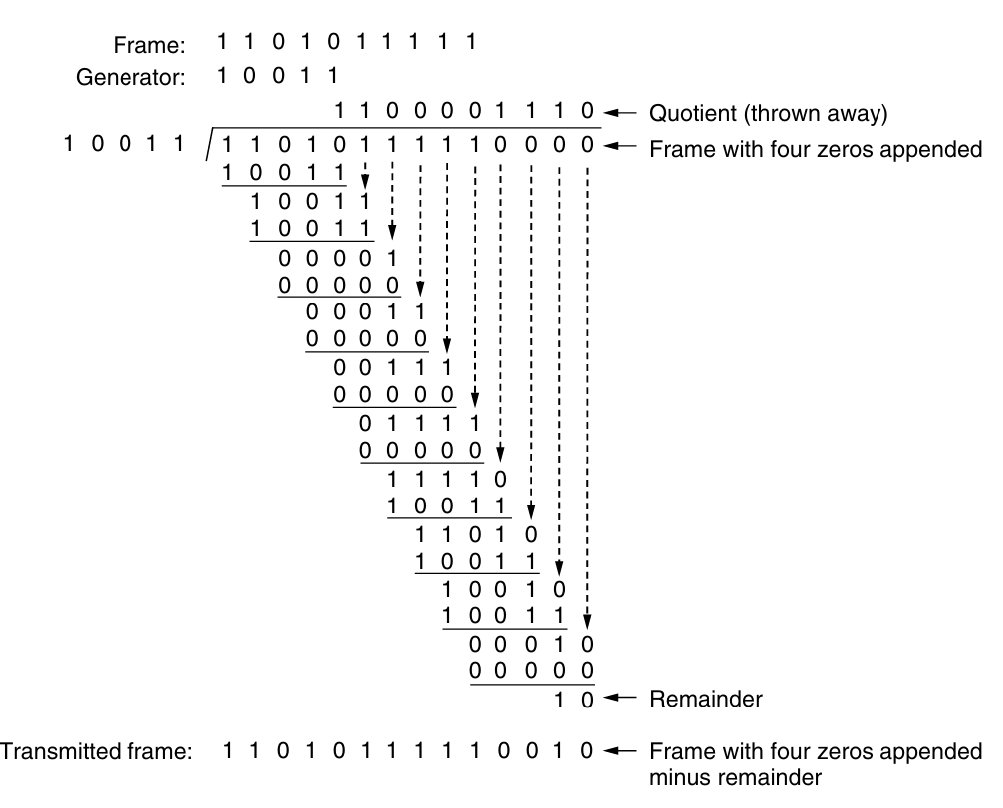

Slide 65
ELEMENTARY DATA LINK PROTOCOLS
The physical layer process and some of the data link layer process run on dedicate hardware called a NIC (Network Interface Card).
The rest of the link layer process and the network layer process run on the main CPU as part of the operating system, with the soft ware for the link layer process often taking the form of a device driver.
A is assumed to have an infinite supply of data ready to send and never has to wait for data to be produced.
Instead, when A’s data link layer asks for data, the network layer is al ways able to comply immediately.

Slide 66
ELEMENTARY DATA LINK PROTOCOLS
We also assume that machines do not crash.
The packet passed across the inter face to it data link layer from the network layer is pure data, whose every bit is to be delivered to the destination’s network layer.
Initially, the receiver has nothing to do. It just sits around waiting for some thing to happen.
The data link layer is waiting for something to happen by the procedure call
When a frame is received from Physical Layer, the checksum is recomputed.

Slide 67
ELEMENTARY DATA LINK PROTOCOLS
As soon as the receiving data link layer has acquired an undamaged frame, passes the packet portion to the network layer.
Under no circumstances is a frame header ever given to a network layer.
A frame is composed of four fields: kind, seq, ack, and info, the first three of which contain control information and the last of which may contain actual data to be transferred.
These control fields are collectively called the frame header.

Slide 68
ELEMENTARY DATA LINK PROTOCOLS
The kind field tells whether there are any data in the frame.
Some of the protocols distinguish frames containing only control information from those containing data as well.
The seq and ack fields are used for sequence numbers and acknowledgements.
Frame sequence numbers are always in the range 0 to MAX SEQ (inclusive), where MAX SEQ is different for the different protocols. advance a sequence number by 1 circularly
The info field of a data frame contains a single packet, may be variable length field or not.
In most of the protocols, we assume that the channel is unreliable and loses entire frames upon occasion.

Slide 69
ELEMENTARY DATA LINK PROTOCOLS
To be able to recover from such calamities, the sending data link layer must start an internal timer or clock whenever it sends a frame.
If no reply has been received within a certain predetermined time interval, the clock times out and the data link layer receives an interrupt signal.

Slide 70
Utopian Simplex Protocol
It does not worry about the possibility of anything going wrong.
Data are transmitted in one direction only.
Both the transmitting and receiving network layers are always ready. Processing time can be ignored.
Infinite buffer space is available.
And best of all, the communication channel between the data link layers never damages or loses frames.
This thoroughly unrealistic protocol

Slide 71
Utopian Simplex Protocol
The protocol consists of two distinct procedures, a sender and a receiver.
The sender runs in the data link layer of the source machine, and the receiver runs in the data link layer of the destination machine.
No sequence numbers or acknowledgements are used here

Slide 72
A Simplex Stop-and-Wait Protocol for an Error-Free Channel
Tackles the problem of preventing the sender from flooding the receiver with frames faster than the latter is able to process them.
The communication channel is still assumed to be error free, however, and A half duplex physical channel would suffice here.
One solution is to build the receiver to be powerful enough to process a continuous stream of back-to-back frames.
It must have sufficient buffering and processing abilities to run at the line rate and must be able to pass the frames that are received to the network layer quickly enough.

Slide 73
A Simplex Stop-and-Wait Protocol for an Error-Free Channel
It requires dedicated hardware and can be wasteful of resources if the utilization of the link is mostly low.
A more general solution to this problem is to have the receiver provide feed back to the sender.
After having passed a packet to its network layer, the receiver sends a little dummy frame back to the sender which, in effect, gives the sender permission to transmit the next frame..
After having sent a frame, the sender is required by the protocol to bide its time until the little dummy (i.e., acknowledge ment) frame arrives. This delay is a simple example of a flow control protocol.

Slide 74
A Simplex Stop-and-Wait Protocol for an Error-Free Channel
Protocols in which the sender sends one frame and then waits for an acknowledgement before proceeding are called stop-and-wait.
The incoming frame is always an acknowledgement.
Frame
Dummy Frame
Frame
Dummy Frame
Frame
Sender
Receiver

Slide 75
Simplex Stop-and-Wait Protocol for a Noisy Channel
The normal situation of a communication channel that makes errors.
Frames may be either damaged or lost completely.
Assume that if a frame is damaged in transit, the receiver hardware will detect this when it computes the checksum.
If the frame is damaged in such a way that the checksum is nevertheless correct—an unlikely occurrence—this protocol (and all other protocols) can fail.
A variation of protocol 2 would work: adding a timer.

Slide 76
Simplex Stop-and-Wait Protocol for a Noisy Channel
The sender could send a frame, but the receiver would only send an acknowledgement frame if the data were correctly received.
If a damaged frame arrived at the receiver, it would be discarded.
After a while the sender would time out and send the frame again.
The data link layer is responsible for ensuring error-free transmission between directly connected nodes.
Since the network layer on a receiving node (B) does not have inherent mechanisms to detect packet loss or duplication (except in some protocols like TCP which operate at a higher level), the data link layer must provide mechanisms to prevent such issues.

Slide 77

Simplex Stop-and-Wait Protocol for a Noisy Channel
Frame
Acknowledge
Frame
Sender
Receiver
Notes:
Consider the following scenario:
The network layer on A gives packet 1 to its data link layer. The packet is correctly received at B and passed to the network layer on B. B sends an acknowledgement frame back to A.
The acknowledgement frame gets lost completely. It just never arrives at all. Life would be a great deal simpler if the channel mangled and lost only data frames and not control frames, but sad to say, the channel is not very discriminating.
The data link layer on A eventually times out. Not having received an acknowledgement, it (incorrectly) assumes that its data frame was lost or damaged and sends the frame containing packet 1 again.
The duplicate frame also arrives intact at the data link layer on B and is unwittingly passed to the network layer there. If A is sending a file to B, part of the file will be duplicated (i.e., the copy of the file made by B will be incorrect and the error will not have been detected). In other words, the protocol will fail

Slide 78
Solution to Problem
Using Sequence Numbers to Resolve Ambiguity
A sequence number in the frame header allows the receiver to differentiate between new transmissions and retransmissions.
The main challenge is determining how many bits are necessary for the sequence number.
Minimum Number of Bits Required :
A 1-bit sequence number (0 or 1)
This means that frame m is assigned sequence number 0, and frame m+1 is assigned sequence number 1.
If an acknowledgment is lost, the receiver will still be able to distinguish between retransmissions and new frames.
The receiver expects a particular sequence number next.
Notes:
Sequence Number : a few bits, 1 byte, or multiple bytes.
Since the only ambiguity in the protocol is between a frame and its immediate predecessor or successor, the sequence numbers only need to alternate between two values (for Stop-and-Wait protocols).

Slide 79
Solution to Problem
Sender
Receiver
Frame 0
Ack 1
Sender sends Frame 0.
Receiver gets Frame 0, sends ACK 1.
Sender receives ACK 1, sends Frame 0.
Receiver gets Frame 0, sends ACK 1.
Sender receives ACK 1, sends Frame 0 (next cycle).
Any arriving frame containing the wrong sequence number is rejected as a duplicate.
However, the last valid acknowledgement is repeated so that the sender can eventually discover that the frame has been received.
Frame 1
Ack 0
Frame 1
Frame Rejected
Ack 0
Notes:
Since the only ambiguity in the protocol is between a frame and its immediate predecessor or successor, the sequence numbers only need to alternate between two values (for Stop-and-Wait protocols).

Slide 80
Protocol 3 (Stop-and-Wait ARQ)
Stop-and-Wait ARQ (Automatic Repeat reQuest) or PAR (Positive Acknowledgement with Retransmission) protocol, ensuring reliable communication through acknowledgments and retransmissions.
Sequence Number Management:
The sender stores the sequence number of the next frame to send (next_frame_to_send).
The receiver stores the sequence number of the next expected frame (frame_expected).
When a frame arrives, the receiver checks the sequence number to detect duplicates.

Slide 81
Protocol 3 (Stop-and-Wait ARQ)
Timer-Based Retransmission:
Sender starts a timer when a frame is transmitted.
If an ACK is received correctly, the sender advances to the next frame.
If the ACK is lost or corrupted, or the timer expires, the sender retransmits the last frame.
If a damaged frame is received, the receiver discards it and resends the last ACK
Handling Transmission Errors:
Duplicate Frames: The receiver checks the sequence number; if the frame is a duplicate, it is discarded, but the last ACK is resent.
Lost or Corrupted Frames: The sender retransmits the last frame upon timeout.
Lost Acknowledgments: If an ACK is lost, the sender times out and resends the last frame, which the receiver recognizes as a duplicate and ignores.

Slide 82
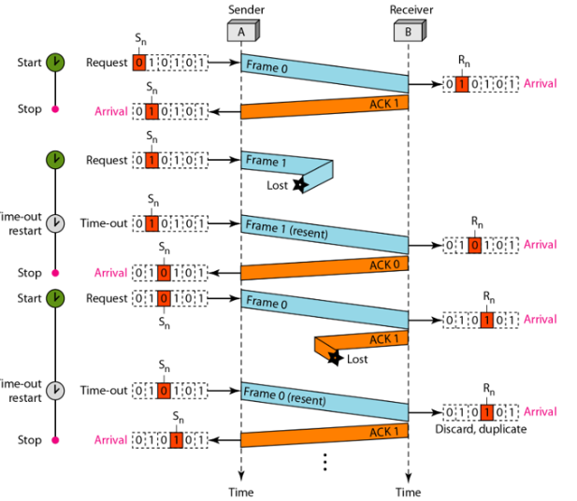

Example : Protocol 3 (Stop-and-Wait ARQ)
FRAME 0
Ack 1

Slide 83
SLIDING WINDOW PROTOCOLS
In traditional simplex communication protocols, data frames are transmitted in only one direction, requiring a separate channel for acknowledgments.
This leads to inefficient use of the reverse channel, which mostly carries small acknowledgment packets while having the capacity to transmit much more.
A more efficient way to implement full-duplex communication is to combine the forward and reverse channels into a single bidirectional link.

Slide 84
SLIDING WINDOW PROTOCOLS
Several techniques can help achieve this:
Piggybacking: Instead of sending acknowledgments separately, they can be attached to outgoing data frames. This reduces the need for dedicated acknowledgment frames, improving channel utilization.
Sliding Window Protocols: These protocols (like Go-Back-N and Selective Repeat) allow multiple frames to be sent before receiving an acknowledgment, making better use of available bandwidth.
Statistical Multiplexing: By dynamically allocating bandwidth between data and acknowledgments, the link can be used more efficiently.
Time-Division Duplexing (TDD): If a single physical medium is used, the link can alternate between transmitting and receiving based on a time schedule, reducing idle time.
Frequency-Division Duplexing (FDD): If two frequency bands are available, one can be used for sending data and the other for acknowledgments, reducing waste.

Slide 85
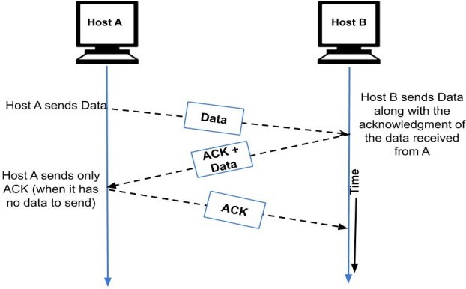
Piggybacking

Slide 86
Piggybacking
Instead of using separate physical links for data and acknowledgments, the same link is used for both directions.
Data frames and acknowledgment frames are intermixed, identified using a "kind" field in the header.
Instead of sending separate acknowledgment frames, the receiver waits for the next outgoing data frame and attaches the acknowledgment to it.
Piggybacking reduces the number of frames transmitted, making better use of the channel.
Fewer frames mean less overhead for both sender and receiver, reducing processing requirements.

Slide 87
Piggybacking
The acknowledgment field typically requires only 1 bit in the frame header, compared to a full acknowledgment frame that needs a header, checksum, etc.
If the receiver has no immediate data to send, acknowledgments might be delayed, which could affect performance in time-sensitive protocols.
Waiting a fixed number of milliseconds. If a new packet arrives quickly, the acknowledgement is piggybacked onto it. Otherwise, if no new packet has arrived by the end of this time period, the data link layer just sends a separate acknowledgement frame.
Piggybacking is more efficient but slightly more complex to implement. It optimizes channel utilization while reducing redundant control frames.

Slide 88
SLIDING WINDOW
These protocols use sequence numbers to track transmitted frames and manage acknowledgments efficiently.
Each frame has a sequence number, typically ranging from 0 to (2ⁿ - 1), ensuring it fits within an n-bit field.
Whereas a basic form of sliding window protocol that uses n = 1, limiting sequence numbers to 0 and 1.
Sophisticated sliding window protocols allow larger n, enabling more outstanding frames in transit for higher efficiency.
The sender maintains a set of sequence numbers representing frames it is allowed to send at a given time (sending window).

Slide 89
SLIDING WINDOW
The receiver keeps track of sequence numbers corresponding to frames it can accept (receiving window).
The sender’s and receiver’s windows do not need to have the same size or boundaries.
In some protocols, the window size is fixed, while in others, it can expand or shrink based on network conditions and frame acknowledgments.
Despite increased flexibility, packets must be delivered to the destination network layer in the same order they were sent.
The physical communication channel must deliver frames in the order sent (like a wire).

Slide 90
SLIDING WINDOW
The sender’s window contains frames that have been sent but not yet acknowledged.
When a new packet arrives from the network layer, it gets the next sequence number, and the window's upper edge moves forward.
When an acknowledgment is received, the window’s lower edge moves forward.
The window maintains a list of frames that may be lost or damaged.
The sender must store these frames for possible retransmission.
If the maximum window size is n, the sender needs n buffers to store unacknowledged frames.
If the window becomes full, the sender must wait before sending new frames.

Slide 91
SLIDING WINDOW
If the sender’s window reaches maximum size, it must stop accepting new packets from the network layer until a buffer is freed.
The receiver’s window tracks frames it can accept.
Accepted frames are stored in the receiver’s buffer.
When a frame matches the lower edge of the window, it is passed to the network layer, and the window shifts forward.
Any frame outside the receiver’s window is discarded.
An acknowledgment (ACK) is always sent to inform the sender of the next expected frame.

Slide 92
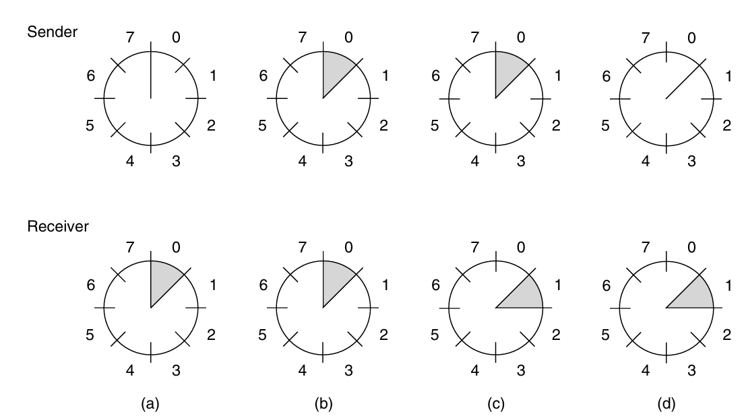
SLIDING WINDOW
Window size = 1: Frames must be received strictly in order.
Window size > 1: Frames may be received out of order by the data link layer.
The network layer always receives data in the correct order, regardless of window size.

Slide 93
Type of SLIDING WINDOW Protocol
A One-Bit Sliding Window Protocol
A Protocol Using Go-Back-N
A Protocol Using Selective Repeat

Slide 94
A One-Bit Sliding Window Protocol
A sliding window protocol with a window size of 1.
The sender fetches a packet from the network layer, creates a frame, and transmits it.
The receiver checks if the received frame is a duplicate (similar to Protocol 3).
If the received frame matches the expected sequence number, it is passed to the network layer, and the receiver's window slides up.
A0 | A1 | A2 | A3 | A4 | A5 | A6
B0 | B1 | B2 | B3 | B4 | B5 | B6

Slide 95
A One-Bit Sliding Window Protocol
The ACK field contains the last successfully received frame number.
If the ACK matches the sender's sequence number, the sender knows the frame was received correctly.
If the ACK does not match, the sender retransmits the same frame.
Every time a frame is received, an acknowledgment frame is also sent back.

Slide 96
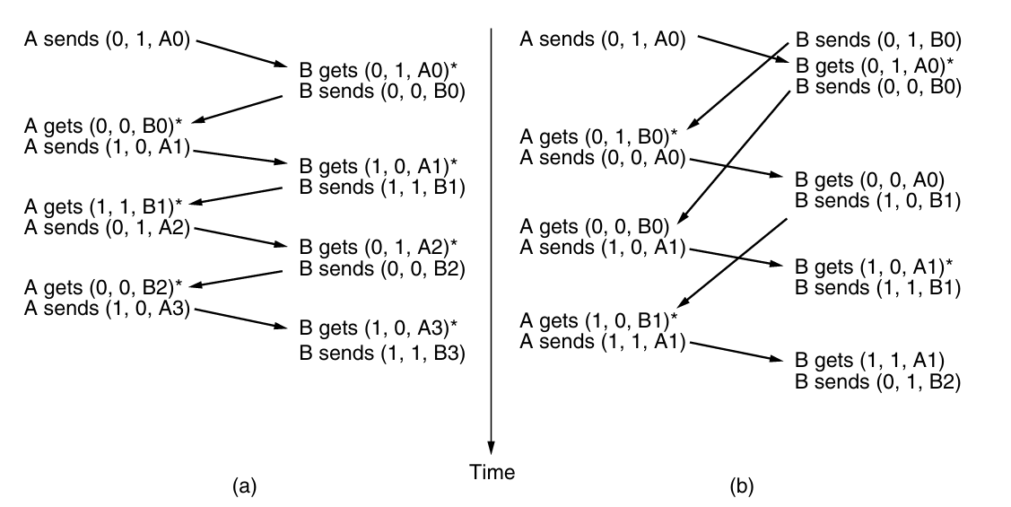
A One-Bit Sliding Window Protocol
Figure 3-17. Two scenarios for protocol 4. (a) Normal case. (b) Abnormal case. The notation is (seq, ack, packet number). An asterisk indicates where a network layer accepts a packet.

Slide 97
A Protocol Using Go-Back-N
Previously, we assumed that the round-trip transmission time (frame transmission + ACK return) is negligible.
In reality, this is not always true, especially in cases with long propagation delays.
The sender remains blocked for most of the time due to the long round-trip delay, utilizing only a small fraction of the available bandwidth.
Instead of waiting for an ACK after each frame, the sender is allowed to send up to w frames before stopping.
This ensures continuous transmission and prevents blocking.
Higher efficiency is achieved by overlapping frame transmission with acknowledgment reception.

Slide 98
A Protocol Using Go-Back-N
To achieve optimal efficiency in a high-latency network, the sender’s window size (w) should be set to:
w=2×BD+1
where BD (Bandwidth-Delay product) represents the number of frames that can be in transit. This ensures that the sender can continuously transmit frames without waiting for acknowledgments, maximizing bandwidth utilization.
For a 50 kbps link with a one-way delay of 250 ms, BD = 12.5 frames, so w = 26 frames ensures 100% utilization. If a smaller window size is used, the sender may be blocked, leading to lower efficiency.

Slide 99
Pipelining
Pipelining allows multiple frames to be in transit simultaneously, improving efficiency over unreliable communication channels.
However, if a frame is lost or damaged, all subsequent frames may arrive before the sender detects the issue.
Since the receiver must deliver packets in order, it has two options:
Discard all subsequent frames until the missing frame is retransmitted (Go-Back-N).
Buffer the correct frames and request only the missing one (Selective Repeat).

Slide 100
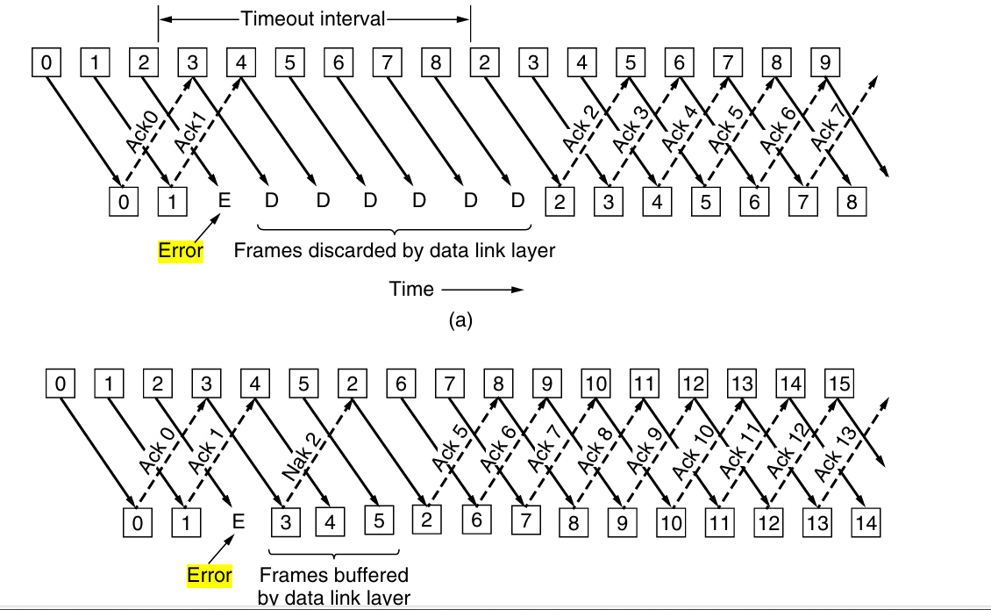
Sender
Receiver
go-back-n
Sender
Receiver
(b) Selective repeat

Slide 101
Go-back-N
The receiver only accepts the next expected frame and discards out-of-order frames.
If a frame is lost or damaged, the receiver does not acknowledge it, causing the sender’s window to fill up (window size is important).
The sender waits for a timeout and then retransmits all unacknowledged frames from the lost/damaged frame onwards.
If errors occur frequently, many correctly received frames may need to be retransmitted, wasting bandwidth.

Slide 102
Go-back-N
The receiver only accepts the next expected frame and discards out-of-order frames.
The sequence numbers are module 2^{m}
If a frame is lost or damaged, the receiver does not acknowledge it, causing the sender’s window to fill up (window size is important).
The sender waits for a timeout and then retransmits all unacknowledged frames from the lost/damaged frame onwards.
If errors occur frequently, many correctly received frames may need to be retransmitted, wasting bandwidth.

Slide 103
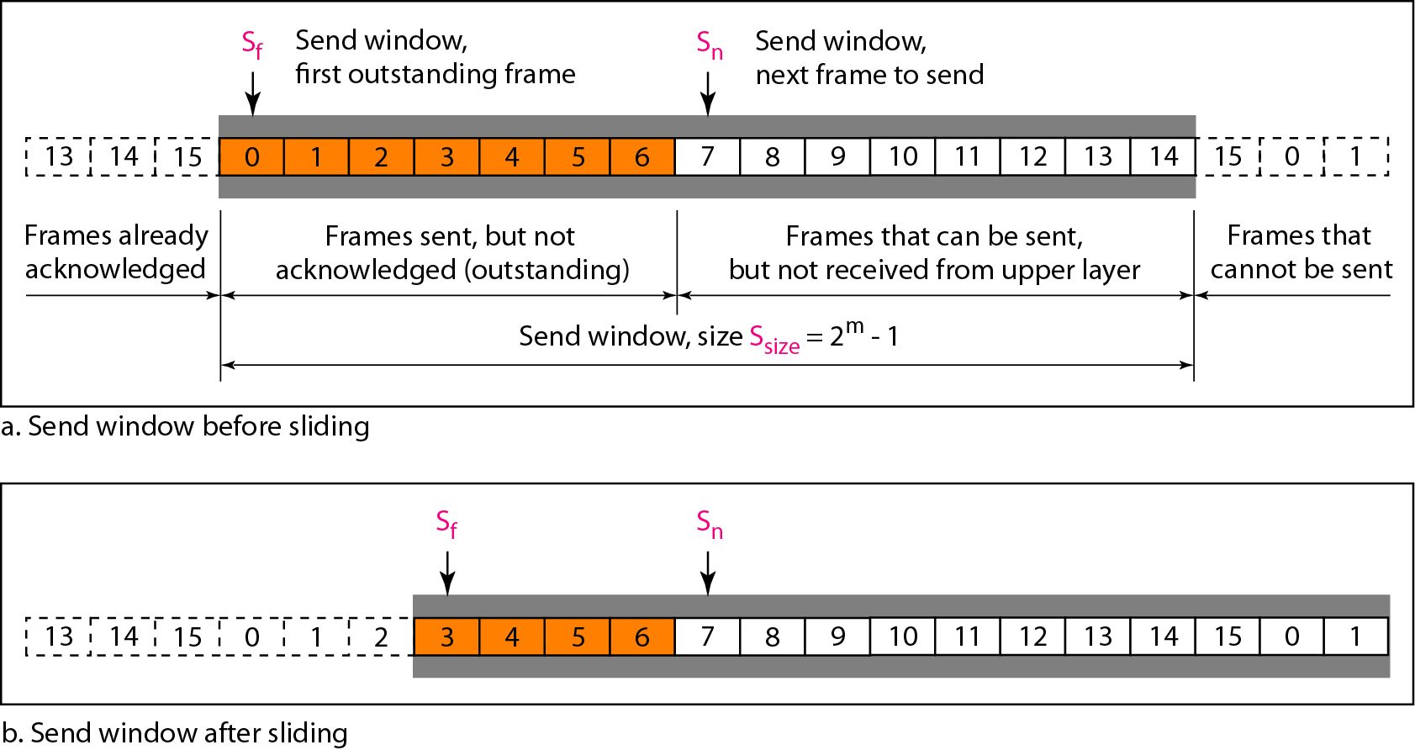
Figure 11.12 Send window for Go-Back-N ARQ

Slide 104
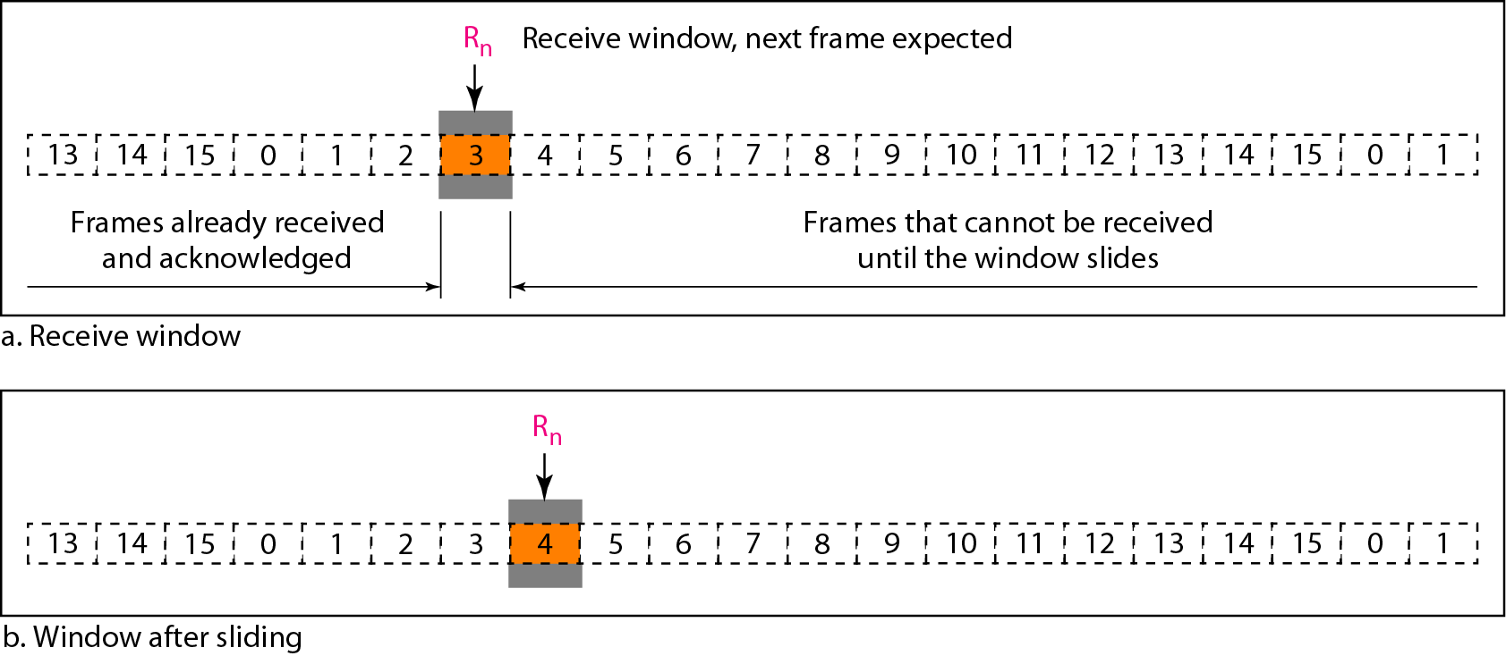
Figure 11.13 Receive window for Go-Back-N ARQ

Slide 105
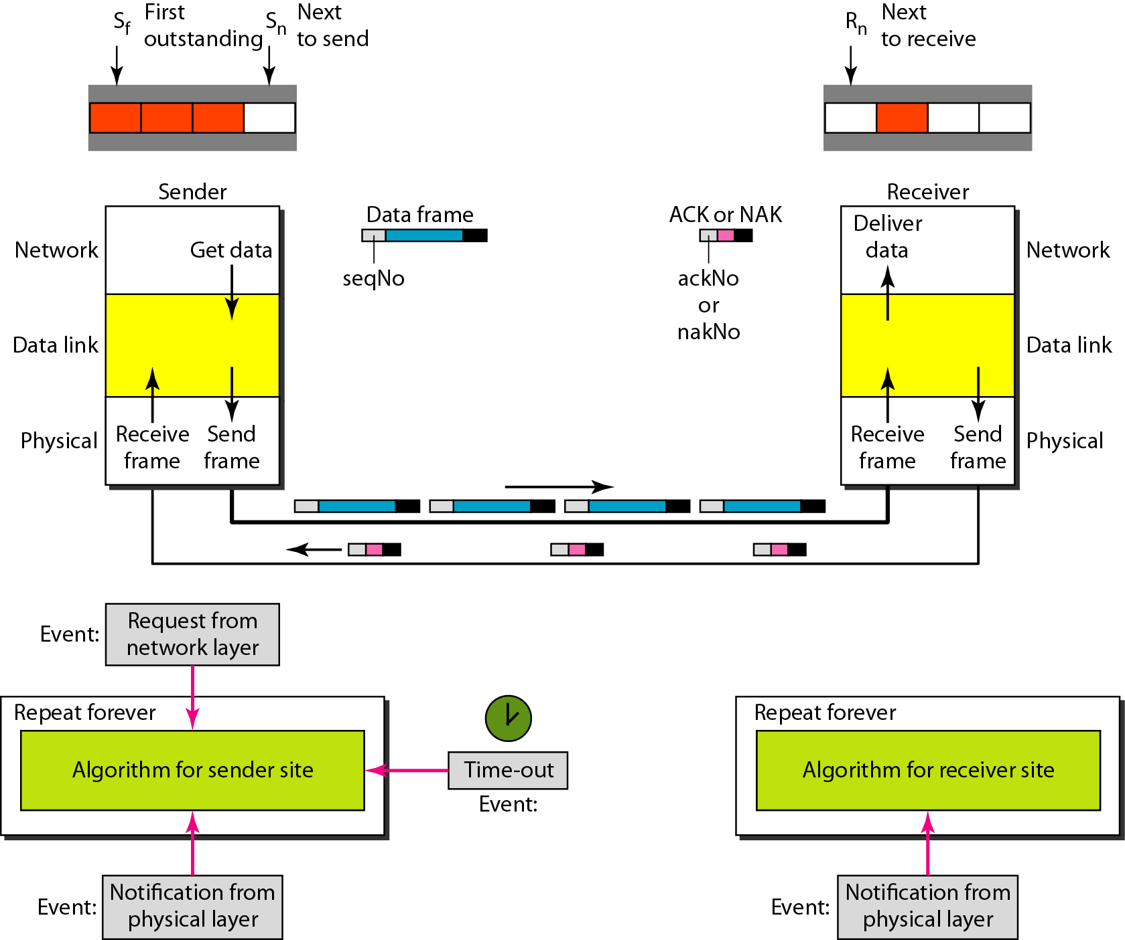
Figure 11.20 Design of Selective Repeat ARQ

Slide 106
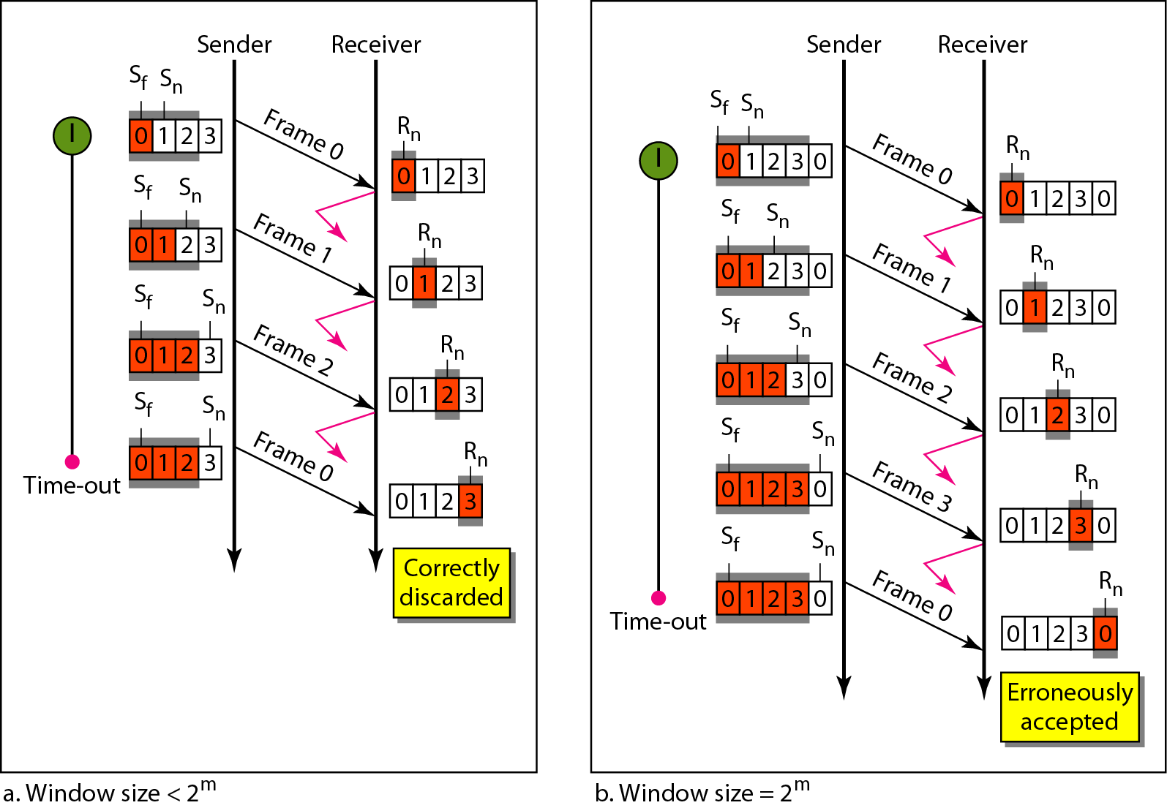
Figure 11.15 Window size for Go-Back-N ARQ

Slide 107
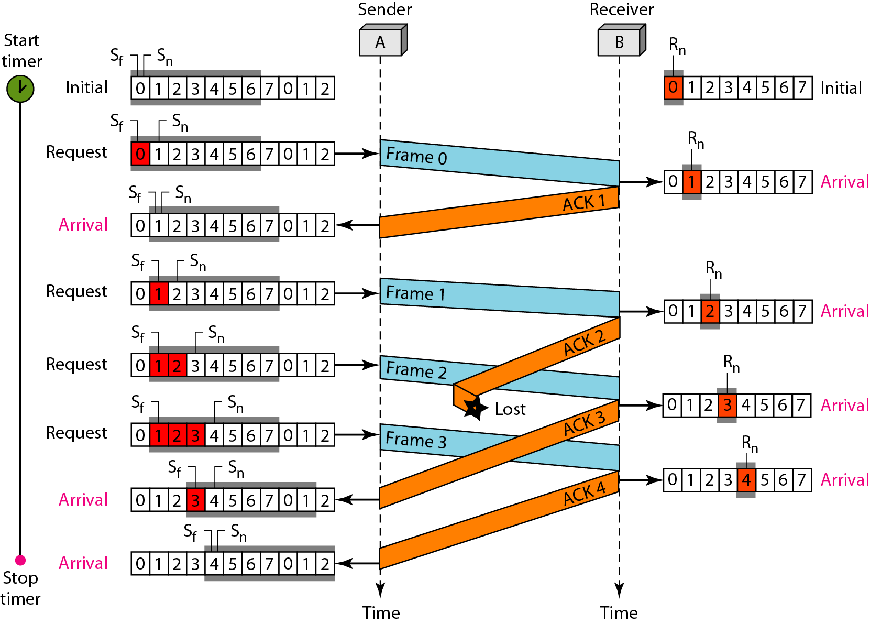
Figure 11.16 Flow diagram for Example 11.6

Slide 108
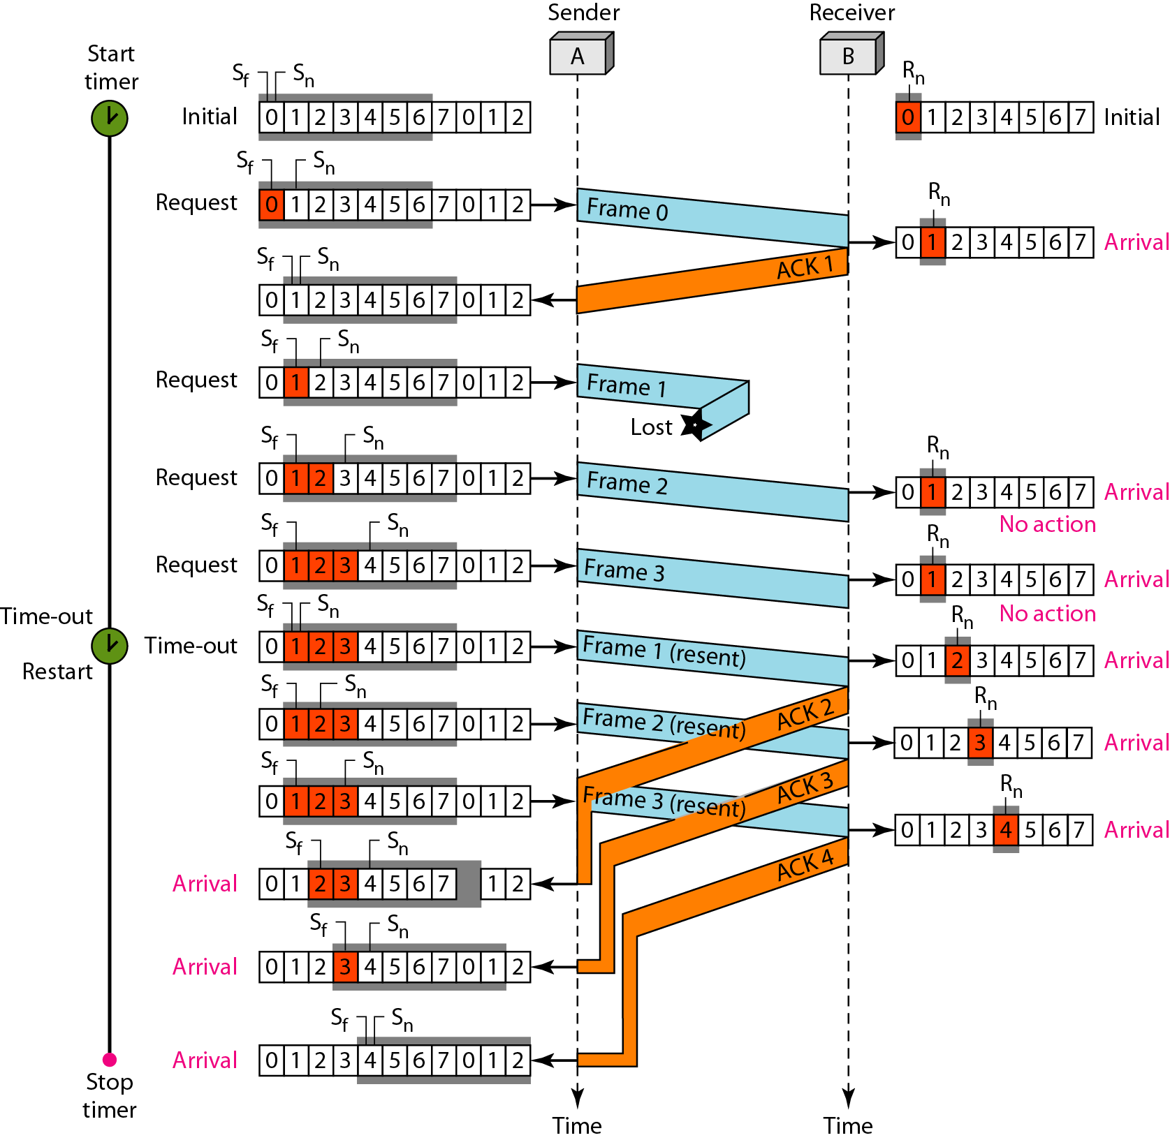
Figure 11.17 Flow diagram for Example 11.7

Slide 109
Selective Repeat Approach
Unlike Go-Back-N, only the lost/damaged frame is retransmitted instead of the entire window.
The receiver accepts and buffers frames received after a lost/damaged frame, ensuring efficient use of bandwidth.
The receiver sends a NAK when an error is detected, prompting the sender to retransmit before the timeout expires.
Selective Repeat uses more buffer space but improves bandwidth utilization by avoiding unnecessary retransmissions.
The sender must limit outstanding frames to MAX SEQ, ensuring the receiver can distinguish between new and previously transmitted frames.

Slide 110
Selective Repeat Approach
Cumulative Acknowledgement – Acknowledging frame n implies all previous frames (n-1, n-2, etc.) are also acknowledged, preventing redundant buffering at the sender’s end.
Handling One-Way Traffic – Unlike Go-Back-N, Selective Repeat optimizes acknowledgment piggybacking and avoids unnecessary retransmissions.
Use of Multiple Timers – Each outstanding frame has a separate timer, managed efficiently using a single hardware clock and a linked list of pending timeouts.

Slide 111
Selective Repeat ARQ Protocol
Sender Window: The sender can transmit multiple frames (up to a certain limit) before needing an acknowledgment.
Receiver Window: The receiver can accept frames out of order and buffer them until the missing frames arrive.
When a frame is lost or corrupted, the receiver only requests a retransmission of that specific frame (using a Negative Acknowledgment (NAK)).
The receiver buffers correctly received frames so they can be delivered in order to the upper layers

Slide 112
Selective Repeat ARQ Protocol
Each frame has a sequence number.
If the sequence number range is too small, new frames might be mistaken for old retransmissions, leading to errors.
To prevent this, the window size is limited to (MAX SEQ + 1)/2 to ensure proper differentiation between new and old frames.
Imagine we have a 3-bit sequence number (0-7) and a sender window size of 7. If all acknowledgments are lost, the sender retransmits frame 0, which now falls into the receiver’s new window range. The receiver cannot tell if it's an old or new frame, causing incorrect packet delivery.
Solution: Restrict the sender window size to half of the total sequence number range (i.e., 4 in this case). This ensures that after the window moves forward, the new sequence numbers never overlap with the old ones.

Slide 113
Selective Repeat ARQ Protocol
Data Frame Timeout: If an acknowledgment (ACK) is not received in time, the sender retransmits that frame.
Auxiliary Timer (for ACKs): If no data frames are sent for a long time, an ACK is sent separately to confirm receipt of frames.
NAKs for Error Handling: If an error is detected, the receiver sends a NAK to request a retransmission of the damaged frame.

Slide 114
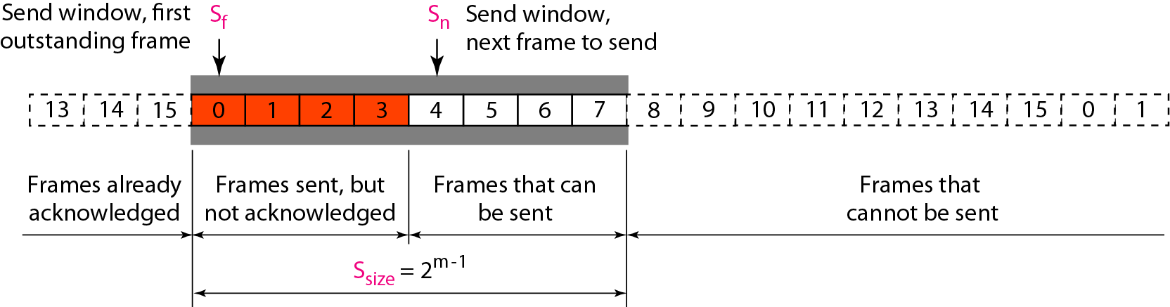
Figure 11.18 Send window for Selective Repeat ARQ

Slide 115
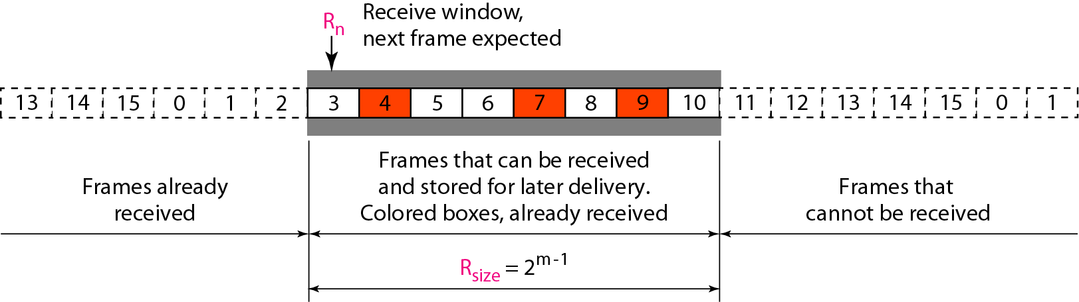
Figure 11.19 Receive window for Selective Repeat ARQ

Slide 116
Figure 11.20 Design of Selective Repeat ARQ

Slide 117
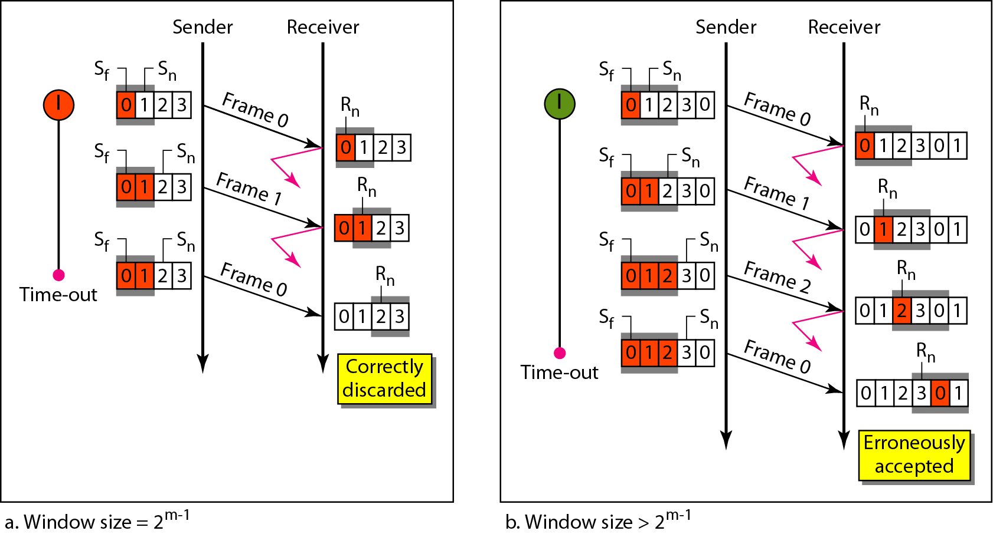
Figure 11.21 Selective Repeat ARQ, window size

Slide 118

Note
In Selective Repeat ARQ, the size of the sender and receiver window
must be at most one-half of 2^{m}.

Slide 119
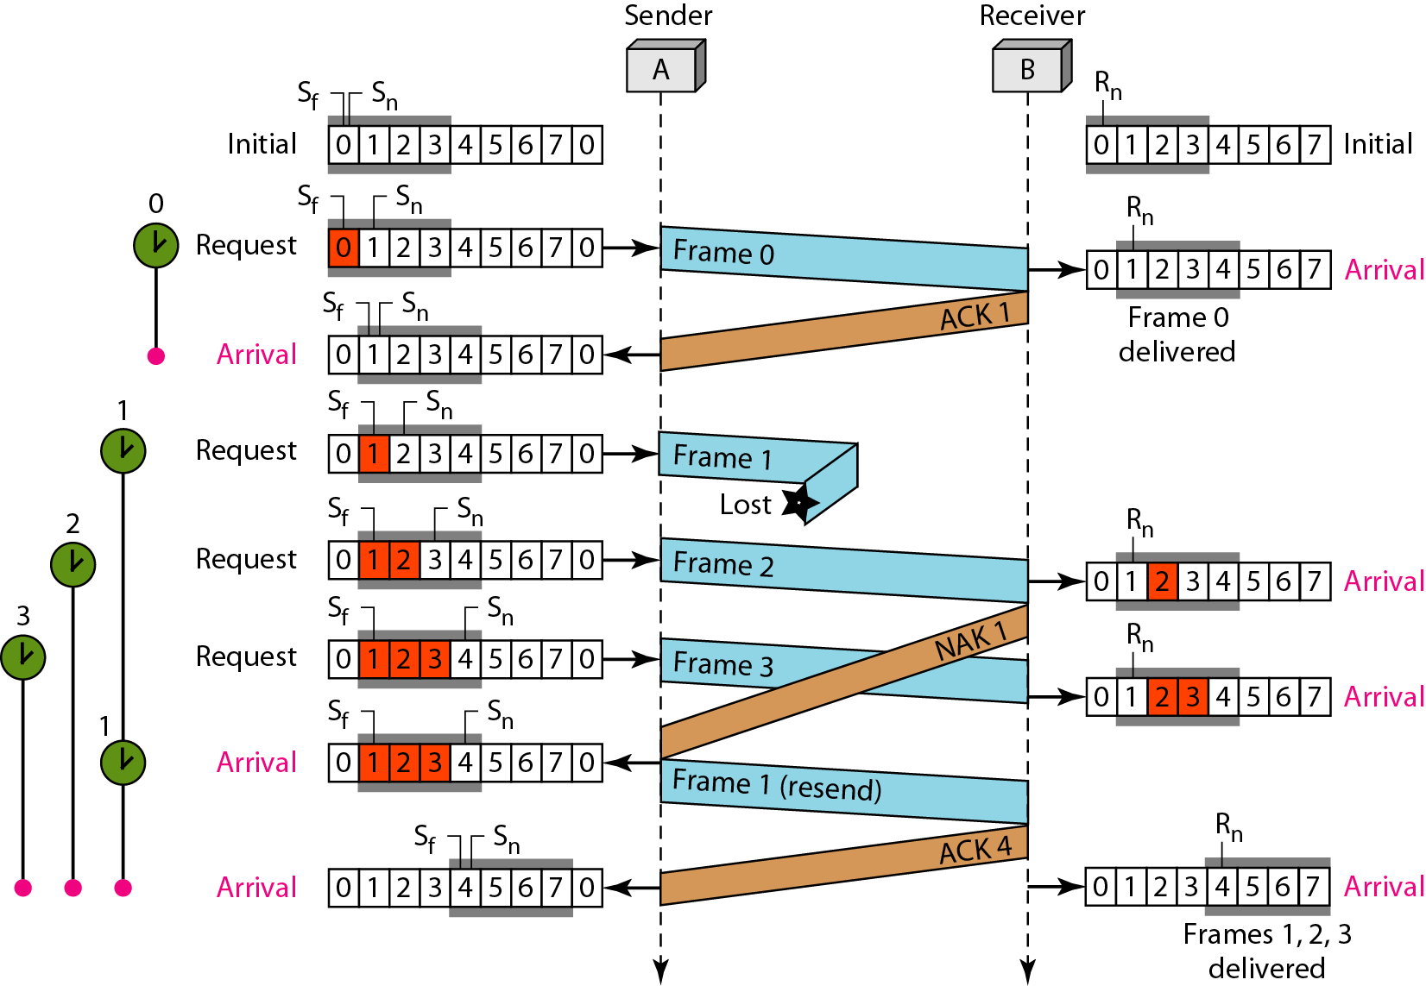
Figure 11.23 Flow diagram for Example 11.8

