Slide 1
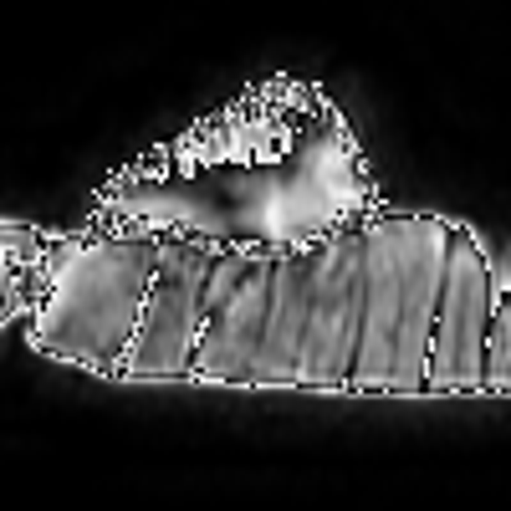

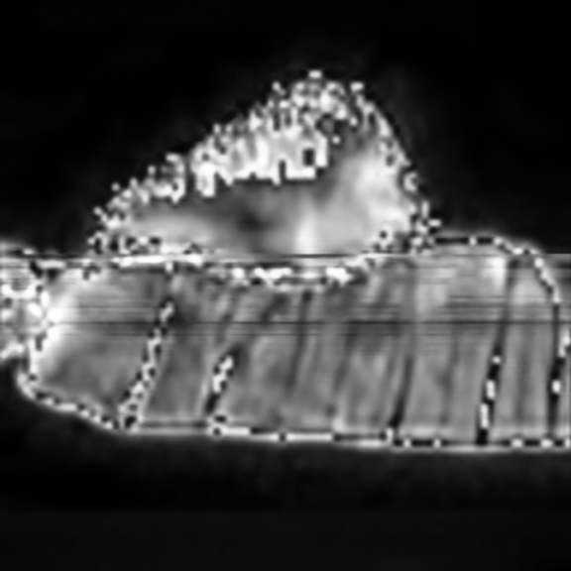
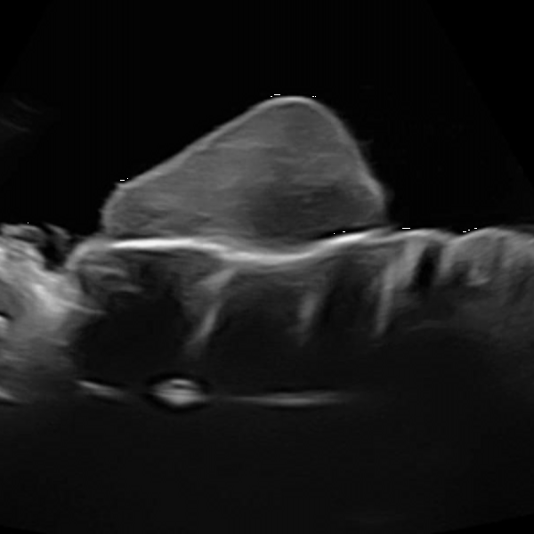
06/05/2021
Sensor Gain S₁
Richardson Lucy Deconvolution
✖️
MSE
Deconvoluted
MR Image
MR Image
➕
Loss
Input
(random noise)
Network
Output
✖️
MSE
Sensor Gain S₂
Deconvoluted US Image
US Image
Loss = MSE( S₁ * Output, deconvolution( MRI )) + MSE( S₂ * Output, deconvolution( USI ))

Slide 2
20/05/2021
Sensor Gain S₁ * Convolution Operator H₁
✖️
MSE
MR Image
➕
Loss
Input
(random noise)
Network
Output
✖️
MSE
Sensor Gain S₂ * Convolution Operator H₂
US Image
Loss = MSE( S₁ * H₁ * Output, MRI ) + MSE( S₂ * H₂ * Output, USI )

