Slide 1
Transferable and Fixable Proofs
William D’Alessandro
University of Oxford, Munich Center for Mathematical Philosophy
Boston Computing Club, September 2023

Slide 2
Acceptable proofs
What makes an informal proof acceptable to mathematicians?

Slide 3


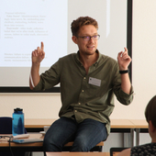
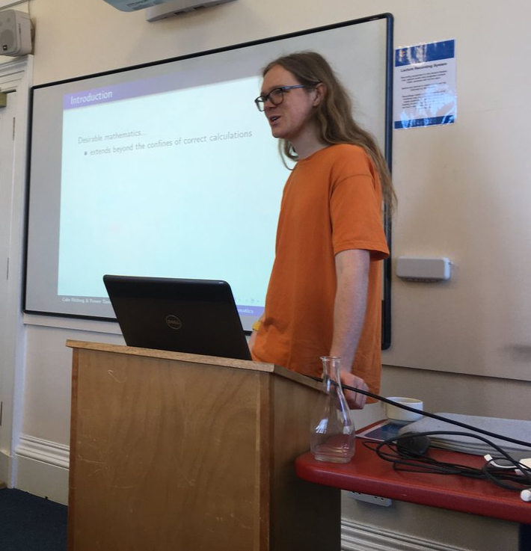
Acceptable proofs
Two interesting suggestions have recently emerged in the literature on this question.
These are transferability and fixability.

Slide 4

Transferability
To a first approximation, a proof $𝒫$ of a theorem $T$ is transferable when it’s possible for a typical expert to become convinced of $T$ solely on the basis of their prior knowledge and the information contained in $𝒫$.

Slide 5

Transferability
To a first approximation, a proof $𝒫$ of a theorem $T$ is transferable when it’s possible for a typical expert to become convinced of $T$ solely on the basis of their prior knowledge and the information contained in $𝒫$.
[Easwaran 2009] argues that transferability is a constraint on acceptable proof.

Slide 6
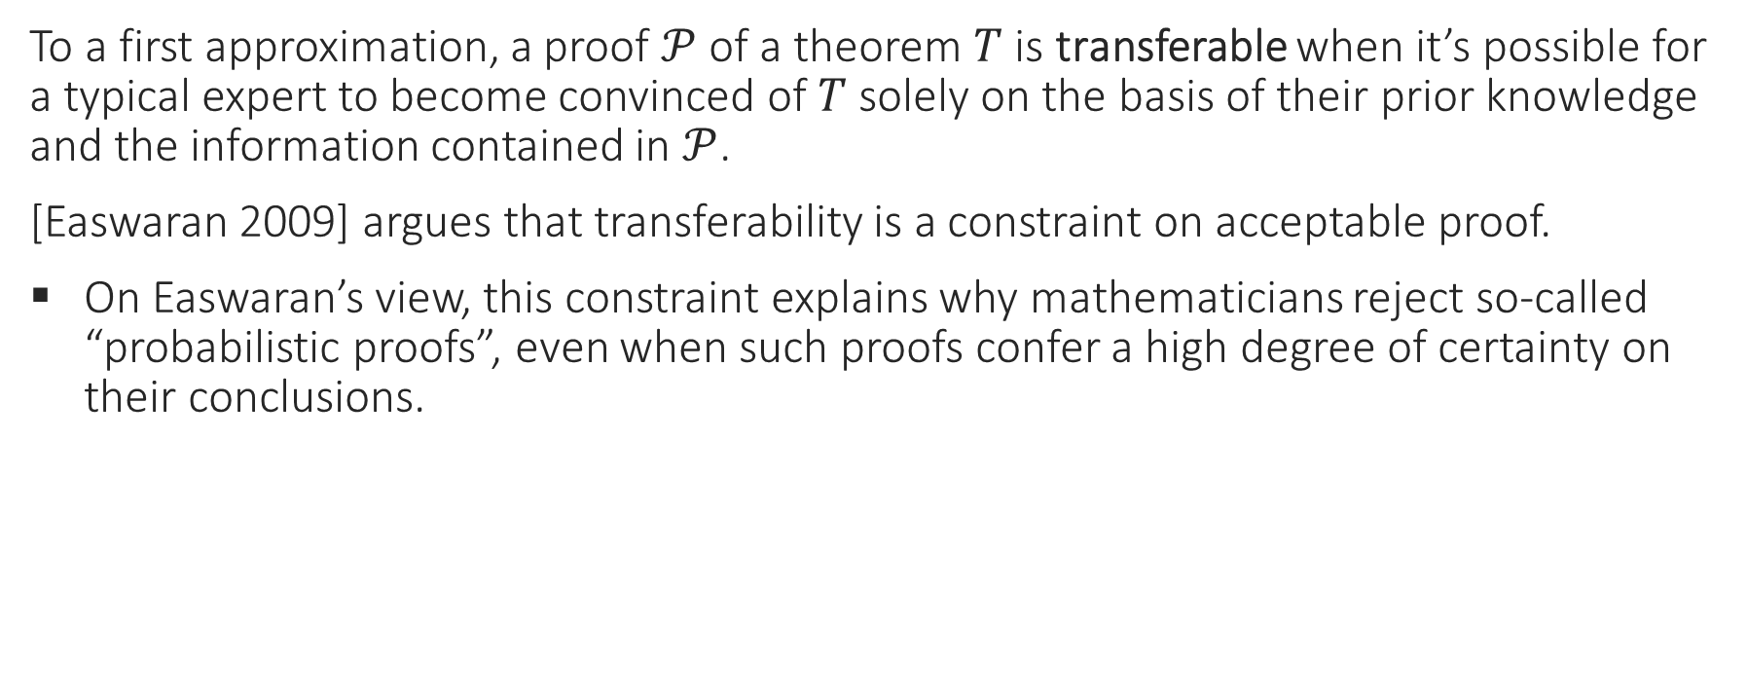
Transferability
To a first approximation, a proof $𝒫$ of a theorem $T$ is transferable when it’s possible for a typical expert to become convinced of $T$ solely on the basis of their prior knowledge and the information contained in $𝒫$.
[Easwaran 2009] argues that transferability is a constraint on acceptable proof.
On Easwaran’s view, this constraint explains why mathematicians reject so-called “probabilistic proofs”, even when such proofs confer a high degree of certainty on their conclusions.

Slide 7
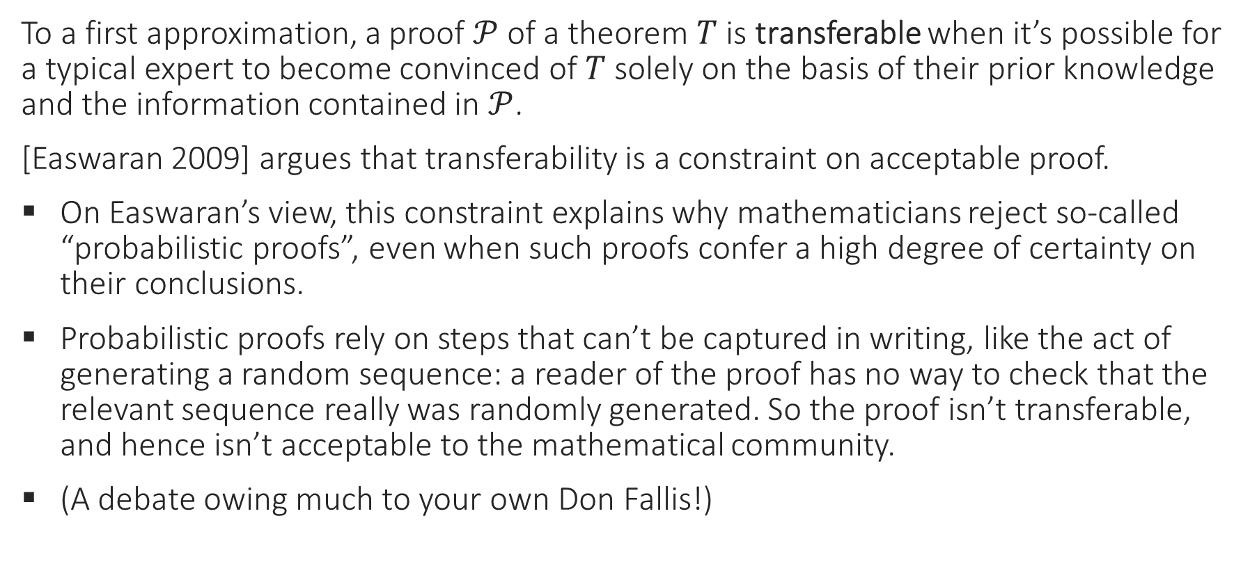
Transferability
To a first approximation, a proof $𝒫$ of a theorem $T$ is transferable when it’s possible for a typical expert to become convinced of $T$ solely on the basis of their prior knowledge and the information contained in $𝒫$.
[Easwaran 2009] argues that transferability is a constraint on acceptable proof.
On Easwaran’s view, this constraint explains why mathematicians reject so-called “probabilistic proofs”, even when such proofs confer a high degree of certainty on their conclusions.
Probabilistic proofs rely on steps that can’t be captured in writing, like the act of generating a random sequence: a reader of the proof has no way to check that the relevant sequence really was randomly generated. So the proof isn’t transferable, and hence isn’t acceptable to the mathematical community.
(A debate owing much to your own Don Fallis!)

Slide 8

Fixability
Meanwhile, a proof $𝒫$ is fixable when it’s possible for other experts to correct any mistakes $𝒫$ contains without having to develop significant new mathematics.

Slide 9

Fixability
Meanwhile, a proof $𝒫$ is fixable when it’s possible for other experts to correct any mistakes $𝒫$ contains without having to develop significant new mathematics.
[Habgood-Coote & Tanswell forthcoming] observe that some acceptable proofs are both fixable and in need of fixing, in the sense that they contain nontrivial mistakes.

Slide 10
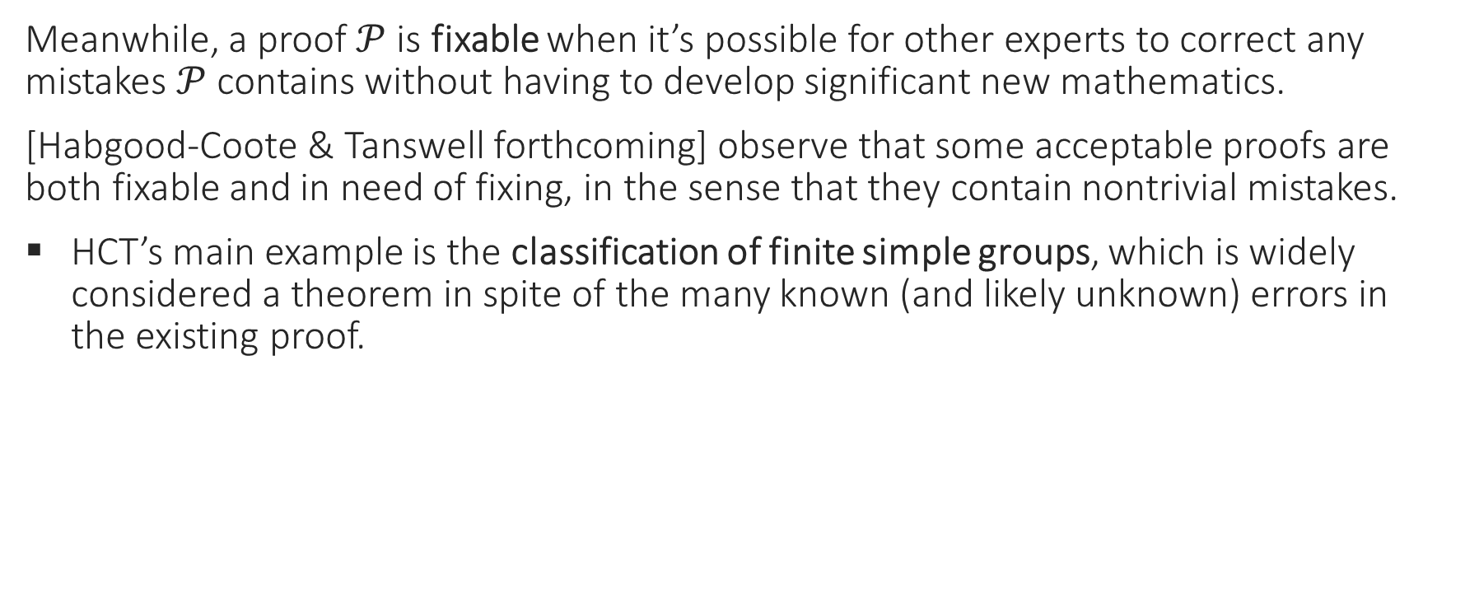
Fixability
Meanwhile, a proof $𝒫$ is fixable when it’s possible for other experts to correct any mistakes $𝒫$ contains without having to develop significant new mathematics.
[Habgood-Coote & Tanswell forthcoming] observe that some acceptable proofs are both fixable and in need of fixing, in the sense that they contain nontrivial mistakes.
HCT’s main example is the classification of finite simple groups, which is widely considered a theorem in spite of the many known (and likely unknown) errors in the existing proof.

Slide 11
Transferability and fixability
The claim that acceptable proofs must be transferable seems quite plausible.
The claim that some acceptable proofs need fixing seems plausible too.

Slide 12
Transferability and fixability
The claim that acceptable proofs must be transferable seems quite plausible.
The claim that some acceptable proofs need fixing seems plausible too.
Unfortunately, these attractive suggestions stand in tension with one another!

Slide 13
Transferability and fixability
The claim that acceptable proofs must be transferable seems quite plausible.
The claim that some acceptable proofs need fixing seems plausible too.
Unfortunately, these attractive suggestions stand in tension with one another!
Before explaining why, let me introduce some terminology.

Slide 14
Some terminology
Say that an error in a proof is substantive if its fix wouldn’t be routine and immediately obvious to an expert.

Slide 15
Some terminology
Say that an error in a proof is substantive if its fix wouldn’t be routine and immediately obvious to an expert.
And say that an error is fatal if it renders the argument as stated incorrect.

Slide 16
Some terminology
Say that an error in a proof is substantive if its fix wouldn’t be routine and immediately obvious to an expert.
And say that an error is fatal if it renders the argument as stated incorrect.
Finally, call a proof broken if it contains at least one error that’s both substantive and fatal.

Slide 17
Some terminology
Say that an error in a proof is substantive if its fix wouldn’t be routine and immediately obvious to an expert.
And say that an error is fatal if it renders the argument as stated incorrect.
Finally, call a proof broken if it contains at least one error that’s both substantive and fatal.
Non-substantive errors aren’t very interesting even if they’re fatal (because they’re trivial to fix), and non-fatal errors aren’t very interesting even if they’re substantive (because they pose no threat to the argument). I want to ignore such uninteresting mistakes here.

Slide 18
Some terminology
Say that an error in a proof is substantive if its fix wouldn’t be routine and immediately obvious to an expert.
And say that an error is fatal if it renders the argument as stated incorrect.
Finally, call a proof broken if it contains at least one error that’s both substantive and fatal.
Non-substantive errors aren’t very interesting even if they’re fatal (because they’re trivial to fix), and non-fatal errors aren’t very interesting even if they’re substantive (because they pose no threat to the argument). I want to ignore such uninteresting mistakes here.
So define a BF proof to be one that’s both broken and fixable. In other words, a BF proof contains at least one error that’s both substantive and fatal, but current experts could correct all its (fatal) errors without having to develop significant new math.

Slide 19
The thesis
More precisely, then, what I want to argue is the following:
The claim that all acceptable proofs are transferable is in tension with the claim that some BF proofs are acceptable.

Slide 20
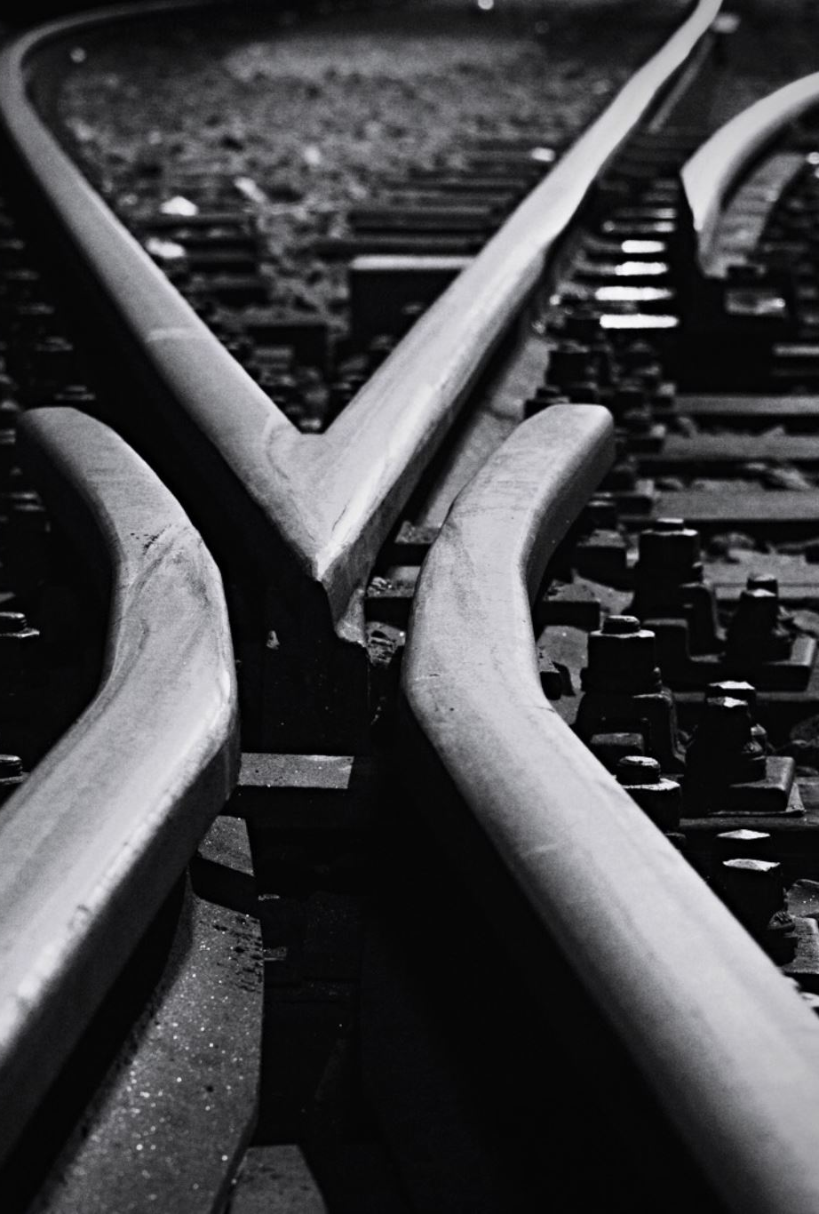
The tension

Slide 21
The tension
The tension, in brief, is this.

Slide 22

The tension
The tension, in brief, is this.
According to the ideal of transferability, everything a suitably well-informed mathematician needs to become convinced of a theorem $T$ is contained in its proof $𝒫$.

Slide 23

The tension
The tension, in brief, is this.
According to the ideal of transferability, everything a suitably well-informed mathematician needs to become convinced of a theorem $T$ is contained in its proof $𝒫$.
But this isn’t the case with broken proofs. Since broken proofs contain substantive errors, a reader will have to do some work of her own—perhaps a considerable amount—in order to identify the mistakes and devise the necessary repairs.

Slide 24
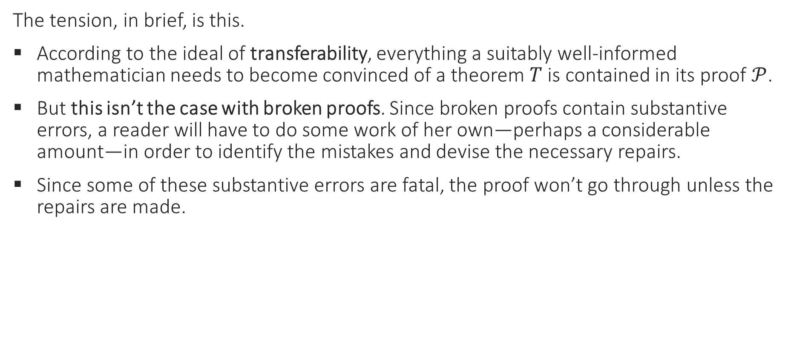
The tension
The tension, in brief, is this.
According to the ideal of transferability, everything a suitably well-informed mathematician needs to become convinced of a theorem $T$ is contained in its proof $𝒫$.
But this isn’t the case with broken proofs. Since broken proofs contain substantive errors, a reader will have to do some work of her own—perhaps a considerable amount—in order to identify the mistakes and devise the necessary repairs.
Since some of these substantive errors are fatal, the proof won’t go through unless the repairs are made.

Slide 25
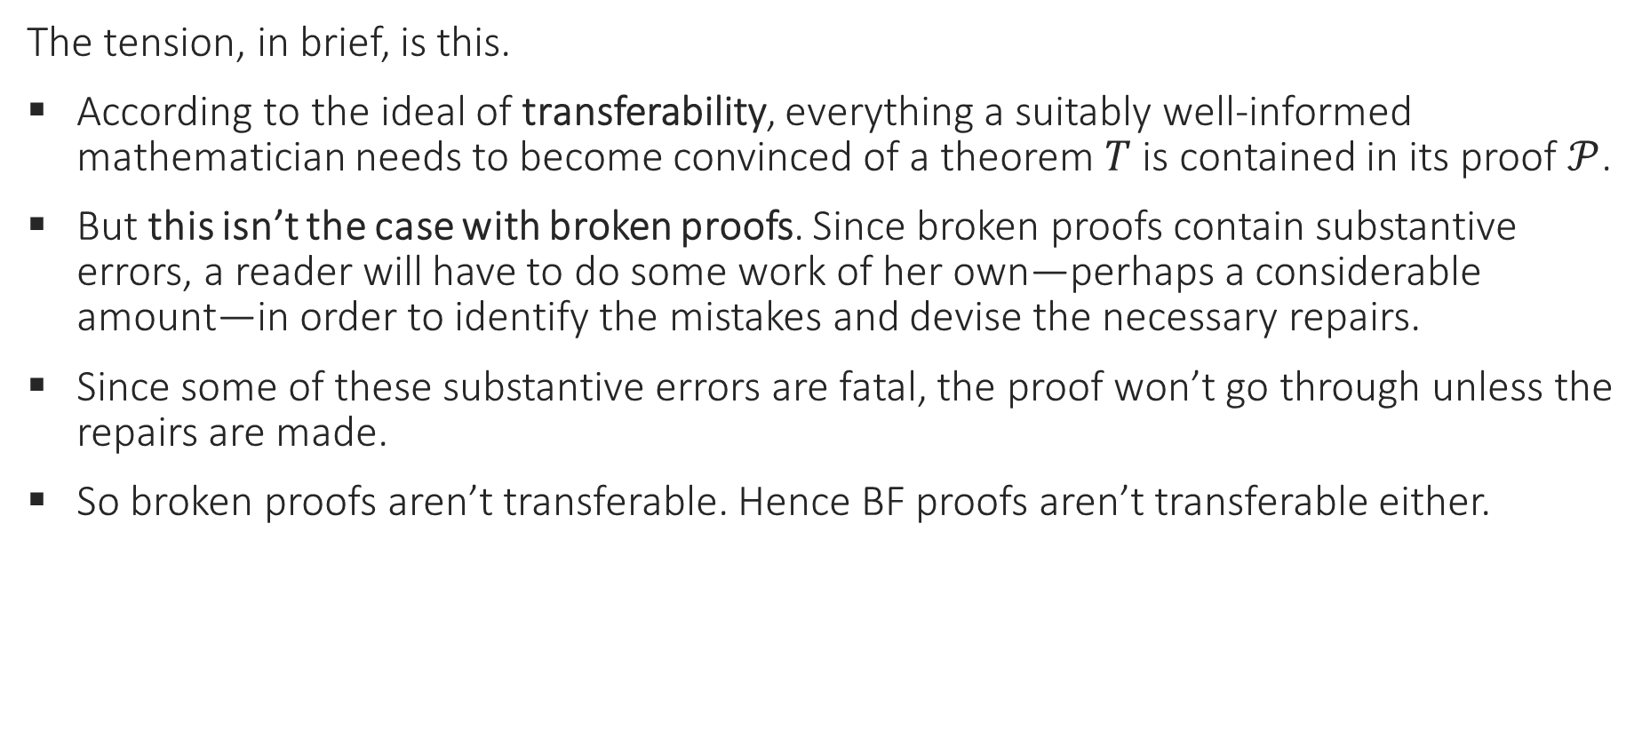
The tension
The tension, in brief, is this.
According to the ideal of transferability, everything a suitably well-informed mathematician needs to become convinced of a theorem $T$ is contained in its proof $𝒫$.
But this isn’t the case with broken proofs. Since broken proofs contain substantive errors, a reader will have to do some work of her own—perhaps a considerable amount—in order to identify the mistakes and devise the necessary repairs.
Since some of these substantive errors are fatal, the proof won’t go through unless the repairs are made.
So broken proofs aren’t transferable. Hence BF proofs aren’t transferable either.

Slide 26
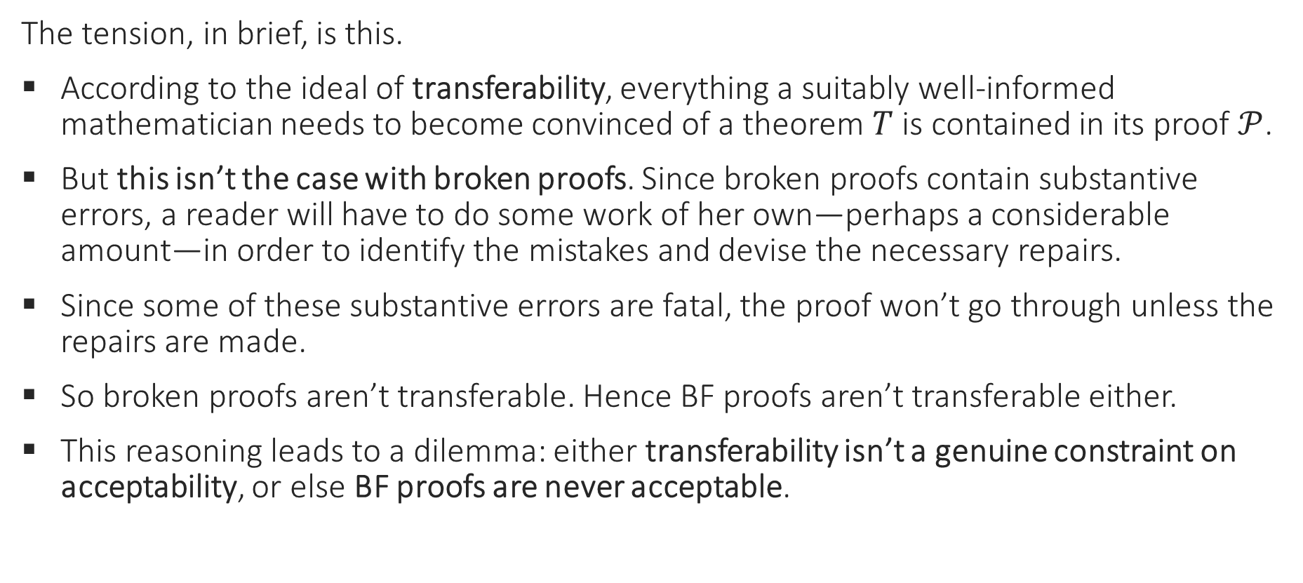
The tension
The tension, in brief, is this.
According to the ideal of transferability, everything a suitably well-informed mathematician needs to become convinced of a theorem $T$ is contained in its proof $𝒫$.
But this isn’t the case with broken proofs. Since broken proofs contain substantive errors, a reader will have to do some work of her own—perhaps a considerable amount—in order to identify the mistakes and devise the necessary repairs.
Since some of these substantive errors are fatal, the proof won’t go through unless the repairs are made.
So broken proofs aren’t transferable. Hence BF proofs aren’t transferable either.
This reasoning leads to a dilemma: either transferability isn’t a genuine constraint on acceptability, or else BF proofs are never acceptable.

Slide 27
The tension
Next, I’ll discuss several responses to this argument.
It’ll be convenient to recast the argument as a reductio. Our task will then be to identify the false premise or premises.

Slide 28
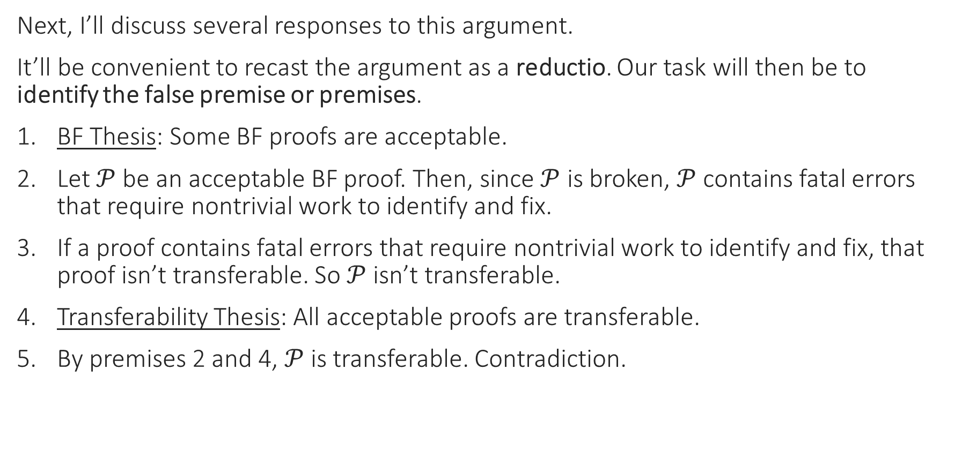
The tension
Next, I’ll discuss several responses to this argument.
It’ll be convenient to recast the argument as a reductio. Our task will then be to identify the false premise or premises.
BF Thesis: Some BF proofs are acceptable.
Let $𝒫$ be an acceptable BF proof. Then, since $𝒫$ is broken, $𝒫$ contains fatal errors that require nontrivial work to identify and fix.
If a proof contains fatal errors that require nontrivial work to identify and fix, that proof isn’t transferable. So $𝒫$ isn’t transferable.
Transferability Thesis: All acceptable proofs are transferable.
By premises 2 and 4, $𝒫$ is transferable. Contradiction.

Slide 29
Possible responses
We have four main options:
Reject the concept of BF proof and insist that brokenness and fixability are incompatible.
Deny BF Thesis and insist that no BF proofs are acceptable.
Deny premise 3 and insist that all BF proofs are transferable.
Deny Transferability Thesis and insist that some acceptable proofs are non-transferable.

Slide 30
Possible responses
We have four main options:
Reject the concept of BF proof and insist that brokenness and fixability are incompatible.
Deny BF Thesis and insist that no BF proofs are acceptable.
Deny premise 3 and insist that all BF proofs are transferable.
Deny Transferability Thesis and insist that some acceptable proofs are non-transferable.
I’ll consider these options in turn.
In the end, I’ll argue that Transferability Thesis is the problem, and that acceptable proofs need only satisfy a weaker constraint I call “corrigibility”.

Slide 31
Option 1: BF proofs don’t exist

Slide 32
Option 1
First, option 1.
Reject the concept of BF proof and insist that brokenness and fixability are incompatible.
Deny BF Thesis and insist that no BF proofs are acceptable.
Deny premise 3 and insist that all BF proofs are transferable.
Deny Transferability Thesis and insist that some acceptable proofs are non-transferable.

Slide 33
BF proofs don’t exist?
You might suspect that our argument rests on a conceptual mistake: the idea that brokenness and fixability are compatible, and the dependent claim that some BF proofs exist.

Slide 34
BF proofs don’t exist?
You might suspect that our argument rests on a conceptual mistake: the idea that brokenness and fixability are compatible, and the dependent claim that some BF proofs exist.
The basic issue: A broken proof, by definition, takes substantial work to repair. But if a proof is too flawed, then repairing it will exceed experts’ capabilities, and hence the proof will no longer count as fixable.

Slide 35
BF proofs don’t exist?
You might suspect that our argument rests on a conceptual mistake: the idea that brokenness and fixability are compatible, and the dependent claim that some BF proofs exist.
The basic issue: A broken proof, by definition, takes substantial work to repair. But if a proof is too flawed, then repairing it will exceed experts’ capabilities, and hence the proof will no longer count as fixable.
It’s unclear that we can have it both ways at once. A skeptic might argue like this:

Slide 36
BF proofs don’t exist?
You might suspect that our argument rests on a conceptual mistake: the idea that brokenness and fixability are compatible, and the dependent claim that some BF proofs exist.
The basic issue: A broken proof, by definition, takes substantial work to repair. But if a proof is too flawed, then repairing it will exceed experts’ capabilities, and hence the proof will no longer count as fixable.
It’s unclear that we can have it both ways at once. A skeptic might argue like this:
“Fixing a broken proof requires creativity and original thinking. But creatively generating a novel piece of a proof is tantamount to devising significant new mathematics. And a proof whose errors require new mathematics is unfixable by definition. So fixability and brokenness aren’t compatible.”

Slide 37
BF proofs don’t exist?
But this argument doesn’t work, and the conclusion is wrong!
The argument fails because it wrongly equates one kind of inventiveness—namely, the insight needed to see how to fix a problem using existing techniques—with a distinct kind—namely, the creation of novel mathematics.

Slide 38
BF proofs don’t exist?
But this argument doesn’t work, and the conclusion is wrong!
The argument fails because it wrongly equates one kind of inventiveness—namely, the insight needed to see how to fix a problem using existing techniques—with a distinct kind—namely, the creation of novel mathematics.
A broken proof can easily require the former without requiring the latter.

Slide 39
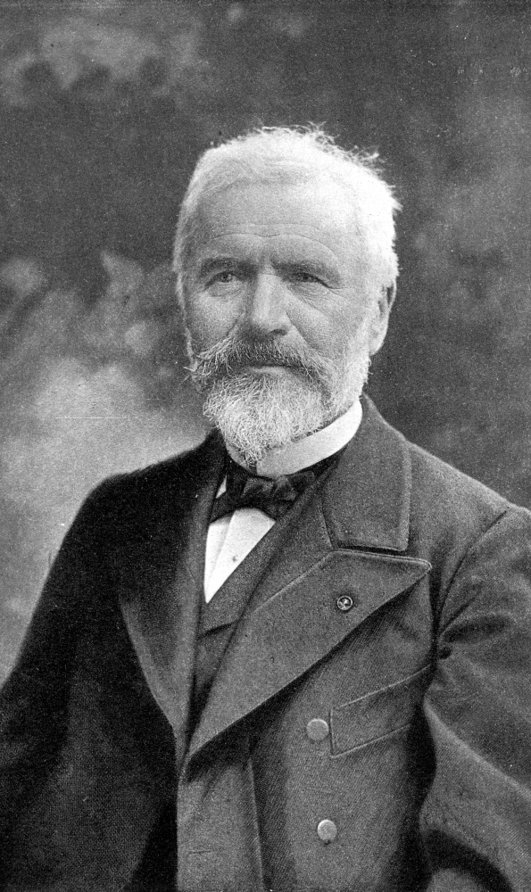
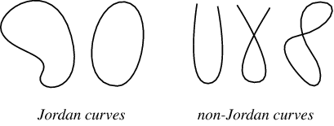
Two historical examples
The original proof of Jordan’s curve theorem is a historical example of a BF proof.

Slide 40
Two historical examples
It’s generally agreed that Jordan’s own attempted proof, given in his Cours d’Analyse, wasn’t completely right. For a while his approach was thought to be hopeless, and the first widely accepted proof used entirely different methods.

Slide 41
Two historical examples
It’s generally agreed that Jordan’s own attempted proof, given in his Cours d’Analyse, wasn’t completely right. For a while his approach was thought to be hopeless, and the first widely accepted proof used entirely different methods.
But subsequent reevaluation of Jordan’s proof has yielded a more positive assessment. Many mathematicians now consider its flaws modest and repairable.

Slide 42
Two historical examples
It’s generally agreed that Jordan’s own attempted proof, given in his Cours d’Analyse, wasn’t completely right. For a while his approach was thought to be hopeless, and the first widely accepted proof used entirely different methods.
But subsequent reevaluation of Jordan’s proof has yielded a more positive assessment. Many mathematicians now consider its flaws modest and repairable.
According to Michael Reeken, “Jordan’s proof does not present the details in a satisfactory way. But the idea is right and with some polishing the proof would be impeccable” ([Hales 2007], 46).

Slide 43
Two historical examples
It’s generally agreed that Jordan’s own attempted proof, given in his Cours d’Analyse, wasn’t completely right. For a while his approach was thought to be hopeless, and the first widely accepted proof used entirely different methods.
But subsequent reevaluation of Jordan’s proof has yielded a more positive assessment. Many mathematicians now consider its flaws modest and repairable.
According to Michael Reeken, “Jordan’s proof does not present the details in a satisfactory way. But the idea is right and with some polishing the proof would be impeccable” ([Hales 2007], 46).
Hales presents a modernized version of the proof, aiming to “preserve all of Jordan’s major ideas, while avoiding [the original proof’s] minor shortcomings” (46).

Slide 44
Two historical examples
It’s generally agreed that Jordan’s own attempted proof, given in his Cours d’Analyse, wasn’t completely right. For a while his approach was thought to be hopeless, and the first widely accepted proof used entirely different methods.
But subsequent reevaluation of Jordan’s proof has yielded a more positive assessment. Many mathematicians now consider its flaws modest and repairable.
According to Michael Reeken, “Jordan’s proof does not present the details in a satisfactory way. But the idea is right and with some polishing the proof would be impeccable” ([Hales 2007], 46).
Hales presents a modernized version of the proof, aiming to “preserve all of Jordan’s major ideas, while avoiding [the original proof’s] minor shortcomings” (46).
The current consensus is that Jordan’s proof was flawed but mostly sound, and that fixing its errors requires no substantial innovations.

Slide 45
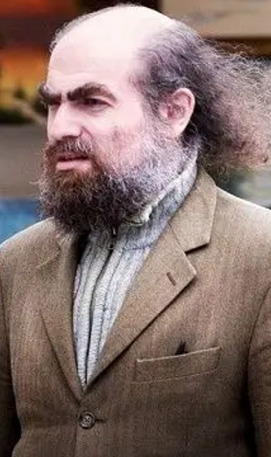
Two historical examples
A second historical case is Perelman’s proof of the Poincaré conjecture.

Slide 46
Two historical examples
Famously, Perelman was awarded (and refused) both a Fields Medal and a Clay Institute Millennium Prize for proving Poincaré’s topological conjecture.

Slide 47
Two historical examples
Famously, Perelman was awarded (and refused) both a Fields Medal and a Clay Institute Millennium Prize for proving Poincaré’s topological conjecture.
What’s less well known is that Perelman’s papers gave a proof sketch rather than a complete argument. Since the appearance of the papers in 2003-4, several groups of mathematicians have worked on turning his ideas into a fully compelling proof.

Slide 48
Two historical examples
Famously, Perelman was awarded (and refused) both a Fields Medal and a Clay Institute Millennium Prize for proving Poincaré’s topological conjecture.
What’s less well known is that Perelman’s papers gave a proof sketch rather than a complete argument. Since the appearance of the papers in 2003-4, several groups of mathematicians have worked on turning his ideas into a fully compelling proof.
This process has uncovered a number of mistakes in Perelman’s arguments. But it’s generally agreed that these errors are all fixable.

Slide 49
Two historical examples
Famously, Perelman was awarded (and refused) both a Fields Medal and a Clay Institute Millennium Prize for proving Poincaré’s topological conjecture.
What’s less well known is that Perelman’s papers gave a proof sketch rather than a complete argument. Since the appearance of the papers in 2003-4, several groups of mathematicians have worked on turning his ideas into a fully compelling proof.
This process has uncovered a number of mistakes in Perelman’s arguments. But it’s generally agreed that these errors are all fixable.
“Regarding the proofs, [Perelman’s papers] contain some incorrect statements and incomplete arguments, which we have attempted to point out to the reader... We did not find any serious problems, meaning problems that cannot be corrected using the methods introduced by Perelman” ([Kleiner & Lott 2008], 2588).

Slide 50
Two historical examples
Famously, Perelman was awarded (and refused) both a Fields Medal and a Clay Institute Millennium Prize for proving Poincaré’s topological conjecture.
What’s less well known is that Perelman’s papers gave a proof sketch rather than a complete argument. Since the appearance of the papers in 2003-4, several groups of mathematicians have worked on turning his ideas into a fully compelling proof.
This process has uncovered a number of mistakes in Perelman’s arguments. But it’s generally agreed that these errors are all fixable.
“Regarding the proofs, [Perelman’s papers] contain some incorrect statements and incomplete arguments, which we have attempted to point out to the reader... We did not find any serious problems, meaning problems that cannot be corrected using the methods introduced by Perelman” ([Kleiner & Lott 2008], 2588).
“[In spite of the need for repairs], full credit [for] proving Poincaré’s conjecture goes to Hamilton and Perelman” ([Cao & Zhu 2006], 4).

Slide 51
BF proofs exist!
These cases shows that BF proofs exist in practice and not just in theory.

Slide 52
BF proofs exist!
These cases shows that BF proofs exist in practice and not just in theory.
They also suggest that Habgood-Coote and Tanswell’s notion of fixability tracks mathematicians’ judgments about acceptability: what determines whether a proof contains “serious problems”, and whether its author deserves credit for the result, is in part whether the errors in the proof can be repaired using existing techniques.

Slide 53
BF proofs exist!
These cases shows that BF proofs exist in practice and not just in theory.
They also suggest that Habgood-Coote and Tanswell’s notion of fixability tracks mathematicians’ judgments about acceptability: what determines whether a proof contains “serious problems”, and whether its author deserves credit for the result, is in part whether the errors in the proof can be repaired using existing techniques.
This gives some reassurance that the fixability criterion captures a genuine element of mathematical practice.

Slide 54
Option 2: BF proofs aren’t acceptable

Slide 55
Option 2
Next, option 2.
Reject the concept of BF proof and insist that brokenness and fixability are incompatible.
Deny BF Thesis and insist that no BF proofs are acceptable.
Deny premise 3 and insist that all BF proofs are transferable.
Deny Transferability Thesis and insist that some acceptable proofs are non-transferable.

Slide 56
BF proofs aren’t acceptable?
The second option, and maybe the most immediately appealing, is to deny that any BF proofs are ever (knowingly) accepted by the mathematical community.

Slide 57

BF proofs aren’t acceptable?
The second option, and maybe the most immediately appealing, is to deny that any BF proofs are ever (knowingly) accepted by the mathematical community.
Let me clarify the notion of acceptance. To say that $𝒫$ is accepted as a proof of $T$ is to say that the relevant experts consider $𝒫$adequate to establish $T$. As the historical cases suggest, some telling signs of $𝒫$’s acceptance are:

Slide 58
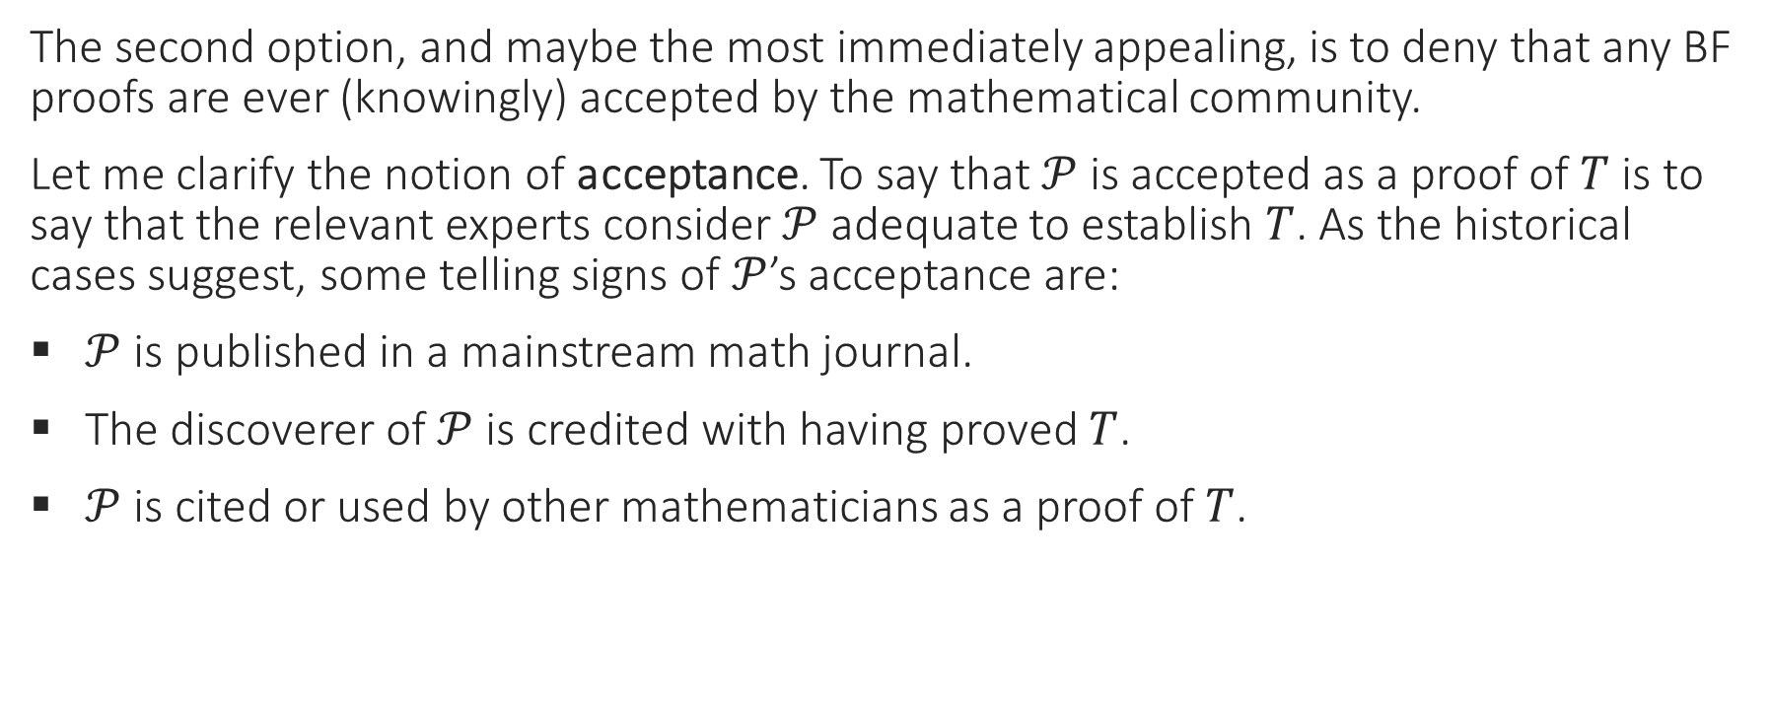
BF proofs aren’t acceptable?
The second option, and maybe the most immediately appealing, is to deny that any BF proofs are ever (knowingly) accepted by the mathematical community.
Let me clarify the notion of acceptance. To say that $𝒫$ is accepted as a proof of $T$ is to say that the relevant experts consider $𝒫$adequate to establish $T$. As the historical cases suggest, some telling signs of $𝒫$’s acceptance are:
$𝒫$ is published in a mainstream math journal.
The discoverer of $𝒫$ is credited with having proved $T$.
$𝒫$ is cited or used by other mathematicians as a proof of $T$.

Slide 59
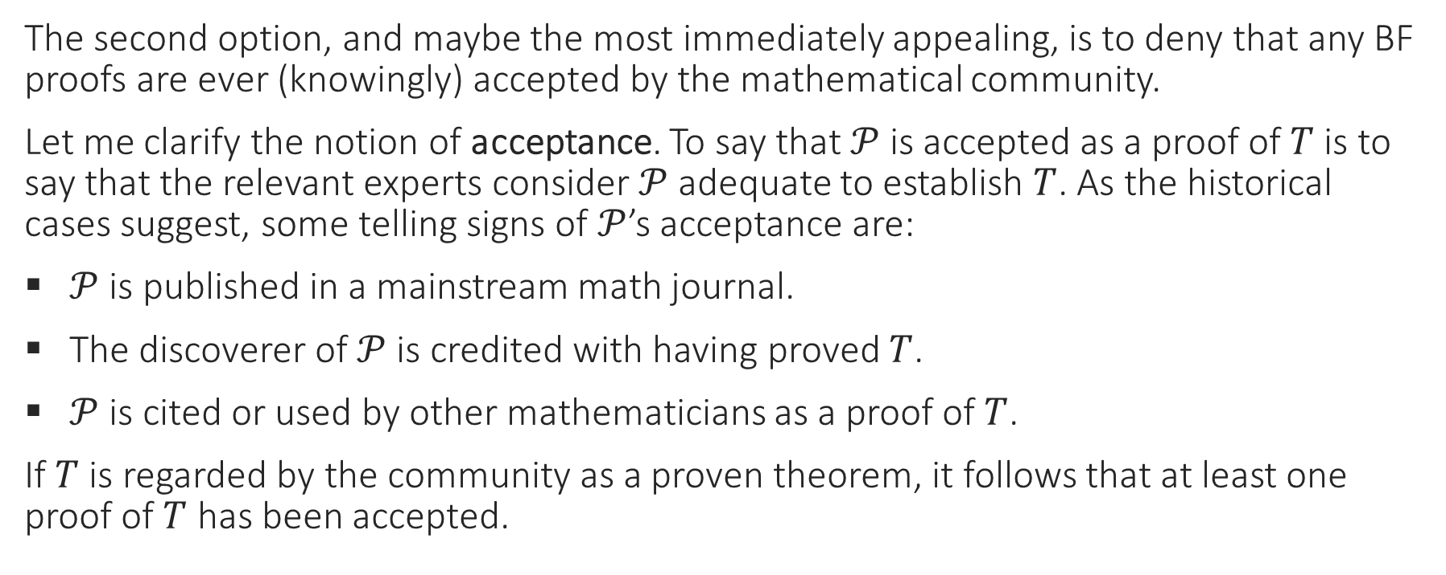
BF proofs aren’t acceptable?
The second option, and maybe the most immediately appealing, is to deny that any BF proofs are ever (knowingly) accepted by the mathematical community.
Let me clarify the notion of acceptance. To say that $𝒫$ is accepted as a proof of $T$ is to say that the relevant experts consider $𝒫$adequate to establish $T$. As the historical cases suggest, some telling signs of $𝒫$’s acceptance are:
$𝒫$ is published in a mainstream math journal.
The discoverer of $𝒫$ is credited with having proved $T$.
$𝒫$ is cited or used by other mathematicians as a proof of $T$.
If $T$ is regarded by the community as a proven theorem, it follows that at least one proof of $T$ has been accepted.

Slide 60
BF proofs aren’t acceptable?
It’s easy to see why BF proofs might seem unacceptable.
After all, BF proofs fail to give complete and correct arguments for their conclusions. And surely an acceptable proof has to do that, whatever else it does.

Slide 61
BF proofs aren’t acceptable?
This line of thought may seem intuitively compelling, but in fact it doesn’t accurately reflect mathematical practice.

Slide 62
BF proofs aren’t acceptable?
This line of thought may seem intuitively compelling, but in fact it doesn’t accurately reflect mathematical practice.
Mathematicians are often happy to accept flawed proofs, provided that the problems aren’t too serious and that someone knows (or could figure out) how to fix them.
The operative standard for proof acceptance is closer to “believed to be correct in outline” than to “confirmed accurate in every detail”.

Slide 63
BF proofs aren’t acceptable?
One way to see this is by considering the refereeing process for math journals.
Reviewers aren’t generally expected to check every line of a submitted proof, and most don’t.

Slide 64
BF proofs aren’t acceptable?
One way to see this is by considering the refereeing process for math journals.
Reviewers aren’t generally expected to check every line of a submitted proof, and most don’t.
“Many (I think most) papers in most refereed journals are not refereed. There is a presumptive referee who looks at the paper, reads the introduction and the statements of the results, glances at the proofs, and, if everything seems okay, recommends publication. Some referees do check proofs line-by-line, but many do not” ([Nathanson 2008], 773).

Slide 65
BF proofs aren’t acceptable?
One way to see this is by considering the refereeing process for math journals.
Reviewers aren’t generally expected to check every line of a submitted proof, and most don’t.
“Many (I think most) papers in most refereed journals are not refereed. There is a presumptive referee who looks at the paper, reads the introduction and the statements of the results, glances at the proofs, and, if everything seems okay, recommends publication. Some referees do check proofs line-by-line, but many do not” ([Nathanson 2008], 773).
In a survey of editors, “estimating the novelty of results” was rated a more important task for referees than “checking the correctness of results”, and about half the editors surveyed said that referees should check some but not necessarily all of a paper’s arguments in detail ([Geist et al. 2010])

Slide 66
BF proofs aren’t acceptable?
Similarly, in interviews with mathematicians about refereeing practices, Line Andersen found them to be focused on overall believability rather than local accuracy:

Slide 67
BF proofs aren’t acceptable?
Similarly, in interviews with mathematicians about refereeing practices, Line Andersen found them to be focused on overall believability rather than local accuracy:
“The interviews suggest that when a referee checks a proof for correctness, she usually does not check every step... She begins by holding the proof, considered in broad outline, up against the landscape of what she knows. She checks whether each subresult of the proof seems reasonable… If so, she will usually not go on to check the subproof line by line... She then turns her focus to the parts that stand out as surprising or suspicious. These are the parts she typically checks line by line.” ([Andersen 2017], 185-6)

Slide 68
BF proofs aren’t acceptable?
Similarly, in interviews with mathematicians about refereeing practices, Line Andersen found them to be focused on overall believability rather than local accuracy:
“The interviews suggest that when a referee checks a proof for correctness, she usually does not check every step... She begins by holding the proof, considered in broad outline, up against the landscape of what she knows. She checks whether each subresult of the proof seems reasonable… If so, she will usually not go on to check the subproof line by line... She then turns her focus to the parts that stand out as surprising or suspicious. These are the parts she typically checks line by line.” ([Andersen 2017], 185-6)
Andersen concludes that “[p]ublished proofs often contain minor errors, but it appears that they rarely contain critical or unrepairable errors” (185).

Slide 69
BF proofs aren’t acceptable?
If BF proofs were deemed generally unacceptable, this is surely not the attitude toward mistakes we’d expect from mathematicians!

Slide 70
BF proofs aren’t acceptable?
If BF proofs were deemed generally unacceptable, this is surely not the attitude toward mistakes we’d expect from mathematicians!
The fact that the discipline shows so much tolerance for fixable errors in published proofs is strong evidence that such mistakes don’t undermine acceptability.

Slide 71
BF proofs aren’t acceptable?
If BF proofs were deemed generally unacceptable, this is surely not the attitude toward mistakes we’d expect from mathematicians!
The fact that the discipline shows so much tolerance for fixable errors in published proofs is strong evidence that such mistakes don’t undermine acceptability.
Cf. also the widely accepted proof of the classification theorem for finite simple groups, which contains many (known and probably unknown) mistakes.

Slide 72
BF proofs aren’t acceptable?
If BF proofs were deemed generally unacceptable, this is surely not the attitude toward mistakes we’d expect from mathematicians!
The fact that the discipline shows so much tolerance for fixable errors in published proofs is strong evidence that such mistakes don’t undermine acceptability.
Cf. also the widely accepted proof of the classification theorem for finite simple groups, which contains many (known and probably unknown) mistakes.
I conclude that BF Thesis is true. So this isn’t the right option.

Slide 73
Option 3: BF proofs are transferable

Slide 74
Option 3
Next, option 3.
Reject the concept of BF proof and insist that brokenness and fixability are incompatible.
Deny BF Thesis and insist that no BF proofs are acceptable.
Deny premise 3 and insist that all BF proofs are transferable.
Deny Transferability Thesis and insist that some acceptable proofs are non-transferable.

Slide 75
BF proofs are transferable?
According to the third strategy, BF proofs are transferable after all, and hence premise 3 of our argument is false.
The most promising way to make this case is by comparing mistakes to gaps.

Slide 76
BF proofs are transferable?
According to the third strategy, BF proofs are transferable after all, and hence premise 3 of our argument is false.
The most promising way to make this case is by comparing mistakes to gaps.
Everyone agrees that acceptable informal proofs are often gappy—i.e., they omit necessary premises or inferential steps.

Slide 77
BF proofs are transferable?
According to the third strategy, BF proofs are transferable after all, and hence premise 3 of our argument is false.
The most promising way to make this case is by comparing mistakes to gaps.
Everyone agrees that acceptable informal proofs are often gappy—i.e., they omit necessary premises or inferential steps.
But the presence of gaps needn’t conflict with transferability. As Easwaran says, “a proof sketch can in many cases be sufficient for the reader to convince herself of the result” (355), and so a gappy proof will be transferable as long as the gaps are “ones that relevant experts can see and still be convinced” (355, fn. 14).

Slide 78
BF proofs are transferable?
According to the third strategy, BF proofs are transferable after all, and hence premise 3 of our argument is false.
The most promising way to make this case is by comparing mistakes to gaps.
Everyone agrees that acceptable informal proofs are often gappy—i.e., they omit necessary premises or inferential steps.
But the presence of gaps needn’t conflict with transferability. As Easwaran says, “a proof sketch can in many cases be sufficient for the reader to convince herself of the result” (355), and so a gappy proof will be transferable as long as the gaps are “ones that relevant experts can see and still be convinced” (355, fn. 14).
In practice, these are the kinds of omissions typically found in published proofs: details which are tedious to state and which would be easily reconstructable by fellow experts.

Slide 79
BF proofs are transferable?
According to the third strategy, BF proofs are transferable after all, and hence premise 3 of our argument is false.
The most promising way to make this case is by comparing mistakes to gaps.
Everyone agrees that acceptable informal proofs are often gappy—i.e., they omit necessary premises or inferential steps.
But the presence of gaps needn’t conflict with transferability. As Easwaran says, “a proof sketch can in many cases be sufficient for the reader to convince herself of the result” (355), and so a gappy proof will be transferable as long as the gaps are “ones that relevant experts can see and still be convinced” (355, fn. 14).
In practice, these are the kinds of omissions typically found in published proofs: details which are tedious to state and which would be easily reconstructable by fellow experts.
Say that a proof has benign gaps if it omits details of this kind.

Slide 80
BF proofs are transferable?
Is a proof containing fixable mistakes really so different from one containing benign gaps? It might seem not.

Slide 81
BF proofs are transferable?
Is a proof containing fixable mistakes really so different from one containing benign gaps? It might seem not.
Both mistakes and gaps represent respects in which a proof is incomplete as stated.

Slide 82
BF proofs are transferable?
Is a proof containing fixable mistakes really so different from one containing benign gaps? It might seem not.
Both mistakes and gaps represent respects in which a proof is incomplete as stated.
Both may require the reader to exert some effort in order to arrive at full conviction and understanding.

Slide 83
BF proofs are transferable?
Is a proof containing fixable mistakes really so different from one containing benign gaps? It might seem not.
Both mistakes and gaps represent respects in which a proof is incomplete as stated.
Both may require the reader to exert some effort in order to arrive at full conviction and understanding.
And a sufficiently well-informed reader should be able to succeed at this, if the mistakes are truly fixable or the gaps truly benign.

Slide 84
BF proofs are transferable?
Is a proof containing fixable mistakes really so different from one containing benign gaps? It might seem not.
Both mistakes and gaps represent respects in which a proof is incomplete as stated.
Both may require the reader to exert some effort in order to arrive at full conviction and understanding.
And a sufficiently well-informed reader should be able to succeed at this, if the mistakes are truly fixable or the gaps truly benign.
It’s tempting to conclude from these similarities that BF proofs must be transferable if gappy proofs are.

Slide 85
BF proofs are transferable?
There’s something to this argument, but I don’t think it overturns premise 3 in general.

Slide 86
BF proofs are transferable?
There’s something to this argument, but I don’t think it overturns premise 3 in general.
To see why the comparison fails, recall that a proof is transferable only if the information contained in the proof is sufficient to convince a well-informed reader of its conclusion.

Slide 87
BF proofs are transferable?
There’s something to this argument, but I don’t think it overturns premise 3 in general.
To see why the comparison fails, recall that a proof is transferable only if the information contained in the proof is sufficient to convince a well-informed reader of its conclusion.
Benignly gappy proofs satisfy this condition because their gaps are chosen to complement experts’ background knowledge.

Slide 88
BF proofs are transferable?
There’s something to this argument, but I don’t think it overturns premise 3 in general.
To see why the comparison fails, recall that a proof is transferable only if the information contained in the proof is sufficient to convince a well-informed reader of its conclusion.
Benignly gappy proofs satisfy this condition because their gaps are chosen to complement experts’ background knowledge.
The mark of a beningly gappy proof is straightforwardness—it’s clear which pieces are missing, and a knowledgeable reader will need minimal creativity to fill them in.

Slide 89
BF proofs are transferable?
There’s something to this argument, but I don’t think it overturns premise 3 in general.
To see why the comparison fails, recall that a proof is transferable only if the information contained in the proof is sufficient to convince a well-informed reader of its conclusion.
Benignly gappy proofs satisfy this condition because their gaps are chosen to complement experts’ background knowledge.
The mark of a beningly gappy proof is straightforwardness—it’s clear which pieces are missing, and a knowledgeable reader will need minimal creativity to fill them in.
The same isn’t true for BF proofs, at least not in general.
In typical cases, identifying and fixing a BF proof will require resources beyond the information contained in the proof and the background knowledge it presupposes.

Slide 90
BF proofs are transferable?
I conclude that premise 3 is true, at least in typical cases. BF proofs are often not transferable.

Slide 91
Option 4: Some acceptable proofs are non- transferable

Slide 92
Option 4
Finally, option 4.
Reject the concept of BF proof and insist that brokenness and fixability are incompatible.
Deny BF Thesis and insist that no BF proofs are acceptable.
Deny premise 3 and insist that all BF proofs are transferable.
Deny Transferability Thesis and insist that some acceptable proofs are non-transferable.

Slide 93
Some acceptable proofs aren’t transferable?
The fourth possibility is that some acceptable proofs are non-transferable, and hence that Transferability Thesis is false.

Slide 94
Some acceptable proofs aren’t transferable?
The fourth possibility is that some acceptable proofs are non-transferable, and hence that Transferability Thesis is false.
Having ruled out the other options, this one had better be right! And I think it is.

Slide 95
Some acceptable proofs aren’t transferable?
In view of our discussion, the problem with Transferability Thesis is as follows.

Slide 96
Some acceptable proofs aren’t transferable?
In view of our discussion, the problem with Transferability Thesis is as follows.
An acceptable proof isn’t necessarily one that a typical expert would find satisfactory as is, but rather one that an expert would judge to be correct in outline and fixable where broken (by the relevant mathematical community using the methods at their disposal, not necessarily by the reader herself).

Slide 97
Some acceptable proofs aren’t transferable?
In view of our discussion, the problem with Transferability Thesis is as follows.
An acceptable proof isn’t necessarily one that a typical expert would find satisfactory as is, but rather one that an expert would judge to be correct in outline and fixable where broken (by the relevant mathematical community using the methods at their disposal, not necessarily by the reader herself).
So acceptable proofs need not be transferable, but (I propose) only “corrigible”.

Slide 98
Some acceptable proofs aren’t transferable?
In view of our discussion, the problem with Transferability Thesis is as follows.
An acceptable proof isn’t necessarily one that a typical expert would find satisfactory as is, but rather one that an expert would judge to be correct in outline and fixable where broken (by the relevant mathematical community using the methods at their disposal, not necessarily by the reader herself).
So acceptable proofs need not be transferable, but (I propose) only “corrigible”.
Corrigibility is closely related but not identical to HCT’s notion of fixability.

Slide 99
Some acceptable proofs aren’t transferable?
In view of our discussion, the problem with Transferability Thesis is as follows.
An acceptable proof isn’t necessarily one that a typical expert would find satisfactory as is, but rather one that an expert would judge to be correct in outline and fixable where broken (by the relevant mathematical community using the methods at their disposal, not necessarily by the reader herself).
So acceptable proofs need not be transferable, but (I propose) only “corrigible”.
Corrigibility is closely related but not identical to HCT’s notion of fixability.
The requirement that corrigible proofs be basically correct, or correct in outline, is one difference.

Slide 100
Some acceptable proofs aren’t transferable?
These problems notwithstanding, though, it’s hard to believe that Transferability Thesis is entirely misguided!

Slide 101
Some acceptable proofs aren’t transferable?
These problems notwithstanding, though, it’s hard to believe that Transferability Thesis is entirely misguided!
There’s surely something to Easwaran’s observation that mathematicians reject probabilistic proofs because some of their steps are uncheckable black boxes. And nothing I’ve said here challenges this insight.

Slide 102
Some acceptable proofs aren’t transferable?
So it may be fruitful to think of Easwaran’s notion of transferability as comprising two distinct properties, only one of which is truly required for acceptability.

Slide 103
Some acceptable proofs aren’t transferable?
So it may be fruitful to think of Easwaran’s notion of transferability as comprising two distinct properties, only one of which is truly required for acceptability.
The first such property is that of all the steps in a proof being independently checkable in principle by any reader. Call this feature evaluability.

Slide 104
Some acceptable proofs aren’t transferable?
So it may be fruitful to think of Easwaran’s notion of transferability as comprising two distinct properties, only one of which is truly required for acceptability.
The first such property is that of all the steps in a proof being independently checkable in principle by any reader. Call this feature evaluability.
The second such property is that of a proof containing all the information necessary to be recognized as correct by a typical expert with appropriate background knowledge. Call this feature impeccability.

Slide 105
Some acceptable proofs aren’t transferable?
So it may be fruitful to think of Easwaran’s notion of transferability as comprising two distinct properties, only one of which is truly required for acceptability.
The first such property is that of all the steps in a proof being independently checkable in principle by any reader. Call this feature evaluability.
The second such property is that of a proof containing all the information necessary to be recognized as correct by a typical expert with appropriate background knowledge. Call this feature impeccability.
Easwaran makes a convincing case that acceptable proofs must be evaluable.

Slide 106
Some acceptable proofs aren’t transferable?
So it may be fruitful to think of Easwaran’s notion of transferability as comprising two distinct properties, only one of which is truly required for acceptability.
The first such property is that of all the steps in a proof being independently checkable in principle by any reader. Call this feature evaluability.
The second such property is that of a proof containing all the information necessary to be recognized as correct by a typical expert with appropriate background knowledge. Call this feature impeccability.
Easwaran makes a convincing case that acceptable proofs must be evaluable.
But I’ve argued that acceptable proofs need not be impeccable—corrigibility will do instead.

Slide 107
Coda: Why corrigibility?

Slide 108
Why corrigibility?
I’ve focused on the standard governing acceptability in current mathematical practice.
But it’s also worth asking what this standard achieves, and whether it’s epistemically justifiable.

Slide 109
Why corrigibility?
I’ve focused on the standard governing acceptability in current mathematical practice.
But it’s also worth asking what this standard achieves, and whether it’s epistemically justifiable.
Why should mathematicians aim at corrigibility rather than some other target?

Slide 110
Why corrigibility?
I’ve focused on the standard governing acceptability in current mathematical practice.
But it’s also worth asking what this standard achieves, and whether it’s epistemically justifiable.
Why should mathematicians aim at corrigibility rather than some other target?
E.g., wouldn’t a stricter policy yield better results?

Slide 111
Why corrigibility?
I’ve focused on the standard governing acceptability in current mathematical practice.
But it’s also worth asking what this standard achieves, and whether it’s epistemically justifiable.
Why should mathematicians aim at corrigibility rather than some other target?
E.g., wouldn’t a stricter policy yield better results?
I think the answer is “no”—the corrigibility standard makes excellent practical sense.
Ask me in the Q&A if you want the whole story!

Slide 112

Thanks!

