Slide 1
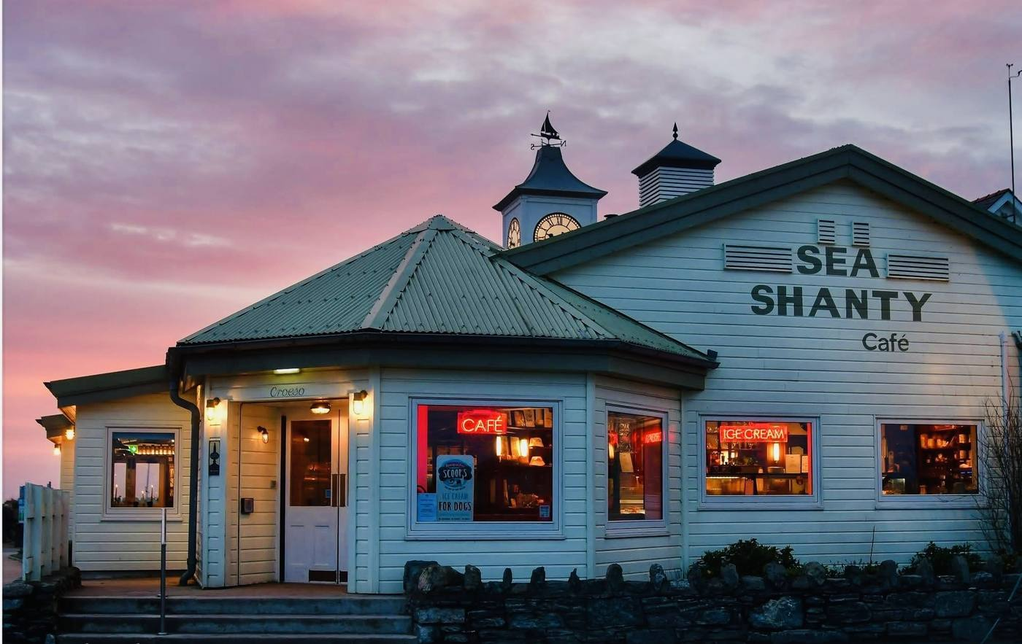
SEA SHANTY CAFE
Website Redesign
A modern, mobile-first website for
Trearddur Bay's favourite cafe
Prepared by Max Walsh
October 2026
Notes:
Title slide. Opening the presentation — introduce yourself and the project.

Slide 2
The Current Website
✕
Not mobile-friendly
Over 60% of customers browse on their phone — the current site doesn't resize or adapt
⏳
Frustrating on mobile
Booking and menus are there but nearly impossible to use on a phone — so customers ring up instead
📋
Outdated design
The current site looks dated and doesn't reflect the quality of your food and location
?
Hard to find answers
No FAQ page, no allergen info, no clear way to book — customers ring instead
Notes:
Walk through each problem. Emphasise how many customers use mobile phones — this is key for a cafe that relies on visitors and tourists.

Slide 3
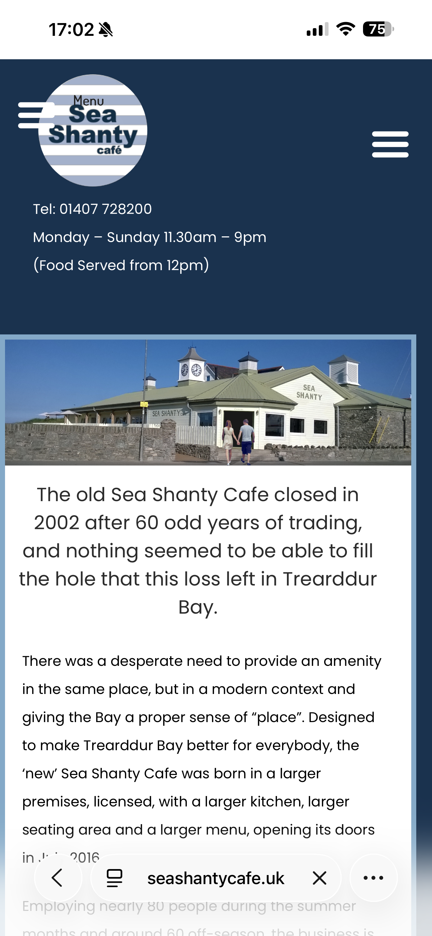
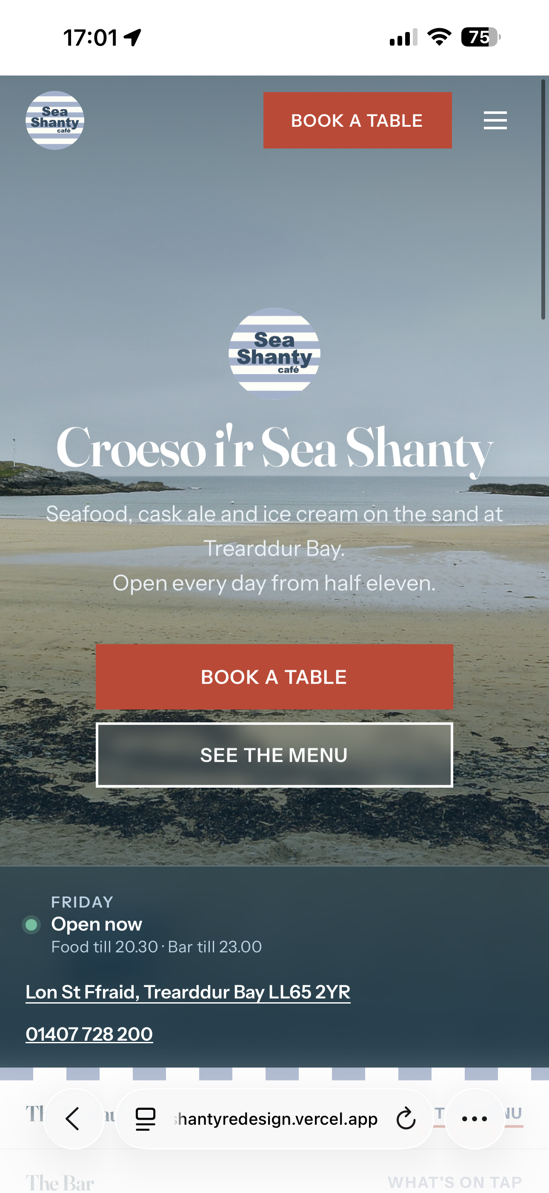
Before & After
BEFORE
AFTER
seashantycafe.uk
seashantyredesign.vercel.app
Notes:
Show the before and after side by side. The links are clickable — click to open each site live. The visual impact should do most of the talking here.

Slide 4
Why It Matters
60%+
24/7
1-tap
Top 5
of customers
browse on mobile
live status
visible online
to book a table
or call you
Google ranking
for local search
A modern website means fewer phone calls asking "are you open?", more online bookings, and a first impression that matches the quality of your food and views.
Google prioritises mobile-friendly sites. Tourists searching "cafe Trearddur Bay" will find you first.
Notes:
Emphasise the business impact. Fewer calls about opening times, more bookings online, better Google ranking. This is where the ROI argument lives.

Slide 5
What's Included
🏠
Home Page
Hero image, live open/closed status, one-tap call and booking
📸
Webcam
Live bay webcam so visitors can check conditions
🍽
Menu Page
Full menu display with downloadable PDF option
🌊
Tide Chart
Live tide times — useful for beachgoers planning a visit
📅
Reservations
Online booking page — no more phone-only bookings
💼
Jobs Page
Staff recruitment page when you're hiring
🎁
Gift Cards
Dedicated gift card page to drive extra revenue
📱
Mobile Optimised
Every page works perfectly on phones and tablets
❓
FAQ Page
Answers to common questions — dogs, parking, groups
🔒
Privacy & 404
Legal compliance page and a branded error page
Notes:
Walk through each page. Emphasise that every single page is mobile-optimised. The gift cards and PDF menu are new additions the original site didn't have.

Slide 6
Key Features
Live Status Bar
One-Tap Actions
Smart Navigation
FAQ Page
Shows whether you're open or closed right now, with today's hours — updates automatically. No more phone calls asking "are you open?"
Book a table, call the cafe, get directions, or download the PDF menu — all within one tap on any device
Sticky header with quick links to every section. Visitors find what they need without scrolling — menus, booking, directions, all one tap away
Dogs, parking, groups, allergens — all answered on one page. Fewer calls about the basics means more time for your customers
Notes:
Highlight the four most impactful features. The live status bar and FAQ page both directly reduce unnecessary phone calls.

Slide 7
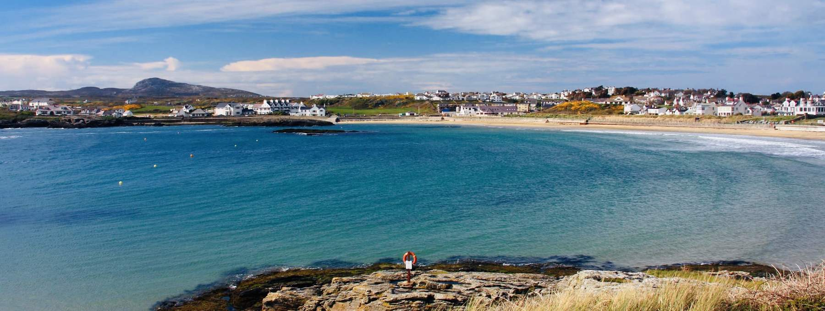
Photography Recommendation
Great photography is the single biggest upgrade for any hospitality website.
The site is built and ready — but professional photos of the food, the views, and the interior will transform it from good to exceptional.
What to photograph
The terrace — outdoor seating and atmosphere
The restaurant interior — decor, the bar, table settings
The seafront nearby — the setting and surroundings
3–5 signature dishes, plated and styled
Exterior and signage — what customers see on arrival
A local photographer can do this in a half-day session. The photos slot straight into the site — no extra build work needed.
Notes:
Photography is optional but highly recommended. Emphasise that the site is ready for photos to be dropped in with no extra cost.

Slide 8
Next Steps
What we need from you to go live
1
Review the menu — Confirm the menu is up to date and send the PDF for the download button
2
Confirm opening hours — Provide regular hours and any seasonal variations for the live status widget
3
ResDiary booking link — Provide the ResDiary link so online table reservations work from the site
4
Google account access — Share Google Business access so we can pull in your reviews and ratings
5
Gift card process — Set up the gift card purchase flow — provider, pricing, and redemption details
6
Photography (optional) — Arrange a half-day photo shoot to replace placeholder imagery
7
Go live — Point your domain to the new site — we handle the technical switch
Suggestion: Consider adding a "What's On" page for special menus, themed events, and seasonal weekends — a great way to give customers a reason to keep coming back.
Notes:
Run through each step. The essentials are the menu PDF, opening hours, ResDiary link, and Google account access. Gift cards and photography can follow. Suggest a What's On page for events and special menus.

Slide 9
Ready,
when you are.
The new Sea Shanty website is built,
mobile-optimised, and waiting to go live.
Max Walsh
maxwalsh0@gmail.com
07733 630 298
Notes:
Thank them for their time. Reiterate that the site is built and ready — just need their content to flip the switch.

