Slide 1


S&P 500 Profitability: Identifying Characteristics of High-Performing Sectors (2013-2018)
Max Weinstein
Binghamton University
B.S Computer Engineering ‘27
MBA Business Analytics ‘28

Slide 2
Objective for Data Analysis
Which sectors and stock characteristics (KPIs) generated the strongest profitability from the S&P 500 from 2013-2018?

Slide 3




Data Analysis Process
Data Collection
Data Analysis
(SQL)
Data Cleaning
Data Visualization
(Pivot Chart)

Slide 4
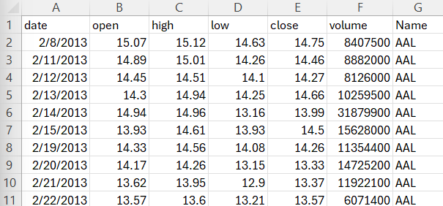
Data Overview
Metric | Value
Stocks | 505
Daily Observations | 619,040
Time Period | 2013-2018
Source | Kaggle (all_stocks_5yr.csv By Janio Martinez Bachmann)
Columns | Date, Open, High, Low, Close, Volume, Name
Sample of Dataset (Excel)

Slide 5
Top Performers
*Found via BigQuery(SQL)
Ticker | Name | Sector | Profit (%)
NVDA | NVIDIA Corp. | Information Technology | +1750%
NFLX | Netflix Inc. | Communication Services | +923%
ALGN | Align Technology Inc. | Healthcare | +616%
EA | Electronic Arts Inc. | Consumer Discretionary | +608%
STZ | Constellation Brands Inc. | Information Technology | +572%
Most
Profitable
Stocks

Slide 6
Bottom Performers
*Found via BigQuery(SQL)
Ticker | Name | Sector | Profit (%)
CHK | Chesapeake Energy ** | Energy | -86%
RRC | Range Resources Corp. | Energy | -82%
UA | Under Armour Inc. | Consumer Discretionary | -72%
DISCA | Discovery Inc. ** | Communication Services | -68%
DISCK | Discovery Inc. ** | Communication Services | -66%
Least
Profitable
Stocks
**Company has merged since 2018

Slide 7
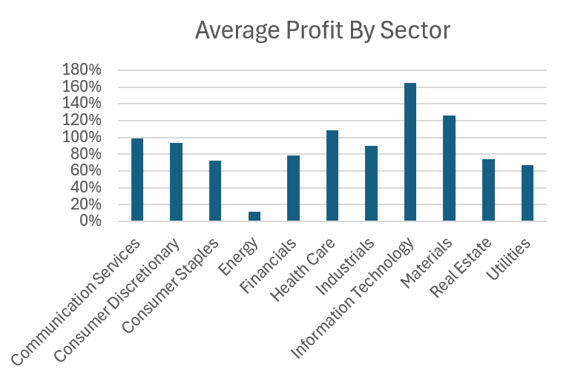
Profit By Sector
*Visualization: Excel Pivot Chart
Top 3 Sectors:
1) Information Technology (+164.9%)
2) Materials (+125.6%)
3) Healthcare (+108.2%)
Bottom 3 Sectors:
1) Energy (+12%)
2) Utilities (+66.6%)
3) Consumer Staples (+72%)
*Found via BigQuery(SQL)

Slide 8
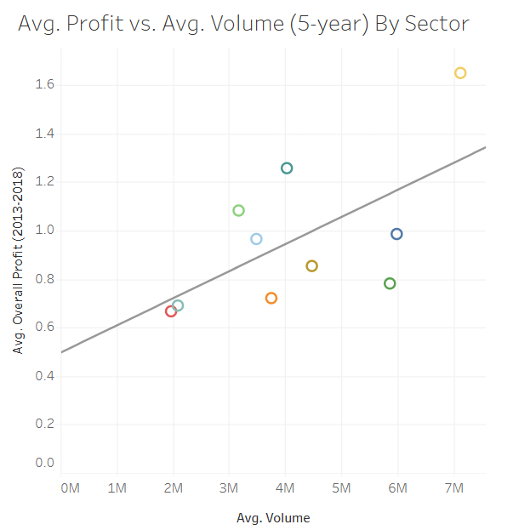
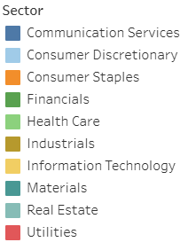
Does Trading Volume Influence Stock Profitability?
*Visualization: Tableau
R-Squared: 0.38
P-value: 0.05
Statistically Significant

Slide 9
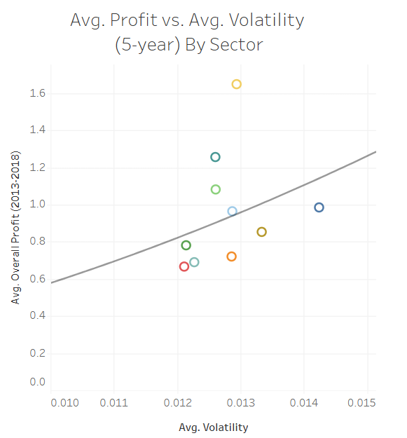
Does Higher Risk Lead to Higher Profit?
*Visualization: Tableau
R-Squared: 0.10
P-value: 0.35
Not Statistically Significant
Volatility =
Standard Deviation of Average Daily Returns

Slide 10
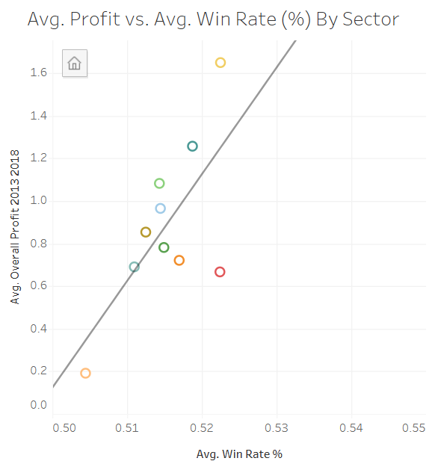
Does Win Rate (%) Influence Profit?
*Visualization: Tableau
R-Squared: 0.48
P-value: 0.02
Statistically Significant
Win Rate (%) =
Positive Trading Days Total Trading Days

Slide 11
Analysis Summary
After my data analysis of the S&P 500 from 2013-2018, I can conclude from this data that:
The most profitable sector was Information Technology
The most profitable position was NVIDIA Corp. with +1750% profit
The least profitable sector was Energy
The least profitable position was Chesapeake Energy with -86% profit
Volume and Profit have a moderately positive linear correlation
Volatility and Profit do not have any significant correlation
Win Rate (%) and Profit have a moderately positive linear correlation

Slide 12
Investor Recommendations
Investors should consider historical sector performance, since some sectors performed substantially better than others
Trading volume may serve as an indicator of future profit for investors
Win Rate (%) may serve as an indicator of future profit for investors
For Future Research:
- More recent market data should be incorporated to determine whether these historical relationships persist under current markets.

Slide 13
Appendices (SQL Scripts)
Scripts for Most/Least Profitable Stocks on Avg.
SELECT
Name,
Sector,
CAST((Overall_Profit_2013_2018)*
100 AS INT64) AS
Overall_Profit_Percentage
FROM `mystic-benefit-497822-
t2.stock_data.stock_data_cleaned`
ORDER BY
Overall_Profit_2013_2018 DESC
LIMIT 5
SELECT
Name,
Sector,
CAST((Overall_Profit_2013_2018)*
100 AS INT64) AS
Overall_Profit_Percentage
FROM `mystic-benefit-497822-
t2.stock_data.stock_data_cleaned`
ORDER BY
Overall_Profit_2013_2018 ASC
LIMIT 5

Slide 14
Appendices (SQL Scripts)
Scripts for Most/Least Profitable Sectors on Avg.
SELECT
Sector,
(100 * AVG(Overall_Profit_2013_2018)) AS
Overall_Profit_Percentage
FROM `mystic-benefit-497822
t2.stock_data.stock_data_cleaned`
GROUP BY
Sector
ORDER BY
Overall_Profit_Percentage DESC
SELECT
Sector,
(100 * AVG(Overall_Profit_2013_2018)) AS
Overall_Profit_Percentage
FROM `mystic-benefit-497822
t2.stock_data.stock_data_cleaned`
GROUP BY
Sector
ORDER BY
Overall_Profit_Percentage ASC

