Slide 1
Planta 1
Planta 2
resposta
resposta
efeito
efeito
Recursos
Ambiente

Slide 2
Efficient | requirement | Inefficient | requirement
Proso millet | 267 | Barley | 518
Sorghum | 304 | Wheat | 557
Corn | 349 (200) | Oats | 583
Foxtail millet | 285 | Rye | 634
Blue grama | 338 | Crested wheatgrass | 678
 |  | Smooth brome | 977
 |  | Rice | 682
University of Nebraska-Lincoln

Slide 3
Efficient | Req. | Inefficient | Req.
Prostrate pigweed | 260 | Sugarbeet | 377
Redroot pigweed | 305 | Lambsquarters | 658
Russian thistle | 314 | Prostrate knotweed | 678
Common purslane | 281 | Cotton | 568
 |  | Velvetleaf | 333
 |  | Potato | 575
 |  | Cocklebur | 415
 |  | Cutleaf nightshade | 487
 |  | Sunflower | 623
 |  | Common ragweed | 912
 |  | Alfalfa | 844
 |  | Common bean | 700
University of Nebraska-Lincoln

Slide 4
 | % N |  | % K
Plant Species | Veg. | Mature | Veg. | Mature
Corn | 3.78 | 1.44 | 4.02 | 0.90
Corn + | 3.45 | 1.38 | 3.08 | 0.70
Pigweed | 4.36 | 2.45 | 4.33 | 1.80
Pigweed + | 4.06 | 2.52 | 4.05 | 2.42
Lambsquarters | 5.30 | 2.66 | 3.92 | 2.00
Lambsquarters + | 5.12 | 2.64 | 4.01 | 2.50
Crabgrass | 4.26 | 2.11 | 3.96 | 1.98
Crabgrass + | 4.02 | 2.09 | 4.17 | 1.80
Barnyardgrass | 3.82 | 1.56 | 2.96 | 0.98
Barnyardgrass + | - | 1.51 | 2.88 | 0.87
University of Nebraska-Lincoln

Slide 5
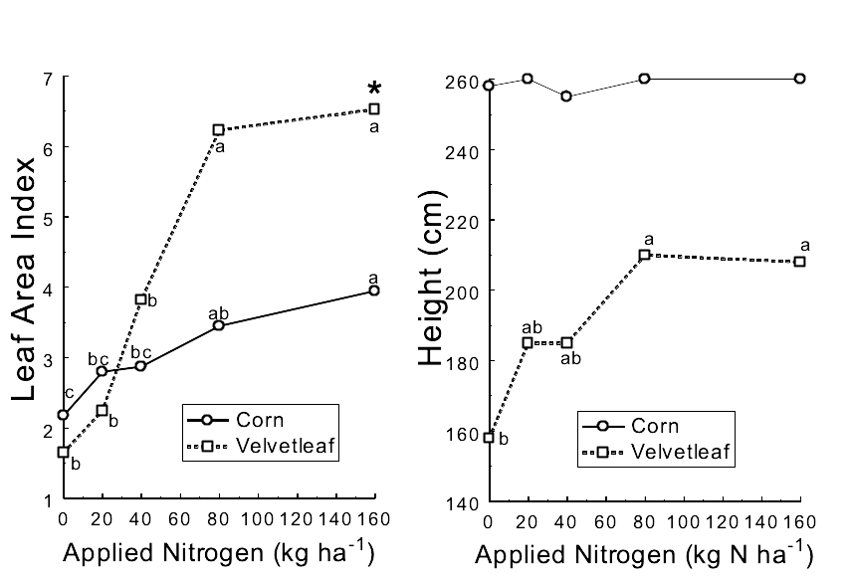
University of Nebraska-Lincoln

Slide 6
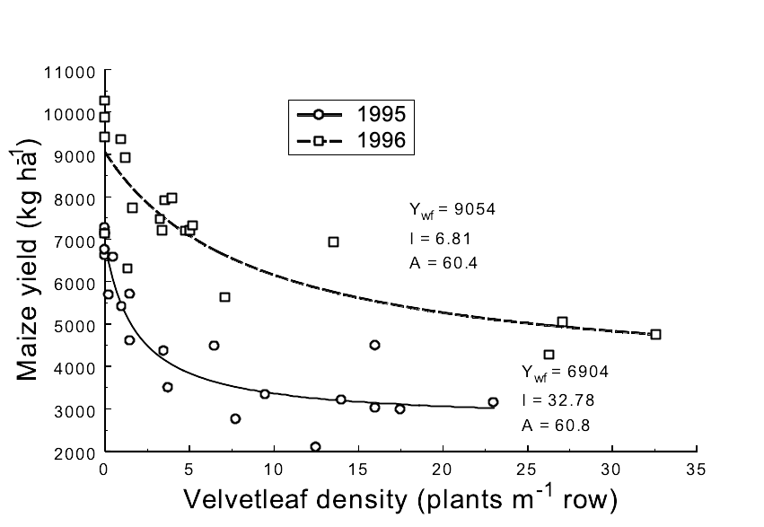
University of Nebraska-Lincoln

Slide 7
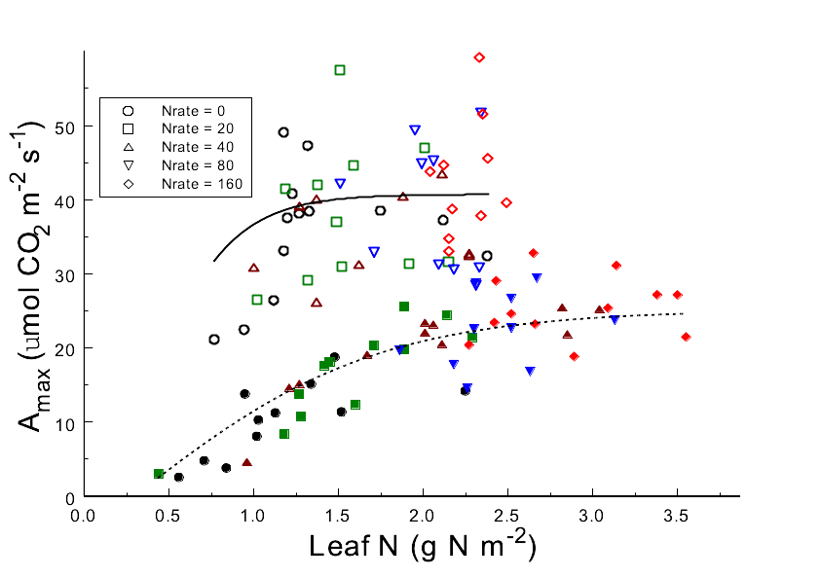
University of Nebraska-Lincoln

