Slide 1
Lecture 12 – Announcements
Homework 1 is due in class on Tuesday (Feb. 24).
Exam grades have been posted.
Questions on Exam or Homework 1?

Slide 2
Competition for Nutrients
Nitrogen, Phosphorous, Potassium (macronutrients: C,H,O,P,K,N,S,Ca,Fe,Mg)
What happens to plants when a nutrient becomes limiting?

Slide 3
saturation
resource limitation

Slide 4
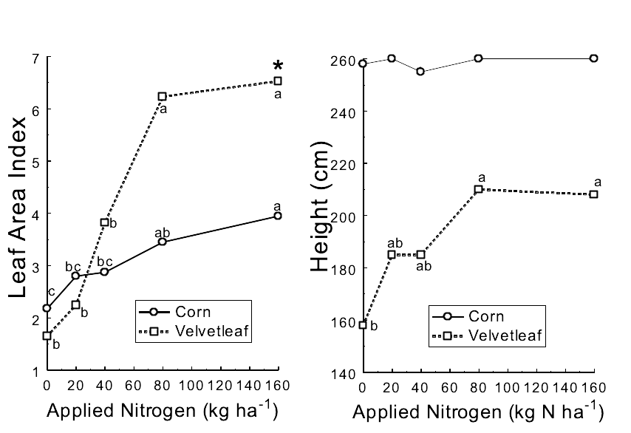
Competition for nutrients versus light

Slide 5
Competition for Nutrients
Why does plant response decline when nitrogen is limiting?
What happens to N when it is taken up? How is it used in plants?

Slide 6
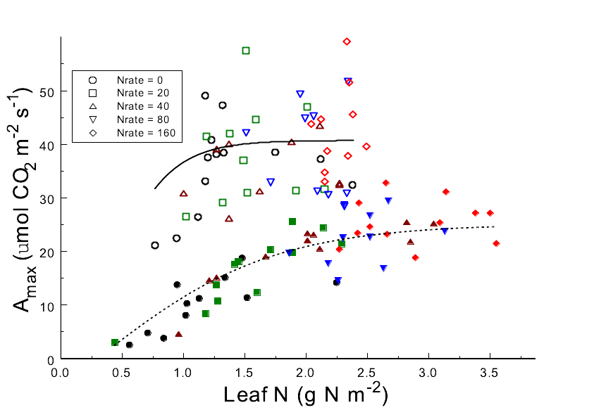
critical nutrient concentrations

Slide 7
typical N & K content of weeds
 | % N |  | % K
Plant Species | Veg. | Mature | Veg. | Mature
Corn | 3.78 | 1.44 | 4.02 | 0.90
Corn + | 3.45 | 1.38 | 3.08 | 0.70
Pigweed | 4.36 | 2.45 | 4.33 | 1.80
Pigweed + | 4.06 | 2.52 | 4.05 | 2.42
Lambsquarters | 5.30 | 2.66 | 3.92 | 2.00
Lambsquarters + | 5.12 | 2.64 | 4.01 | 2.50
Crabgrass | 4.26 | 2.11 | 3.96 | 1.98
Crabgrass + | 4.02 | 2.09 | 4.17 | 1.80
Barnyardgrass | 3.82 | 1.56 | 2.96 | 0.98
Barnyardgrass + | - | 1.51 | 2.88 | 0.87

Slide 8
Competition for Nutrients
Should we add more fertilizer to reduce the effects of weeds?

Slide 9
Competition for Water
Water is the most critical of all the plant growth requirements because it is the least reliable.
Water use efficiency (WUE: g plant dry matter per unit water transpired)

Slide 10
Water requirement (1/WUE) of some monocot species g water needed to produce 1 g dry matter
Efficient | requirement | Inefficient | requirement
Proso millet | 267 | Barley | 518
Sorghum | 304 | Wheat | 557
Corn | 349 (200) | Oats | 583
Foxtail millet | 285 | Rye | 634
Blue grama | 338 | Crested wheatgrass | 678
 |  | Smooth brome | 977
 |  | Rice | 682

Slide 11
Water requirement (1/WUE) of some dicot species g water needed to produce 1 g dry matter
Efficient | Req. | Inefficient | Req.
Prostrate pigweed | 260 | Sugarbeet | 377
Redroot pigweed | 305 | Lambsquarters | 658
Russian thistle | 314 | Prostrate knotweed | 678
Common purslane | 281 | Cotton | 568
 |  | Velvetleaf | 333
 |  | Potato | 575
 |  | Cocklebur | 415
 |  | Cutleaf nightshade | 487
 |  | Sunflower | 623
 |  | Common ragweed | 912
 |  | Alfalfa | 844
 |  | Common bean | 700

Slide 12
Competition for water and nutrients
Root characteristics that influence nutrient and water uptake?

Slide 13
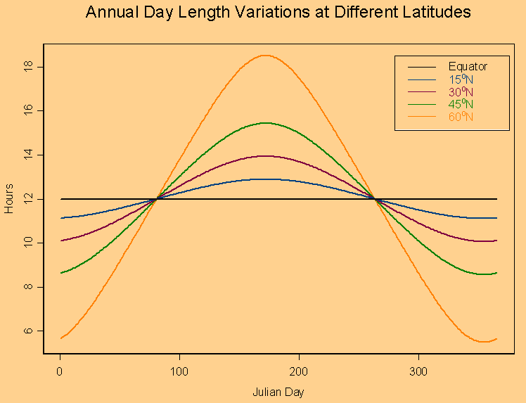
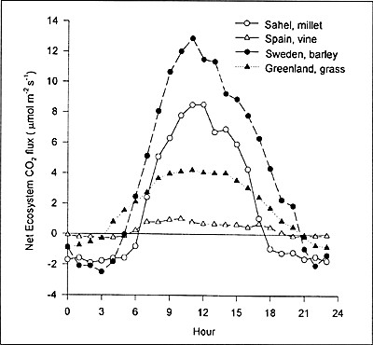
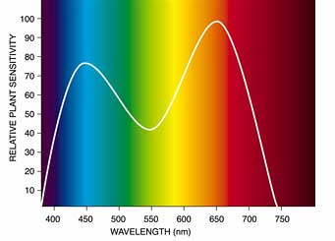
Competition for Light
Light varies in duration (day length), quantity, quality.

Slide 14
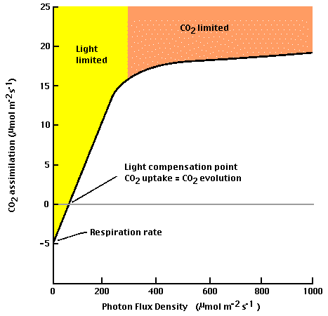
Competition for Light

Slide 15
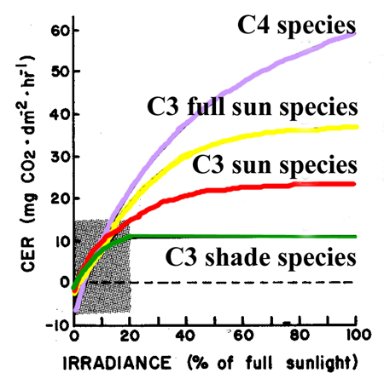
C₃ versus C₄ photosynthesis

Slide 16
Competition for Light
Competition for light is instantaneous, direct

Slide 17
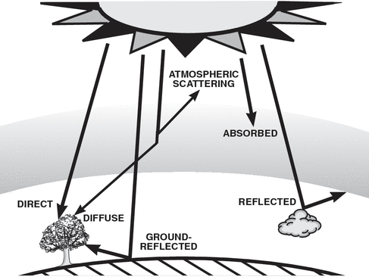
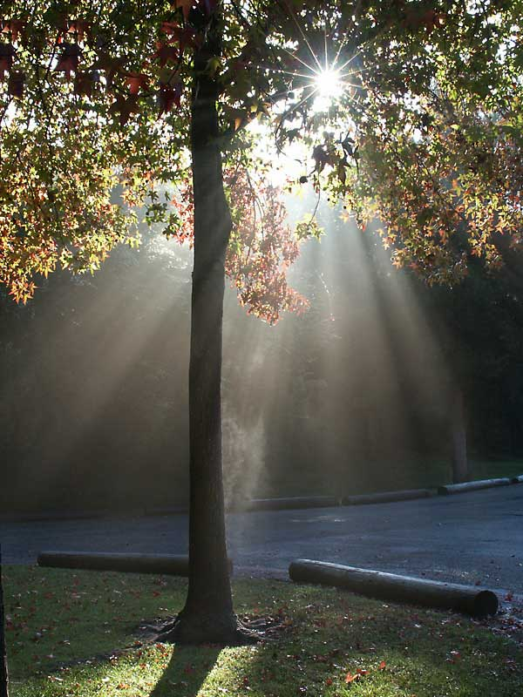

Slide 18
Competition for Light
Canopy characteristics that influence light interception
  More leaf area = more interception = more competition
  Leaf angle
  Vertical leaf area distribution

Slide 19
Review - Interplant Interactions
Objectives:
  Describe how plants compete for resources
  Explain which resources are most critical and why
  Describe characteristics that make plants more competitive for critical resources

Slide 20
Weed Control Thresholds
Objectives:
  Draw the relationship between both yield, yield loss and weed density
  Use the yield loss – weed density relationship to calculate an economic threshold weed density
  Calculate the net return under various weed control strategies

Slide 21
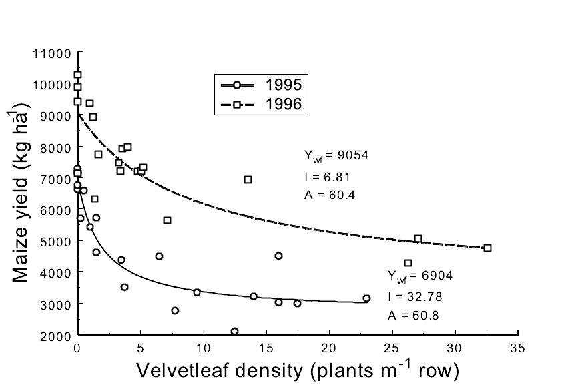
Weed Interference

Slide 22
Yield Loss
Yield loss (Y_{L}) is determined from the relative yield in mixture and weed-free yield:
Y_{L} = (Y_{wf} -Y_{mix})/Y_{wf} = 1-Y_{mix}/Y_{wf}
Or:
Y_{L} (%) = (1-Y_{mix}/Y_{wf})*100

Slide 23
Yield loss – weed density relationship
When no weeds are present, there can be no yield reduction.
Effects of the weed are additive at low weed densities (N):
  Y_{L} = I N
Yield loss can never exceed 100%, but approaches some asymptotic limit typically below 100%.

Slide 24
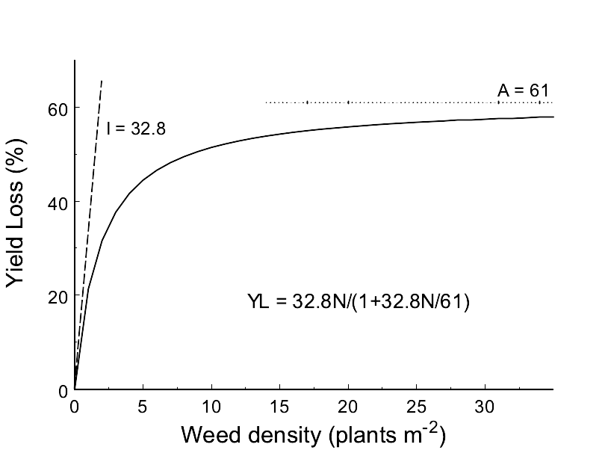
Yield Loss – weed density relationship

Slide 25
Yield loss function
where:
  Y_{L} = yield loss
  I = the proportional yield loss as weed density approaches zero
  A = the maximum proportional yield loss (the upper asymptote)
  N = weed density

Slide 26
Weed Interference

Slide 27
Yield Loss – weed density relationship
1995
1996

Slide 28
Weed Control Thresholds
Economic threshold (T_{e}) is the weed density at which the cost of a control measure equals the loss in value resulting from weed interference.
T_{e} = C/(Y_{wf}PIE_{f})
where:
  C = cost of the herbicide and its application ($/acre)
  Y_{wf} = weed-free crop yield (bu/acre) or yield goal
  P = crop price ($/bu)
  I = yield loss as weed density approaches zero (from yield loss equation)
  E_{f} = herbicide efficacy (proportion of seedlings killed).

Slide 29
Net Economic Returns
Net Return = Gross Return - Costs of Production
NR = [Y * P] - [C + M]
where:
  NR = net return ($/acre)
  Y = crop yield (bu/acre)
  P = price received for crop ($/bu)
  C = cost of weed management ($/acre)
  M = all other management costs ($/acre)

Slide 30
Weed Management Decisions
How do you know how many weeds are in a field?
How do you use that information to make a recommendation?
Are weeds uniformly distributed across fields?

Slide 31
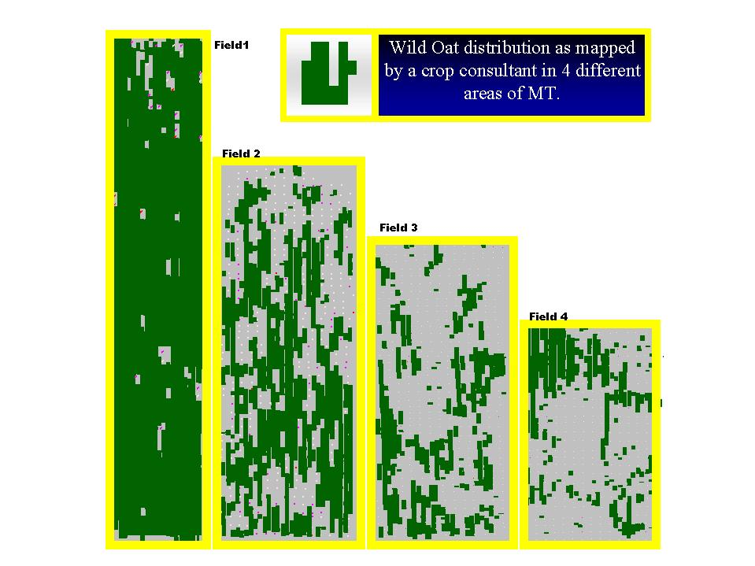

Slide 32
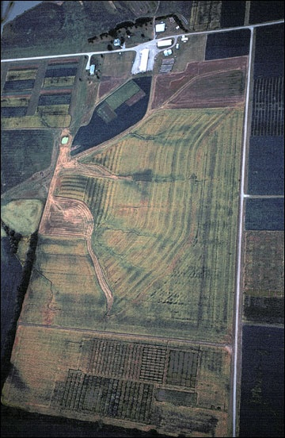

Slide 33
Suppose the cells of the following table list the mean density of redroot pigweed (plants m⁻²) for a 5 acre area (i.e. 20 cells each representing 5 acres means the field is 100 acres total size)
0 | 0 | 0 | 1 | 0
0 | 0 | 0 | 0.4 | 0
0 | 0 | 0 | 0.4 | 0
0 | 0 | 0 | 0 | 0
Mean redroot pigweed density across this entire field is 1.8/20 = 0.09 plants m⁻².

Slide 34
Now suppose we've identified the following values:
  C = $35 /acre (this will vary depending on your management program)
  Y = 190 bu/acre (depends upon climate, soil environment, and management)
  P = 4.25 $/bu (depends on a lot of things, quite variable)
  I = 30% yield loss (varies depending on climate, soil environment, and management - those things that can influence plant performance and competition)
  E_{f} = 95% (depends on environmental conditions, weed age, etc. at the time the management is applied)
  A = 60% (also variable)
T_{e} = C/YPIE_{f}

Slide 35
Site specific weed control
If we used the whole field redroot pigweed density and this economic threshold redroot pigweed density to decide whether management is warranted, what would we do?
Should we spray the whole field? or just the blocks that have densities exceeding the threshold?
Would T_{e} change if the price obtained for the crop decreased?

