Slide 1
Building a “Pun Generator” in Python
Max Schwartz

Slide 2
Me!
Research Engineer on NLP team at ETS
PyGotham Organizer
Likes: dogs, music, chess
Overly fond of terrible jokes
Copyright © 2016 by Educational Testing Service. All rights reserved. ETS, the ETS logo and MEASURING THE POWER OF LEARNING are registered trademarks of Educational Testing Service (ETS). 34728

Slide 3

First: A Very Good Joke
Q: What do you call a bloodsucking cat who runs a town?
A: Fluffy the Vampire Mayor!
Thanks,
Rebecca Lovering!

Slide 4
What We Will Build
User enters phrase
Select certain words (based on defined criteria)
Find other words that sound like these (+ other criteria)
Replace words with similar sounding words
Return to user
Buffy the Vampire Slayer → Fluffy the Vampire Mayor

Slide 5
Edit Distance (Levenshtein Distance)
What?
Method of measuring similarity of strings
Number of (character-level) edits
Why?
Autocorrect
Plagiarism Detection
Biology (e.g. genomic sequences)

Slide 6
How?
Insertions: A → AB
Deletions: AB → A
Substitutions: A → B
Equal (Substitutions): A → A

Slide 7
Why Doesn’t This Work?
C A T
C A B
Equal +0
Equal +0
Sub B for T +2
Total = 2

Slide 8
Problems!
C A T
C A R T
Equal +0
Equal +0
Sub R for T +2
Insert T +1
Total = 3
(Should be 1)

Slide 9
Thing Get Complicated Quickly
C A T
S C A N T
Sub S for C +2
Sub C for A +2
Sub A for T +2
Insert N +1
Insert T +1
Total = 8
(Should be 2)

Slide 10
Solution!
Target (Ins) →
 | ∅ | S | C | A | N | T
∅
C
A
T
Source
(Dels) ↓

Slide 11
Solution!
Target (Ins) →
 | ∅ | S | C | A | N | T
∅ | 0
C
A
T
Source
(Dels) ↓

Slide 12
Solution!
Target (Ins) →
 | ∅ | S | C | A | N | T
∅ | 0 | 1 | 2 | 3 | 4 | 5
C
A
T
Source
(Dels) ↓

Slide 13
Solution!
Target (Ins) →
 | ∅ | S | C | A | N | T
∅ | 0 | 1 | 2 | 3 | 4 | 5
C | 1
A | 2
T | 3
Source
(Dels) ↓

Slide 14
Solution!
Target (Ins) →
 | ∅ | S | C | A | N | T
∅ | 0 | 1 | 2 | 3 | 4 | 5
C | 1
A | 2
T | 3
+2
+1
Source
(Dels) ↓
+1

Slide 15
Solution!
Target (Ins) →
 | ∅ | S | C | A | N | T
∅ | 0 | 1 | 2 | 3 | 4 | 5
C | 1 | 2
A | 2
T | 3
+2
+1
Source
(Dels) ↓
+1

Slide 16
Solution!
Target (Ins) →
 | ∅ | S | C | A | N | T
∅ | 0 | 1 | 2 | 3 | 4 | 5
C | 1 | 2
A | 2
T | 3
+0
+1
Source
(Dels) ↓
+1

Slide 17
Solution!
Target (Ins) →
 | ∅ | S | C | A | N | T
∅ | 0 | 1 | 2 | 3 | 4 | 5
C | 1 | 2 | 1
A | 2
T | 3
+0
+1
Source
(Dels) ↓
+1

Slide 18
Solution!
Target (Ins) →
 | ∅ | S | C | A | N | T
∅ | 0 | 1 | 2 | 3 | 4 | 5
C | 1 | 2 | 1
A | 2
T | 3
+2
+1
Source
(Dels) ↓
+1

Slide 19
Solution!
Target (Ins) →
 | ∅ | S | C | A | N | T
∅ | 0 | 1 | 2 | 3 | 4 | 5
C | 1 | 2 | 1 | 2
A | 2
T | 3
+2
+1
Source
(Dels) ↓
+1

Slide 20
Solution!
Target (Ins) →
 | ∅ | S | C | A | N | T
∅ | 0 | 1 | 2 | 3 | 4 | 5
C | 1 | 2 | 1 | 2
A | 2
T | 3
+2
+1
Source
(Dels) ↓
+1

Slide 21
Solution!
Target (Ins) →
 | ∅ | S | C | A | N | T
∅ | 0 | 1 | 2 | 3 | 4 | 5
C | 1 | 2 | 1 | 2 | 3
A | 2
T | 3
+2
+1
Source
(Dels) ↓
+1

Slide 22
Solution!
Target (Ins) →
 | ∅ | S | C | A | N | T
∅ | 0 | 1 | 2 | 3 | 4 | 5
C | 1 | 2 | 1 | 2 | 3
A | 2
T | 3
+2
+1
Source
(Dels) ↓
+1

Slide 23
Solution!
Target (Ins) →
 | ∅ | S | C | A | N | T
∅ | 0 | 1 | 2 | 3 | 4 | 5
C | 1 | 2 | 1 | 2 | 3 | 4
A | 2
T | 3
+2
+1
Source
(Dels) ↓
+1

Slide 24
Solution!
Target (Ins) →
 | ∅ | S | C | A | N | T
∅ | 0 | 1 | 2 | 3 | 4 | 5
C | 1 | 2 | 1 | 2 | 3 | 4
A | 2
T | 3
Source
(Dels) ↓
+2
+1
+1

Slide 25
Solution!
Target (Ins) →
 | ∅ | S | C | A | N | T
∅ | 0 | 1 | 2 | 3 | 4 | 5
C | 1 | 2 | 1 | 2 | 3 | 4
A | 2 | 3
T | 3
Source
(Dels) ↓
+2
+1
+1

Slide 26
Solution!
Target (Ins) →
 | ∅ | S | C | A | N | T
∅ | 0 | 1 | 2 | 3 | 4 | 5
C | 1 | 2 | 1 | 2 | 3 | 4
A | 2 | 3
T | 3
Source
(Dels) ↓
+2
+1
+1

Slide 27
Solution!
Target (Ins) →
 | ∅ | S | C | A | N | T
∅ | 0 | 1 | 2 | 3 | 4 | 5
C | 1 | 2 | 1 | 2 | 3 | 4
A | 2 | 3 | 2
T | 3
Source
(Dels) ↓
+2
+1
+1

Slide 28
Solution!
Target (Ins) →
 | ∅ | S | C | A | N | T
∅ | 0 | 1 | 2 | 3 | 4 | 5
C | 1 | 2 | 1 | 2 | 3 | 4
A | 2 | 3 | 2
T | 3
Source
(Dels) ↓
+0
+1
+1

Slide 29
Solution!
Target (Ins) →
 | ∅ | S | C | A | N | T
∅ | 0 | 1 | 2 | 3 | 4 | 5
C | 1 | 2 | 1 | 2 | 3 | 4
A | 2 | 3 | 2 | 1
T | 3
Source
(Dels) ↓
+0
+1
+1

Slide 30
Solution!
Target (Ins) →
 | ∅ | S | C | A | N | T
∅ | 0 | 1 | 2 | 3 | 4 | 5
C | 1 | 2 | 1 | 2 | 3 | 4
A | 2 | 3 | 2 | 1
T | 3
Source
(Dels) ↓
+2
+1
+1

Slide 31
Solution!
Target (Ins) →
 | ∅ | S | C | A | N | T
∅ | 0 | 1 | 2 | 3 | 4 | 5
C | 1 | 2 | 1 | 2 | 3 | 4
A | 2 | 3 | 2 | 1 | 2
T | 3
Source
(Dels) ↓
+2
+1
+1

Slide 32
Solution!
Target (Ins) →
 | ∅ | S | C | A | N | T
∅ | 0 | 1 | 2 | 3 | 4 | 5
C | 1 | 2 | 1 | 2 | 3 | 4
A | 2 | 3 | 2 | 1 | 2
T | 3
Source
(Dels) ↓
+2
+1
+1

Slide 33
Solution!
Target (Ins) →
 | ∅ | S | C | A | N | T
∅ | 0 | 1 | 2 | 3 | 4 | 5
C | 1 | 2 | 1 | 2 | 3 | 4
A | 2 | 3 | 2 | 1 | 2 | 3
T | 3
Source
(Dels) ↓
+2
+1
+1

Slide 34
Solution!
Target (Ins) →
 | ∅ | S | C | A | N | T
∅ | 0 | 1 | 2 | 3 | 4 | 5
C | 1 | 2 | 1 | 2 | 3 | 4
A | 2 | 3 | 2 | 1 | 2 | 3
T | 3
Source
(Dels) ↓
+2
+1
+1

Slide 35
Solution!
Target (Ins) →
 | ∅ | S | C | A | N | T
∅ | 0 | 1 | 2 | 3 | 4 | 5
C | 1 | 2 | 1 | 2 | 3 | 4
A | 2 | 3 | 2 | 1 | 2 | 3
T | 3 | 4
Source
(Dels) ↓
+2
+1
+1

Slide 36
Solution!
Target (Ins) →
 | ∅ | S | C | A | N | T
∅ | 0 | 1 | 2 | 3 | 4 | 5
C | 1 | 2 | 1 | 2 | 3 | 4
A | 2 | 3 | 2 | 1 | 2 | 3
T | 3 | 4
Source
(Dels) ↓
+2
+1
+1

Slide 37
Solution!
Target (Ins) →
 | ∅ | S | C | A | N | T
∅ | 0 | 1 | 2 | 3 | 4 | 5
C | 1 | 2 | 1 | 2 | 3 | 4
A | 2 | 3 | 2 | 1 | 2 | 3
T | 3 | 4 | 3
Source
(Dels) ↓
+2
+1
+1

Slide 38
Solution!
Target (Ins) →
 | ∅ | S | C | A | N | T
∅ | 0 | 1 | 2 | 3 | 4 | 5
C | 1 | 2 | 1 | 2 | 3 | 4
A | 2 | 3 | 2 | 1 | 2 | 3
T | 3 | 4 | 3
Source
(Dels) ↓
+2
+1
+1

Slide 39
Solution!
Target (Ins) →
 | ∅ | S | C | A | N | T
∅ | 0 | 1 | 2 | 3 | 4 | 5
C | 1 | 2 | 1 | 2 | 3 | 4
A | 2 | 3 | 2 | 1 | 2 | 3
T | 3 | 4 | 3 | 2
Source
(Dels) ↓
+2
+1
+1

Slide 40
Solution!
Target (Ins) →
 | ∅ | S | C | A | N | T
∅ | 0 | 1 | 2 | 3 | 4 | 5
C | 1 | 2 | 1 | 2 | 3 | 4
A | 2 | 3 | 2 | 1 | 2 | 3
T | 3 | 4 | 3 | 2
Source
(Dels) ↓
+2
+1
+1

Slide 41
Solution!
Target (Ins) →
 | ∅ | S | C | A | N | T
∅ | 0 | 1 | 2 | 3 | 4 | 5
C | 1 | 2 | 1 | 2 | 3 | 4
A | 2 | 3 | 2 | 1 | 2 | 3
T | 3 | 4 | 3 | 2 | 3
Source
(Dels) ↓
+2
+1
+1

Slide 42
Solution!
Target (Ins) →
 | ∅ | S | C | A | N | T
∅ | 0 | 1 | 2 | 3 | 4 | 5
C | 1 | 2 | 1 | 2 | 3 | 4
A | 2 | 3 | 2 | 1 | 2 | 3
T | 3 | 4 | 3 | 2 | 3
Source
(Dels) ↓
+0
+1
+1

Slide 43
Solution!
Target (Ins) →
 | ∅ | S | C | A | N | T
∅ | 0 | 1 | 2 | 3 | 4 | 5
C | 1 | 2 | 1 | 2 | 3 | 4
A | 2 | 3 | 2 | 1 | 2 | 3
T | 3 | 4 | 3 | 2 | 3 | 2
Source
(Dels) ↓
+0
+1
+1

Slide 44
Solution!
Target (Ins) →
 | ∅ | S | C | A | N | T
∅ | 0 | 1 | 2 | 3 | 4 | 5
C | 1 | 2 | 1 | 2 | 3 | 4
A | 2 | 3 | 2 | 1 | 2 | 3
T | 3 | 4 | 3 | 2 | 3 | 2
Source
(Dels) ↓

Slide 45
Spelling vs Pronunciation
Gerard Nolst Trenité – The Chaos (1922)
Dearest creature in creation Studying English pronunciation, I will teach you in my verse Sounds like corpse, corps, horse and worse.
…
Don't you think so, reader, rather, Saying lather, bather, father? Finally, which rhymes with enough, Though, through, bough, cough, hough, sough, tough??

Slide 46
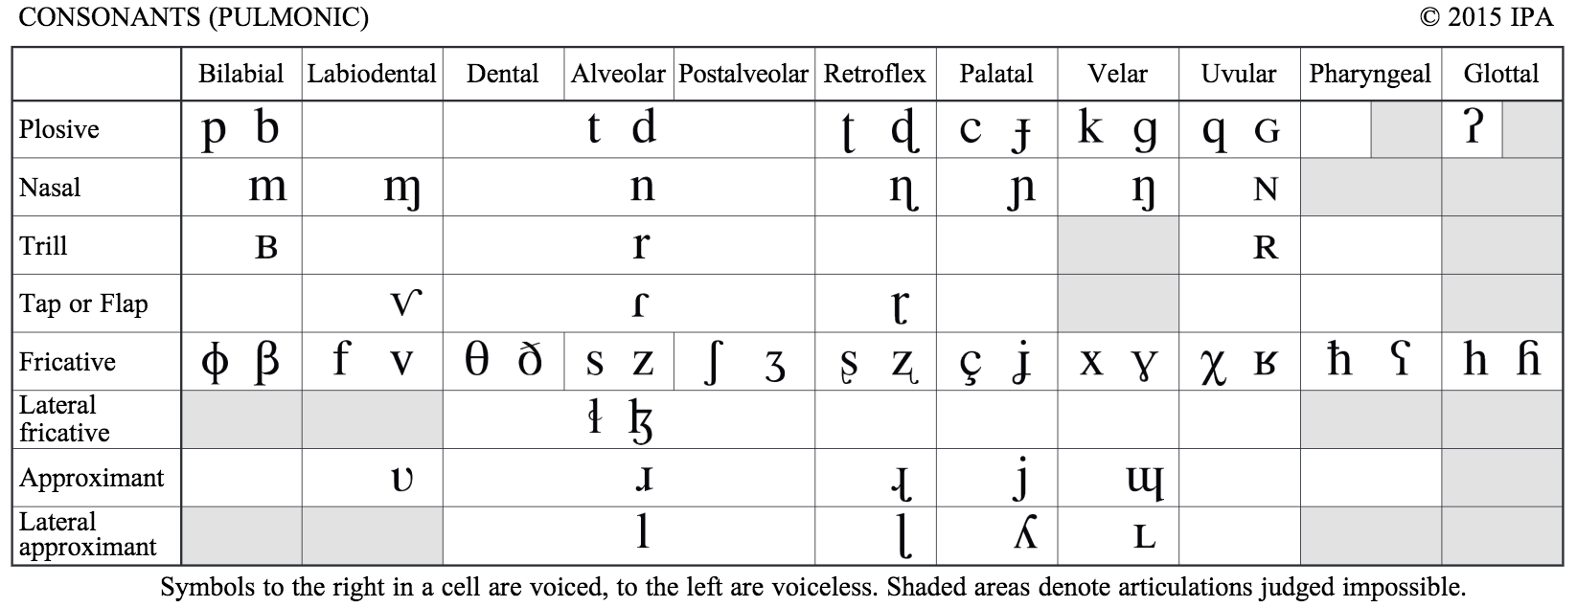
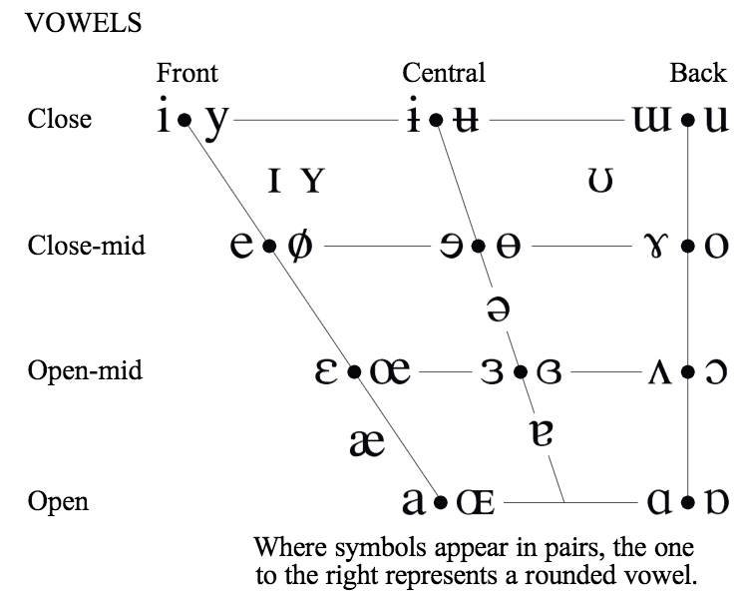
IPA

Slide 47
ASCII Options
ARPABET https://en.wikipedia.org/wiki/ARPABET
Phonemes as unique combos of ASCII characters
Requires dictionary lookup
Double Metaphone https://en.wikipedia.org/wiki/Metaphone#Double_Metaphone
Algorithmic translation of words to simplified phonemes
Less precise (similar words produce identical results)

Slide 48
Parts of Speech
Penn Treebank (36 tags)
NN = singular noun
NNS = plural noun
NNP = proper noun
NNPS = plural proper noun
Algorithmic
Higher accuracy
Takes longer
Assumes proper grammar
Universal Tagset (12 tags)
NOUN
VERB
ADJ
ADV
Lookup
Less accurate (but not bad!)
Fast
Syntax agnostic

Slide 49
Some Ideas For Next Steps
Varied costs
B → P vs B → K
Rebracketing
An app → A nap
Spoonerisms
Save the whales → Wave the sails

Slide 50
Thank You!
Github:
Me – maxwell-schwartz
ETS – EducationalTestingService
Twitter:
@DeathAndMaxes

