Slide 1
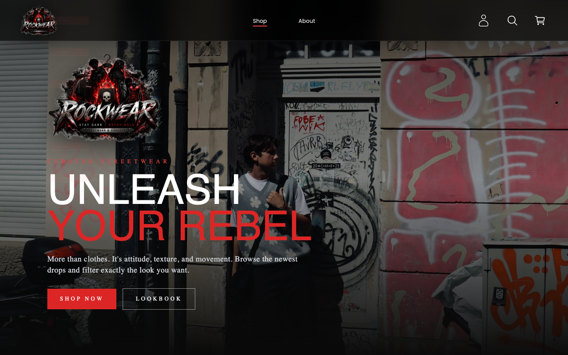

SWP391 PROJECT INTRODUCTION
ROCKWEAR CLOTHING SHOP WEBSITE
UNLEASH
YOUR REBEL
A streetwear e-commerce platform built for curated shopping, order management, stock control, and campaign operations.
Project Pitch
Can Tho, April 2026
Team: Nguyễn Gia Bảo (Leader) · Nguyễn Phúc An · Phạm Trí Trọng Ân · Nguyễn Phúc An
Lecturer: Quách Luyl Đa

Slide 2
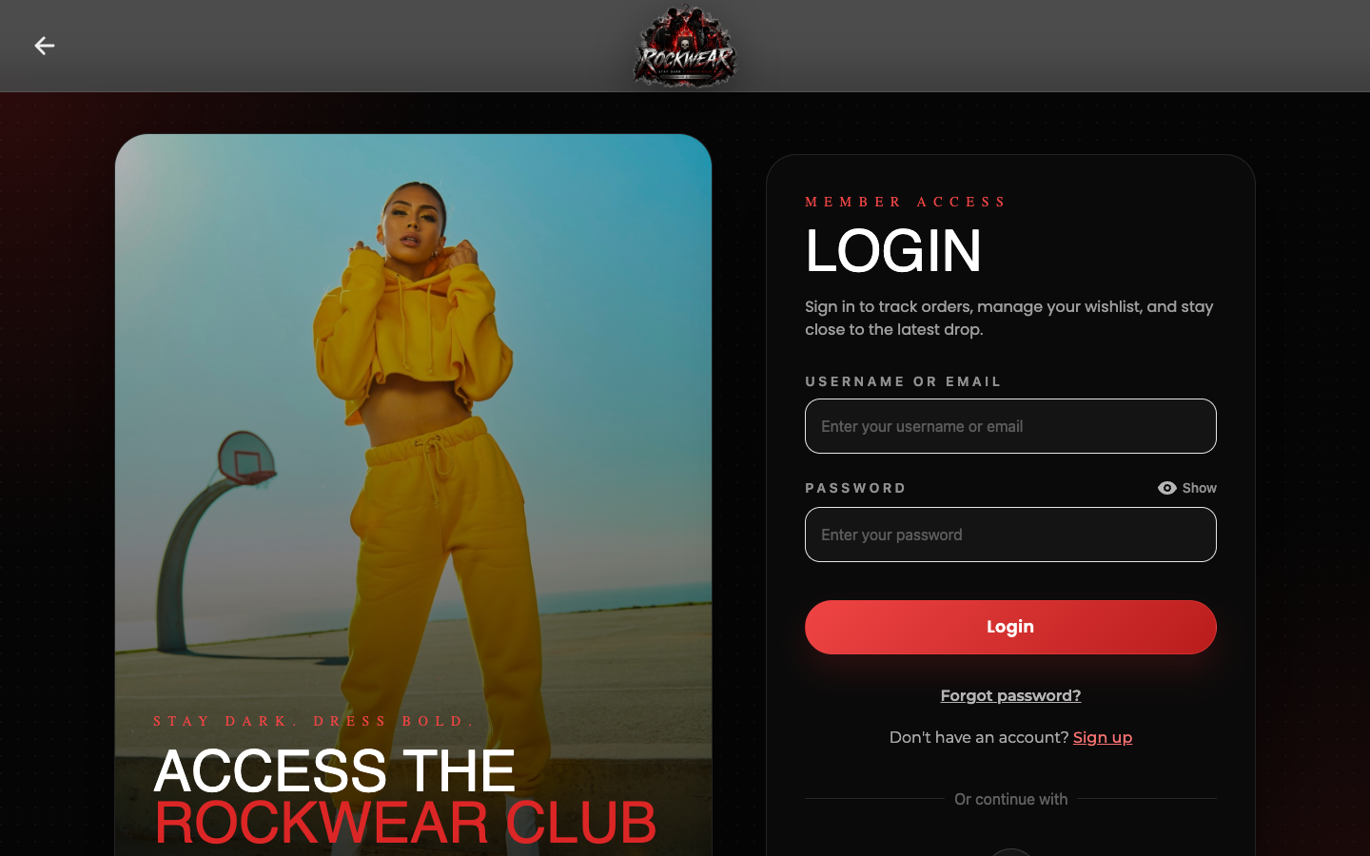
PROJECT SNAPSHOT
A fashion shop that balances style and operations
ROCKWEAR is not only a customer storefront. The system also gives staff and admins the tools to keep products, orders, campaigns, stock, and customer communication under control.
■
Customer-first shopping
Browse products, search, wishlist, cart, checkout, order history, and reviews.
Back-office workflows
■
Manage catalog data, suppliers, warehouse stock, orders, vouchers, promotions, and notifications.
Full-stack implementation
■
React UI connects to REST APIs, service-layer business logic, repositories, and a relational database.

Slide 3
USER ROLES
Four actor groups, one connected shopping system
The requirement document separates access and responsibilities so each role sees the workflow they actually need.
01
02
03
04
Guest
Customer
Staff
Admin
Explore shop, search products, register, and access public pages.
Build cart and wishlist, place orders, use vouchers, review purchased products.
Support operations: products, orders, stock, suppliers, reviews, and notifications.
Control accounts, permissions, product master data, campaigns, and statistics.

Slide 4
CUSTOMER JOURNEY
From discovery to repeat purchase
The core customer flow stays simple, while the system quietly handles availability, payment, discounts, notifications, and review eligibility.
Browse
Select
Checkout
Track
Review
Shop, search, filter
→
Size, color, quantity
→
COD, VNPay, voucher
→
History, status, detail
→
Verified purchase only
WHAT THIS UNLOCKS
A clean demo path for presentation day
Start with the storefront, add a product to cart, apply a voucher, place an order, then show the dashboard side handling the order lifecycle.

Slide 5
ADMIN & STAFF WORKSPACE
Operations behind the storefront
The dashboard turns the store into a managed business process instead of a static product catalog.
Catalog
Orders
Stock
Products, categories, brands, variations
Approval, status updates, order detail
Warehouse view, import products, transaction history
Campaigns
Community
Control
Vouchers, promotions, product assignment
Reviews, replies, customer notifications
Accounts, role permissions, statistics

Slide 6
SYSTEM ARCHITECTURE
A layered full-stack design
The SDS organizes implementation around REST controllers, services, models/DTOs, repositories, security utilities, and configuration.
FRONTEND
BACKEND
DATA
React WebPages
REST → Service
Repository → DB
Shopping UI, dashboard screens, routing, API client, form validation
Controllers handle requests; services apply business rules and orchestrate workflows
Repositories persist users, products, orders, discounts, stock, reviews, notifications
→
→
SECURITY LAYER
JWT, Google login, password hashing, role-based authorization, account status checks, and email services.

Slide 7
DATA BACKBONE
The database mirrors real store operations
The SDS table description lists 36 tables grouped around catalog, inventory, checkout, user management, campaigns, and engagement.
User & Access
Catalog
Inventory
user, role, account profile, authentication state
product, category, brand, size, color, variation
stock, stock variation, provider, transactions
Checkout
Campaigns
Engagement
orders, order status, payment, shipping, order items
discounts, vouchers, sale, promotion products
reviews, comments, notifications, wishlist
Design goal: every customer-facing action has a corresponding operational record for tracking, validation, and reporting.

Slide 8
SCOPE AT A GLANCE
Requirements broad enough for a real store demo
The presentation stays short, but the source documents define a much larger implementation surface.
4
27
36
79
86
actor groups
RDS use-case groups
database tables
business rules
SDS code designs
This gives the project enough depth to demonstrate both user experience and software engineering: flows, rules, persistence, security, and reporting.

Slide 9
QUALITY DECISIONS
Rules that protect the shopping experience
The business rules focus on security, valid inventory, proper authorization, and trustworthy customer interactions.
Role-based access control
Account and password safety
■
Guests, customers, staff, and admins only see the actions they are allowed to perform.
■
Unique usernames/emails, password strength, hashing, session timeout, and reset-link expiration.
Stock-aware checkout
Promotion integrity
■
Products can only be ordered when available; quantity changes and cancellations update stock records.
■
Unique voucher codes, valid date ranges, usage limits, and admin/staff-managed campaigns.
Verified reviews
Operational visibility
■
Customers can review only products from completed purchases, protecting review quality.
■
Dashboards expose revenue, order status, best-selling products, and workflow history.

Slide 10
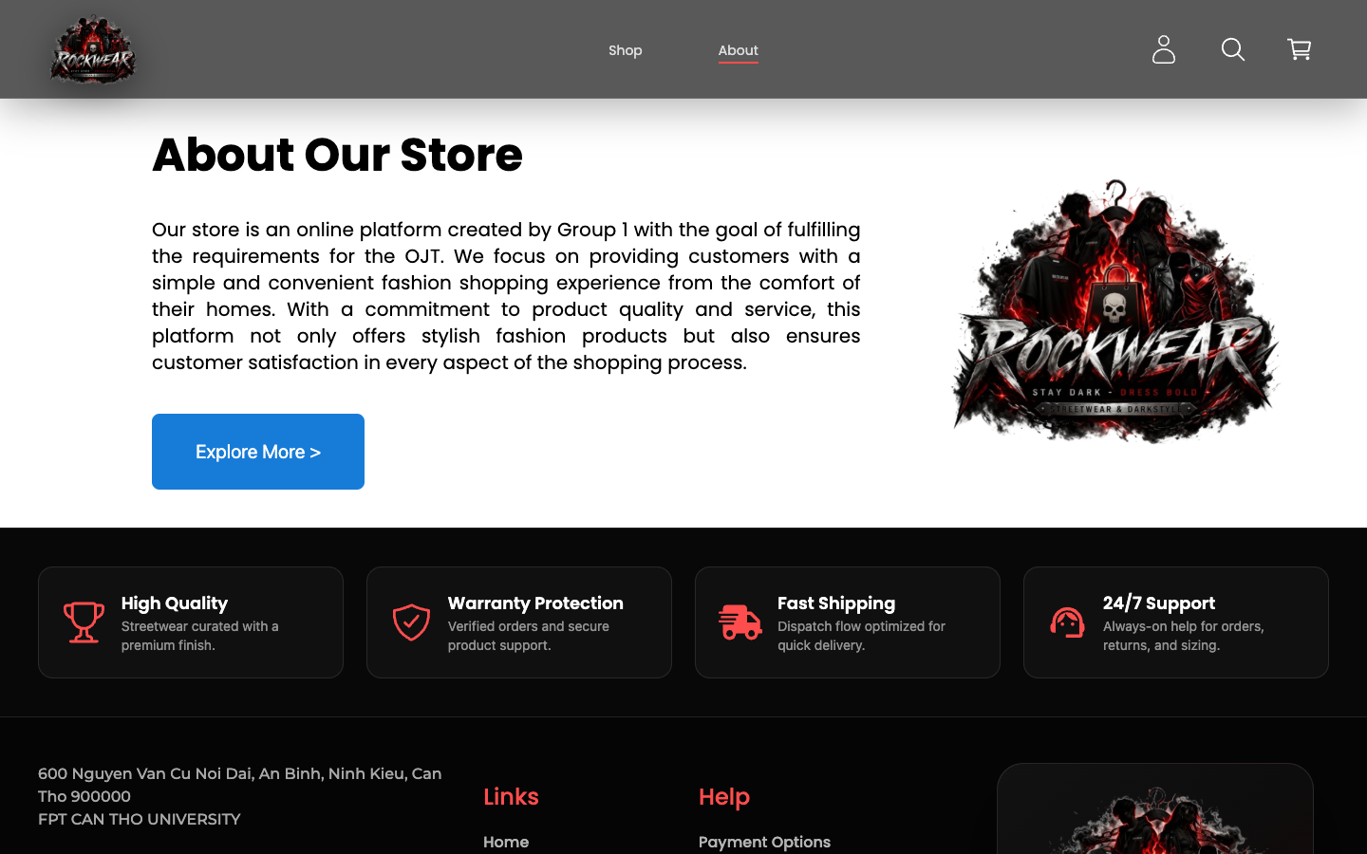
UI IDENTITY
Streetwear energy, product-system clarity
The current interface uses a dark canvas, red highlights, bold display type, and high-contrast product imagery.
Palette: black / white / ROCKWEAR red, with blue retained for legacy action states.

Slide 11
LIVE DEMO SCRIPT
A short story the audience can follow
For a 5-minute class presentation, demo the project as one connected operational loop.
■
1. Open storefront
PRESENTATION PROMISE
Show the ROCKWEAR hero, product browsing, search/filter, and product detail.
Show the store.
Show the system.
Show the engineering.
■
2. Act as customer
Log in, add to wishlist/cart, apply voucher, choose payment, and place order.
3. Switch to operation view
■
Show order management, stock, product/catalog control, campaign management, and statistics.
4. Close with architecture
That sequence makes the project understandable to both non-technical viewers and software evaluators.
■
Explain how React, REST APIs, services, repositories, and database tables support the demo.

Slide 12
OPTIONAL DIAGRAM SLOT
Paste a detailed diagram here if the lecturer asks
The short deck already contains a simplified architecture diagram. Use this slide only when you want to show an official SDS/RDS diagram.
Use Case or ERD
Sequence or Class Diagram
Suggested files: customer/admin/staff use-case diagram or database ERD from SDS/RDS.
Suggested files: login sequence, order class diagram, product/catalog class diagram, or stock import class diagram.
Keep this slide as backup; delete it if the final presentation must stay very concise.

