Slide 1
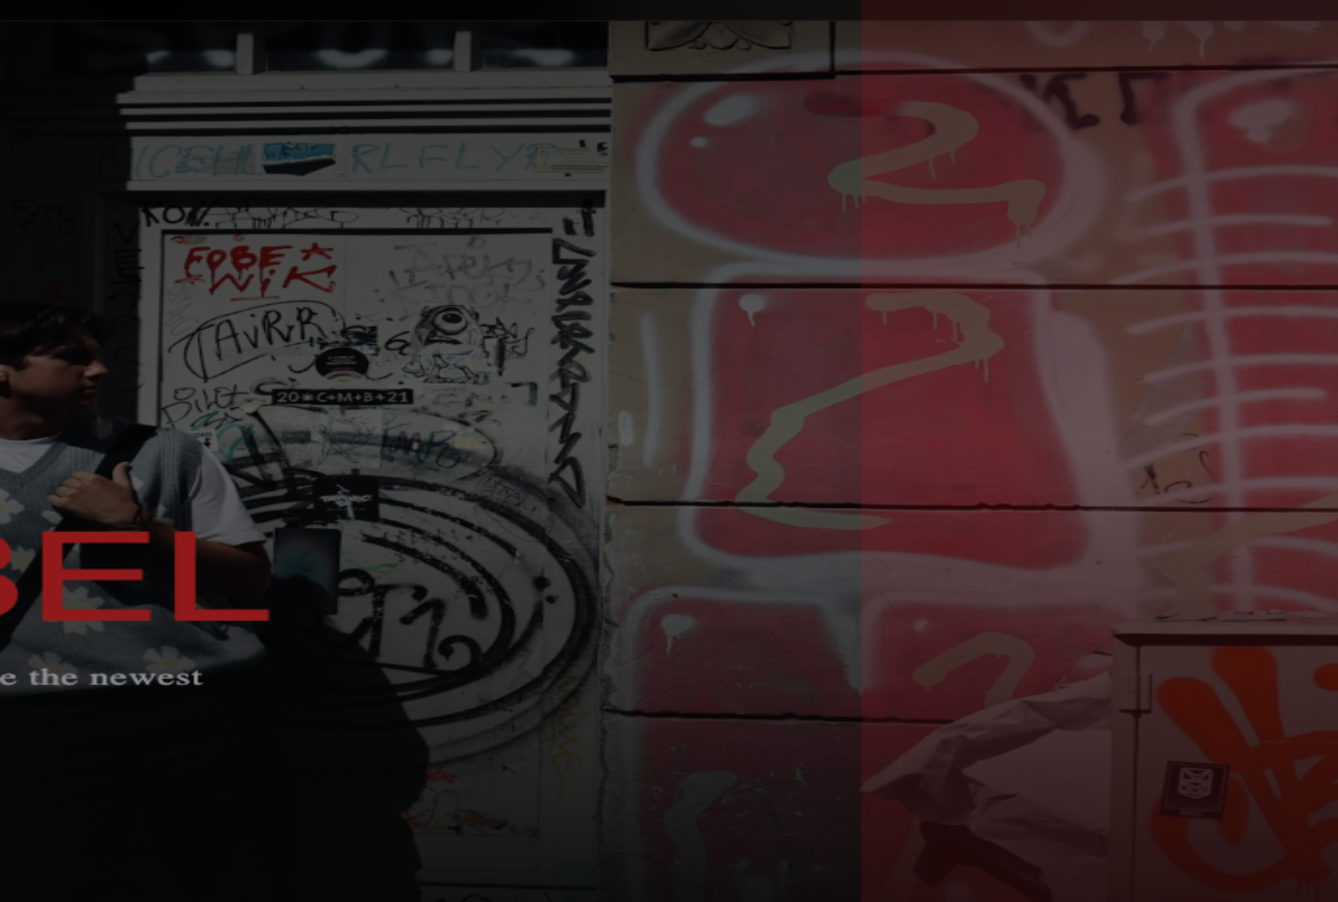
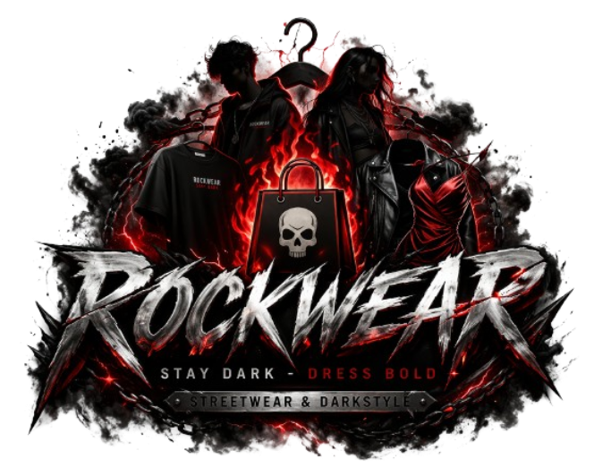
SWP391 PROJECT INTRODUCTION
ROCKWEAR
Clothing Shop Website
A streetwear e-commerce platform for shopping, order processing, stock control, and promotion operations.
PRESENTED BY
Nguyễn Gia Bảo (Leader)
Nguyễn Phúc An
Phạm Trí Trọng Ân
Nguyễn Phúc An
Lecturer: Quách Luyl Đa

Slide 2
PROJECT POSITIONING
What we built, and how to present it
Use this slide to introduce the project clearly before jumping into diagrams.
TEAM TALKING MAP
■
Nguyễn Gia Bảo
Leader · project overview and closing
■
Nguyễn Phúc An
Customer flow and UI demo
■
Phạm Trí Trọng Ân
■
Problem
Architecture, data model, and backend logic
Streetwear shopping needs a fast storefront, reliable stock visibility, and clear order tracking.
■
Nguyễn Phúc An
■
Solution
Dashboard operations and QA points
ROCKWEAR connects customer shopping flows with staff/admin operational workflows.
■
Scope
Storefront, authentication, cart, checkout, orders, vouchers, promotions, stock, reviews, notifications, and statistics.

Slide 3
DIAGRAM 1
System actors and use-case scope
Place the main use-case diagram here so the audience understands the system boundary before seeing implementation details.
WHAT TO SAY
■
Guest
Can browse, search, register, and login.
Paste Use-Case Diagram
■
Customer
Recommended: Guest / Customer / Staff / Admin use-case diagram from RDS.
Can wishlist, cart, checkout, review, and track orders.
■
Staff/Admin
Drop the diagram image here before presenting.
Manage products, orders, stock, campaigns, accounts, and statistics.
■
RBAC
Each role only reaches its authorized screens and APIs.

Slide 4
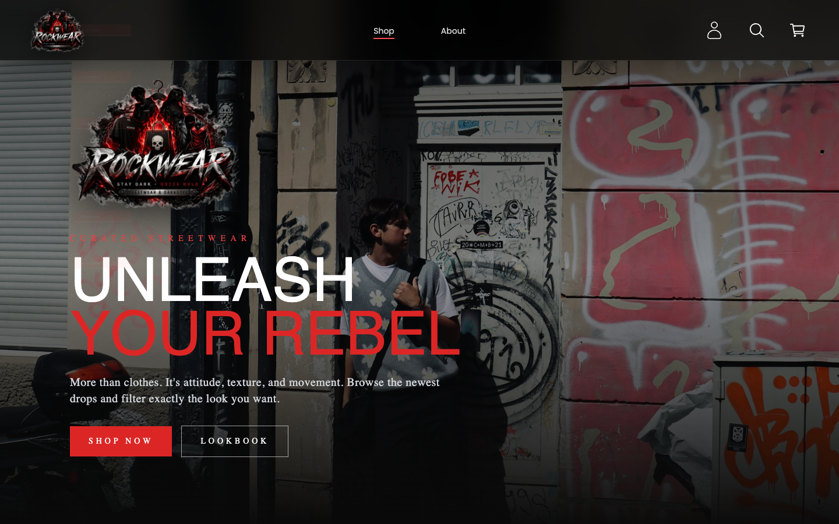
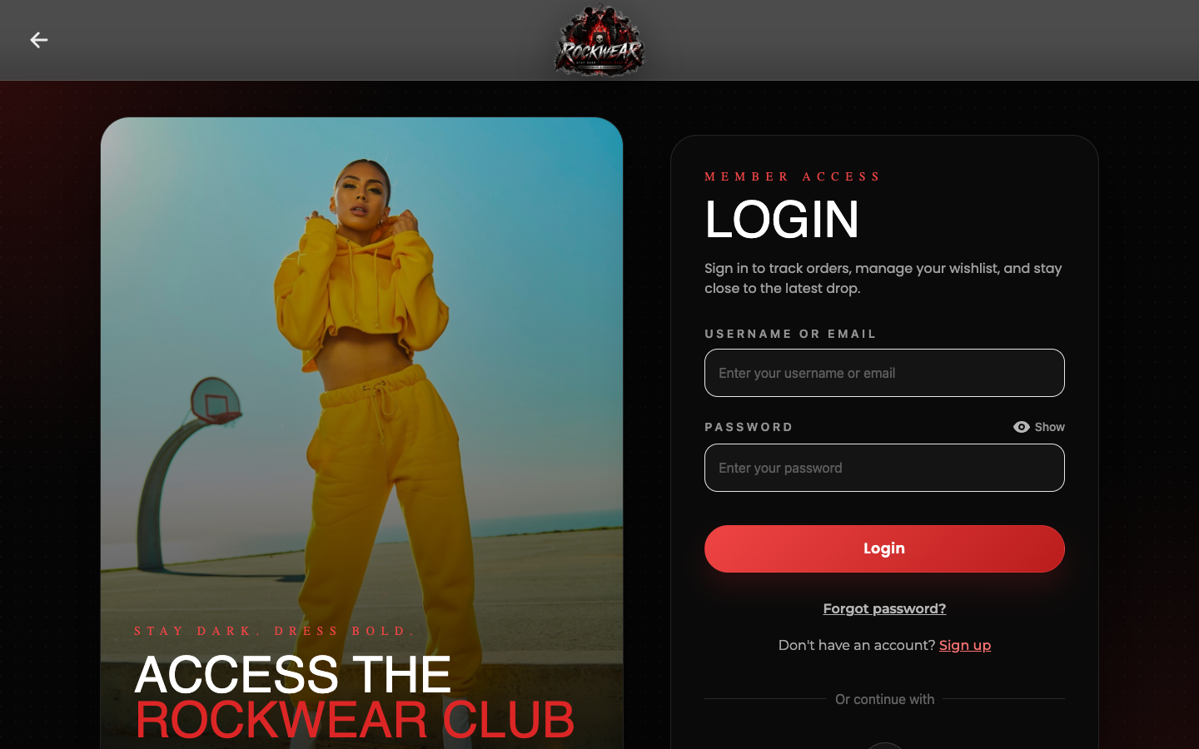
CUSTOMER EXPERIENCE
A simple path from discovery to order
The customer side is designed as a familiar e-commerce journey, but backed by stock checks, vouchers, and order history.
■
Browse
Shop, search, and inspect product details.
■
Choose
Pick variation, quantity, cart, or wishlist.
■
Checkout
Apply voucher and choose payment method.
■
Track
Follow order status and review after purchase.

Slide 5
DIAGRAM 2
Architecture, ERD, or class diagram
Use this slot for the technical diagram that best supports your demo route.
BEST PICKS
■
ERD
Paste Technical Diagram
Use if you want to prove database completeness.
■
Sequence
Recommended: ERD, login sequence, order class diagram, or stock import class diagram.
Use if you want to explain request flow.
■
Class diagram
Drop the diagram image here before presenting.
Use if you want to connect controllers, services, and repositories.
Delete one diagram slide if the presentation needs to be even shorter.

Slide 6
SYSTEM DESIGN
React UI → REST API → Services → Repositories → Database
The implementation follows a layered structure so business rules stay separate from UI and persistence.
FRONTEND
API
LOGIC
DATA
React WebPages
REST Controllers
Services + DTOs
Repositories + DB
Routes, forms, shop UI, dashboard UI
→
Request handling and authorization
→
Business rules and workflow orchestration
→
Persistent product, order, stock, user data
36
79
86
database tables
business rules
SDS code designs

Slide 7
WHAT MAKES IT COMPLETE
Customer value plus operational control
The project can be presented as more than a CRUD website because each feature connects to a real store workflow.
SHOPPING
OPERATIONS
QUALITY
Browse, cart, checkout, review
Orders, stock, suppliers, campaigns
Security, RBAC, validation, statistics
A customer can move from discovery to purchase without leaving the product context.
Staff and admins can keep catalog data, stock flow, and promotions synchronized.
JWT, Google login, password safety, stock checks, voucher rules, and dashboard metrics support reliability.
RDS / SDS PROOF POINTS
27
36
79
86
Use these numbers as the bridge from feature list to demo: the project is documented, designed, and implementation-ready.
use-case groups
database tables
business rules
code designs

Slide 8
LIVE DEMO
Let’s demo
ROCKWEAR
We will show the store, place the project in context, then connect the demo back to architecture and operations.
1. Storefront
2. Customer Flow
3. Dashboard

