Slide 1
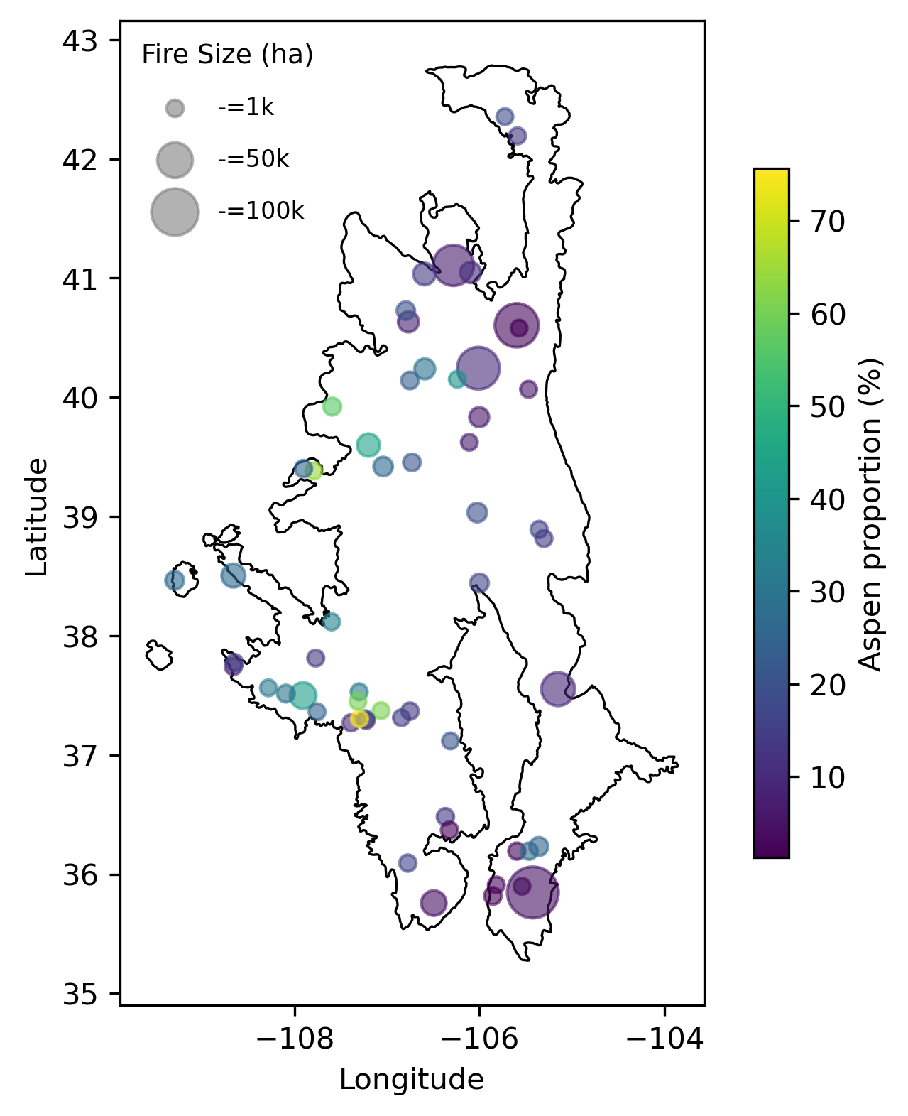
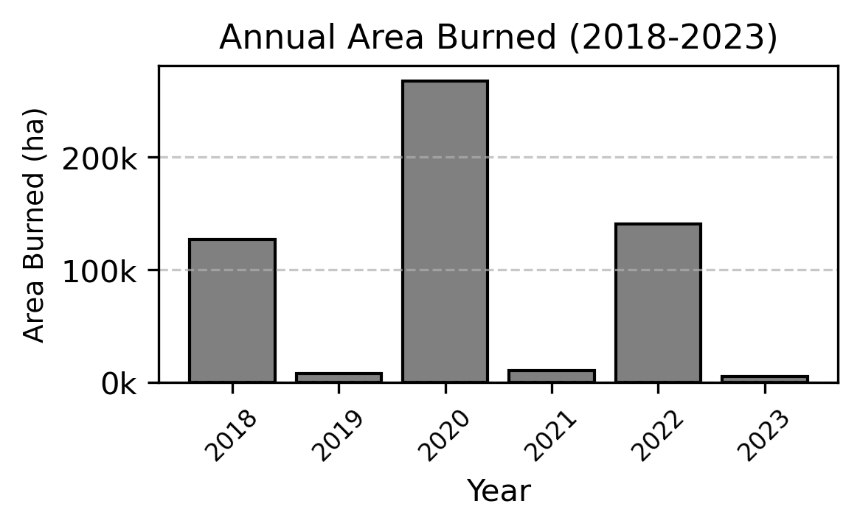
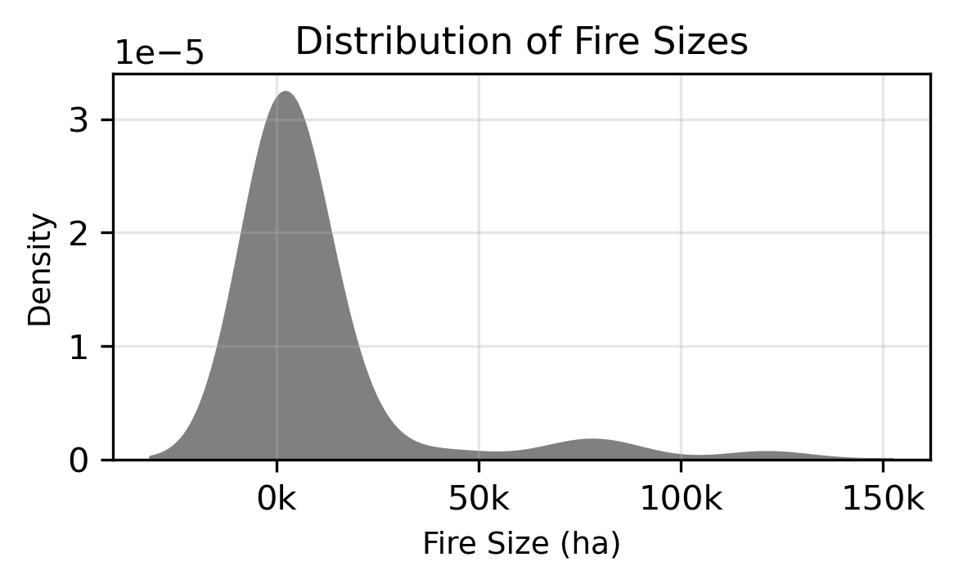
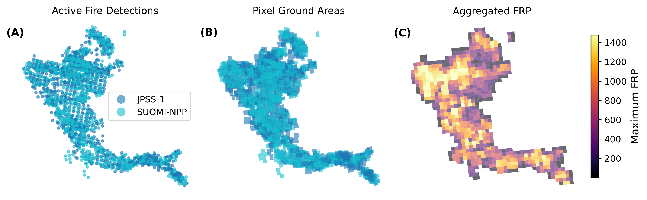
Figure 1. Study region and wildfire events. (A) Map of the SRM showing the locations of wildfire events with >1% pre-fire aspen cover. Point size represents the burned area (ha), color scale represents the percentage of aspen forest cover; (B) annual burned area (ha); (C) distribution of fire size (or other statistics ??).
Figure 2. Aggregation of VIIRS FRP retrievals onto a regular grid. (A) Pixel centers of AFD from both satellites (S-NPP and JPSS-1); (B) Pixel ground area based on swath position (relative nadir position); (C) Cumulative FRP based on fractional assignment.

Slide 2
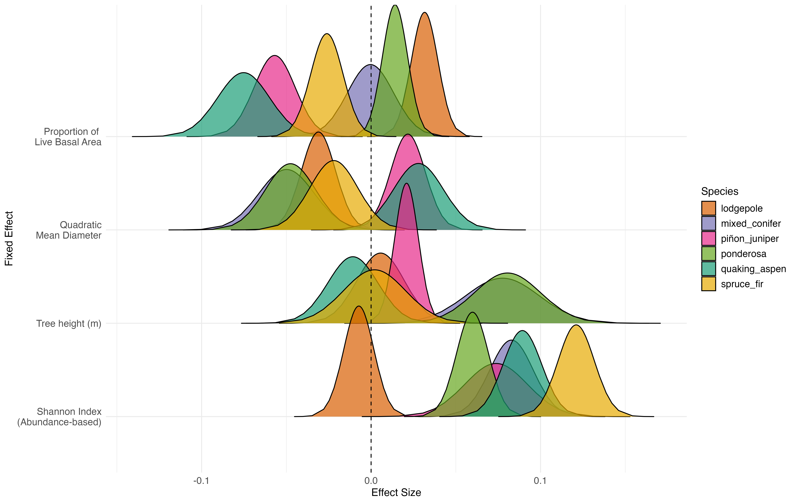
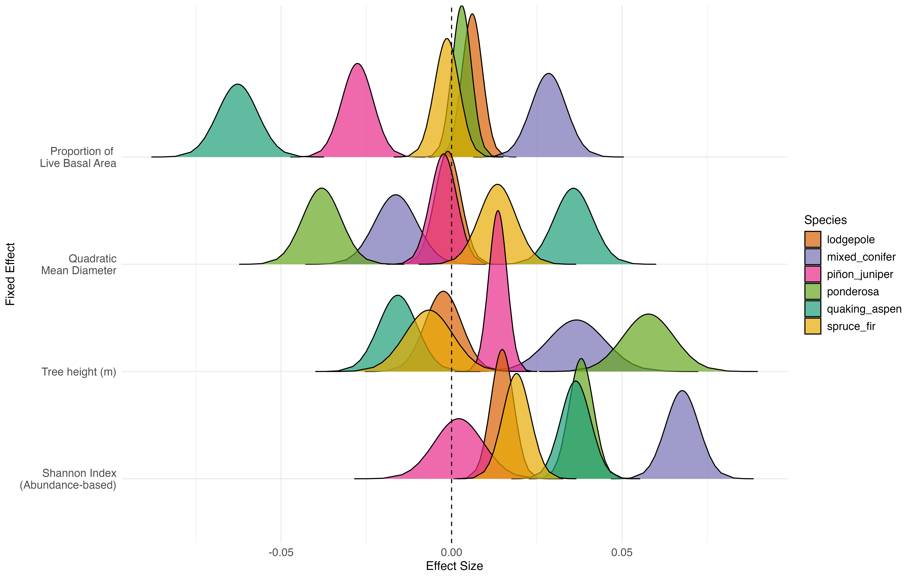

Slide 3
Figure 1. Study region and wildfire events. (A) Map of the SRM showing the locations of wildfire events with >1% pre-fire aspen cover. Point size represents the burned area (ha), color scale represents the percentage of aspen forest cover; (B) annual burned area (ha); (C) distribution of fire size (or other statistics ??).
Figure 2. Aggregation of VIIRS FRP retrievals onto a regular grid. (A) Pixel centers of AFD from both satellites (S-NPP and JPSS-1); (B) Pixel ground area based on swath position (relative nadir position); (C) Cumulative FRP based on fractional assignment.

Slide 4
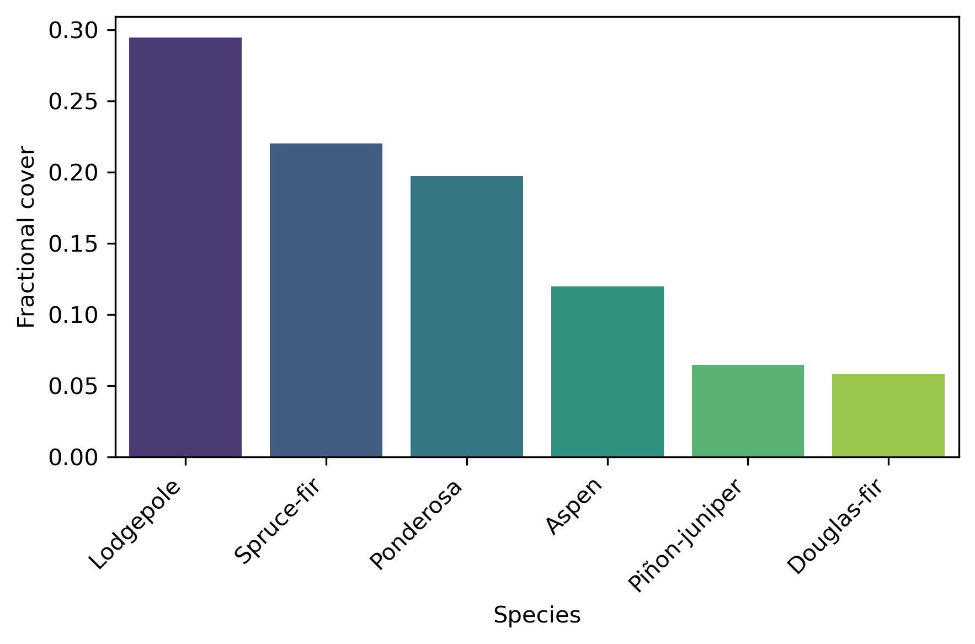
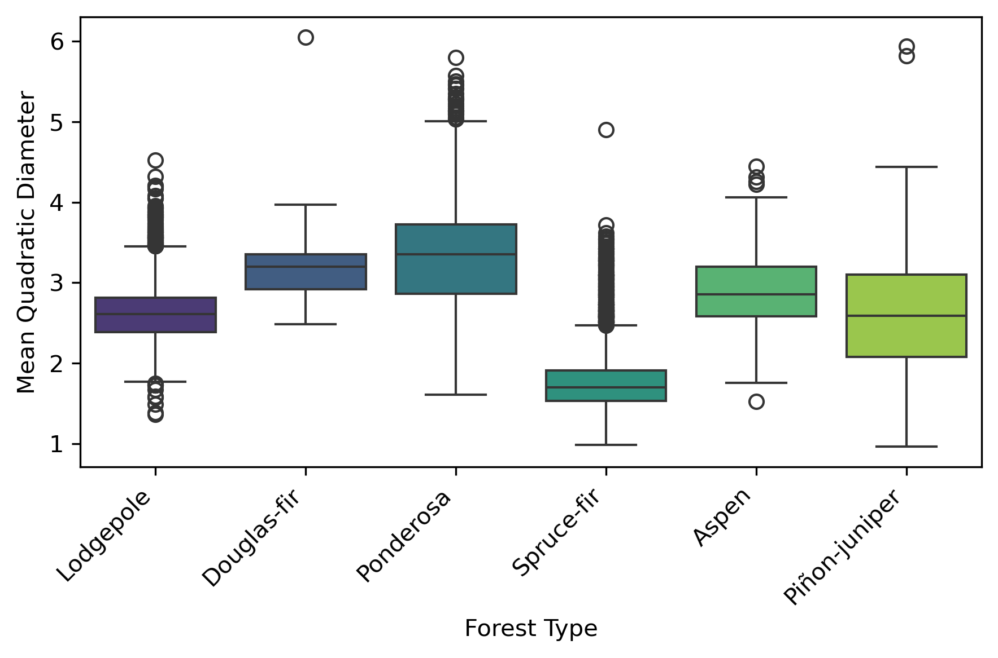
Figure 3. Landscape proportion of forest types making up 97% of the burned area within the aggregated FRP grids.
Figure 4. Maximum FRP (log-scaled) within dominant forest types. Dominance was determined based on the percent cover for each gridcell where one species made up >80% of the total forested area.

Slide 5
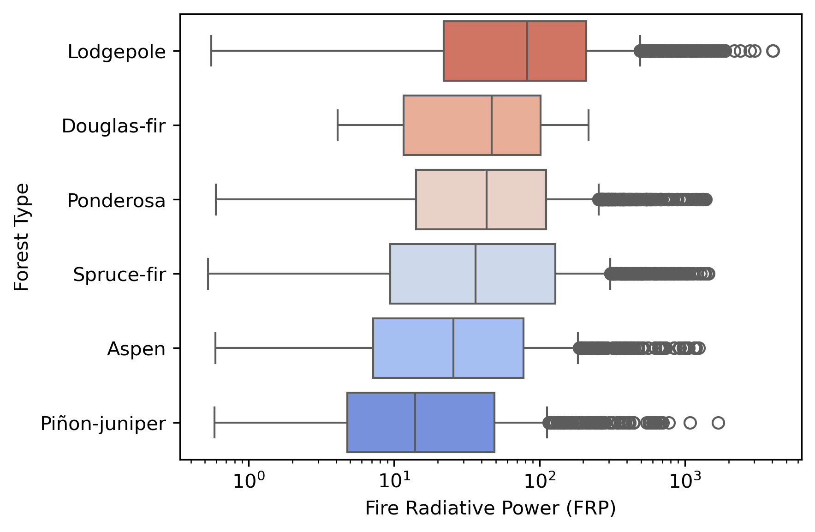
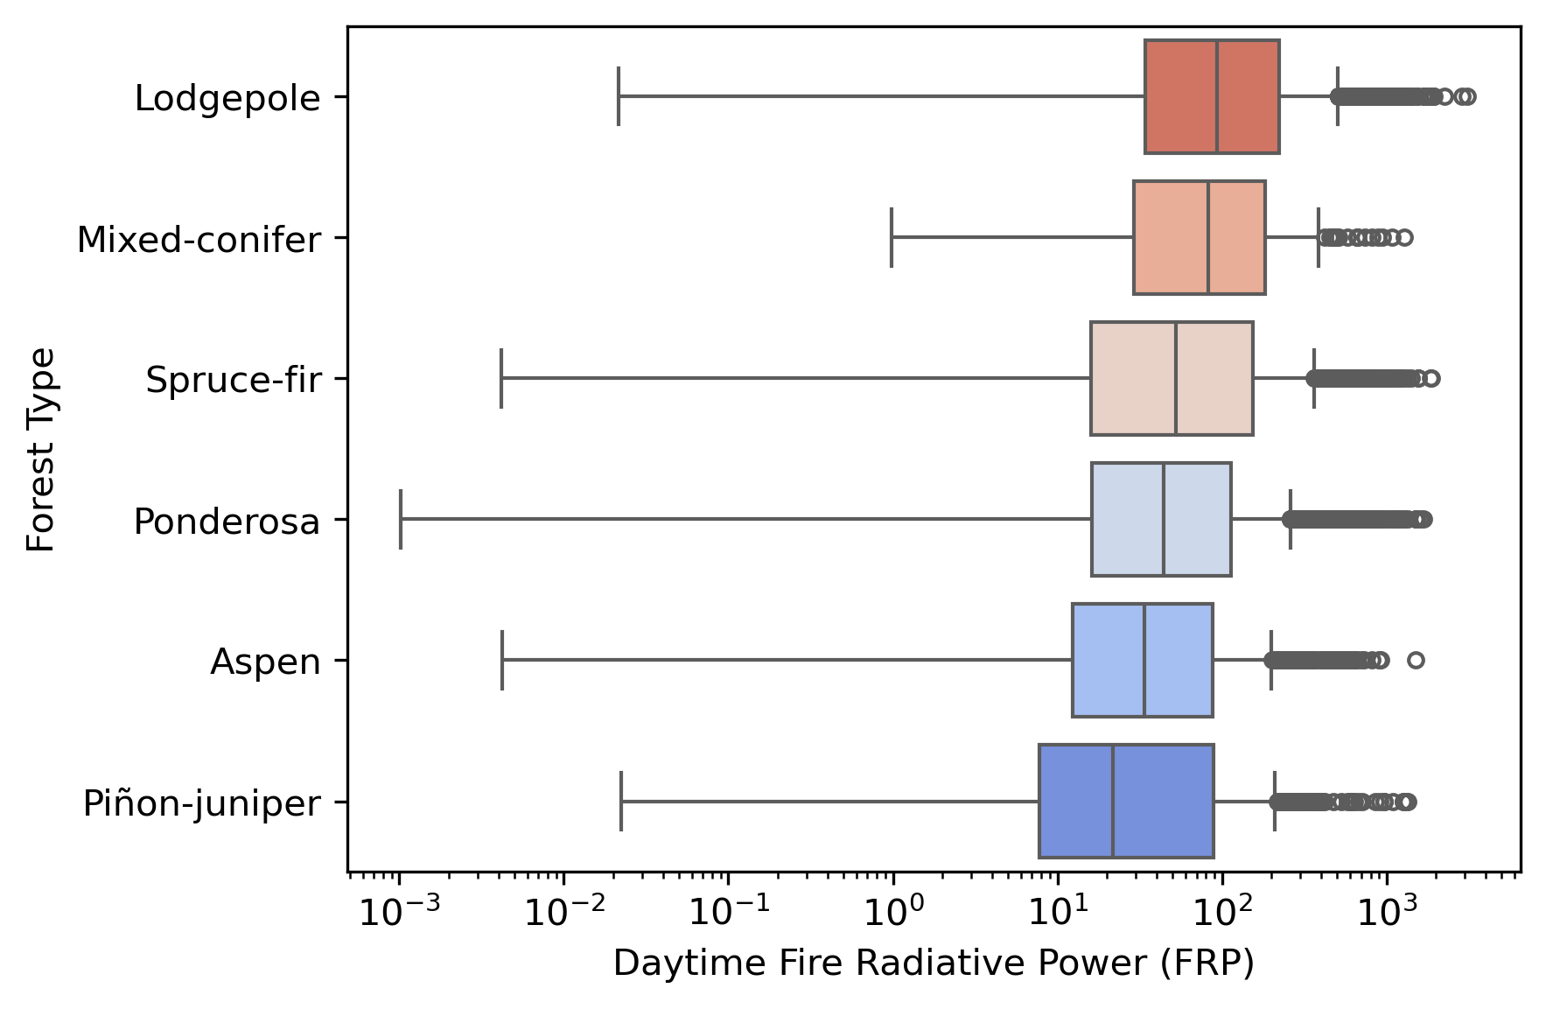
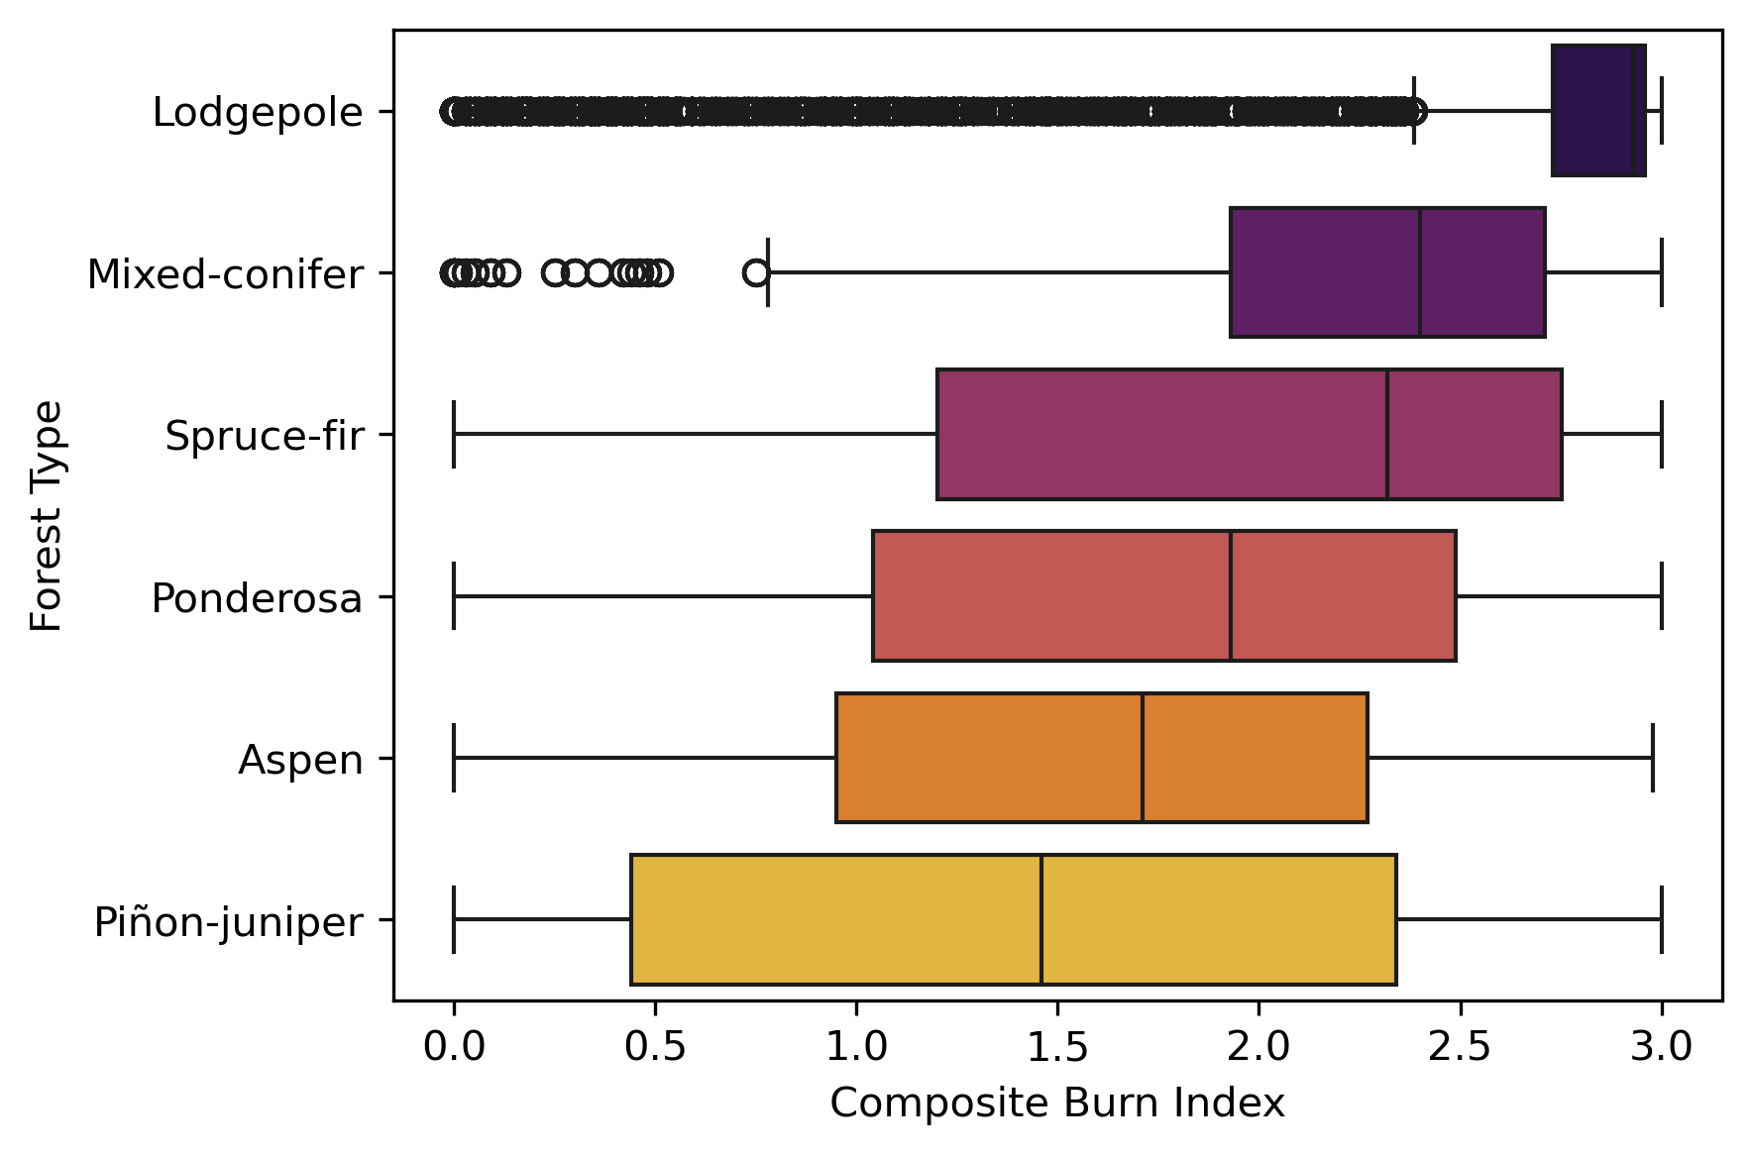
Figure 4. Maximum FRP (log-scaled) within dominant forest types. Dominance was determined based on the percent cover for each gridcell where one species made up >80% of the total forested area.

Slide 6
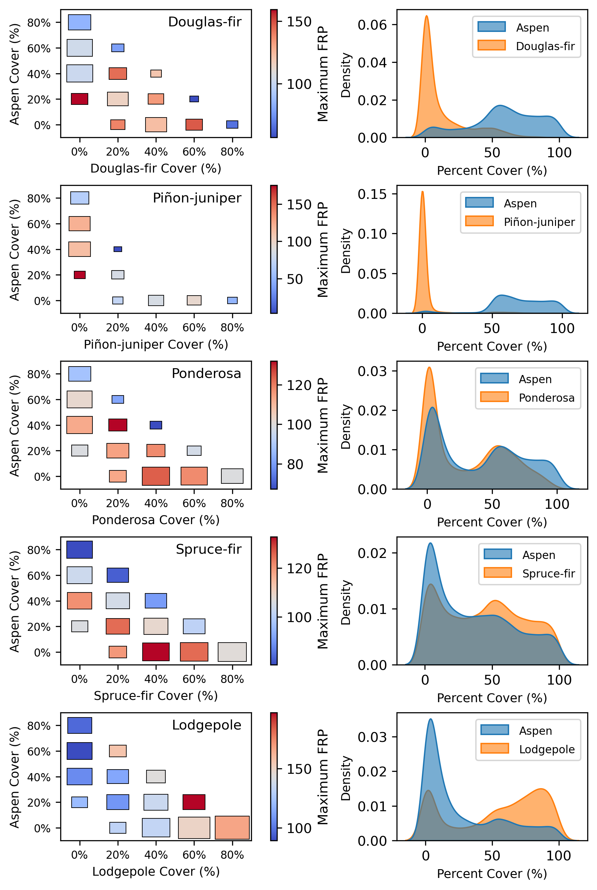
Figure 5. Effects of species co-occurrence on maximum FRP. Column (A) two-way interactions between aspen and co-occurring conifer percent cover where the aspen + co-occurring cover is >50%. Column (B) distribution of aspen and co-occurring species percent cover, again where at least 50% of forested area is made up of those two types.

Slide 7
