Slide 1
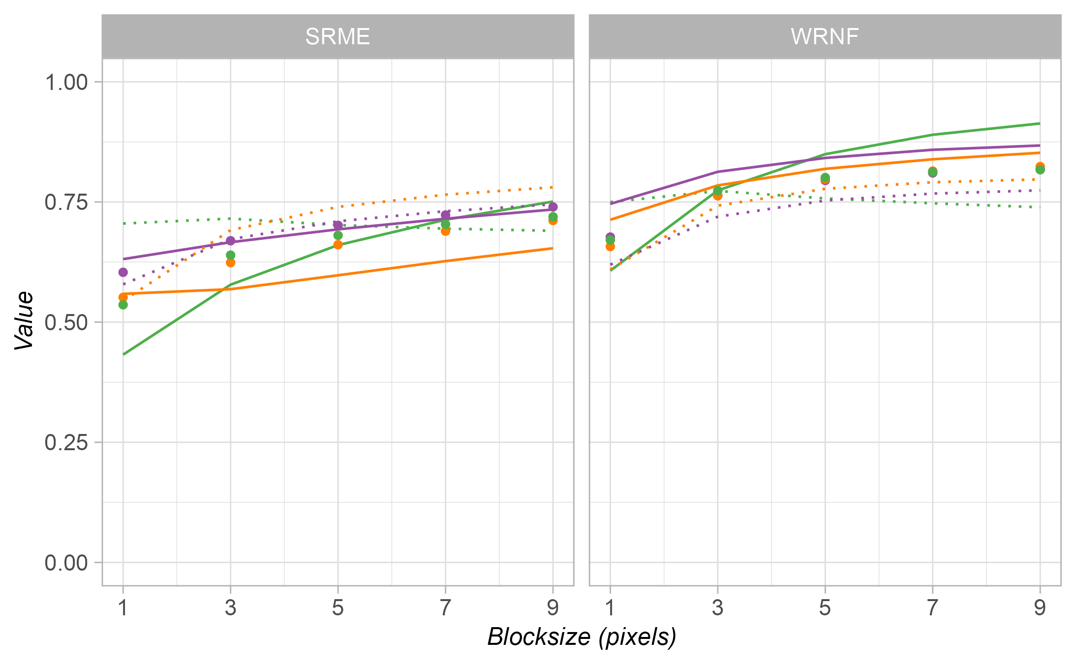
Precision
Recall
F1-score

